Slide 1

Project-II
Customer Segmentation (using K-Means)
Guided By:
Dr. Sourabh Jain
Assistant Prof.
IIIT Sonepat
Gaurav Yadav
11911038
CSE

Slide 2
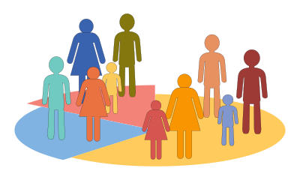
What is Customer segmentation?
Customer Segmentation is the process of division of customer base into several groups of individuals that share a similarity in different ways that are relevant to marketing such as gender, age, interests, and miscellaneous spending habits.

Slide 3
OBJECTIVE
The objective of the project are as follows:
To find the best customer, using customer segmentation methodology.
To explore the data upon which building a segmentation model.
Identify the potential customer base for selling the product.
Implement Clustering Algorithms to group the customer base.

Slide 4
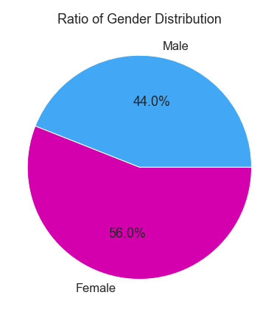
EXPLORATORY DATA ANALYSIS
Visualization of Distribution of Males and Females:

Slide 5
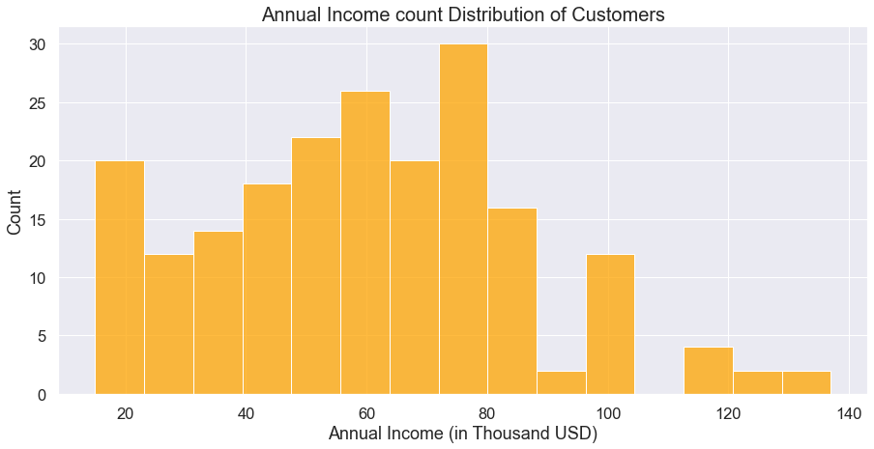
Annual Income and Spending Score Analysis:
The distribution of Annual Income and Spending Score exhibited an approximation of normal distribution, with highest density around the mean of the variables. The maximum and minimum of Annual Income are 137 and 15 respectively, with the mean at 60.56. From the plot, we can see that the peak of the distribution fell in the region of 60 to 75.

Slide 6
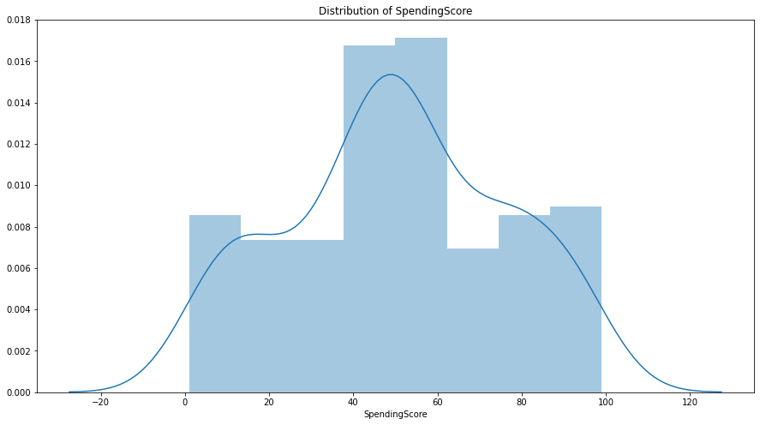
For the Spending score, the maximum and minimum are 99 and 1, while the histplot indicated that the highest number of customers have the spending score ranging from 40 to 60.

Slide 7
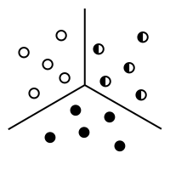
WHAT IS CLUSTERING ?
The process of segregating objects into groups based on their respective characteristics is called clustering. In clusters, the features of objects in a group are similar to other objects present in the same group.
K-Means Clustering
The algorithm works as follows:
First, we initialize k points, called means or cluster centroids, randomly.
We categorize each item to its closest mean and we update the mean’s coordinates, which are the averages of the items categorized in that cluster so far.
We repeat the process for a given number of iterations and at the end, we have our clusters.

Slide 8
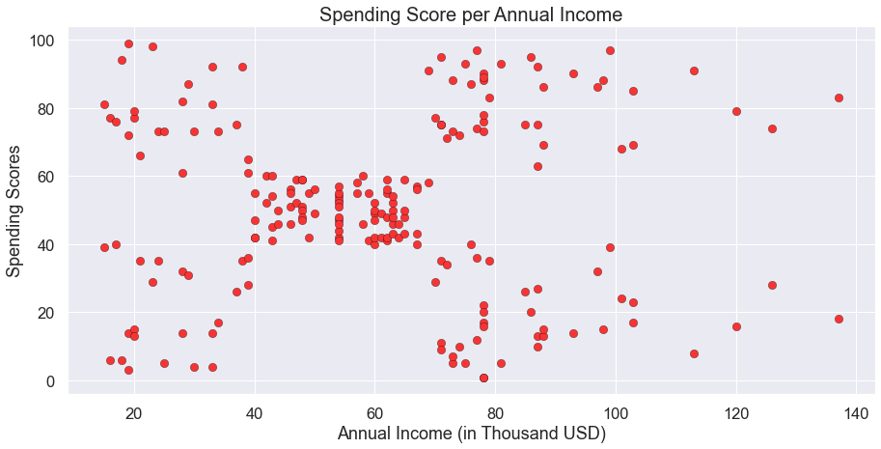
Building the k-means model
We need to visualize the data which we are going to use for the clustering. This will give us a fair idea about the data we're working on. This will give us a fair Idea and patterns about some of the data.

Slide 9
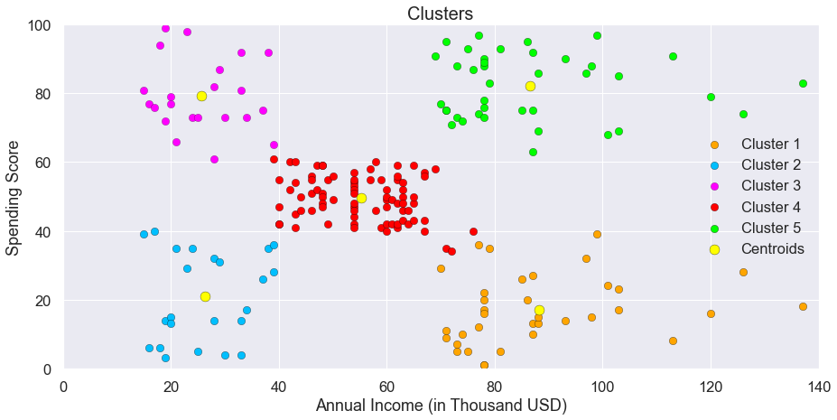
Cluster analysis :
The following clusters are created by the model,
Cluster Orange
Cluster Blue
Cluster Purple
Cluster Red
Cluster Green

Slide 10
CLUSTER ORANGE – BALANCED CUSTOMERS:
They earn less and spend less. We can see people have low annual income and low spending scores, these are the wise people who know how to spend and save money. The shops/mall will be least interested in people belonging to this cluster.
CLUSTER BLUE – PITCH PENNY CUSTOMERS:
Earning high and spending less.. These can be the prime targets of the mall, as they have the potential to spend money. So, the mall authorities will try to add new facilities so that they can attract these people and can meet their need
CLUSTER PURPLE – NORMAL CUSTOMERS:
Customers are average in terms of earning and spending, these people again will not be the prime targets of the shops or mall, but again they will be considered and other data analysis techniques may be used to increase their spending score.

Slide 11
CLUSTER RED – SPENDERS :
This type of customers earns less but spends more Annual Income is less but spending high, so can also be treated as potential target customer. The shops/malls might not target these people that effectively but still will not lose them.
CLUSTER GREEN – TARGET CUSTOMERS:
Earning high and also spending high Target Customers. Annual Income High as well as Spending Score is high, so a target consumer. These people might be the regular customers of the mall and are convinced by the mall’s facilities.

Slide 12
Thank You!

