Slide 1
Git
21-12-2021
Day 2

Slide 2
Version Control System
Also known as Software Control Management or Source Code Management – SCM
What is it?
A category of software tools that helps in recording changes made to files by keeping a track of modifications done to the code so that it can be recalled later if required
Why is it required?
Maintaining multiple versions of source code file(s) manually is a complex activity
Changes made by every developer needs to be tracked
Who made the change?
When was the change made?
What change(s) were/was made?
Accidental overwriting of code should not happen
Sharing code with peer developers so that developers can work in a collaborative manner
Promotes parallel development
Access control as to who can read/modify code

Slide 3
Version Control System
Working Directory / Workspace
Where developers create/modify files
Here VCS is not applicable, it's used only for storing files
Repository
Stores files, version history & metadata
VCS is applicable here
Some kind of client utility is required for the developer(s) to store versions of modified files into the repository
Repository contains one or more commits
A commit essentially a revision to a file/files which git stores along with some metadata
Each commit has some kind of information associated with it along with a unique commit id
Process of sending files from working directory to repository is called a COMMIT or CHECK IN
Process of getting the required file version from repository to working directory is called a PULL or CHECK OUT

Slide 4
Version Control System – Centralized / Client-Server
Only one central repository
All the source code is stored in the central repository
Scales to very large codebases
Ability to lock files exclusively to handle complex merge scenarios
Best used for large integrated codebases
Limitations:
Every developer is required to remain connected with the repository to commit and pull changes
Single point of failure since it's centralized
All check-in and checkout is always done on the centralized server which forces developers to be always connected to the repository
Since all operations are performed on a network, performance is slow

Slide 5
Version Control System – Distributed
Repository is distributed → each developer has his/her own copy of the repository locally in addition to a main repository
Cross platform
Since all check-ins and check outs are performed on the local repository, there is a fast performance
Developers need not be continuously connected to the main repository
Single point of failure risk is eliminated
Complete repository with portable history
Pull requests for code review
Process of sending commits from local repo to remote repo is PUSH
Process of getting a commit from remote repo to local repo is PULL

Slide 6
Version Control System – Distributed
Best used when
Modular codebases not too big in size
Highly distributed teams who need to work offline
Need to work on various platforms

Slide 7
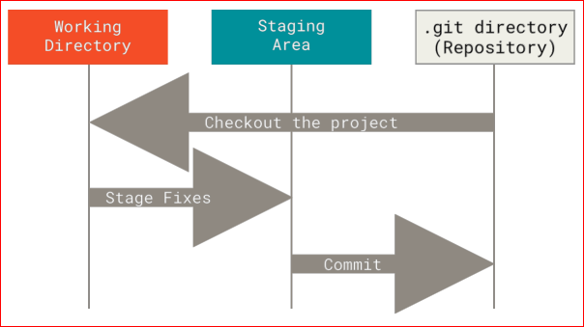
DVCS
How does Git work?
Git thinks of its data more like a series of snapshots of a miniature filesystem
With Git, every time you commit, or save the state of your project, Git takes a picture of what all your files look like at that moment and stores a reference to that snapshot
Git thinks about its data more like a stream of snapshots
The Three States

Slide 8
Basic Git Workflow
You modify files in your working tree
Selectively stage just those changes you want to be part of your next commit, which adds only those changes to the staging area
Do a commit, which takes the files as they are in the staging area and stores that snapshot permanently to your Git directory
If a particular version of a file is in the Git directory, it’s considered committed
If it has been modified and was added to the staging area, it is staged
If it was changed since it was checked out but has not been staged, it is modified

Slide 9
Configuring Git
In pervious session we have seen how to create local repository and configure using commands
git config --global user.name <<DomainName>>
git config --global user.password <<DomainPassword>>
git config --global user.email <<CompanyEmail>>

Slide 10
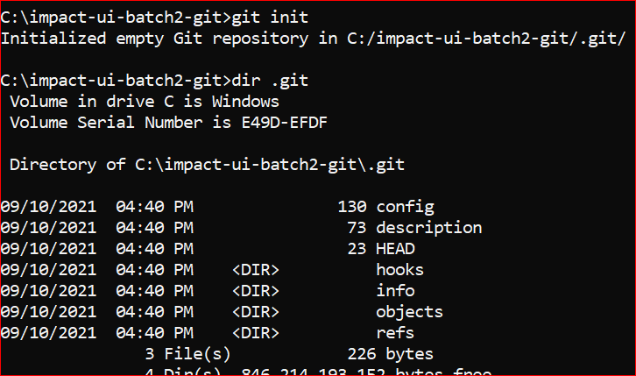
Initializing a Git Repository locally – DO IT
A Git repo represents a virtual storage of a project
Each project in Git is referenced as a repo
To initialize a project or a project that already exists, get into the folder & use the git init command
This tells Git to version control the all files and sub-directories in the project
Adds a hidden folder named .git which contains metadata used by Git internally to version control the project

Slide 11
Code Hosting Providers
Allows a developer to access a Git repository from anywhere, any device & pull down a local copy of the repo
Several companies specialize of this type of product offering → web-based Git repository hosting services with additional features
GitHub
Bitbucket
GitLab
Azure Repos → part of Azure DevOps offerings
AWS Code Commit → part of AWS DevOps offerings
Others….
Developers can push changes from their local Git repositories to an online hosting service
Allows collaboration with other peer developers
Allows contributions to me made to the repository from other developers
Integrate collaborations easily with multiple developers
To start → choose a provider and create an account

Slide 12
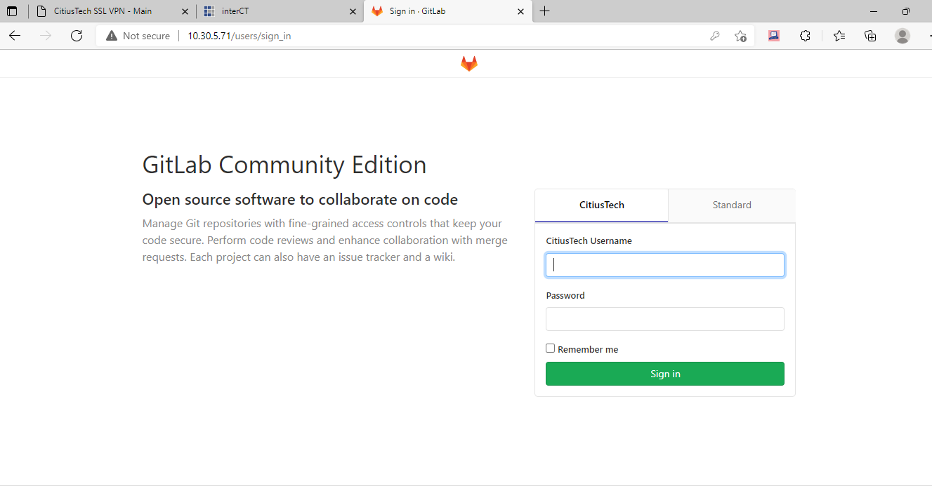
Steps to create centralized Repo
Connect to CTVPN and key the following URL: http://10.30.5.71/
Login with your Domain UserName, Password and Authshield Pin

Slide 13
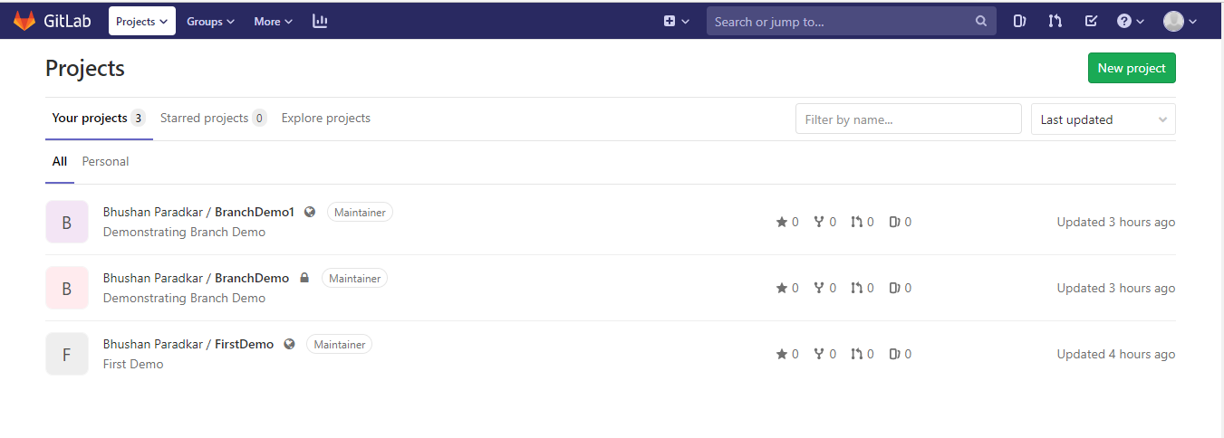
Steps to create centralized Repo

Slide 14
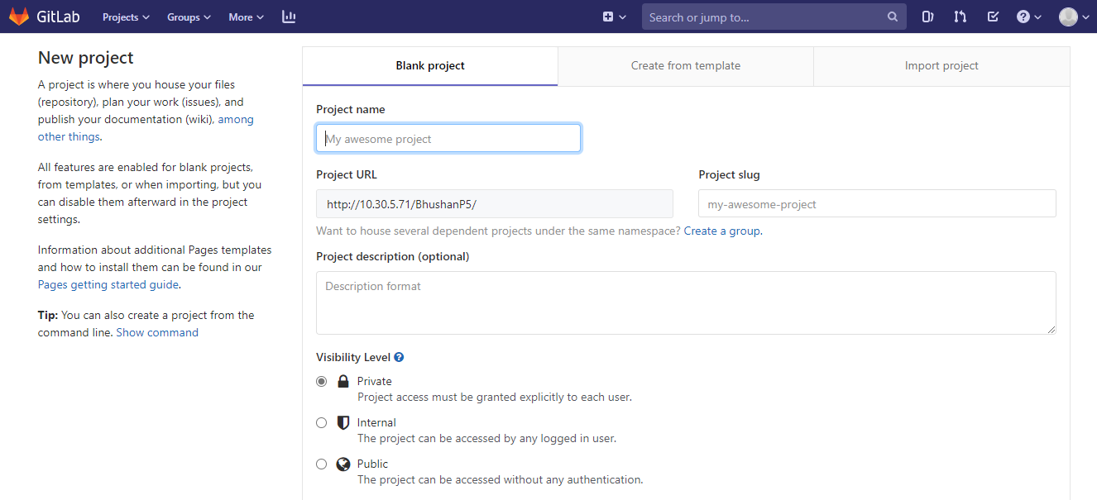
Steps to create centralized Repo

Slide 15
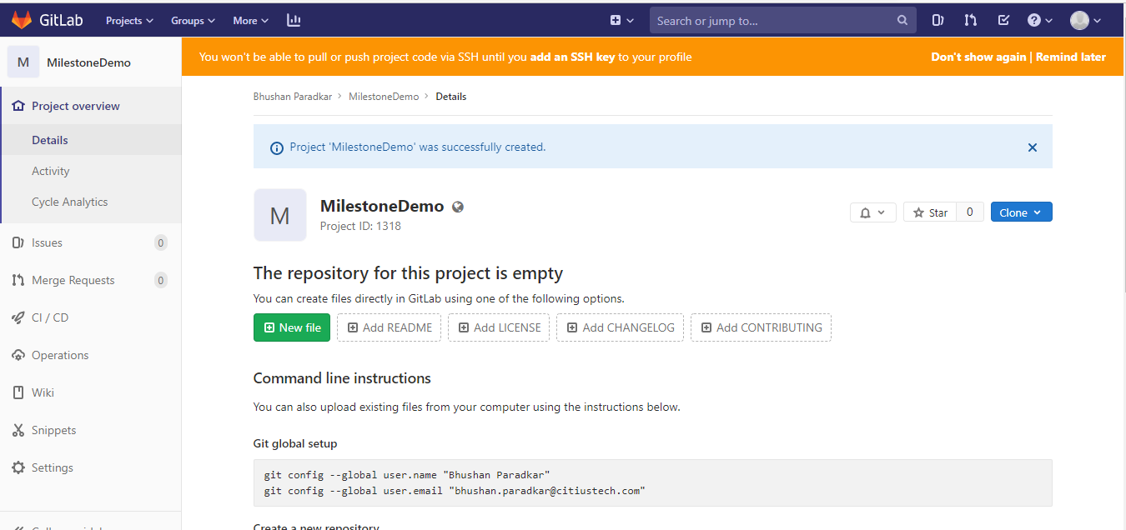
Steps to create centralized Repo

Slide 16
Steps to create centralized Repo

Slide 17
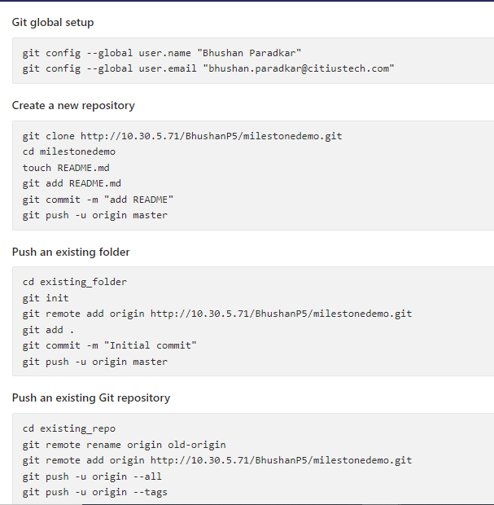
Steps to create centralized Repo

Slide 18
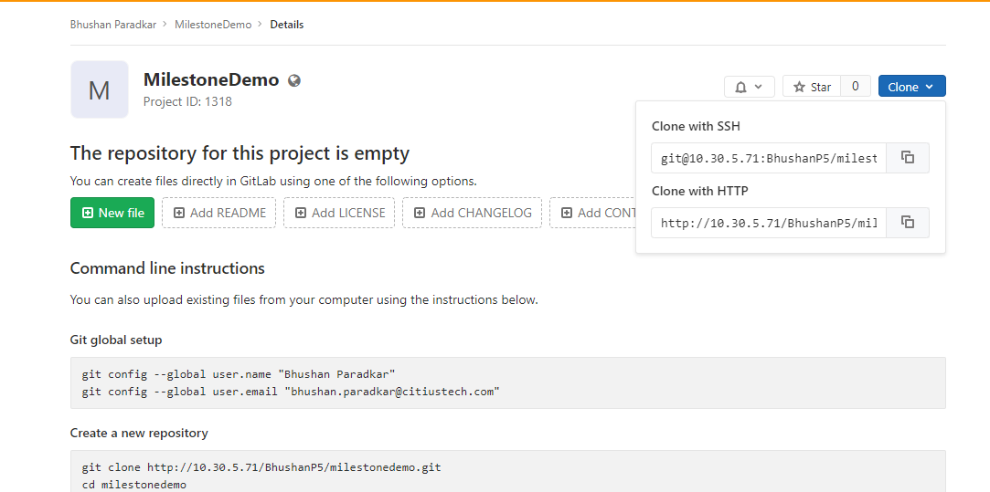
Steps to create centralized Repo
To clone centralized project to create it in local repo.

Slide 19
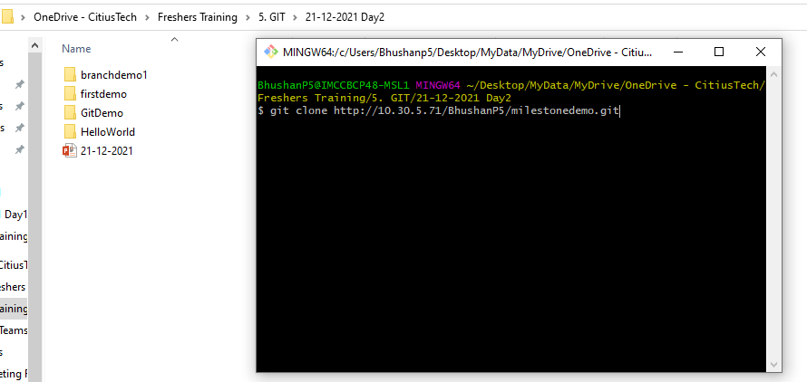
Steps to create centralized Repo
To clone centralized project to create it in local repo.

Slide 20
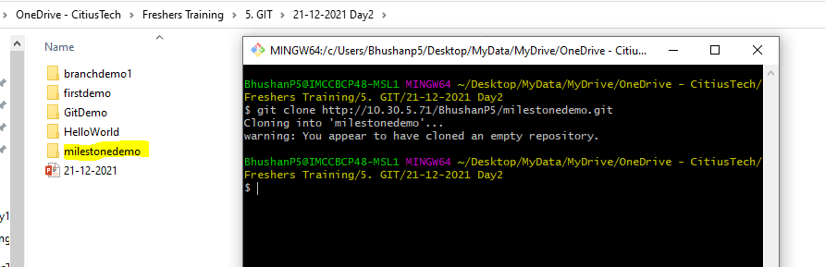
Steps to create centralized Repo
To clone centralized project to create it in local repo.

Slide 21
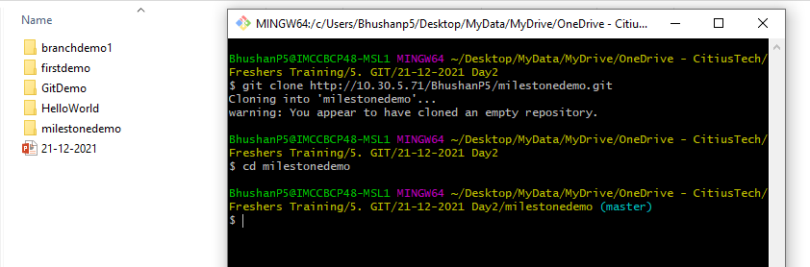

Slide 22
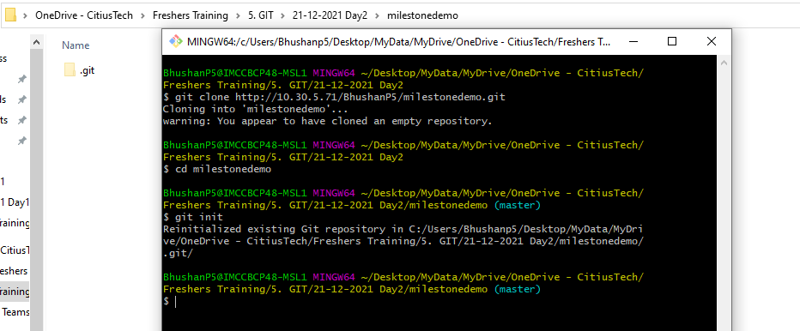

Slide 23
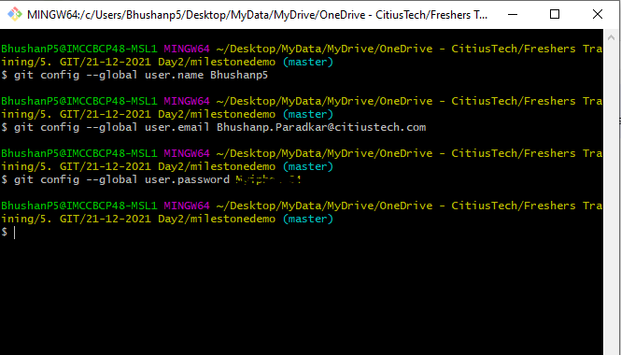

Slide 24
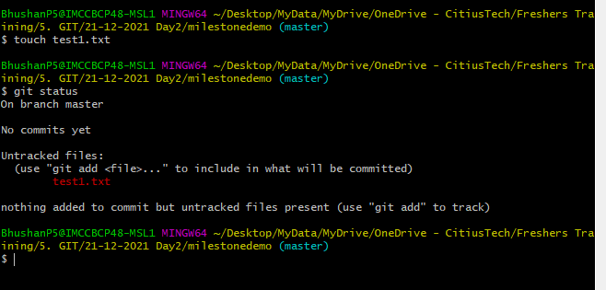

Slide 25
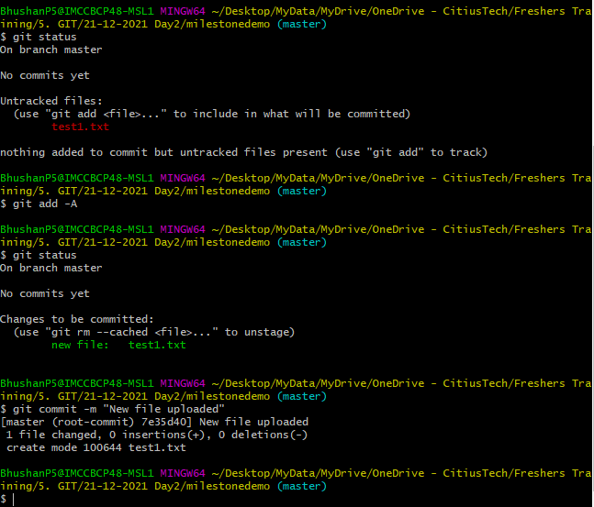

Slide 26
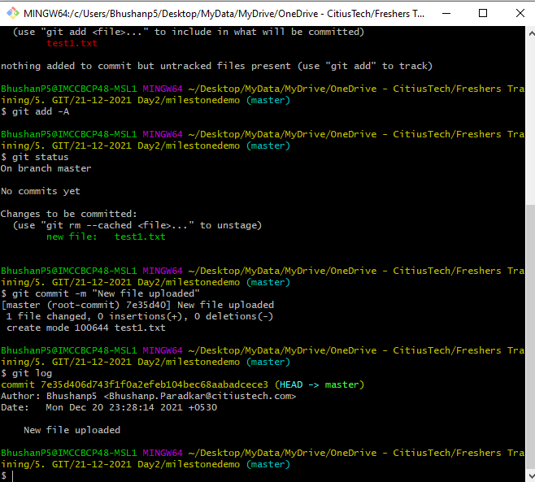

Slide 27
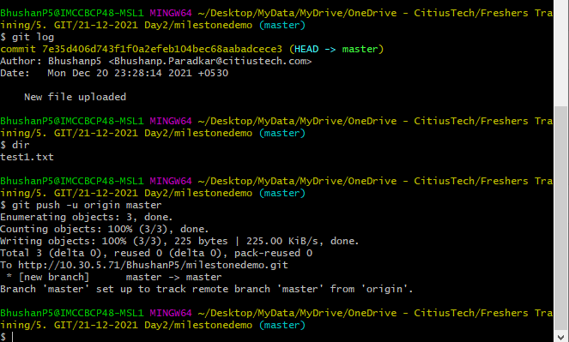

Slide 28
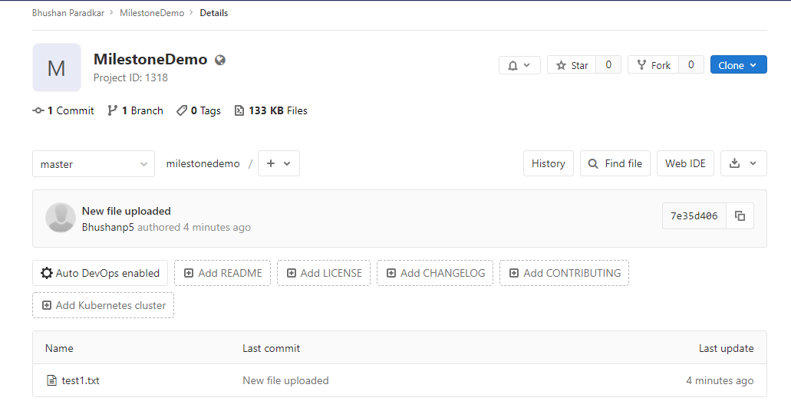

Slide 29
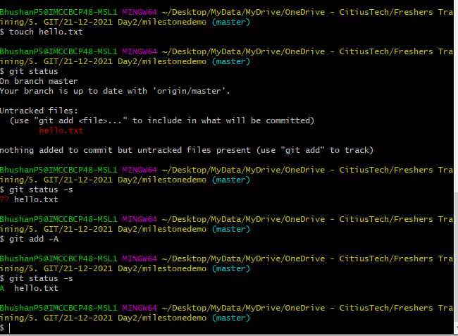

Slide 30
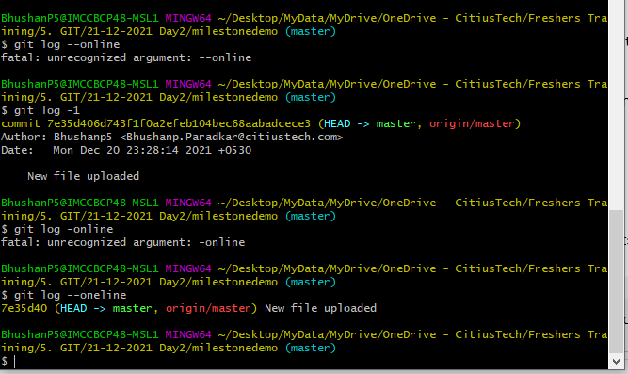

Slide 31
Branching and Merging
What is a Branch?
A lightweight movable pointer to a commit
Default branch name is master
Each time a commit is made, the master branch pointer moves forward automatically
Branches are isolated from each other
Why is it required?
Enables multiple parallel development workflows
Developers can commit changes to a branch and then merge the changes with the master branch
Creating a new branch simply creates a new pointer
Git maintains a special pointer named HEAD which simply points to a specific branch
This is how Git knows the current branch on which a developer is currently working

Slide 32
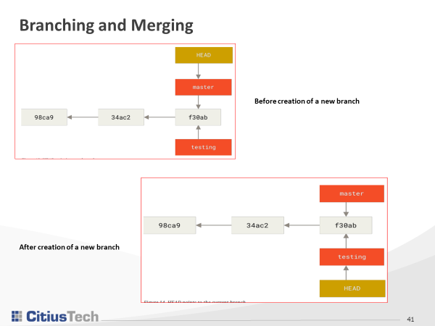

Slide 33

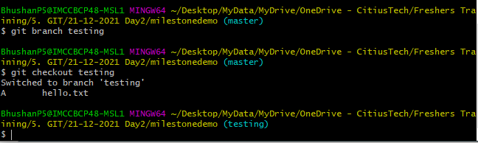
Working with branches
Create a new branch
Switch to a branch
Switch back to the default master branch
When switching branches in Git, files in the working directory will change
When switched to an older branch, the working directory will be reverted to look like it did the last time when a commit was made on that branch

Slide 34
A basic branching workflow
Do some work on a website
Create a branch for a new user story
Do some work in that branch
Some another issue is critical and there is a need for a hotfix
Switch to the production branch
Create a branch to add the hotfix
After it’s tested, merge the hotfix branch, and push to production
Switch back to the original user story and continue working

Slide 35
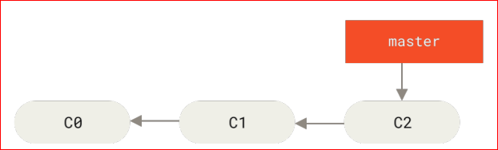
Basic Branching – DO IT (1)
Create a new remote repo
Create a new folder and initialize an empty Git repo
Add the remote repo
Create two text files in the local folder
Perform some commits

Slide 36
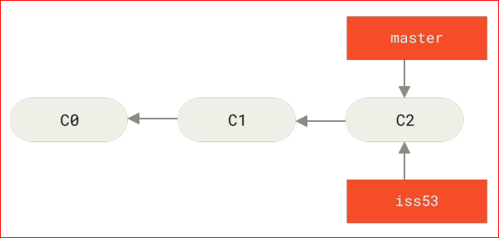

Basic Branching – DO IT (2)
Create a new branch for a new user story and switch to it

Slide 37
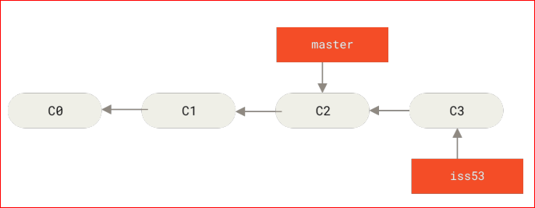
Basic Branching – DO IT (3)
Perform some commits in this new branch

Slide 38
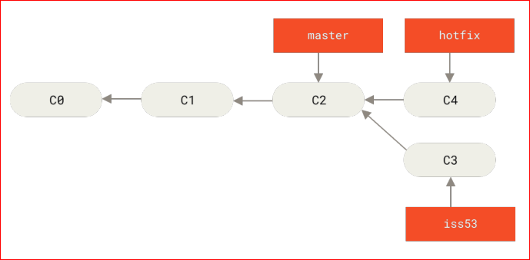
Basic Branching – DO IT (4)
Switch back to master branch and create a new branch to work on the hotfix
Perform some commits on the new hotfix branch

Slide 39
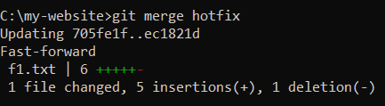
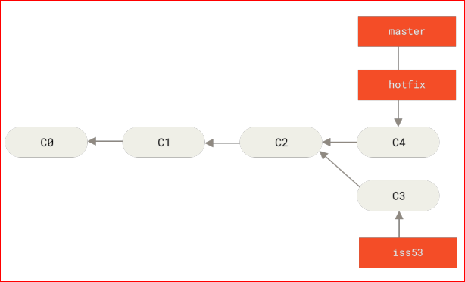
Basic Branching – DO IT (5)
After testing the hotfix, merge the hotfix branch, switch back to the master branch and merge the hotfix branch with the master branch
The change is now in the snapshot of the commit pointed to by the master branch, and the fix can now be deployed
When you try to merge one commit with a commit that can be reached by following the first commit’s history, Git simplifies things by moving the pointer forward because there is no divergent work to merge together — this is called a “fast forward”

Slide 40
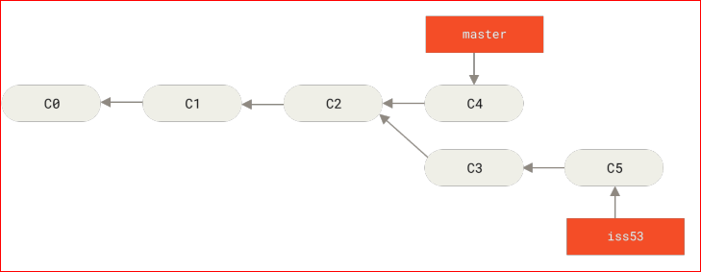
Basic Branching – DO IT (6)
Delete the hotfix branch and continue working on the new user story branch which was created earlier
git checkout newuserstory
Perform one more commit in the new user story

Slide 41
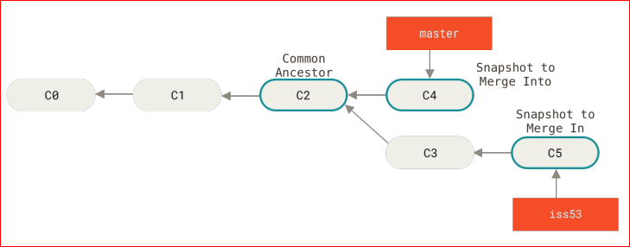
Basic Branching – DO IT (7)
Now merge the changes made in the user story with the master branch
Switch to the master branch first and then use the git merge newuserstory command
Because the commit on the branch you’re on isn’t a direct ancestor of the branch you’re merging in, Git has to do some work
In this case, Git does a simple three-way merge, using the two snapshots pointed to by the branch tips and the common ancestor of the two

Slide 42
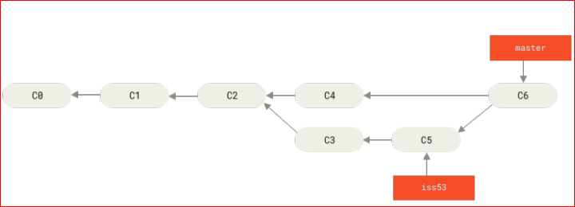
Basic Branching – DO IT (8)
Instead of just moving the branch pointer forward, Git creates a new snapshot that results from this three-way merge and automatically creates a new commit that points to it
This is known as a merge commit, which essentially has more than one parent

