Slide 1
Internship Project - Oral Cancer Detection
Christ University – Demo II
Student Name: Yashas R. Shetty
Register Number: 2340263

Slide 2
Project / Task Understanding
Project title: Oral Cancer Detection
Objective of the project: Develop a mobile application that any individual can use to perform a preliminary self assessment pertaining to oral cancer.
Expected outcome: A mobile application with an image processing network to detect oral cancer. A short survey to enumerate the exposed risk to oral cancer. A final quantifier providing a weighted score.

Slide 3
Summary of Work Completed
Conducted extensive literature review on digital health tools and AI-based approaches for oral cancer detection.
Completed survey paper on analyzed existing oral cancer screening and diagnostic mobile applications in the global market.
Studied Content-Based Image Retrieval (CBIR) approaches for medical image analysis (Literature Review)
Designed the overall system architecture for oral cancer risk assessment combining Risk questionnaire module, Image-based lesion analysis and Self-examination educational guide for both web and android.

Slide 4
Development
Developed Web Application with complete model pipeline for image-based analysis using CBIR techniques.
Implemented image similarity matching system for oral lesion comparison.
Built a mobile application using the Flutter framework, replicating the same analysis pipeline and ensuring compatibility with Android devices.
Optimized the mobile application to reduce application size and improve performance.

Slide 5
Modules in the Application
Image Matcher for lesion image comparison
Questionnaire-based risk Screener for preliminary oral cancer risk assessment
Self-Examination Guide with step-by-step instructions for oral self-screening

Slide 6
Proposed Outcomes (Seed Money Proposal) | Current Achievements
Development of AI-powered mobile app for oral cancer risk assessment | Functional web platform and Flutter mobile app prototype developed
Image-based analysis for oral lesion detection | CBIR-based image similarity model pipeline designed
Risk assessment based on questionnaire data | Risk screening questionnaire implemented in the application
Awareness and education module for self-screening | Self-examination guide integrated into the application
Scholarly publications | CBIR literature survey completed, implementation research paper currently being written
Prototype ready for validation | Working system ready for dataset integration and testing

Slide 7
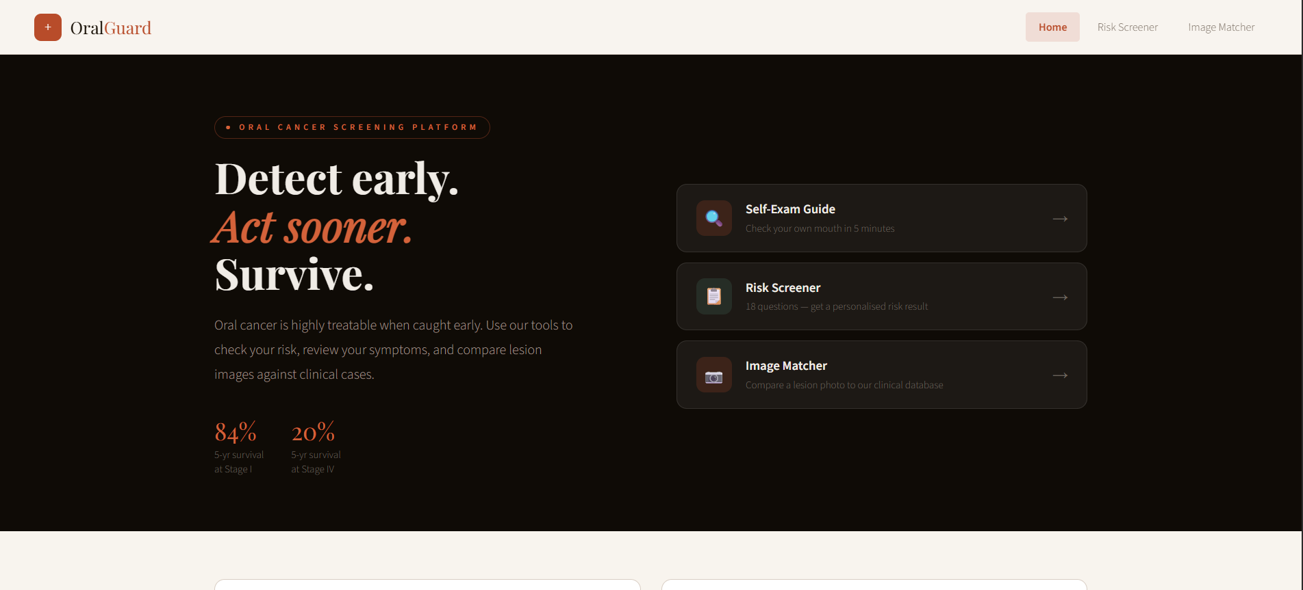
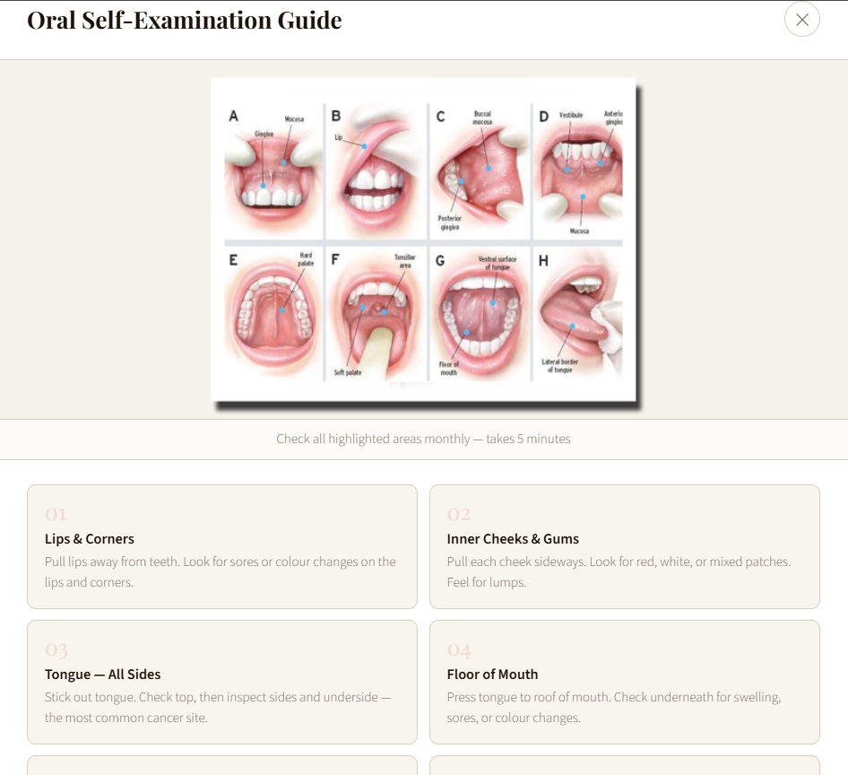
Screenshots of the Web Application

Slide 8
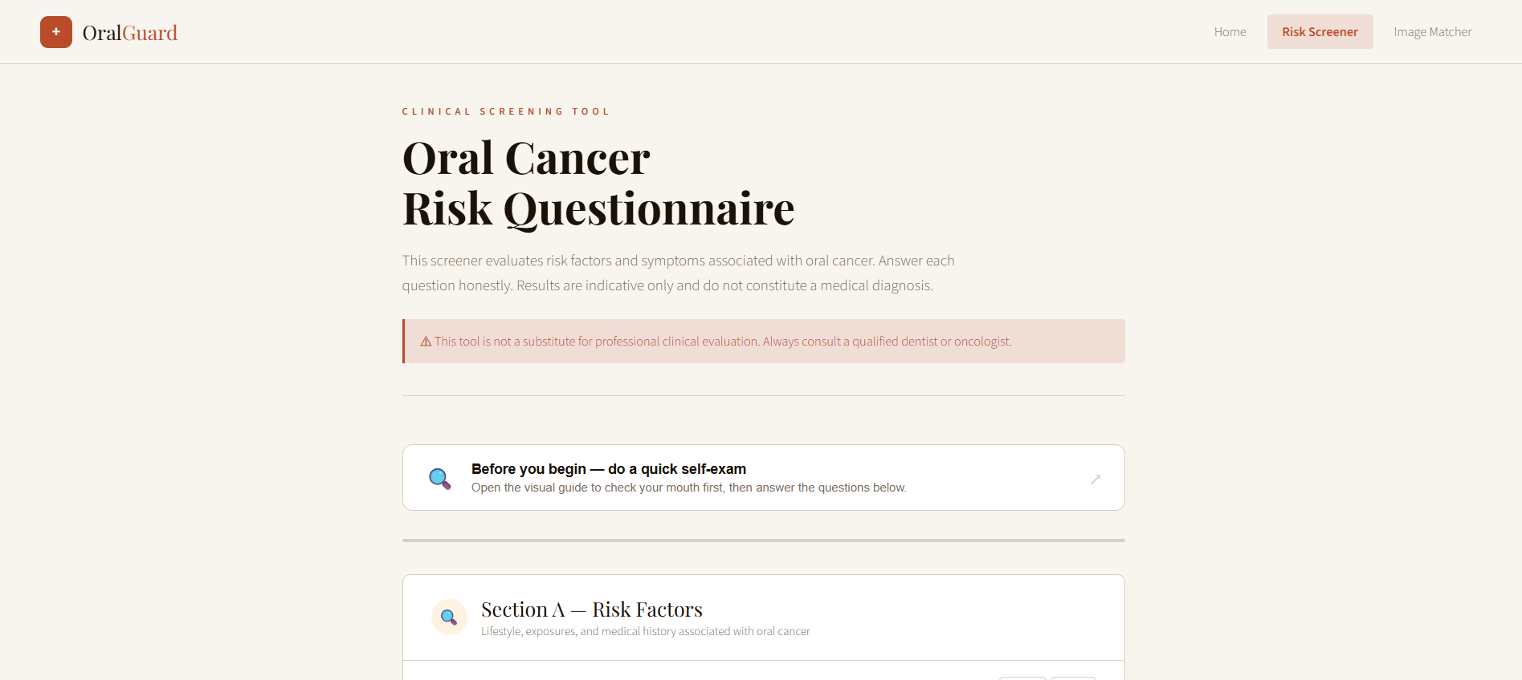
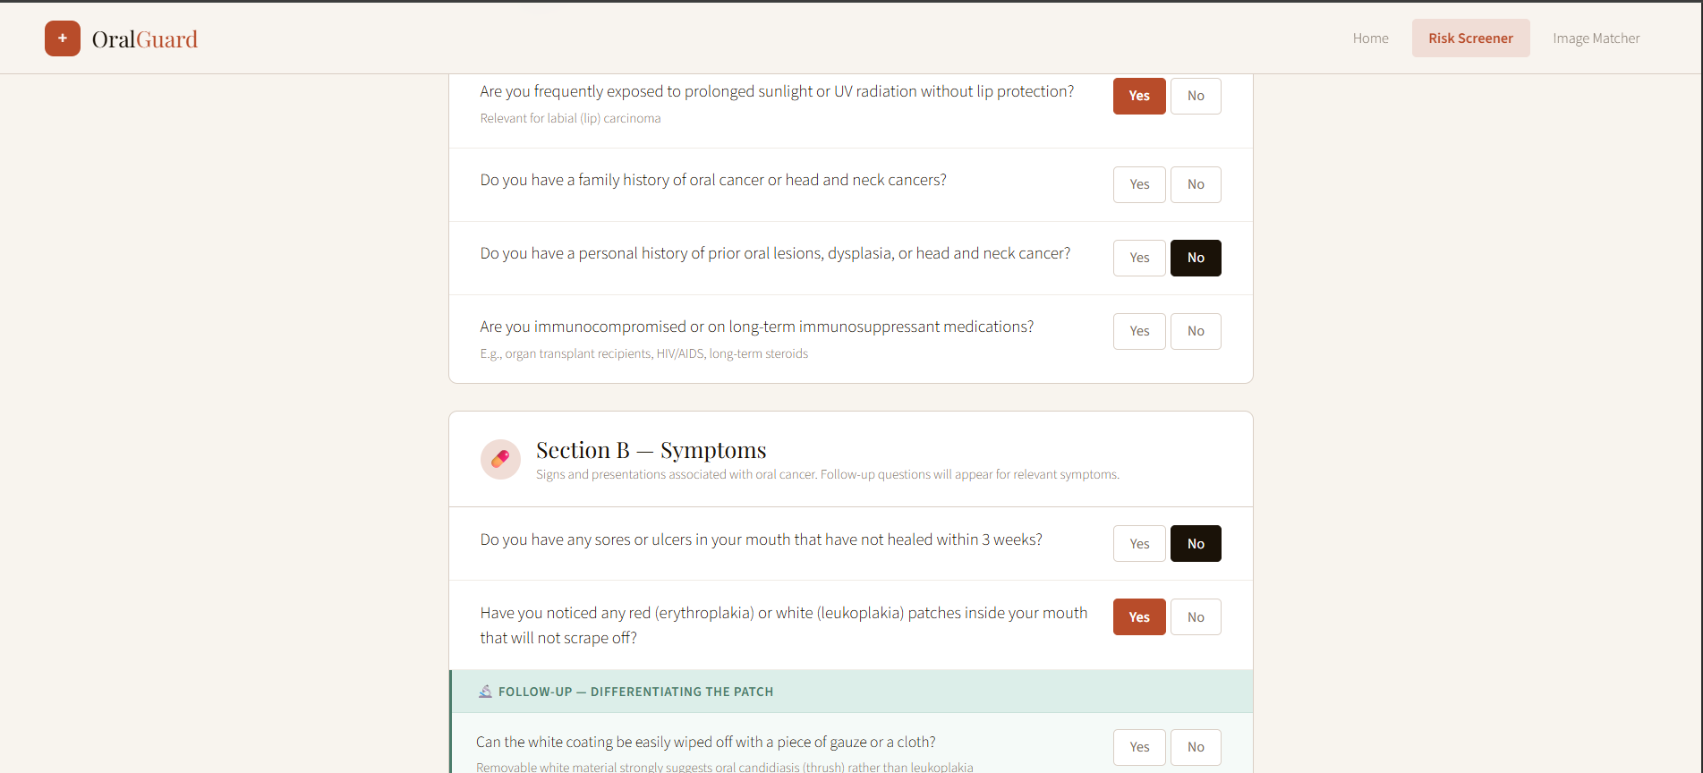
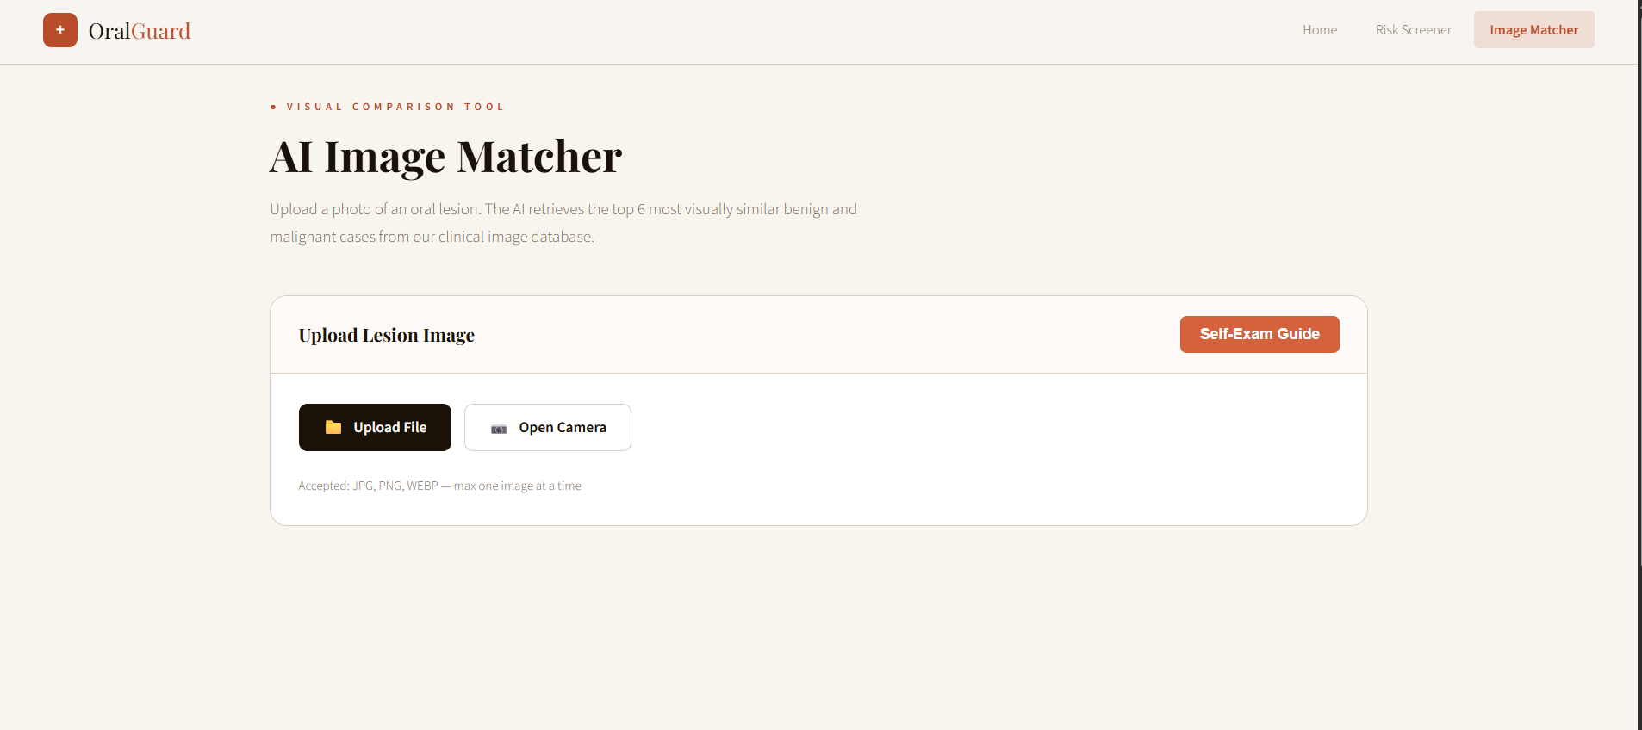

Slide 9
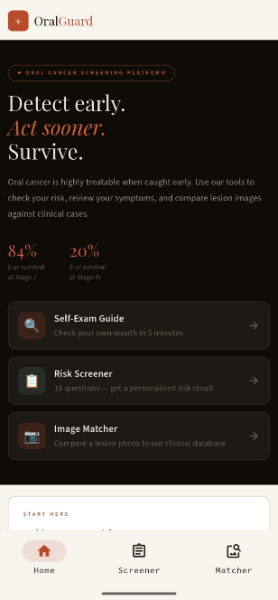
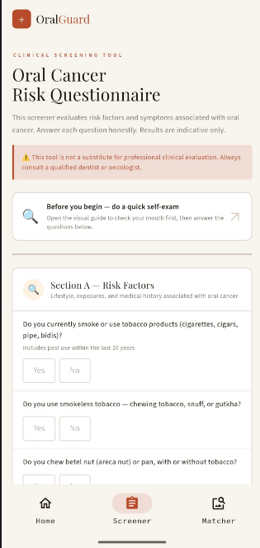
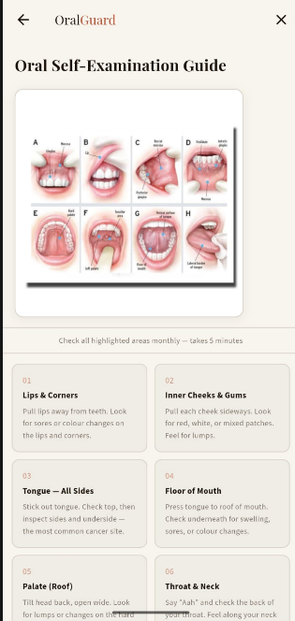
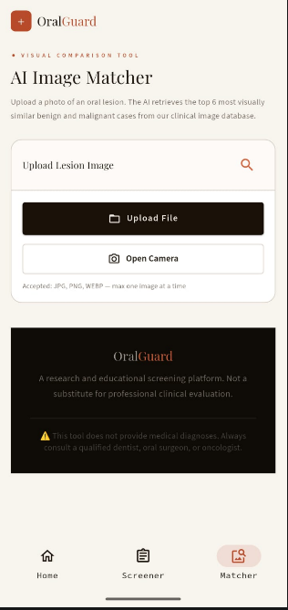
Screenshots of the Mobile Application
n

Slide 10
Tools & Technologies
Framework: Flutter (Dart)
Backend Framework: FastAPI (Python)
Model: MobileNetV2
AI/ML Integration: CNN Feature Extractor + CBIR (Content-Based Image Retrieval) {PyTorch deep learning framework}
Cosine similarity (scikit-learn)
Pillow (PIL) image processing
Web Interface: Gradio / HTML5 / CSS3 / Vanilla JS
Hosting: Hugging Face Spaces

Slide 11
Software Requirements Specifications
Functional: Home Page (Dashboard), Risk Questionnaire, Self-Exam Guide, Image Matcher, Similarity Score calculator, Results & Feedback.
Non-Functional: Fast Response Time, Reliable Image Processing, Data Privacy

Slide 12
System Design & Architecture (Mobile Application)
Presentation Layer — Flutter UI
Application Layer — App logic & navigation
Data Layer — Models & API handling
Backend Layer — FastAPI services
AI Layer — CNN + CBIR similarity engine

Slide 13
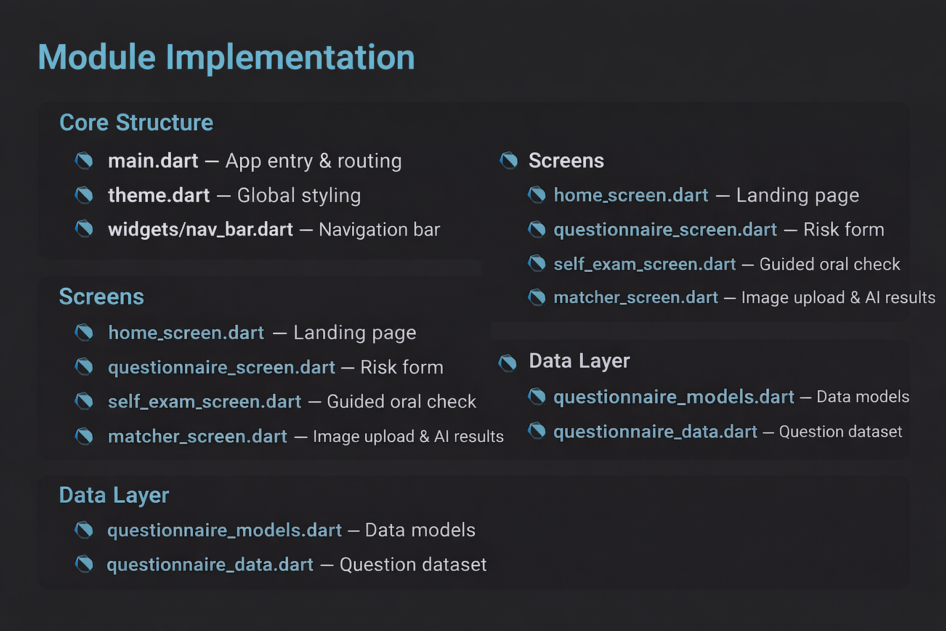
Module Implementation (Flutter)

Slide 14
Project Functionality
User opens app - Navigates via home screen - Completes risk questionnaire - Follows self-exam guide - Uploads lesion image - Image sent to AI backend - CNN extracts visual features - CBIR retrieves similar cases - Cosine similarity scoring - Benign & malignant matches shown - Clinical decision-support feedback displayed

Slide 15
Conclusion
The experience so far has provided practical exposure to professional real-world projects. It aligns with my academic background and offers relevant experience for my future career path. I appreciate the support and guidance provided by my mentor Dr. Neetha.

Slide 16
Future Plans
Awaiting access to an improved and larger medical image dataset to enhance the performance of the CBIR model. The dataset requires institutional approval before use, as it contains restricted medical data.

