Slide 1
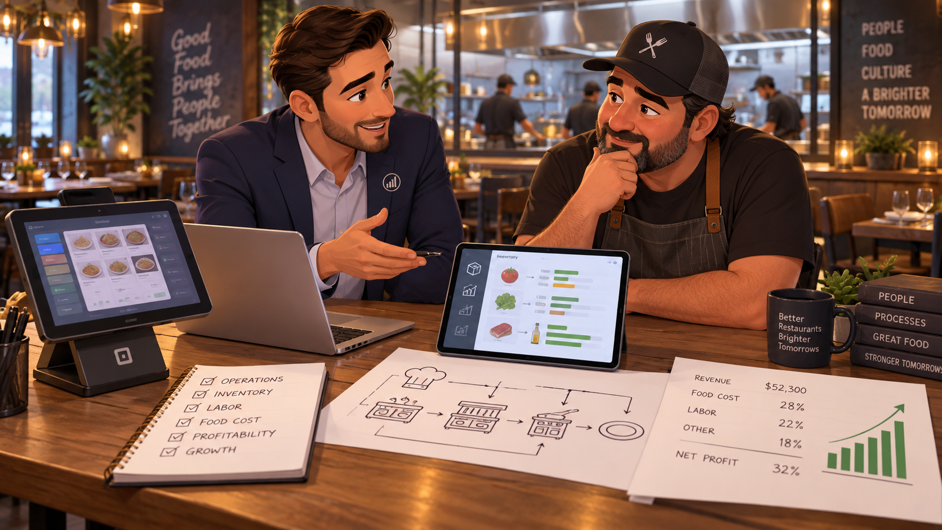
SALES ENGINEER PLAYBOOK
Restaurant POS +
Odoo ERP Negotiation
A presentation that starts with the owner’s pain, not with software.
Goal: $899 POS + tax and $7,500 restaurant Odoo ERP implementation
Yudaro.com • Restaurant POS + Odoo ERP
01

Slide 2
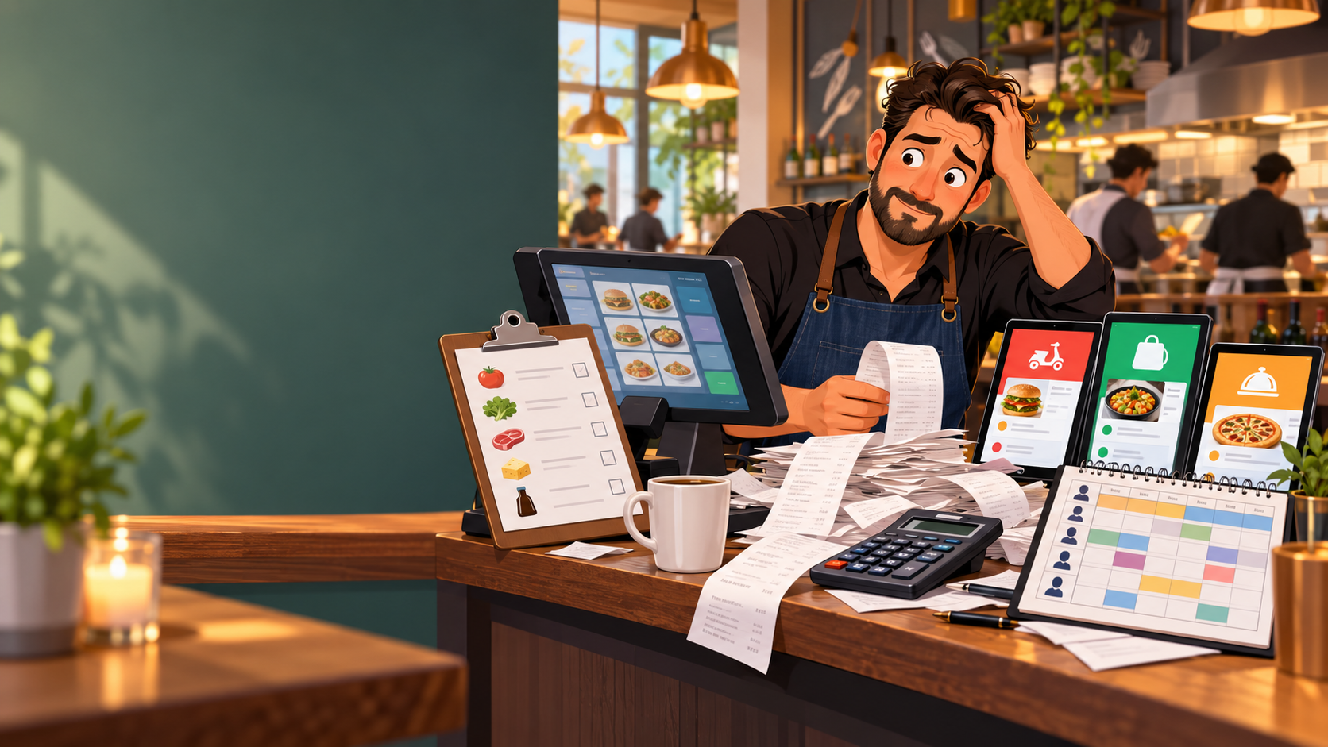
The uncomfortable truth
The owner has heard POS sales talk before. You need to sound like operations help.
Do not sell a terminal.
Diagnose business leakage.
The strongest negotiation position is created when the owner explains the cost of today’s broken process in their own words.
Your job: turn “software purchase” into “restaurant control system.”
Yudaro.com • Restaurant POS + Odoo ERP
02

Slide 3
What the restaurant owner is really thinking
Speak to their daily reality: staff, waste, mistakes, cash, time, and trust.
“I don’t need another system.”
Translation: “I don’t want another headache.”
Can I trust my manager’s numbers?
Where is food cost leaking?
Why does inventory not match sales?
How do I stop manual reconciliation?
Can I see the restaurant from home?
Yudaro.com • Restaurant POS + Odoo ERP
03

Slide 4
The six-stage negotiation framework
Move from curiosity → pain → value → commitment → implementation.
1
Diagnose pain
2
Quantify cost
3
Demo only what matters
Ask before showing.
Let owner build the ROI.
Never demo irrelevant screens.
4
Anchor against loss
5
Gain small commitments
6
Close implementation
Compare to current leakage.
Owner agrees to priorities.
Decide start date & contact.
Yudaro.com • Restaurant POS + Odoo ERP
04

Slide 5
Preparation: build the business case before the pitch
Know what to observe before talking about price.
Restaurant Loss Worksheet
Daily order volume
Current POS / delivery apps
$52,300
Food cost 28%
Labor 22%
Discounts $318
Voids $74
Inventory method
Accounting workflow
This week sales
Labor scheduling
Manager access control
Voids, comps, discounts
Owner remote visibility
Arrive with hypotheses. Leave with the owner’s numbers.
Owner view: sales, labor, inventory, purchasing, finance
Yudaro.com • Restaurant POS + Odoo ERP
05

Slide 6
Opening script: disarm the sales reflex
The first two minutes must prove you are not rushing to sell.
“Before I show you anything, I want to understand how your restaurant actually operates. If our system does not solve enough problems to justify the investment, I will tell you.”
Then ask and wait:
What is the biggest operational headache right now?
How are you handling it today?
How much time does it take each week?
What happens when somebody makes a mistake?
What do you think this costs every month?
Yudaro.com • Restaurant POS + Odoo ERP
06

Slide 7
Strategic silence: let the owner hear their own answer
Silence works after pain questions, price statements, and closing questions.
Ask:
“Roughly what do you think that problem costs you every month?”
7
seconds of silence after a serious question
Then stop talking.
Do not rescue the owner from the pause. The pause is where the financial pain becomes real.
Calm silence says: “I am not desperate. I am thinking with you.”
Yudaro.com • Restaurant POS + Odoo ERP
07

Slide 8

Turn vague pain into measurable leakage
The owner’s own numbers make the investment feel logical.
Potential monthly leakage
Order mistakes
$400
Food waste
$600
Inventory mismatch
$750
Overtime / time theft
$500
Manual admin
$800
Delivery reconciliation
$400
$3,450 / month
$41,400 / year
The comparison is not $7,500 vs. nothing.
It is $7,500 vs. the cost of staying blind.
Yudaro.com • Restaurant POS + Odoo ERP
08

Slide 9
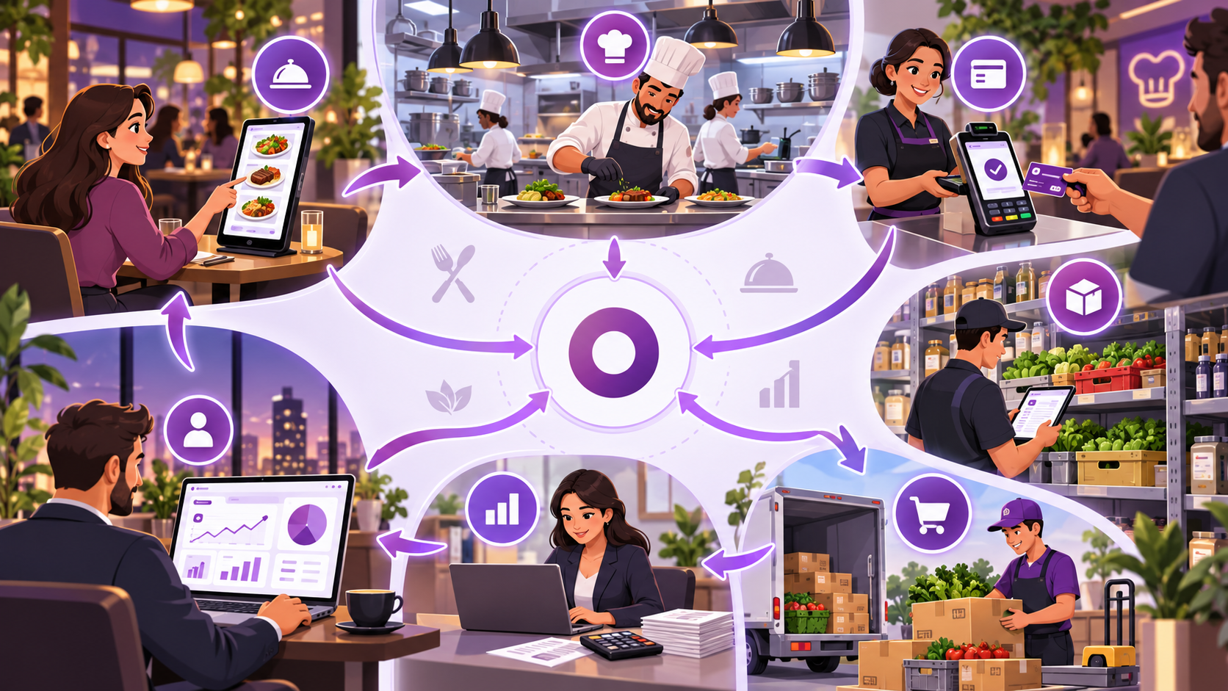
Demo a restaurant story, not random software screens
Show the owner what happens from order to business control.
Order
Kitchen
Payment
Inventory
Purchasing
Finance
Owner dashboard
Yudaro.com • Restaurant POS + Odoo ERP
09

Slide 10
Decision 1: $899 + tax POS package
Make the first decision simple and concrete.
Odoo Restaurant POS screen
$899 + tax
Order
Food
Drink
Dessert
Combo
Beef Noodle $12.80
Noodle
Burger
Soup
Tea
Front-end transaction infrastructure
Dumplings $8.50
Iced Tea $3.00
Rice
Fish
Cake
Soda
Fast order entry
Wings
Salad
Boba
Steak
Menu categories and modifiers
Receipt / kitchen workflow
Payment-ready checkout
Simple training for staff
TOTAL
$24.30
Script: “The POS handles what happens at the counter.”
Yudaro.com • Restaurant POS + Odoo ERP
10

Slide 11
Decision 2: $7,500 Odoo ERP implementation
The ERP connects transactions to the rest of the business.
Inventory + purchasing
Owner dashboard
$7,500
Chicken
$52,300
Food cost 28%
Labor 22%
Discounts $318
Voids $74
Rice
This week sales
Customized restaurant operating system
Oil
Inventory + purchasing
Vegetables
Vendor control
Sauce
Food-cost visibility
User permissions
Reporting dashboards
Low-stock alerts
Purchasing suggestions
Variance tracking
Owner view: sales, labor, inventory, purchasing, finance
Training + testing
Script: “The ERP handles what happens to the business because of those transactions.”
Yudaro.com • Restaurant POS + Odoo ERP
11

Slide 12
Leverage signals: read changes, not single gestures
Body language is a clue. Ask, don’t assume.
Leans toward screen
Feature may solve real pain
Asks “Can I see this from home?”
Remote control matters
Asks about training
Adoption risk
Looks to partner/manager
Hidden decision maker
Repeats price question
Value or budget not resolved
Use: “I noticed you spent more time on the inventory section. Is inventory control a major issue here?”
Yudaro.com • Restaurant POS + Odoo ERP
12

Slide 13
Objection handling: diagnose the objection before answering
Separate budget, value, risk, and decision-maker issues.
“$7,500 is too expensive.”
“Do you mean cash flow is difficult, or you are not yet convinced it creates $7,500 of value?”
“I already have Square / Toast / Clover.”
“Then I would not replace it just because ours is different. What can’t you do with your current system?”
“I need to think about it.”
“Of course. What specifically would you like to think through?”
“I need to talk to my partner.”
“What do you think your partner’s biggest concern will be?”
Do not discount before you know which problem you are solving.
Yudaro.com • Restaurant POS + Odoo ERP
13

Slide 14
Pricing psychology: anchor against the cost of doing nothing
Use the owner’s leakage estimate to create financial context.
Current leakage
Investment
$41,400 / year
$8,399 total
Say: “I would not compare $7,500 with spending nothing. I would compare it with what the current process is already costing the restaurant.”
Never promise full savings unless you can prove it. Keep the claim defensible.
Yudaro.com • Restaurant POS + Odoo ERP
14

Slide 15
Closing sequence: move from “buying” to “starting”
Ask for blockers, then move to implementation details.
“Based on what we went through, is there anything important that would prevent you from moving forward?”
Then stop talking.
If no blocker appears:
“Then let’s get the POS ordered and start the ERP discovery process.”
“Who should be the primary contact for menu data and restaurant operations?”
Yudaro.com • Restaurant POS + Odoo ERP
15

Slide 16
Post-agreement roadmap: prevent buyer’s remorse
Show exactly what happens after the owner says yes.
1
2
3
4
5
6
7
8
Payment / deposit
Menu + SKU import
Workflow discovery
Configuration
Testing
Staff training
Go-live
Post-launch review
Reinforce their own reasons: “We will keep coming back to the three goals you identified: inventory control, management visibility, and reducing administrative work.”
Yudaro.com • Restaurant POS + Odoo ERP
16

Slide 17
Leave-behind summary for the owner
This turns the presentation into a practical business assessment, not a sales visit.
Top 3 pain points identified
Owner dashboard preview
$52,300
Food cost 28%
Labor 22%
Discounts $318
Voids $74
Estimated monthly leakage
This week sales
POS hardware included
ERP implementation scope
Timeline and next steps
Decision makers and project contact
Owner view: sales, labor, inventory, purchasing, finance
Whether they buy today or not, give them something useful.
Yudaro.com • Restaurant POS + Odoo ERP
17

Slide 18
MEMORIZE THIS
Don’t sell the POS.
Diagnose the restaurant.
When the owner sees the current process is already costing money every month, the POS + ERP becomes a business-control investment — not another tech expense.
Next action: schedule discovery → confirm scope → collect deposit → start POS + ERP setup
Yudaro.com • Restaurant POS + Odoo ERP
18

