Slide 1
Libev installation
Presenter : 莊于鋅 碩二
Date : 2022/11/22

Slide 2
Content
Installation
Example

Slide 3
Installation

Slide 4
Environment
Linux – Ubuntu 18.04/ 20.04/ 22.04/
  Virtual Box
  Original OS

Slide 5
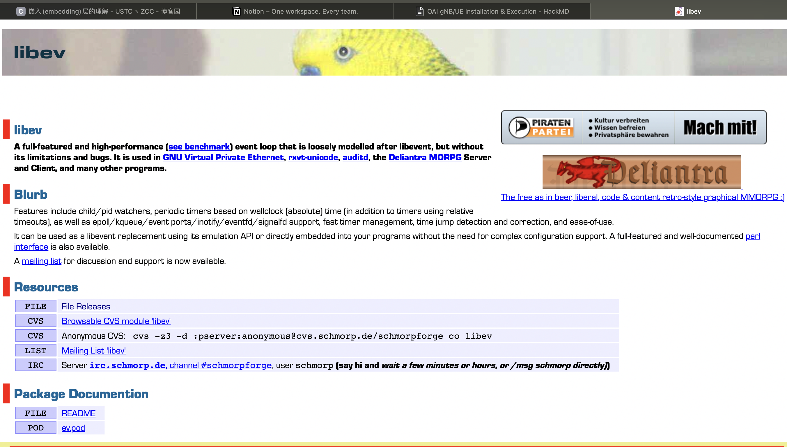
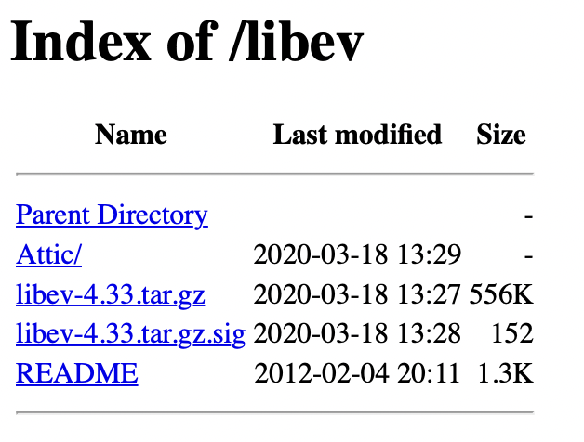
Download Libev
Libev_official_web

Slide 6
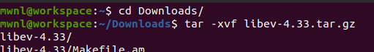
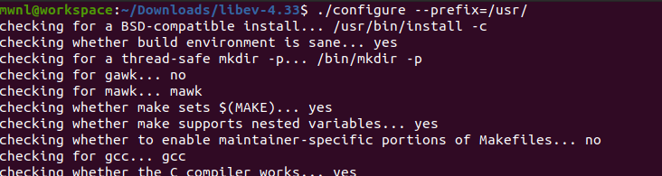
Config Libev
1
Get into Download and decompress it
Then get into the folder
Then configure
Then wait
2

Slide 7
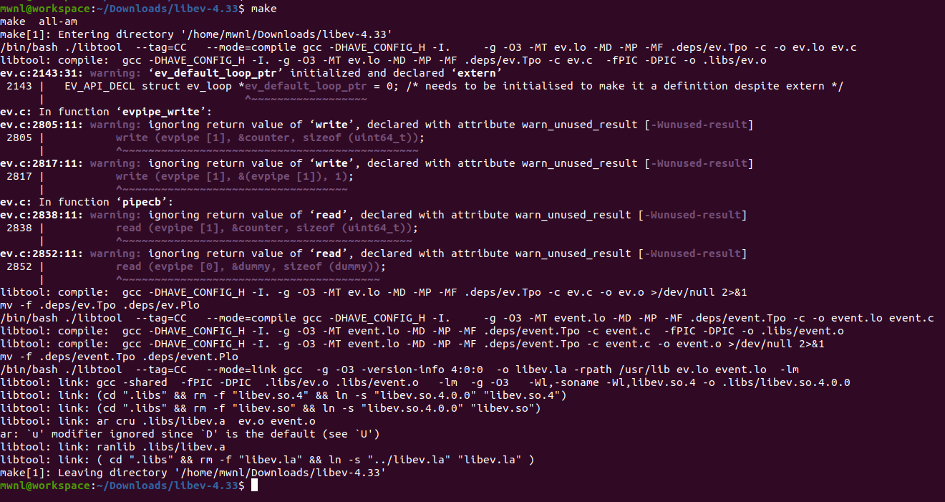
Make

Slide 8
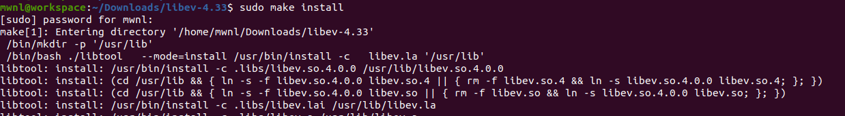
Install
$ sudo make install

Slide 9
Example

Slide 10
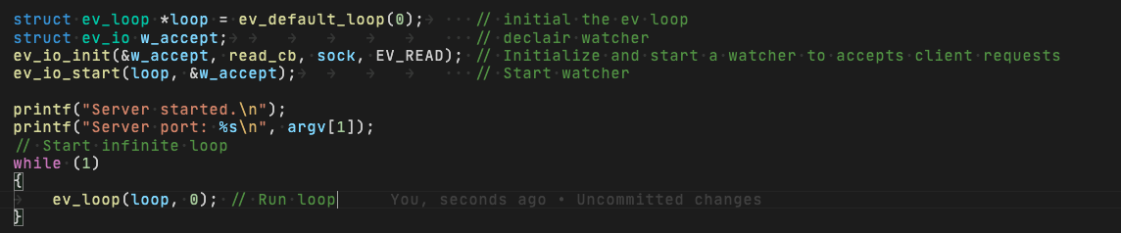
Coding

Slide 11
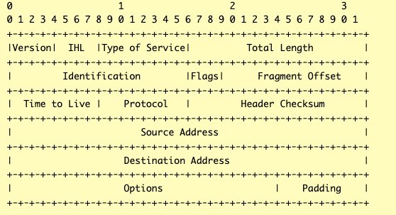
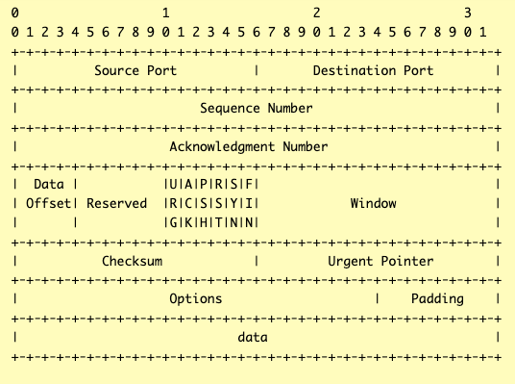
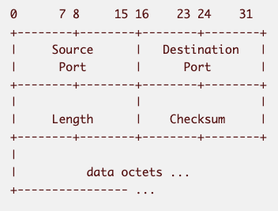
Raw socket
10

Slide 12
Libev says goodbye.

