Slide 1

Slide 1
The Battle of Neighborhoods
CAPSTONE PROJECT

Slide 2

Slide 10
Background
The success of a new business depends on a number of factors, one of them is to perform market research. Market research allows a prospective business owner to identify gaps in supply as well as determine if an area has demand for their goods. Doing this research will ensure a new business is set up for success and their hard work does not go to waste, however it is currently very time consuming.
Your logo

Slide 3
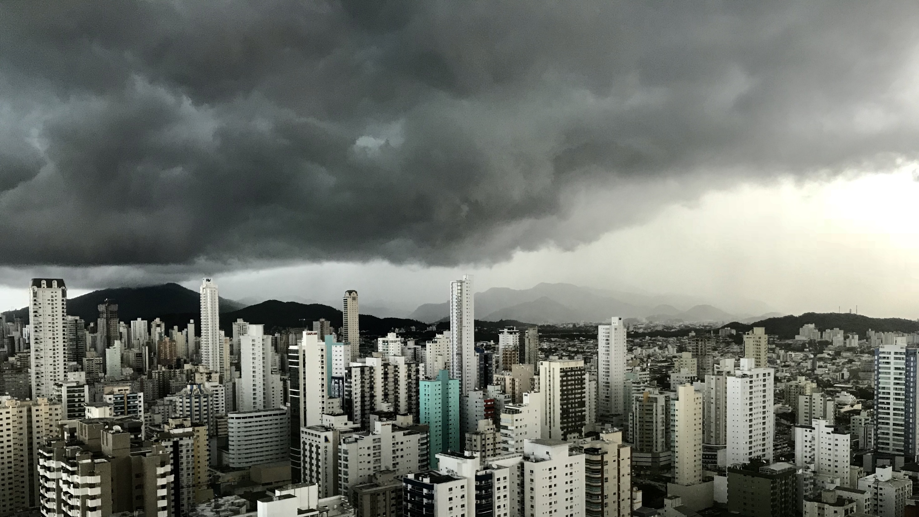
Slide 11
The findings will allow new restaurant owners
to decide where to open their venue as well as
what type of food they will serve.

Slide 4


Slide 7
Data
35%
25%
Geospatial data will be gathered from http://www.geonames.org/
Census data from Statistics Canada https://www.statcan.gc.ca/
Current business/venue data from https://foursquare.com/
43%

Slide 5
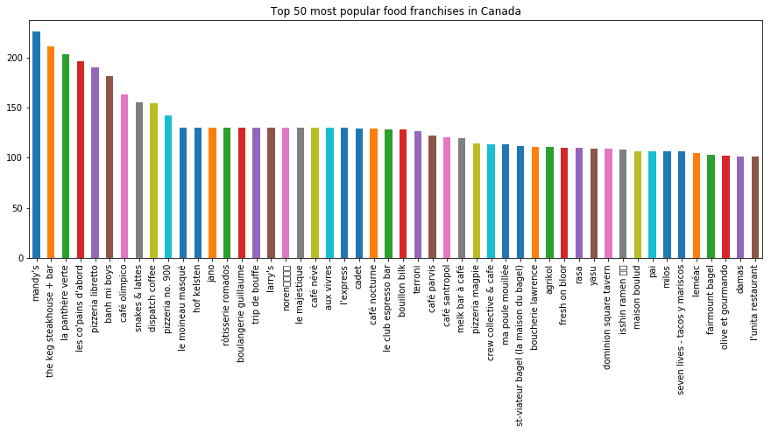
Slide 2
The current market

Slide 6
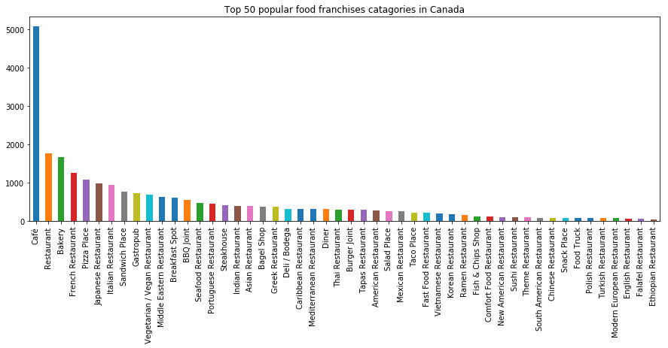
Slide 2
The current market

Slide 7
Slide 10
Measure of success
Three matrices will be used to determine if and what type of business will succeed in a given area:
Area population/venue density vs national statistics
Area population change vs national statistics
Area population/venue/category density vs national statistics
Your logo

Slide 8
Example Report
Downtown Toronto has a total population of 15951 and 1700 venues. The standardised population/venue ratio is 0.423 which is more than the national median of 0.026, nationally the population/venue is an average is 22087 and 25450 per Neighbourhood. Downtown Toronto has had a population change of 0.011% p/a which is less than the national average of 0.01%. Therefore, new businesses in Downtown Toronto has a greater chance of success. Based on the data, there are 7 types of venues that are likely to do well in Downtown Toronto (see graph below). A Portuguese Restaurant is most likely to do well and a Café is likely to do the worst as it is oversaturated based on the national data. Top 10 Venue Categories for new businesses in Downtown Toronto: 0 Portuguese Restaurant Tibetan Restaurant Bagel Shop Fast Food Restaurant Noodle House Deli / Bodega Turkish Restaurant Afghan Restaurant Hot Dog Joint9 Falafel Restaurant

Slide 9
Example Report (Continued…)
Bottom 10 Venue Categories for new businesses in Downtown Toronto: Vegetarian / Vegan Restaurant Steakhouse Sandwich Place 75 Diner 76 Bakery 77 Restaurant 78 Japanese Restaurant 79 Pizza Place 80 Italian Restaurant 81 Café Name: Venue Category, dtype: object

Slide 10
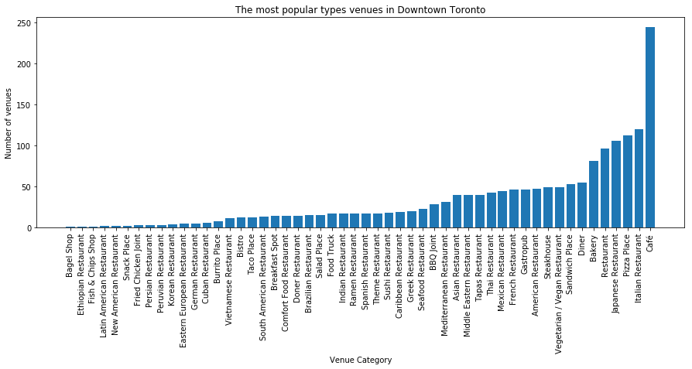
Example Report (Continued…)

Slide 11
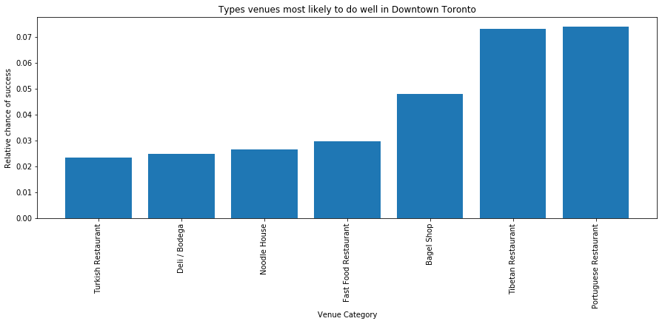
Example Report (Continued…)

Slide 12
Slide 11
Thank You!

