Slide 1
w(ν)B_{ki}
w(ν)B_{ik}
A_{ik}
E_{i}
hν
hν
2hν
hν
E_{k}

Slide 2
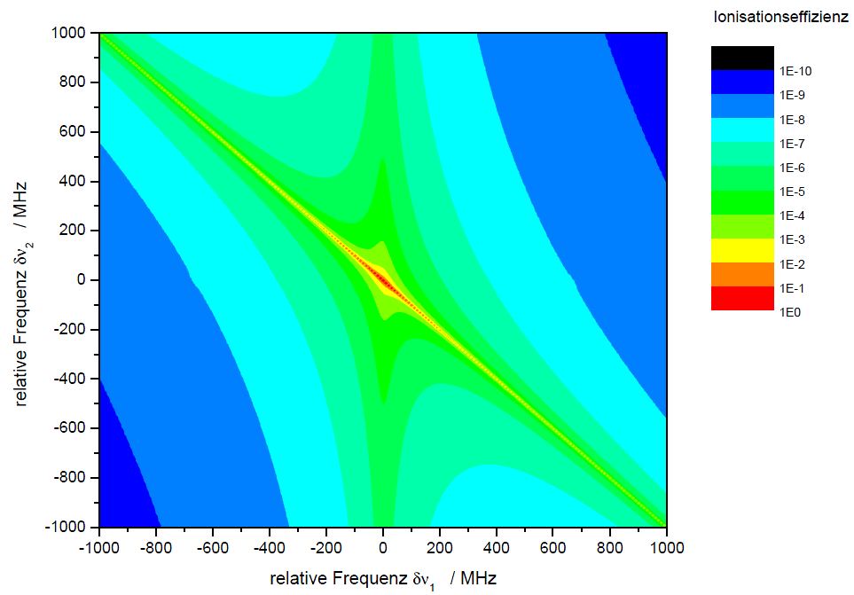
B
A
C
A
B
C
SES
FES

Slide 3
a)
b)
w(ν)B₂₁
e)
E₂
hν
2hν
c)
d)
E₁

Slide 4
p-Halbleiter
n-Halbleiter
E
E
E_{F,n}
E_{L}
E_{L}
E_{L}
E_{D}
hν
E_{F}
E_{g}
eU
E_{F}
E_{D}
E_{V}
E_{V}
E_{V}
E_{F,p}
E
E_{L}
eV_{D}
E_{L}
E_{F}
E_{D}
E_{D}
E_{V}
E_{V}
E
E_{L}
E_{V}
E_{F}
E_{L}
E_{V}

