Slide 1
Customer Churn Example
You’re a manager at MegaTelco, responsible for reducing customer churn. You need to understand how much churn is costing your organization and develop a strategy for mitigating that loss.
What you know:
Studies show that a company with 5 million customers and 2% average monthly churn loses $1.4 billion per year

Slide 2
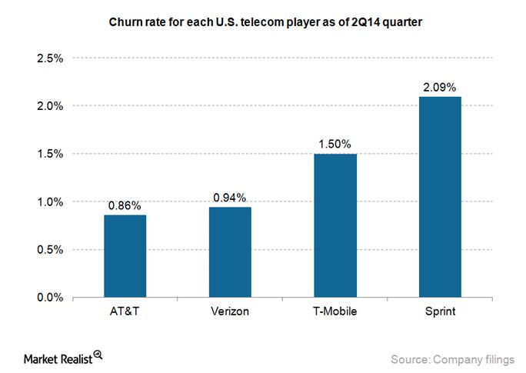
Current Industry Churn Rates

Slide 3
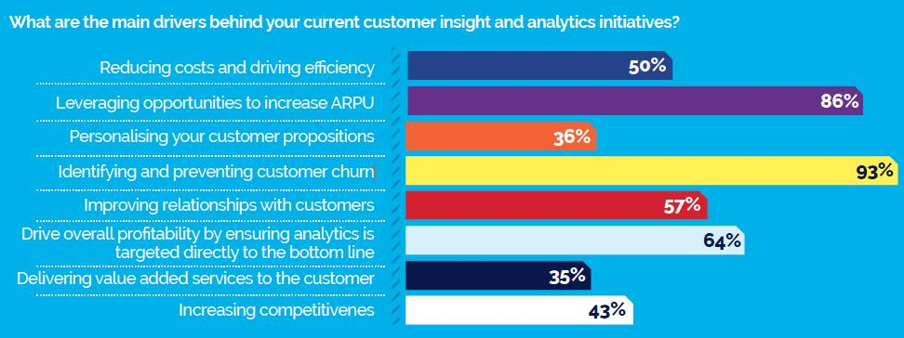
Drivers for CRM efforts in the telecommunications industry

Slide 4
The Data

Slide 5
EM Demonstration Basic Decision Tree Modified Decision Tree Interactive Decision Tree

Slide 6
Evaluating the Results
How do you decide if the model that has been delivered is a “good” model?
Evaluate the model from a statistical perspective (as discussed in class – fit statistics, significant effects in the model, correct sign on the coefficients, etc)
But, more importantly – you must connect the results of the analysis back to the goal that you set when you requested the analysis.
Question: What is the real business goal behind developing a model to identify customers who are at risk for churning?

Slide 7
Evaluating Classification Models
Accuracy
Easy to measure
May be too simplistic
Confusion Matrix
Shows the different kinds of “wrong” answers
Helpful if one kind of wrong answer is worse than another (cost of wrong answer)
Be careful of rare events

Slide 8
Questions to Ask When Evaluating a Model
What was the original goal (or motivation) for doing the analysis?
Are we assessing the model results properly given the actual goal?
Does the metric make sense in terms of the problem?
What is your baseline for comparison?

Slide 9
Returning to the Churn Problem
Why is churn a problem?
It causes us to lose money. So, the issue that we need to address is not so much that we’re losing customers but that we’re losing money.
Case in point: If a customer is costly to keep, we might not mind if she leaves. We would like to limit the amount of money that we’re losing – not simply keep the most customers.
The answer to this question should influence the way in which we evaluate the “goodness” of a churn model.

Slide 10
Churn Model (continued)
It will also influence the way that we act on the model results.
Suppose that we are designing a promotional offer to try to combat churn. We built a model to identify churners, but do we really want to target our marketing offer at the customers who are most likely to leave?
Take the value of the customer into account when evaluating and implementing the model
For example, target the customers where we would lose the most value if they were to leave
We also want to consider the cost of targeting – If we don’t target a customer, the value could actually be higher if they stay because we didn’t spend the promotional dollars.

Slide 11
Where does it end?
You can iterate on a problem for a long time, but at some point you must conclude:
We can’t get data on this event; or
It would be too expensive to model this aspect accurately; or
This event is so improbable that we’re just going to ignore it; or
This formulation seems sufficient for the time being, so we should probably just go with it…

