Slide 1
Dr. Tonya Etchison Balan
BUS 458H: Analytics from Data to Decisions

Slide 2
Navigating the Analytics Process
Data
What data do I need to answer this question?
Insight
Are there any obvious trends or issues with the data?
Decision
How do I interpret the results of the analysis?
Action
What changes need to be made to the business process?
Is the data of good quality?
Do I have that data available?
What analytical methods should be applied?
What additional analyses need to be run?
How do I map the analytical results to the business problem at hand?
How do I get these results into my operational systems?
What additional questions need to be answered?

Slide 3
People
Technology
Process

Slide 4
Analytics for Big Data
Data management / storage issues
Statistical issues
Technology issues
Applications
Tom Davenport: Analytics 3.0 (from 9:30 – 18:40)

Slide 5
Preparing to Lead in an Analytically Driven Organization
To successfully implement analytics for maximum impact to the bottom line:
Champion analytics from the top
Create a single analytics initiative
Focus the company’s analytics efforts
Establish an analytics culture
Hire the right people
Use the right technology
(from “Competing on Analytics,” HBR, Davenport)

Slide 6
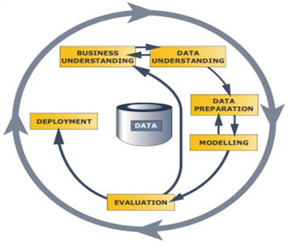
Predictive Modeling Process
CRISP-DM
Cross-Industry Standard Process for Data Mining
Business Understanding
Data Understanding
Data Preparation
Modeling
Evaluation
Deployment
SEMMA
SAS Model Building Framework
Sample
Explore
Modify
Model
Assess

Slide 7
Predictive Modeling Software
JMP
Desktop (PC or Mac)
Highly interactive but limited to data that can fit in memory
SAS Enterprise Miner
PC or Server – Access through VCL
Scales to very large data volumes although processing time will increase significantly with data size
Designed around SEMMA process
Generates repeatable processes and complete score code
SAS Visual Analytics and SAS Visual Statistics
Designed for big data problems
Web interface on top of massively parallel compute platform
Highly interactive
Accessed via Teradata University

Slide 8
Homework
Follow the links on the Moodle site to
Download a local copy of JMP 11.2
Access the VCL, reserve a SAS 9.4 image, and start up Enterprise Miner
Read the “Statistical Thinking Concepts” article

Slide 9
Structure and Assessment
There are 5 major case studies that will be covered during the semester
There will be one or more minor assignments and one major assignment associated with each case.
The minor assignments will collectively count as a major assignment.
Each major assignment is worth 20%, and the lowest grade will be dropped.

Slide 10
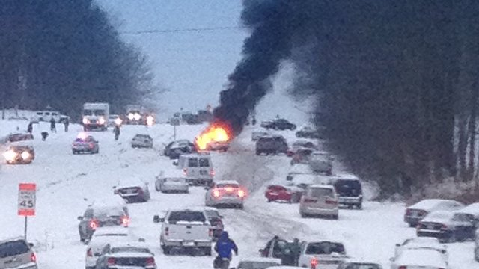
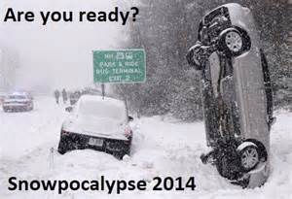

Weather

