Slide 1

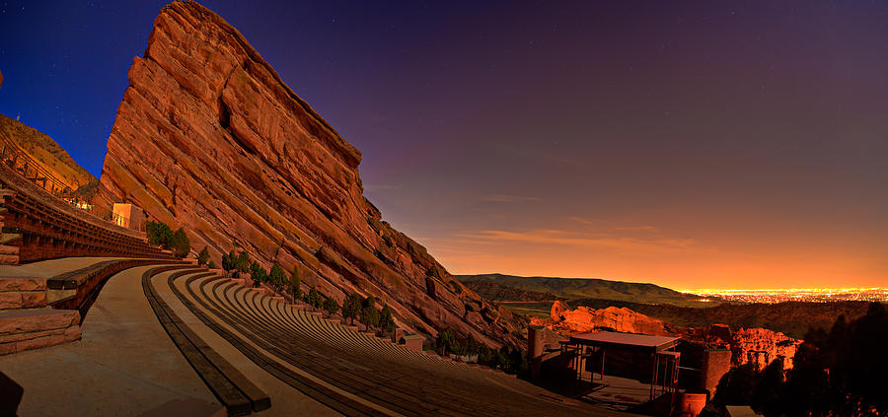
Films on the Rocks Analysis
Thi Duong
Notes:
Films on the rocks is a summer movie series held at the world-renowned Red Rocks Amphitheater located

Slide 2
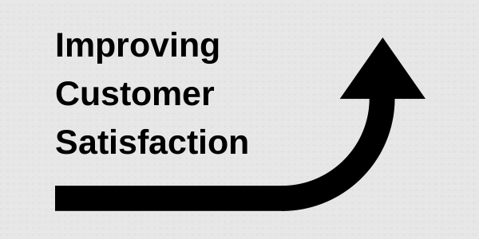

Slide 3
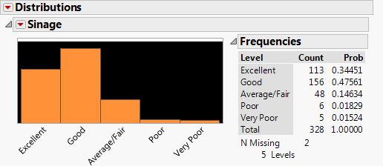
Signage Distributions
Notes:
We have generated signage distributions to see how

Slide 4
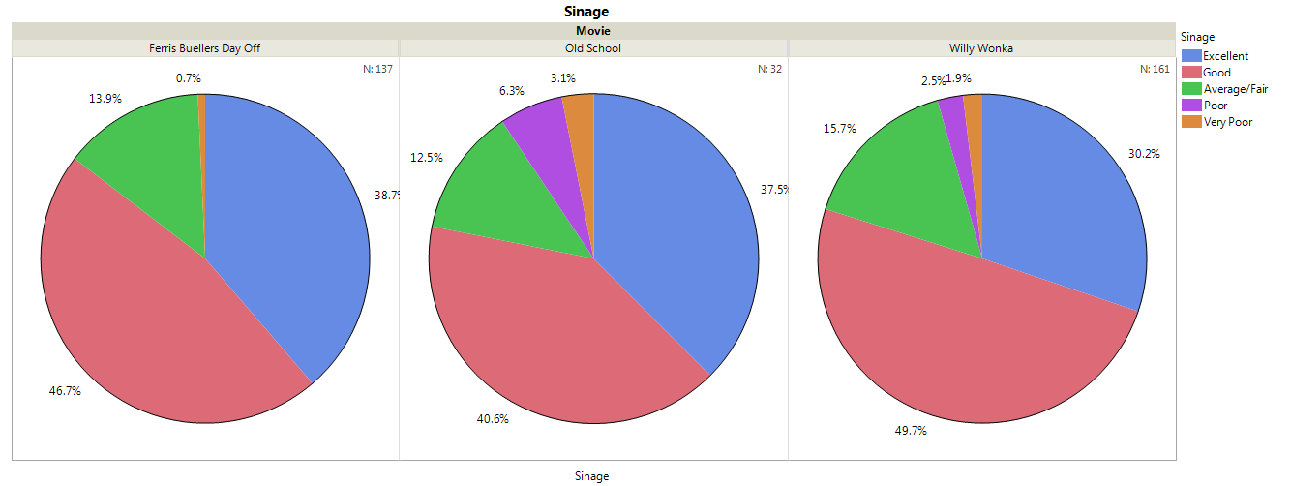
Signage by Movies

Slide 5
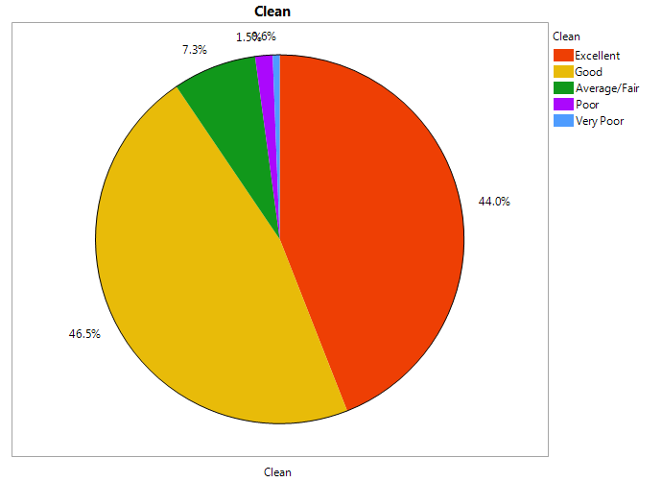
Cleanness overview

Slide 6
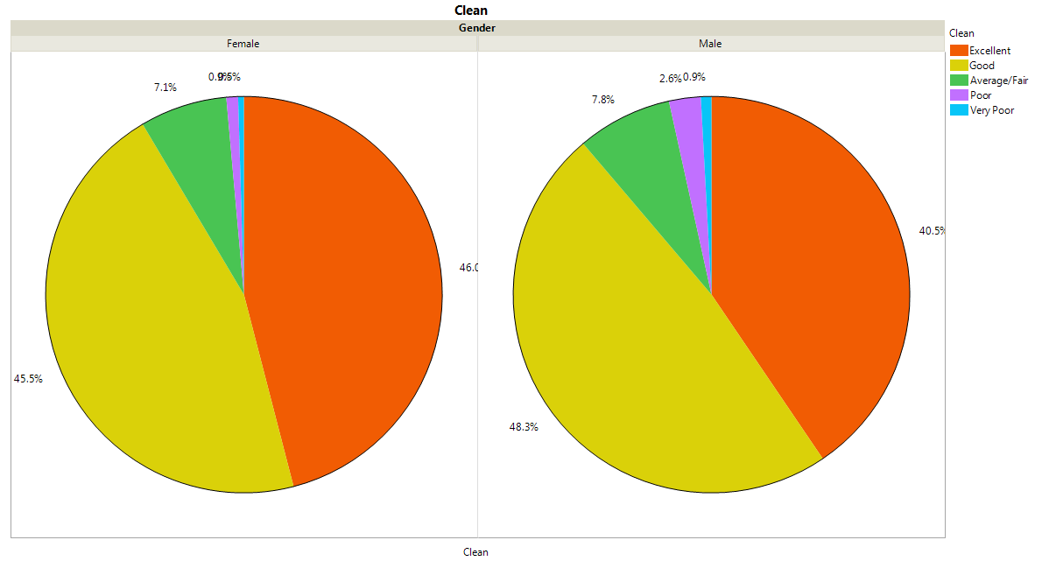
Cleanliness by Gender

Slide 7
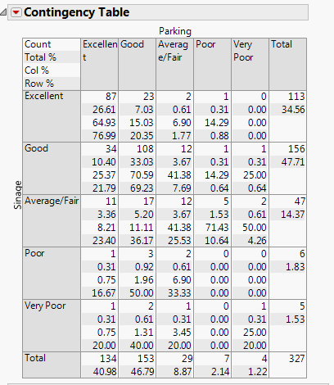
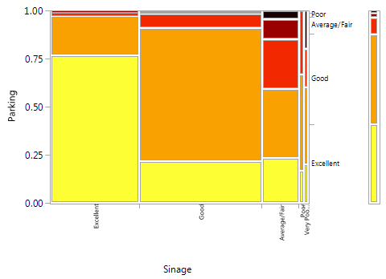
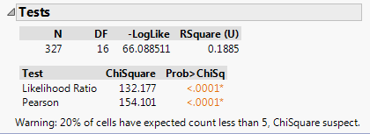
Parking by Signage (Fit Y by X)
Notes:
High levels of parking satisfaction are associated with higher levels of satisfaction with signage, as is evidenced by the mosaic plot. (good signage lead to good parking experience)
The p-value of Likelihood Ratio and Pearson are both very small (<0.0001) suggesting a strong association between these two satisfaction measures.

Slide 8
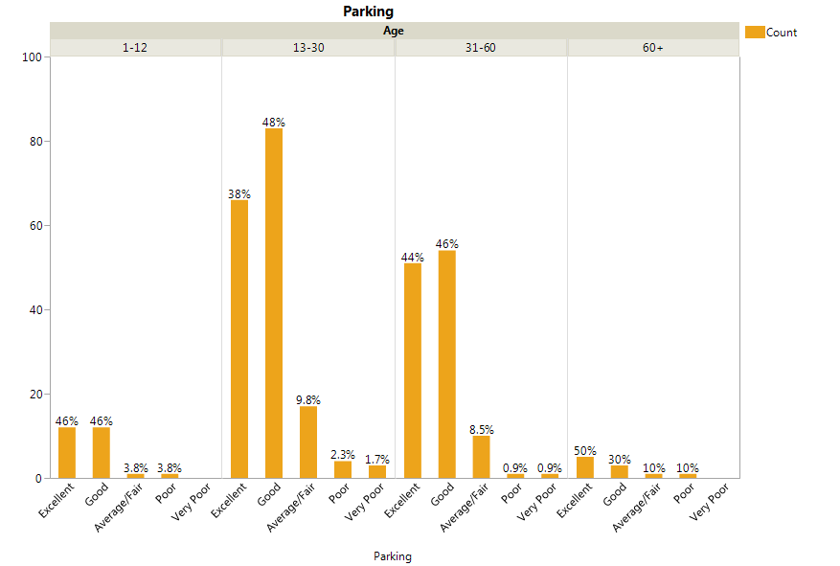

Slide 9
Logistic Regression Model

Slide 10
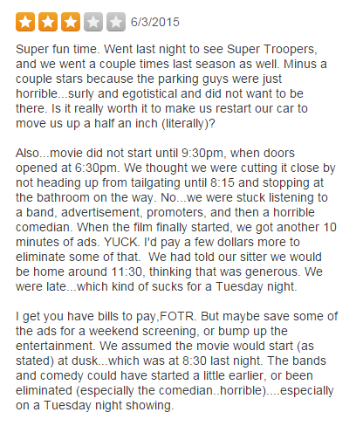
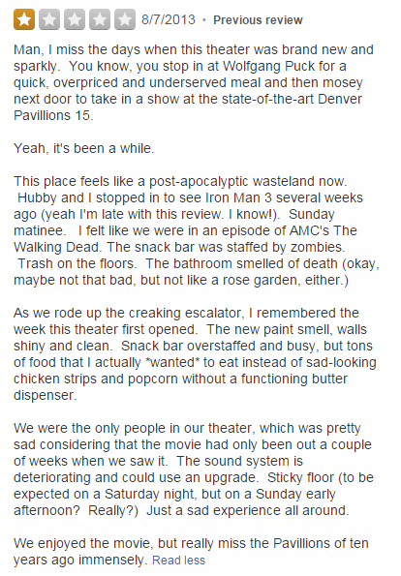
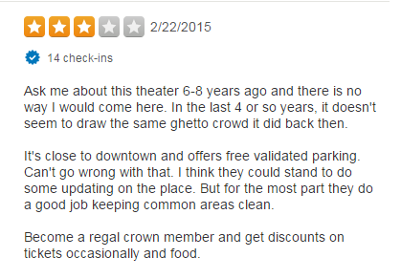
Highlighted Negative Feedbacks
Notes:
http://www.yelp.com/biz/united-artists-denver-pavilions-15-denver?hrid=JmfRbNHDS05_qEMaWJxf0w
http://www.yelp.com/biz/film-on-the-rocks-redrocks-amphitheatre-morrison

Slide 11
Customer feedback research
Red Rock Amphitheater is ranked high and has great customer reviews. According to the existing analysis, the overall customer satisfaction is very high with 94.8% of respondents reporting either good or excellent customer service experience. However, some negative feedbacks always mention about the facilities, such as sound systems, bathroom, stairs, etc., which can be improved to be better.

Slide 12
Recommendations
Upgrade facilities: more bathroom with better services, update sound systems, chairs, floors, and stage maintenance.
Additional security measures
Better bartending services
Better hospitality
Provide shuttles to drive senior-customers and parents with kids from parking lot to the amphitheater to give out the best parking and signage experience. Based on the analysis, high signage-experience satisfaction leads to high parking satisfaction, and high parking satisfaction leads to high overall satisfaction.
Try to avoid long advertisements before and during the movies.

Slide 13
What to add/change on the 2nd survey:
Facilities satisfaction levels
Hospitality satisfaction levels
Ticket Price
Viewing experience at a particular seat location

