Slide 1
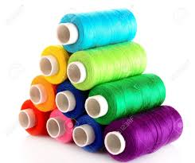
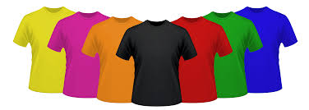
Do you know what chemicals are in your clothes?
1
2

Slide 2
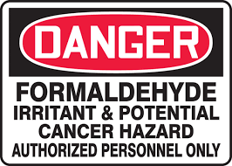
What no one wants to talk about...
Your clothes go through multiple processes before they are ready to ship to stores. Many processes contain mixtures of chemicals to create the characteristic you want in apparel products. One example, a chemical named formaldehyde used in wrinkle resistance, is a known carcinogen, but there is no known alternative. There are trace amounts, which mostly only matters for work health. The other problem is the affluent these chemicals create and the disposal of this affluent.
3

Slide 3

Zero Waste
It is projected by 2020 that there will be a zero waste law on the textile industry. This will not fix the problems with the waste. The waste will simply turn to other forms. For example, some companies have evaporated it into the atmosphere.
4

Slide 4
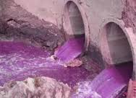
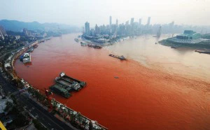
The Banned Chemicals
The U.S. has banned many chemicals used for dyeing in the textile industry; however, it is not as stringent as Europe on the subject. There is no global list of banned chemicals, and many companies depend on their suppliers in China or India to know this information. These suppliers use the cheapest chemicals, and they don’t care about environmental impact.
5
6

Slide 5

A Global List
There are lists that contain banned chemicals but not fully encompassing. I have found 4 lists and am working to compile this information into a global one. For example, the AAFA keeps the most up to date list for banned chemicals, but there are lists, such as the Washington Green Guides, that are not included because they pertain only to one state and are focused on children.
7

Slide 6
This leads us to the… BUS 442 Final Project:
Textile Restricted Substances and Sustainable Substitutes Prototype

Slide 7
Functional Requirements for the project
Build a database to house data for restricted substances and their sustainable substitutes. This would include the ability to track data on 66 dangerous (or of high concern) chemicals to children under age 12.
Include the ability to report the presence of 66 chemicals to the U.S. states from the database
Include the ability to add in a sustainable substitution substance. (The SME plans to acquire this knowledge by reaching out to companies and asking them to send their substance list.)
Include the ability to retrieve this information in order to compare and analyze it. This would include the ability for a user to search for a chemical (by name or id). Eventually, the prototype would provide the capability to pull the sustainable substitute from the database.

Slide 8
Restricted substance Categories
Arylamines
Asbestos
Dioxins & Furans
Disperse Dyes
Fame Retardants
Fluorinated Greenhouse Gases
Metals
Misc
Organotin Compounds
Pesticides
Phthalates
Solvents

Slide 9
Data Collected for Restricted substances
Category (Example: see prior slide)
CAS Number (Example, 7440-43-9) A CAS Registry Number is a unique numerical identifier assigned by Chemical Abstracts Service (CAS) to every chemical substance. It includes up to 10 digits which are separated into 3 groups by hyphens. The first part of the number, starting from the left, has 2 to 7 digits; the second part has 2 digits. The final part consists of a single check digit.
Chemical Name / Color Index Name (Example: Cadmium (Cd), Lead (Pb))
Restriction / Maximum Limit on Final Product or Tested Component
Final Product or Tested Component (Example: Textiles, Leather, Metal, Plastic)
Country
Regulation (Example: CNS 15290)
Test Method
Other Countries / U.S. States that also regulate this substance
Comments
GAFTI Comments
Type of Toxicity (Example: Cancer)
Date Listed

Slide 10
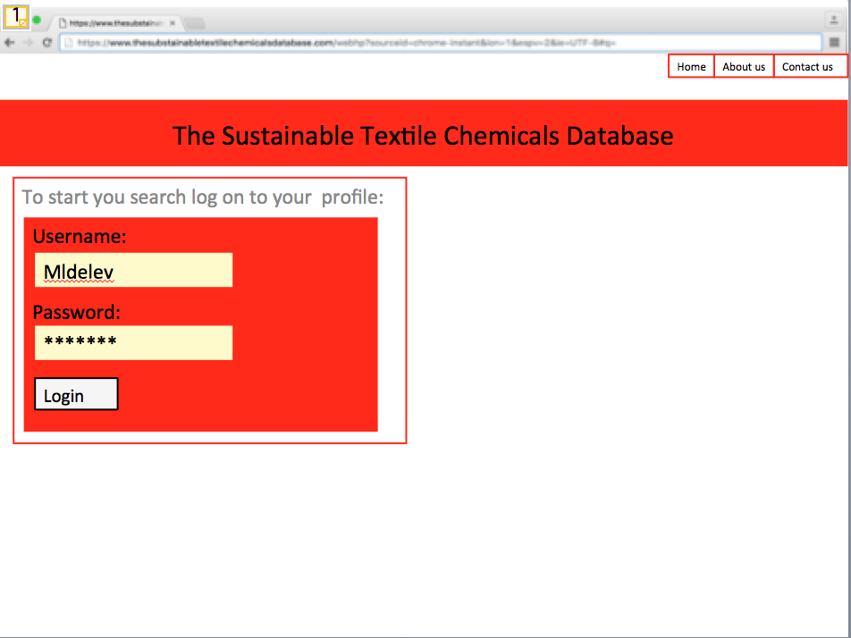
Layout

Slide 11
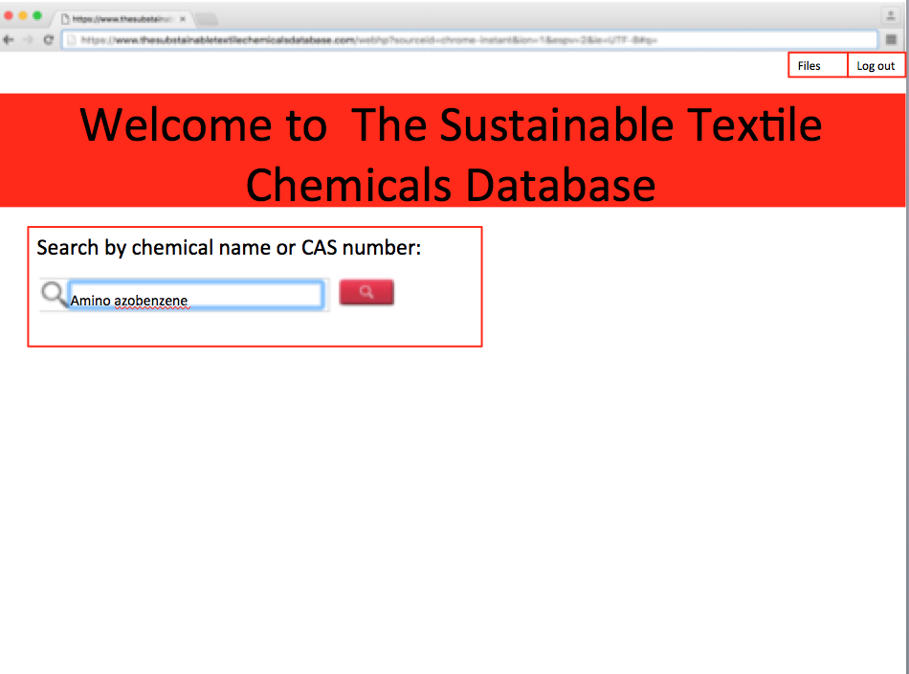
Layout

Slide 12
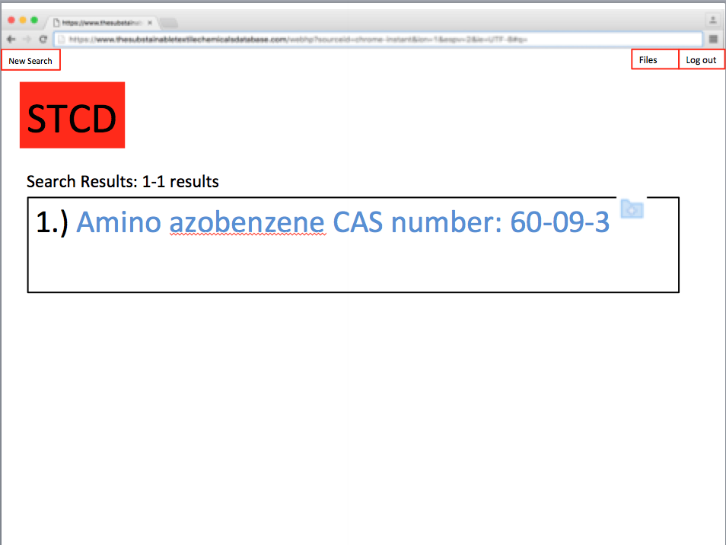
Layout

Slide 13
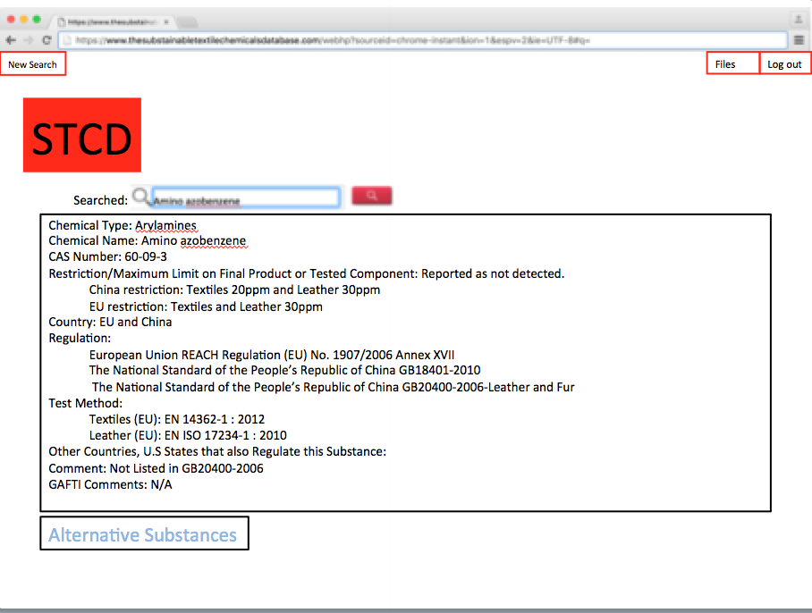
Layout

Slide 14
References
1: "BS Uniform." BS Uniform. Web. 21 Mar. 2016.
3: "Formaldehyde Levels Testing Archives - EMF - Radon - Indoor Air Quality Testing : Dallas / Fort Worth / Austin / Houston - Texas 214.912.4691." EMF Radon Indoor Air Quality Testing Dallas Fort Worth Austin Houston Texas 2149124691. Web. 21 Mar. 2016.
7: "Media Kit - Media Kit | American Apparel & Footwear Association." Media Kit - Media Kit | American Apparel & Footwear Association. Web. 21 Mar. 2016.
4: "NY Textile Recycling Program Is a Great Step Towards Zero Waste." Wellness Warrior. Web. 21 Mar. 2016.
5 and 6: "Threading Our Way." Threading Our Way. Web. 21 Mar. 2016.
2: "Thread Stock Photos and Images." 123RF Stock Photos. Web. 21 Mar. 2016.

