Slide 1

Zone Segmentation for Secure Networks
Advanced segmentation methods reduce risks and strengthen access control in data center, campus, and branch networks.
IT
IT Admin
2026-01-11
Notes:
Zone segmentation establishes logical boundaries inside the network, allowing more granular access controls and limiting the impact of potential threats. These methods are vital in securing diverse environments, including data centers, campuses, and branches.

Slide 2
Introduction to Zone Segmentation
1
4
Integrated approach for securing networks
Supports scalable policy enforcement
2
5
Minimizes lateral movement risks
Enhances visibility into network zones
3
Enables compliance with security standards
Notes:
Zone segmentation organizes a network into isolated sections to limit threats and better enforce security policies. This approach helps reduce the impact of lateral attacks, improves compliance, and allows for flexible policy controls at scale.

Slide 3

Introduction to Zone Segmentation
Zone Segmentation enables targeted security controls and reduces risks within complex networks.
Granular Network Partitioning
Facilitates secure separation of environments to protect sensitive resources and maintain compliance.
Minimized Attack Surfaces
Reduces exposure to threats by limiting lateral movement between zones.
Rapid Threat Containment
Supports quick isolation of incidents to prevent escalation and cross-network compromise.
Notes:
Zone Segmentation divides networks into secure segments. This approach restricts unauthorized lateral movement and quickly isolates threats, protecting sensitive assets and supporting robust security strategies across diverse environments.

Slide 4
Why Zone Segmentation Matters
1
3
Zone Segmentation enables targeted internal controls
68% of firms saw rising lateral attacks last year
68%
2
Perimeter security no longer stops multi-vector threats
4
Reduces blast radius for faster incident containment
Notes:
Zone segmentation is necessary because lateral attacks are rising and perimeter defenses fall short against modern multi-vector threats. By dividing networks into segments, organizations can control traffic more effectively, isolate issues quickly, and reduce the impact of breaches.

Slide 5

Solution Portfolio Overview
1
Data Center Solution
2
Campus Solution
Advanced segmentation secures critical workloads, improving performance and policy control.
Real-time enforcement manages user and device access for higher security.
3
Branch Solution
Context-aware segmentation enables secure, efficient distributed office networking.
graph TD; A[Start]-->B{Choice}; B-->C[Path 1]; B-->D[Path 2];
Notes:
The solution portfolio covers data center, campus, and branch sites. Each segment employs tailored security strategies: Data centers use advanced segmentation, campuses ensure access control, and branches enable efficient context-aware networking. Together, they deliver optimized protection and performance for all locations.

Slide 6

Key Features & Capabilities
Advanced Segmentation
Context-Aware Policies
RTC Integration
Reduces exposure by 72% over flat networks, enabling stronger risk management.
Automates threat detection for rapid incident containment and reduced manual intervention.
Applies identity-based, dynamic access controls tailored to workload and user context.
Comprehensive Monitoring
Delivers continuous visibility into network traffic, access patterns, and potential risks.
Notes:
Highlight the main security features: advanced segmentation significantly reduces risk, context-aware policies enable granular access control, RTC integration ensures fast threat response, and robust monitoring keeps security teams informed of activity and threats.

Slide 7

Zone Segmentation: DC ACI RTC
Enabling secure, multi-tenant environments with swift, automated threat response and seamless ACI integration.
Multi-Tenancy & Isolation
Ensures workload separation and scalable, secure environments for diverse clients.
Seamless ACI Integration
Direct interoperability with Cisco ACI streamlines network management and policy enforcement.
Automated Threat Response
Achieves median containment times <30s, as validated by Cisco 2025 Labs, minimizing security breach impact.
Regulatory Compliance
Supports mandates such as PCI-D, helping meet critical statutory requirements.
Notes:
Zone segmentation in DC ACI RTC delivers secure, multi-tenant network architectures, reduces risk via rapid automated threat containment, integrates efficiently with Cisco ACI, and supports major compliance mandates, including PCI-D.

Slide 8

Zone Segmentation for Campus Networks
Segmenting campus networks boosts breach containment and integrates smoothly with Cisco FTD and ISE.
Enhanced Segmentation
Network segments by user, device, and application for up to 90% stronger breach containment (Forrester, 2025).
Cisco Integration
Works seamlessly with Cisco Firepower Threat Defense and Identity Services Engine for holistic security.
Context-Aware Security
Dynamically adapts segmentation using user, device, and application context cues for real-time protection.
Notes:
This slide highlights improved zone segmentation in campus networks, emphasizing integration with Cisco FTD and ISE, 90% containment of breaches, and the role of context-awareness for enhanced security.

Slide 9

Zone Segmentation for Branches
Delivering context-aware segmentation ensures security and consistency for distributed branches through intelligent policies and centralized management.
Granular Segmentation
Enhances visibility and control by extending fine-grained segmentation to all branch locations.
Adaptive Policies
Deploys context-based policies to securely support BYOD and IoT devices.
Reduced Incidents
Cuts branch security incidents by up to 62% per recent Gartner analysis.
Centralized Consistency
Ensures unified security posture and simplifies administration across distributed sites.
Notes:
Zone segmentation in branch environments leverages granular policies and centralized management. This approach secures remote offices, accommodates modern device use, and significantly reduces incident rates, ensuring unified security standards.

Slide 10

Real-World Use Cases & Scenarios
Data Center
Campus Network
Branch Office
Segment sensitive databases for optimal isolation and contain potential malware threats within one tenant environment.
Apply guest VLAN separation and segment IoT devices to improve operational security and limit threat exposure.
Enhance compliance by separating POS systems from main business networks, reducing risk of unauthorized access.
Notes:
Here are practical examples of segmentation: in data centers, it protects sensitive resources; on campus, it improves safety and management; and in branch offices, it secures POS systems for regulatory compliance.

Slide 11
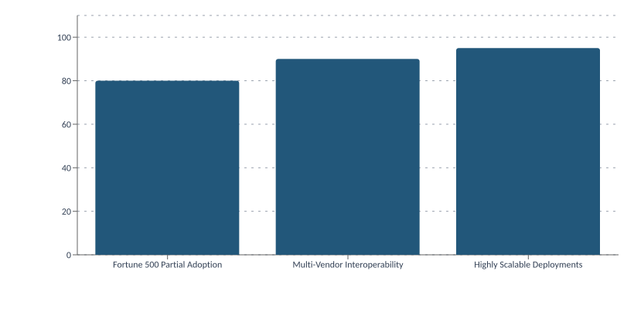
Integration & Deployment Options
Seamless Integration
Works with existing switches, gateways, and security appliances.
Flexible integration works across various network environments, supporting on-premises, hybrid, and cloud-based deployments for scalable enterprise use.
Multiple Deployments
Supports on-premises, hybrid, and cloud set-ups.
100
80
60
40
20
0
Fortune 500 Partial Adoption
Multi-Vendor Interoperability
Highly Scalable Deployments
Notes:
Highlight the platform's flexibility in working with current network equipment and various vendors. Emphasize widespread adoption among large enterprises and outline the choice of deployment models and their scalability.

Slide 12
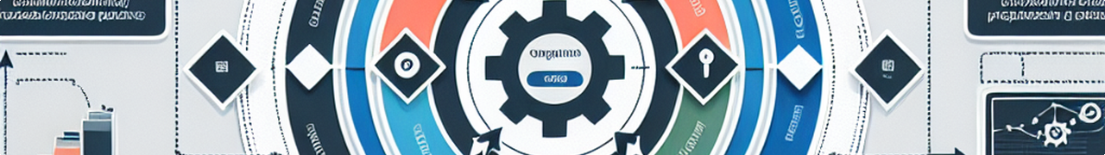
Best Practices & Key Recommendations
1
Map Processes & Segmentation
2
Risk-Based Policies
Align business processes with segmentation zones to protect sensitive assets and data flows.
Establish control policies that focus on assets with the highest value or risk within the environment.
3
Adaptive Access Control
4
Automation & Continuous Review
Implement context-aware mechanisms for access that respond dynamically to changing risk factors.
Deploy automated threat detection tools and review controls periodically to ensure constant risk mitigation.
graph TD; A[Start]-->B{Choice}; B-->C[Path 1]; B-->D[Path 2];
Notes:
Highlight how these practices help organizations enhance security and agility. Emphasize the importance of ongoing review, automation, and aligning controls to the value and risk of business assets.

