Slide 1

Zone Segmentation: Modern Network Security
Dividing networks into secure zones limits access, restricts lateral movement, and improves risk management for IT and security teams.
IT
IT Security Lead
2026-01-12
Notes:
Zone segmentation divides a network into multiple zones based on trust and security requirements. This limits unauthorized access and curbs lateral movement by attackers. Implementing defined boundaries enhances security monitoring and simplifies compliance.

Slide 2
Table of Contents
1
6
Introduction to Zone Segmentation
3
Campus: RTC FTD ISE
8
2
7
The Need for Zone Segmentation
4
Branch: Context-Aware Segmentation
9
3
8
Solution Portfolio Overview
5
Real-World Use Cases
10
4
9
Key Features & Capabilities
6
Integration & Deployment
11
5
Data Center: ACI RTC
7
Notes:
This slide provides an overview of the topics covered, starting with an introduction and the need for zone segmentation. It outlines solution portfolios across key network areas, highlights features, and summarizes use cases, as well as integration and deployment.

Slide 3
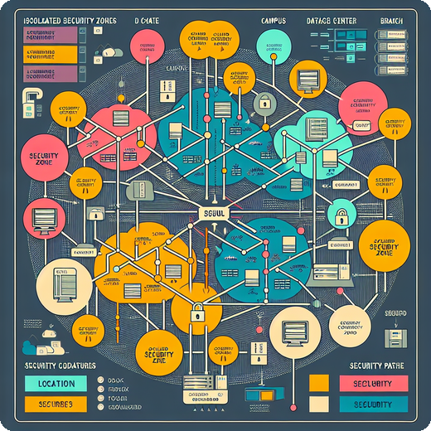
Understanding Zone Segmentation
Zone Segmentation improves security by dividing networks, reducing risks, and enabling swift threat response.
Advanced Security Portfolio
Offers comprehensive solutions for protecting data center, campus, and branch environments.
Minimized Attack Surface
Dividing the network into isolated zones reduces the scope for potential cyberattacks.
Faster Threat Response
Enables quicker identification and containment of threats, limiting their impact.
Notes:
Zone segmentation divides network infrastructures into isolated zones, reducing the risk of cyberattacks and enabling organizations to respond to threats more efficiently.

Slide 4
Why Zone Segmentation Matters
1
1
60% orgs hit by lateral attacks in 2025
60%
Zone segmentation reduces internal attack surface
2
Networks are more complex: IoT, cloud, remote staff
2
Improved containment, response, and compliance
3
Perimeter security misses internal threat movement
Notes:
Zone segmentation is critical as lateral movement of threats inside networks is rising, with 60% of organizations impacted last year. Increasing network complexity from trends like IoT and remote work makes traditional perimeter defenses insufficient. Segmenting zones helps limit attack spread internally and supports better security controls.

Slide 5


Zone Segmentation Solution Portfolio
1
Data Center: ACI RTC
2
Campus: RTC FTD ISE
Leverages ACI and real-time controls to secure traffic flows in data centers with dynamic segmentation.
Combines RTC, Firepower Threat Defense, and Identity Services Engine for flexible campus network segmentation.
3
Branch: Context-Aware Segmentation
Implements adaptive policies, enabling secure branch operations based on real-time context and application needs.
flowchart LR DC[Data Center\nACI RTC] Campus[Campus\nRTC FTD ISE] Branch[Branch\nContext-Aware Segmentation] DC --> Campus Campus --> Branch
Notes:
The solution portfolio addresses unique segmentation requirements across the data center, campus, and branch. Over 70% of large enterprises are considering network segmentation for enhanced security. Each environment leverages specialized tools for robust protection.

Slide 6

Key Features & Capabilities
Policy-Based Segmentation
Context-Aware Enforcement
Rapid Threat Containment
Advanced enforcement separates network traffic for enhanced security and compliance.
Access controls adjust based on user, device, or application context, increasing precision.
Seamless integration quickly identifies and contains threats using automated technologies.
Realtime Monitoring & Response
Flexible, Scalable Deployment
Continuous monitoring paired with automated response ensures quick mitigation of potential risks.
Supports diverse environments, adapting to data center, cloud, and hybrid requirements.
Notes:
This overview covers essential capabilities: policy-based segmentation for strict traffic controls, context-aware enforcement that adapts to users and devices, integration with threat response tools for rapid containment, and real-time monitoring. The solution is flexible and scalable, fitting data centers and hybrid cloud environments.

Slide 7

Zone Segmentation with ACI RTC
Enhances data center security by integrating micro-segmentation and automated policies within Cisco ACI environments.
Cisco ACI Integration
Seamlessly connects with Cisco Application Centric Infrastructure for zone segmentation.
Dynamic Policy Automation
Enables swift policy changes and automated threat responses.
Micro-segmentation
Provides detailed isolation for sensitive workloads, improving internal security.
Reduced Threat Movement
Studies show ACI RTC cuts lateral threats in DCs by up to 80%.
Notes:
This slide summarizes how ACI RTC strengthens zone segmentation and security in data centers using Cisco ACI, supporting dynamic threats and workload isolation while notably reducing lateral threat movement.

Slide 8
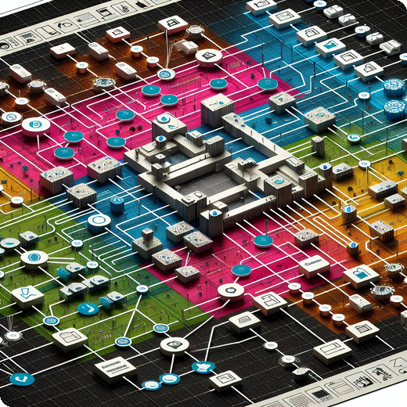
Zone Segmentation: RTC FTD & ISE
Modern campus networks use segmentation to improve security through Cisco Firepower Threat Defense and Identity Services Engine.
Integrated Security Controls
FTD and ISE together provide context-aware access for both users and connected devices.
Policy-Based Isolation
Granular policies restrict guest and IoT network access, limiting lateral movement and risk.
Proven Results
A university reduced security incidents by 40% after deploying zone segmentation.
Notes:
This slide highlights how campus zone segmentation with Cisco FTD and ISE improves security, enforces isolation for guest and IoT traffic, and delivers measurable incident reduction based on real-world outcomes.

Slide 9
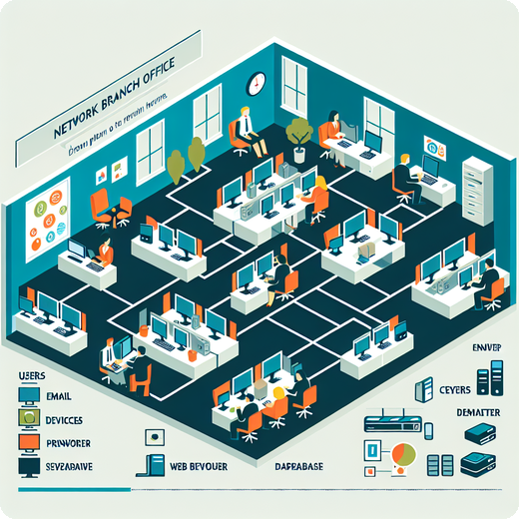
Context-Aware Zone Segmentation
Segmenting networks in branch locations enhances security and simplifies management with user, role, device, and application awareness.
Policy by Identity
Access controls dynamically applied based on user, role, device, and app context for robust security.
Streamlined Operations
Unified approach simplifies policy management and enforcement across distributed branch environments.
Policy Consistency
Centralized control helps maintain compliance and consistent security policies everywhere.
Widespread Adoption
55% of retail and financial branches implemented context-aware segmentation in 2025 (IDC).
Notes:
This slide covers how context-aware zone segmentation customizes network security in branches by leveraging user, device, and application data, reduces management overhead, ensures policy consistency, and is widely used among retail and financial institutions.

Slide 10

Real-World Segmentation Use Cases
1
Data Center Protection
2
Campus Network Zoning
Isolate critical assets and secure sensitive workloads from internal and external threats.
Create separate zones for IT, guests, and IoT devices to enhance security posture.
3
Branch Regulatory Compliance
4
Rapid Ransomware Response
Safeguard point-of-sale systems, ensuring adherence to industry regulations and preventing breaches.
Contain ransomware outbreaks within hours, minimizing business impact and recovery time.
graph TD; A[Start]-->B{Choice}; B-->C[Path 1]; B-->D[Path 2];
Notes:
This slide highlights four key use cases for network segmentation. Data centers leverage segmentation to protect critical assets. Campuses implement distinct zones for IT, guest, and IoT traffic. Branch offices focus on regulatory compliance by securing POS systems. Finally, segmentation accelerates incident response, allowing for swift ransomware containment.

Slide 11
Integration & Deployment Options
1
Seamless integration with multi-vendor environments
4
Automated policy enforcement saves 30% manual effort
2
Supports on-premises, hybrid, and cloud models
3
Scalable for 100 to 100K+ endpoints
Notes:
The platform ensures seamless integration with varied environments, supporting all deployment models. Scalability is built-in for organizations of any size, and automation significantly reduces manual management workloads.

Slide 12
Implementation Best Practices
Network Security
Segment architecture by risk, assign tailored zones, apply context-aware policies, and automate via analytics and SOAR.
Notes:
Summarize the most effective ways to implement secure network environments: segment networks according to risk, designate zones for business needs, enforce adaptive policies, and automate using analytics and orchestration tools.

