Slide 1

AI Defense: Advanced Security Solutions
Utilizing advanced segmentation and policy management empowers organizations to proactively identify threats and strengthen defenses, improving incident response and risk mitigation capabilities.
AI
AI Analyst
2026-01-12
Notes:
By leveraging AI for segmentation and policy management, organizations can quickly detect potential breaches and impose tailored controls. This approach supports rapid incident response and significantly reduces overall security risk.

Slide 2
The Need for Advanced AI Defense
1
Cyber threats evolve rapidly, increasing enterprise risks
3
Adapting to new threat vectors is critical for resilience
2
AI-driven defense strengthens response capabilities at scale
4
Legacy approaches often lag behind modern attack methods
Notes:
Highlight the importance of evolving cyber threats and the limitations of traditional defenses. Emphasize how AI-driven solutions offer scalable and adaptive protection, enabling organizations to keep up with new challenges and better secure their environments.

Slide 3
Driving Forces for Advanced AI Defense
1
4
Cyber threats evolving at unprecedented speed
Greater complexity in network environments
2
Encrypted traffic exceeds 95% in enterprises
3
Over 80% use hybrid cloud/on-prem models
Notes:
Evolving cyber threats, high encrypted traffic volumes, and widespread hybrid cloud adoption have raised the bar for security. AI-driven tools are essential to keep up with these advancing threats and the complexities of today’s network environments.

Slide 4

Addressing Enforcement Gaps in Security
Many solutions struggle with encrypted traffic, leading to costly processes or uninspected blind spots in security enforcement.
Competitor Weaknesses
Decryption-heavy or bypass strategies are inefficient, increasing costs and leaving gaps in threat detection.
Encrypted Traffic Volume
Over 90% of network traffic is now encrypted, compounding the risk of uninspected threats.
Notes:
Competitors face challenges due to encryption, often either exhausting resources on decryption or skipping inspection. Over 90% of traffic being encrypted creates large blind spots, highlighting why new approaches are critical.

Slide 5

Efficient Encrypted Traffic Inspection
1
AI-Powered Inspection
2
Resource Optimization
Delivers deep analysis of encrypted packets, minimizing reliance on full decryption for security.
Reduces hardware needs for inspection by up to 80% using advanced algorithms.
3
Threat Detection
Identifies hidden threats within TLS/SSL traffic with high accuracy.
graph TD; A[Start]-->B{Choice}; B-->C[Path 1]; B-->D[Path 2];
Notes:
This slide highlights how AI-driven inspection techniques improve encrypted traffic analysis. Hardware needs drop dramatically, with up to 80% less equipment required, while maintaining strong detection of threats hidden in encrypted traffic.

Slide 6
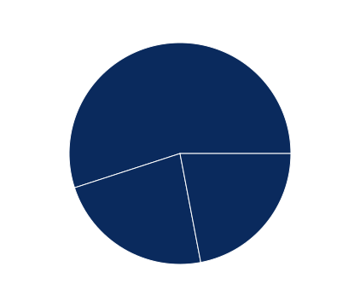
AI-Driven Segmentation: Macro vs. Micro
Macro Segmentation
Micro Segmentation
Adoption Trends
Focuses on dividing organizations into large, distinct business units or functional areas to enhance overall security boundaries.
Establishes finer segmentation within enterprise networks, restricting communication between individual workloads or applications for improved control.
Growing number of companies are integrating micro-segmentation, with over 55% implementing or planning AI-based models.
Notes:
AI-driven segmentation strategies operate at both macro and micro levels. Macro segmentation separates business units for broad security, while micro segmentation creates granular protections around specific workloads. Most organizations are moving toward adopting micro-segmentation, as highlighted by the 55% adoption rate.

Slide 7

Zone Segmentation: Context-Aware Security
Dynamic zone segmentation leverages Security Group Tags for efficient, context-based policy assignment.
Policy Assignment
Security policies are mapped dynamically to users, devices, or apps using SGT.
Integrated Enforcement
Real-time policy application through FTD and ISE for immediate response.
Operational Efficiency
Reduces manual effort in managing policies by automating context-based controls.
Notes:
Zone segmentation uses dynamic context, such as user or device identity, to assign security policies. Integrating FTD and ISE allows immediate, automated enforcement, which minimizes manual policy management workload.

Slide 8

Unified Policy Management Across Environments
1
Centralized Oversight
2
Automated Policy Updates
Manage policies across on-premises and multi-cloud with unified visibility.
Real-time updates via dynamic tag-based assignment streamline policy alignment.
3
Accelerated Response Times
4
Consistent Security
Reduce response time to policy changes by up to 50%.
Ensure security standards remain uniform across environments using centralized controls.
graph TD; A[Start]-->B{Choice}; B-->C[Path 1]; B-->D[Path 2];
Notes:
Unified policy management ensures consistent control and oversight for both on-premises and cloud environments. Automation through dynamic tagging dramatically improves update speed and accuracy, leading to a significant reduction in response times. Centralized controls help maintain strong, consistent security across all platforms.

Slide 9
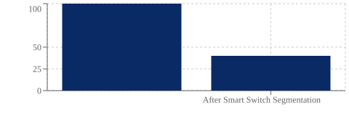

Smart Switches & L4 Segmentation
1
Enhanced Application Awareness
2
Dynamic Policy Enforcement
Smart switches recognize and manage traffic at the application level, increasing control in the access layer.
Policies are applied based on app, user, and device attributes, moving beyond traditional VLAN and IP-based rules.
3
Security Impact
Deployment cuts lateral movement attack vectors by 60%, limiting threat spread within the network.
100
50
25
0
After Smart Switch Segmentation
graph TD A[App-Aware Smart Switch] B[User & Device Policies] C[L4 Segmentation] D[Reduced Threat Movement] A --> B --> C --> D
Notes:
Smart switches enable application-level visibility at the access layer. Leveraging Layer 4 segmentation, security policies can be enforced based on applications, users, or devices, not just network addresses. This approach significantly reduces the risk of threats moving laterally.

Slide 10
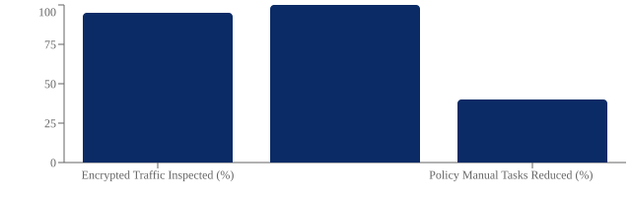

Competitive Differentiators: Quantitative Insights
Encrypted Traffic Inspection
Unified Visibility
Policy Automation Gains
Achieves total asset coverage in both cloud and on-prem environments, supporting comprehensive monitoring and governance.
Manual policy interventions reduced by 40%, streamlining operations, lowering risk, and improving efficiency across teams.
Inspection of up to 95% of encrypted flows enables advanced threat detection and regulatory compliance.
100
75
50
25
0
Encrypted Traffic Inspected (%)
Policy Manual Tasks Reduced (%)
graph TD; AssetCoverage[100% Asset Coverage] -->|Drives| EnhancedSecurity; EncryptedInspection[95% Encrypted Traffic Inspection] -->|Enables| AdvancedThreatDetection; AutomationGains[40% Less Manual Intervention] -->|Improves| OperationalEfficiency;
Notes:
Highlight how deep inspection of encrypted flows, unified asset visibility, and major reductions in manual policy changes set us apart. Emphasize concrete metrics to illustrate operational and security gains.

Slide 11

Key Takeaways: AI-Driven Security
Modern segmentation and policy solutions bridge major security gaps through context-aware, unified controls across environments.
Encrypted Traffic Inspection
Efficiently secures and inspects encrypted flows to ensure compliance and threat visibility.
Unified Policy Management
Delivers consistent, environment-wide enforcement, minimizing gaps across cloud and on-prem environments.
Context-Aware Enforcement
AI enables dynamic adaptation of policies, responding in real time to changing conditions and risks.
Proven Impact
Advanced segmentation users report up to 70% lower incident rates, improving security posture and resilience.
Notes:
AI-powered segmentation and dynamic policy enforcement can close critical security gaps by enabling consistent controls, detailed traffic inspection, and automation. Organizations using these solutions have seen tangible reductions in security incidents.

Slide 12
Key References
Source Demos
Macro micro segmentation, policy management, smart switch, cloud edge, and campus zone segmentation use cases reviewed.
Notes:
Reviewed demos cover segmentation and policy management, including macro/micro segmentation, smart switches, dynamic tags, and campus context-aware solutions.

