Slide 1

Switch Level Segmentation: Hypershield L4 Approach
Smart Switch Hypershield enables precise, scalable L4 network segmentation for enhanced security and performance.
YN
Your Name
2026-01-12
Notes:
Introduce Smart Switch Hypershield, which delivers Level 4 segmentation at the switch layer. Emphasize its role in improving network security and simplifying scalable segmentation for data centers. This sets the context for a technical deep dive into the solution.

Slide 2
Overview of Switch Level Segmentation
1
Strengthens security via Layer 2 switch segmentation
4
Reduces spread of threats within segmented zones
2
5
Simplifies compliance audits for network boundaries
Limits lateral attacker movement in local networks
3
Enables granular control over device communication
6
Supports scalable security architectures
Notes:
Switch-level segmentation increases network defense by dividing the local environment into secure segments, which limits attacker movements, enforces clear communication rules, and aids in threat containment. This approach is vital for compliance and scalable security.

Slide 3

Switch Level Segmentation Overview
Switch-level segmentation leverages L4 features in smart switches to boost network security, streamline traffic control, and restrict access.
Enhanced Security
Utilizes L4 capabilities to safeguard network segments, limiting risks from lateral movements and unauthorized access.
Optimized Traffic
Intelligent segmentation enables precise traffic management, reducing congestion and improving overall network performance.
Access Regulation
Implements strict controls to define which assets and users can interact, aligning with advanced Hypershield principles.
Notes:
Switch-level segmentation uses advanced switch features to separate and secure network segments. This approach is central to Hypershield, enabling better protection, efficient traffic flow, and access control throughout the network.

Slide 4
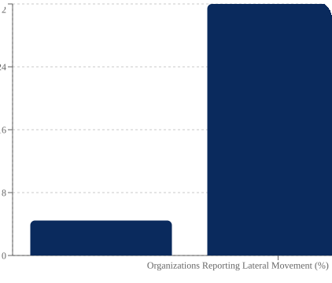
Importance of Switch Level Segmentation
Mitigates Lateral Threat Movement
Reduces Breach Financial Impact
Reducing lateral traversal limits attack spread, containing breaches effectively within segments.
Lower exposure and risk through segmentation help decrease average data breach costs, protecting business assets.
32
24
16
8
0
Organizations Reporting Lateral Movement (%)
Notes:
Switch level segmentation is essential in preventing attackers from moving laterally across the network, helping to contain incidents and minimize financial losses from breaches. These strategies are proven by both rising breach costs and common lateral movement tactics.

Slide 5

Advanced Layer 4 Segmentation
Detailed Policy Enforcement
Application-Level Segmentation
Empower Network Teams
Apply precise rules using source/destination IPs and ports to improve network control.
Segment traffic patterns at the application layer for more granular network security.
Enable teams to define access rules with greater precision and flexibility based on L4 attributes.
Notes:
Layer 4 segmentation provides control using IPs and ports, allowing for policies based on actual traffic patterns. This empowers teams to optimize access and security tailored to application needs.

Slide 6

Dynamic Policy Enforcement
Automated, Adaptive Policies
Immediate Policy Updates
Application Discovery Response
Smart Switch Hypershield adjusts policies automatically to match network needs and potential threats.
Continuous monitoring allows prompt changes based on user roles, threat intelligence, or anomalies.
When a new app is identified, system instantly applies tailored access rules.
Notes:
Smart Switch Hypershield offers dynamic and automated policy enforcement. It can detect changes in user roles, emerging threats, or new applications, and immediately applies the appropriate security policies to ensure continuous protection and compliance.

Slide 7

Seamless Integration and Deployment
Effortlessly integrates with diverse network environments, enabling flexible deployment and broad compatibility.
Network Compatibility
Supports Ethernet, PoE, and integrates with existing infrastructures for minimal disruption.
Flexible Deployments
Deploy across core, distribution, and edge switches at on-premises, branch, or remote sites.
Management Integration
Compatible with major infrastructure solutions for unified network control.
Notes:
Highlighting easy integration with current infrastructure, support for multiple deployment scenarios, and compatibility with management platforms simplifies both adoption and ongoing network operations.

Slide 8

Enhanced Security Posture with Segmentation
Reduced Attack Surface
Sensitive Data Protection
Key Breach Insight, 2025
Network segments are isolated, limiting opportunities for attackers to move laterally.
HR, Finance, and R&D data are separated at the switch level for improved confidentiality.
72% of breaches involved poor segmentation, highlighting its security importance.
Notes:
Segmenting network areas significantly limits attacker movement within the organization. Separating sensitive functions like HR, Finance, and R&D protects critical information. The 72% breach rate in 2025 emphasizes the necessity of effective segmentation strategies.

Slide 9
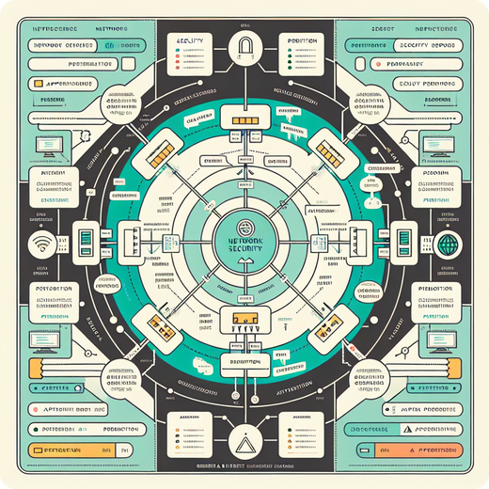
Enhanced Access Control Strategies
Implementing least-privilege access ensures only necessary permissions while adapting to evolving organization needs.
Granular Least-Privilege
Limits permissions at segment, port, and application levels to minimize exposure.
Adaptive User Mapping
Aligns access rights with dynamic changes in organization structure and roles.
Reduces Risk
Lowers chance of breaches; misconfigurations account for up to 35% of incidents (Gartner).
Notes:
This slide covers strategies for access control, emphasizing least-privilege principles, adaptability through flexible mapping, and reduced risks from access misconfigurations.

Slide 10

Real-World Segmentation Use Cases
1
Departmental Isolation
2
IoT Segmentation
Finance, HR, and workforce operate in dedicated segments with custom policies for enhanced security.
Medical devices remain isolated from general hospital systems to minimize risk and contain threats.
3
Guest Access Control
Visitors receive limited network access, keeping internal resources secure and protected.
graph TD; A[Start]-->B{Choice}; B-->C[Path 1]; B-->D[Path 2];
Notes:
This slide highlights practical examples of network segmentation: separating departments with unique policies, isolating sensitive medical devices from core systems, and restricting guests to protect essential resources.

Slide 11
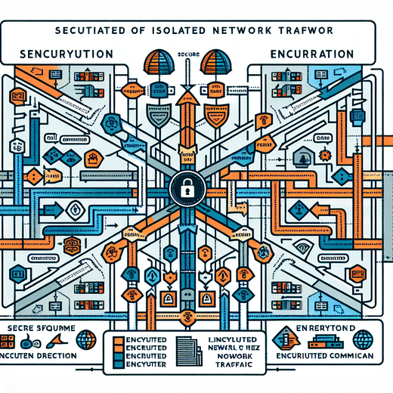
Security Best Practices: L4 Segmentation
Strengthen security posture by applying NIST and ISO 27001-aligned L4 segmentation, enabling zero trust and simplifying compliance management.
Aligned with Leading Standards
L4 segmentation follows NIST and ISO 27001, ensuring robust and compliant network segmentation.
Zero Trust Networking
Never trust, always verify approach prevents lateral movement and reduces risk of breaches.
Streamlined Compliance Reporting
Achieve up to 60% reduction in audit effort by automating policy enforcement and evidence collection.
Policy Versioning
Manage policy changes efficiently with clear audit trails and rollback capabilities.
Notes:
Layer 4 segmentation aligns with major security standards while enabling zero trust networking. It leads to marked reductions in audit efforts and simplifies policy management with strong versioning features.

Slide 12
L4-Segmentation Benefits
Smart Switch Hypershield
Advanced traffic control and automation reduce lateral risk by up to 50% while improving security flexibility.
Notes:
Highlight how the solution offers precise traffic control and automation, resulting in improved security and a notable reduction in lateral movement risks.

