Slide 1
E-Services / E-Commerce
06/19/2018

Slide 2
Contents
Business Case
Project Goals & Metrics for Success
Business
Project Guiding Principles
Demo (Wireframes)
Project Scope
Proposed Tech Stack
Technical Architecture Overview
Technical Spikes
Security Impacts and Controls
Agile Process
Staffing & Stakeholders
Decisions
Risks
Target Release Plan

Slide 3
Business Case
Business Opportunity
Improve communication with customers making it easier to do business with ADS.
Investment Summary & Financial Objective
ADS to insert Opportunity Assessment if needed
Financial Benefit
ADS to insert ROI analysis if needed

Slide 4
Project Goals and Metrics for Success
Goals
Online product ordering
Proactive notification with our customers
Global customer ID
Improve customer interaction
Automatically create service and billing tickets
Metrics for Success
Increase number of customers (sales)
Decrease number of call center interaction
Reduce manual data entry
Provide visibility into operations - reporting

Slide 5
Wireframe Presentation
View Demo

Slide 6
Release One - Profile and Quotes - 4-6 weeks
In Scope | Out of Scope
Login Reset Password Create e-service account Existing User Quotes Residential Temporary Roll Off | B2B Municipal User Commercial Services (e-commerce)
Unresolved

Slide 7
Release Two - Subscription and Buy Path - 4-6 weeks
In Scope | Out of Scope
Create e-service account New User Subscribe to Residential Services Order a Temporary Roll-Off Make a Payment Profile Management Account Profile Site Contact Info Payment Info | B2B Municipal User Commercial Services (e-commerce)
Unresolved

Slide 8
Release Three - Report Issues and New Requests - 4 weeks
In Scope | Out of Scope
Report a Service Issue Report a Billing Issue Request Pickup and Return of a Roll-Off Request Change in Service Request Additional Services (bulk pickup, special pickup, extra pickup, etc.)
Unresolved

Slide 9
Release Four - Notification and Admin Dashboard - 4 weeks
In Scope | Out of Scope
Notification (SMS and E-mail) Admin Dashboard Reset password - Agent Report (analytics) - MKT and Sales
Unresolved
Notification Platform decision between HubSpot or AWS SNS Sales/Marketing are expected to request more reports

Slide 10
Release Five - Chat - 6-8 weeks
In Scope | Out of Scope
Utilize “Chat with an Agent” capabilities (or Chatbot) or Both
Unresolved
Choice of Technology/Product

Slide 11
Release Six - Mobile - Inception in 1 month
In Scope | Out of Scope
All of the previous features via a mobile application Notification (Mobile Push Notification)
Unresolved
Inception may identify some constraints

Slide 12
Proposed Tech Stack
Backend
Java 8
Spring Framework (Spring Boot / Spring Data)
MuleSoft
Tomcat
FrontEnd
ReactJS
Redux
SASS
Webpack
Database
SQL
Hosting
AWS (for the e-service/e-commerce application)
CloudHub (for MuleSoft integration layer)
DevOps
Github
Jenkins

Slide 13


Technical Outcome Vision - System Context & Flow
E-services/e-commerce
Five9
KUBRA
Mobile interfaces
Common Processes
Web interfaces
Dynamics
Trux
Trux DBs
E-services DB
Login
Password
Audit Information
E-services Preferences
Customer Master ID
CPQ
Shapefile
Notification System (Hubspot? AWS SNS?)
Customer Master DB
Umbraco
(CMS)
Name
Email
Service Address
Billing Address
TruxDB
TruxAccountID
TruxSiteID
DynamicsID

Slide 14
Security Impacts and Controls
ADS should be PCI compliant to hold credit card information
Code development by Avenue Code should follow PCI guidelines
ADS will provide outside VPN access to all staff working remotely

Slide 15
Agile Process - High Level Goals
Benefits of using Agile Software Development Methodology
Provides ADS with flexibility over feature release
Produces Software product with highest code quality
Maintain communication and collaboration with ADS leading to Higher satisfaction
Increases project control
Sprint meetings.
Transparency.
Jira usage (visibility of each step of the project for both parties).
On average, Agile project management decreases time to market by 37% and increases team productivity by 16%

Slide 16
Project Staffing
Project Stakeholders
Doug Saunders
CIO
Mark Nighbor
Marketing
Tammy Wilson
Sales
Core Team
Susan Mozo
QA
Liana Korek
Development Manager
Robert Smith
Technology Manager
David Reisinger
BA
Janine Garbacz
ADS PM
Jonathan Greene
MuleSoft
Developer
Michel Correa
PdM / SM
Renan Camponez
Solutions Architect
Bernardo Matos
UX
Rafael Carmo
Backend Developer
2 UI Dev.
Pedro
TBD
Thiago Santana
MuleSoft Developer
Supported By
QE
TBD
DevOps
TBD
Operation
Marketing
Robert Smith
Technology Manager
Kubra
Ed Mills
Data Architect
Sales
Customer Care
Trux
Business Partners
IT Business Partners

Slide 17
Assumptions/Decisions
# | Assumptions | Decision
1 | Ed Mills team will be responsible for migrating Kubra's Database to Master Data | Confirmed
2 | No integration needed with inventory | As there is no inventory system, we will use 2 business days as standard to attend customer requests.
3 | Dev and CI environment will be hosted on AWS | TBD/Present Pros & Cons to Robert
4 | Existing ADS customers creating an e-service account need to provide ADS account number | Customers will need the account number on the invoice or call ADS to get this number to integrate existing account to the new ADS e-service account.
5 | Request a Return on Temporally Roll Off will continue to be offline via Phone | TDB/Verify with Tammy
6 | Municipal user is out of scope | Confirmed
7 | E-commerce for commercial user subscription is out of scope | Confirmed
8 | Two or more e-services users can control the same services | Confirmed. But they will not share Account Billing information
9 | Additional Security requirement for Buy Path | ADS will become PCI compliant
10 | ADS will replace Kubra as the System of Record | Confirmed

Slide 18
Top Project Risks and Mitigation
# | Risk | Mitigation
1 | ADS is creating a database (master data) to integrate the existing 192 databases. | Work closely with Master Data Team
2 | Kubra APIs details are not fully understood | Work closely with Kubra's team, use Kubra’s test environment to confirm that everything is working
3 | Five9 does ability to support chat functionality | We will have to create our own chat system or use another tool and it will take more time.
4 | Test environment for Trux, Dynamics, Kubra, Cpq, Shapefiles, Five9, Hubspot | Create mockup services based on production data, but it will take more development time.
5 | Status of MuleSoft integration with each service | Work closely with ADS Mulesoft developers

Slide 19
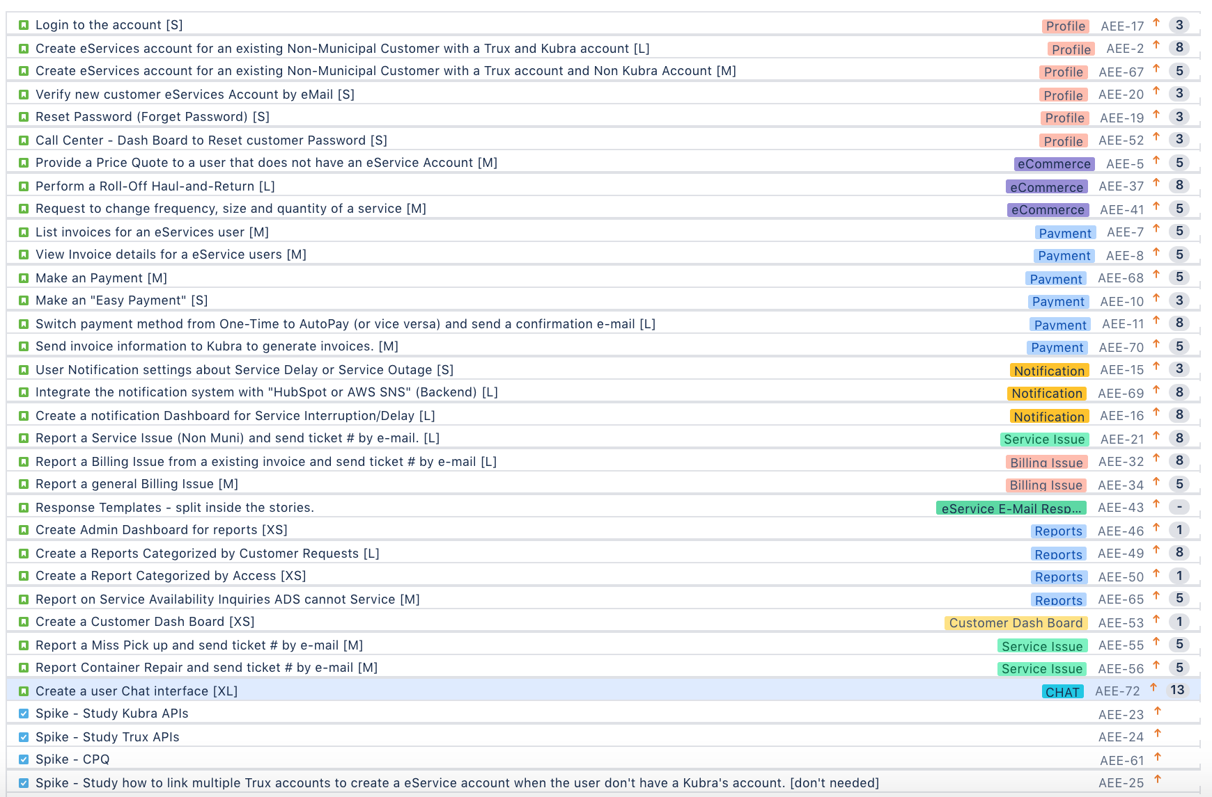
Jira Backlog

Slide 20
Technical Spikes
# | Spikes | Outcome
1 | Kubra | We will create a MuleSoft project to abstract the Kubra Bill Payments API. For existing Kubra users, Kubra will give us existing current user information as a file (format and fields TBD)
2 | Trux | The Trux API supports all needed operations: CRUD for services, users, issues, work orders and sites. Some of this operations are already on the MuleSoft abstract layer
3 | CPQ | We will need a "get quote by address" operation from the CPQ.
4 | Shapefile | There is already a ADS MuleSoft project connecting to Google that retrieves the information from the Shapefile
5 | Five9 - Chat | There is no MuleSoft abstraction layer in place for Five9
6 | Dynamics | There is a ADS MuleSoft project to connect with Dynamics, we will need to review the available operations
7 | Umbraco | We will connect directly to Umbraco in order to get ADS dynamic content (as ads and banners)
8 | Hubspot | We will connect directly to Hubspot (or AWS SNS - TBD) to handle the user notification.

Slide 21
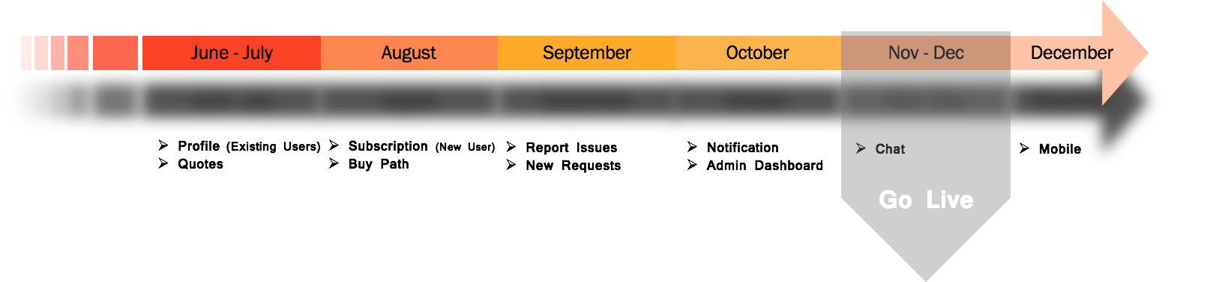
Target Release Plan
Size | # of Stories | Dev Capacity in weeks
XSmall | 3 | 1
Small | 7 | 7
Medium | 12 | 24
Large | 8 | 24
Totals | 30 | 56
Initial estimated Dev Capacity is 72+ Weeks – WE ARE FINE

Slide 22
Questions?
?

