Slide 1
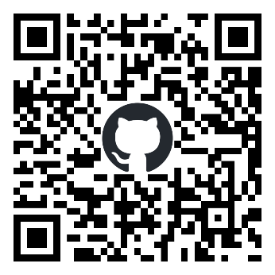

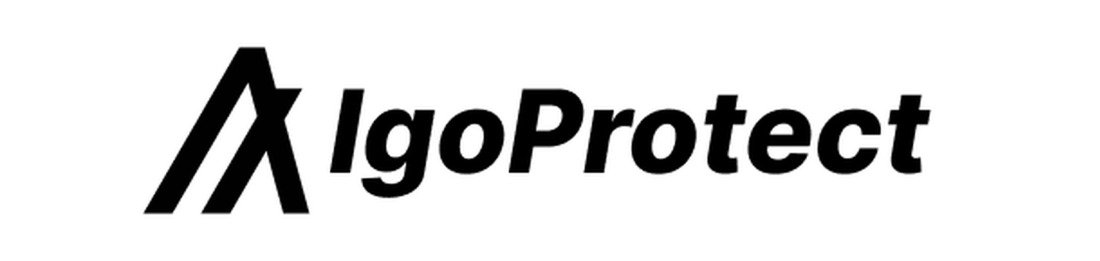
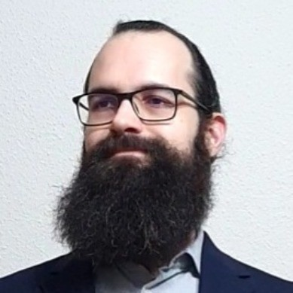




Supported by
Decentralized Peer-to-Peer Consensus Delegation Platform
by
Uroš Hudomalj
Smart contracts and UI
PhD student at ETH Zürich
Teodora Mitrevska
Product management
PhD student at LMU München
Alexander Marinšek
Backend
PhD student at KU Leuven

Slide 2


Problem
Blockchains need nodes to run and secure the network
The more nodes, the more robust and decentralized the network
The more tokens participate on these nodes, the higher the security
Barriers for participation:
Technical knowledge
Time
Costs

Slide 3




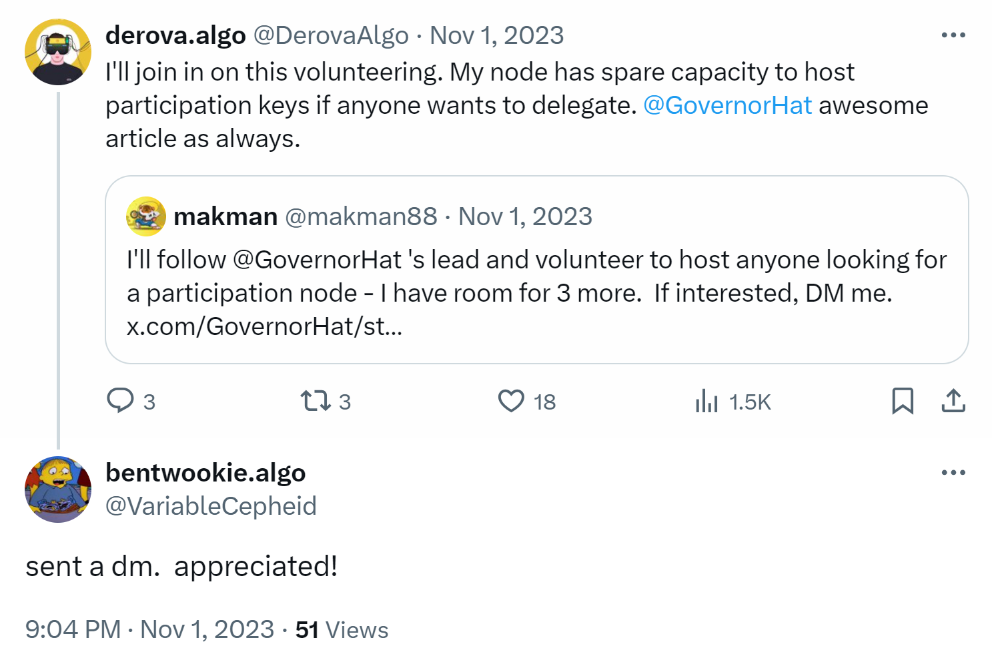
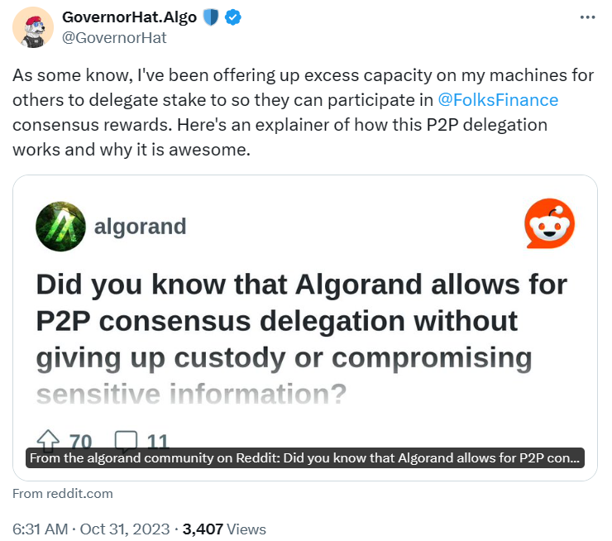
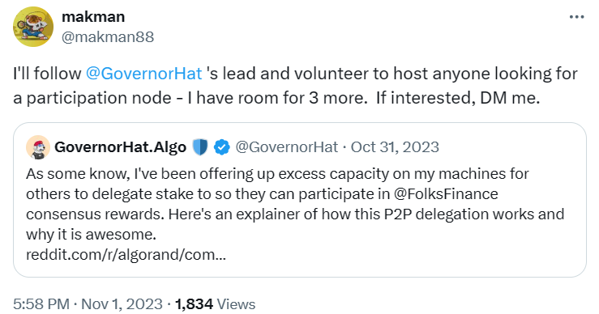
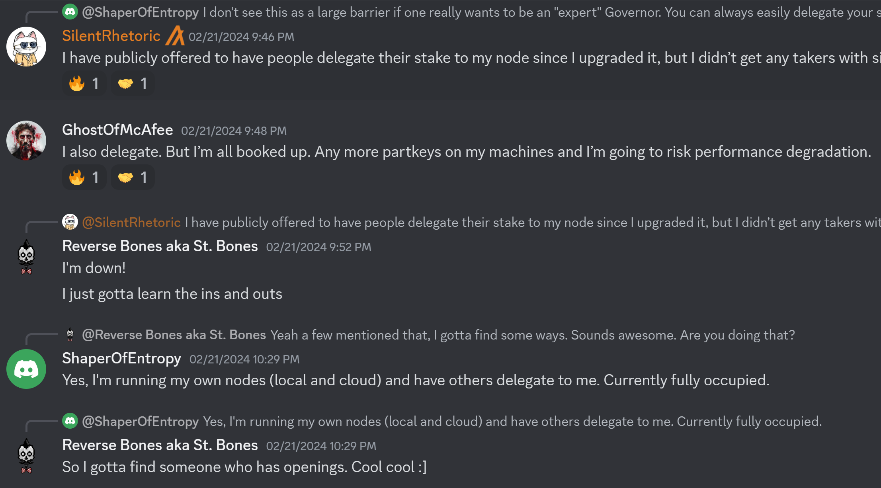
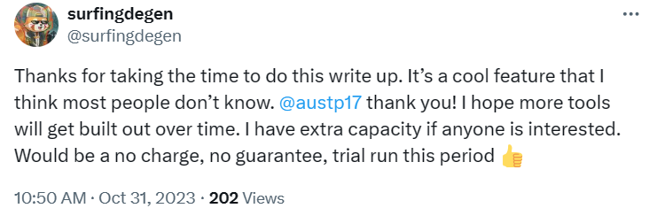
Problem
Users
Node runners
Users are seeking ways to delegate their security budgets to existing node runners

Slide 4


Solution
Users
Node runners
Decentralized platform for connecting users to node runners
Create a system with mutual benefits
Support for becoming a node runner
$$$
$$
$
$$

Slide 5

Competition
Who | Individuals | Folks Finance | Txn Lab
Type | Self-running | Liquid staking | Pooling | P2P delegation
Decentralization | Highest | Low | Medium | High
User risk | Lowest | Medium | Medium | Low
User effort | High | Low | Low | Low
Users
Competitors
Node runners
Funds stay in your wallet!
Funds leave your wallet!
Use of locked funds (MBR) and direct participation in xGov

Slide 6
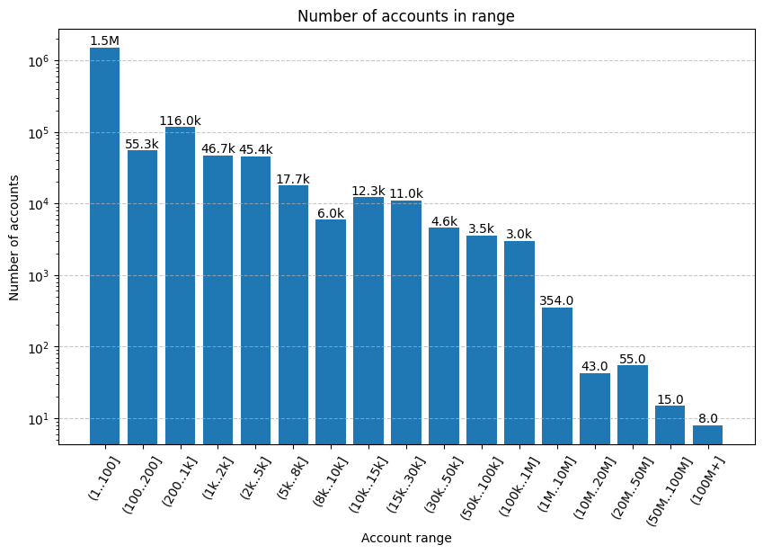
Market Size
Txn Lab
Our
primary
target
Our secondary
target
Target total stake:
Txn Lab: 10%
Folks Finance: 4%
Our primary: 15%
Our secondary: 76%
Folks Finance
*Surge in demand for nodes expected due to upcoming incentives (2024 Q4) for accounts with +30k ALGO
**Current number of nodes: Bitcoin = 15k – 45k, Ethereum = +7k, Cardano = 2.5k, Algorand = 1.5k

Slide 7
Sustainable Business Model
TAM
333k users
⇨$3.3M
Percentage of node runners’ fees: e.g. 10%
Assumed node costs [per year]: $240
Assumed fee charged by node runners per user [per year]: $72
Partial redistribution to node runners and users based on loyalty points for increased engagement
Fees from offered node running services
Protocol rewards from participation with platform’s stake
SAM
15k users
⇨$150k
SOM
10k users
⇨$100k
*Surge in demand for nodes expected due to upcoming incentives (2024 Q4) for accounts with +30k ALGO
**Current number of nodes: Bitcoin = 15k – 45k, Ethereum = +7k, Cardano = 2.5k, Algorand = 1.5k

Slide 8

Roadmap
2024 Q2:
MVP
2024 Q3:
New features:
Payment with ASAs
Loyalty program
Accountability
2024 Q4:
UI & UX improvements
Multi-node support
Launch on ALGO and VOI
2025 Q1:
Platform analytics
Real-life applications with verifiable randomness
Algorand rewards go live
Public launch of

Slide 9
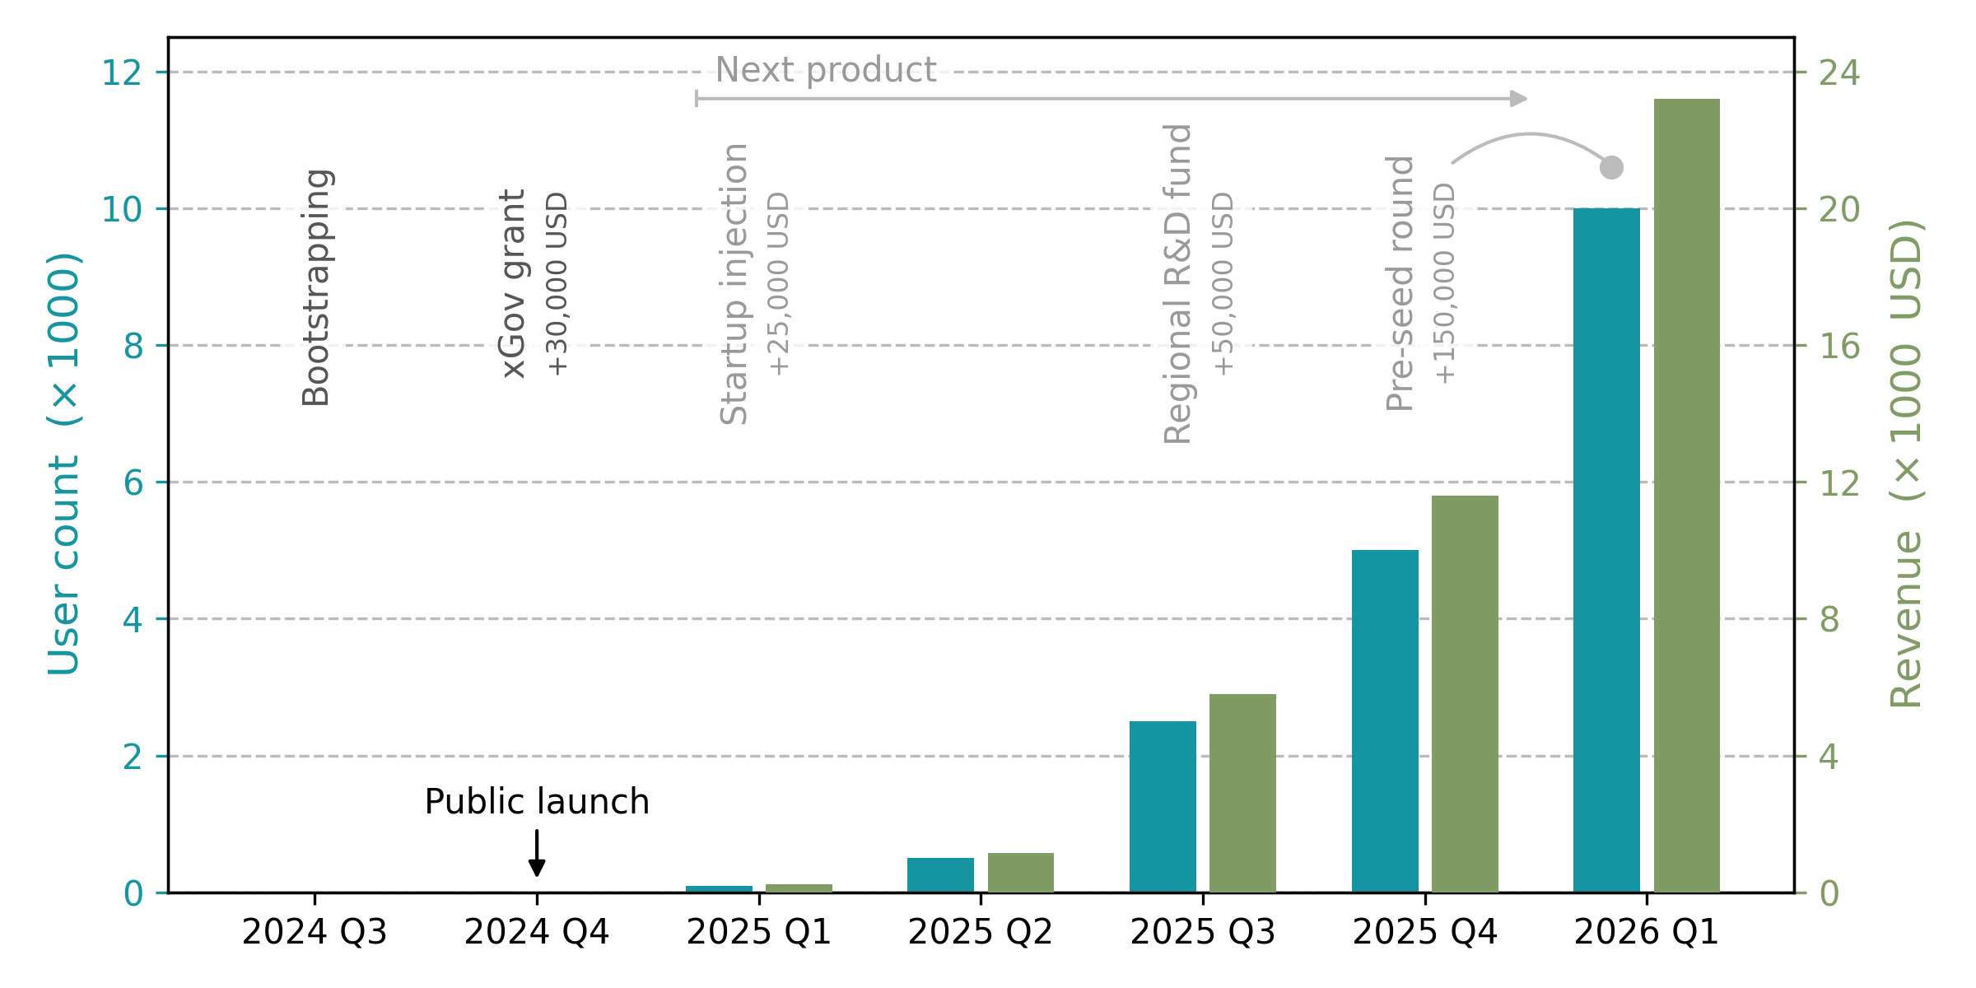
Financial and Funding Projection

Slide 10
Ask
Partnerships to offer node running services to projects’ users
Support in xGov grant program
Consider us for investments in our following products
Use our product, spread the word about it, and
let’s protect Algorand together!

