Slide 1
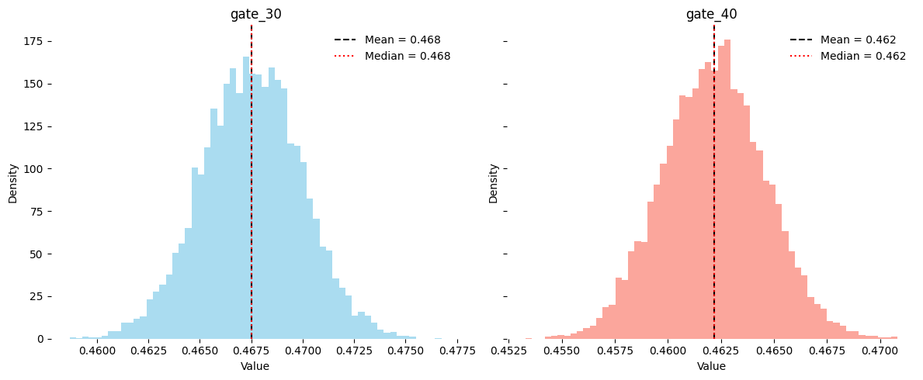
Retention Day 1
Posterior Distribution

Slide 2
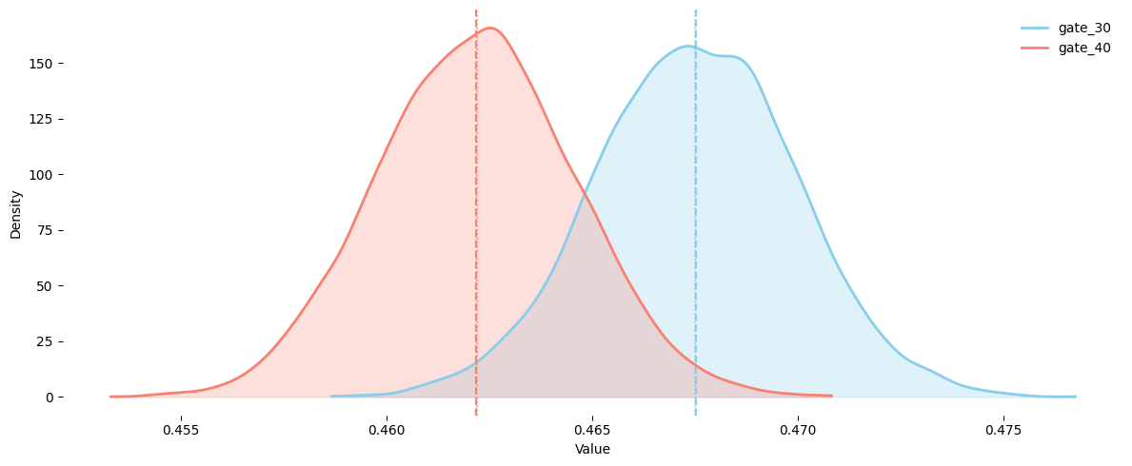
Retention Day 1
Posterior Distribution

Slide 3
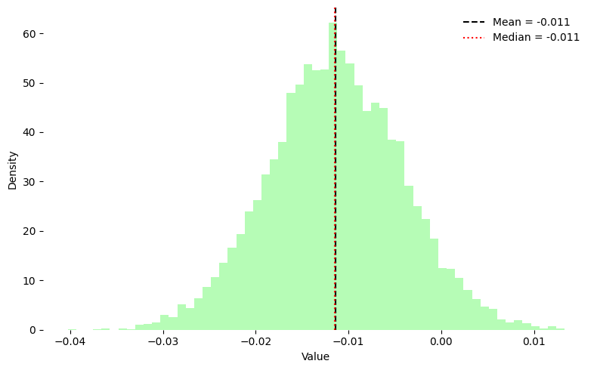
Retention Day 1
Lift Distribution

Slide 4
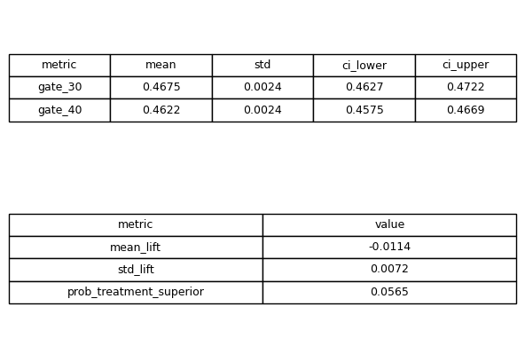
Retention Day 1
Summary

Slide 5
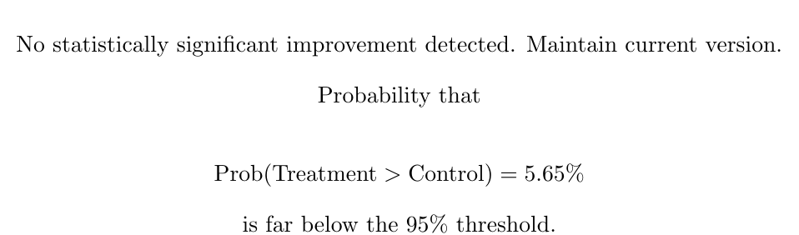
Retention Day 1
Recommendations

Slide 6
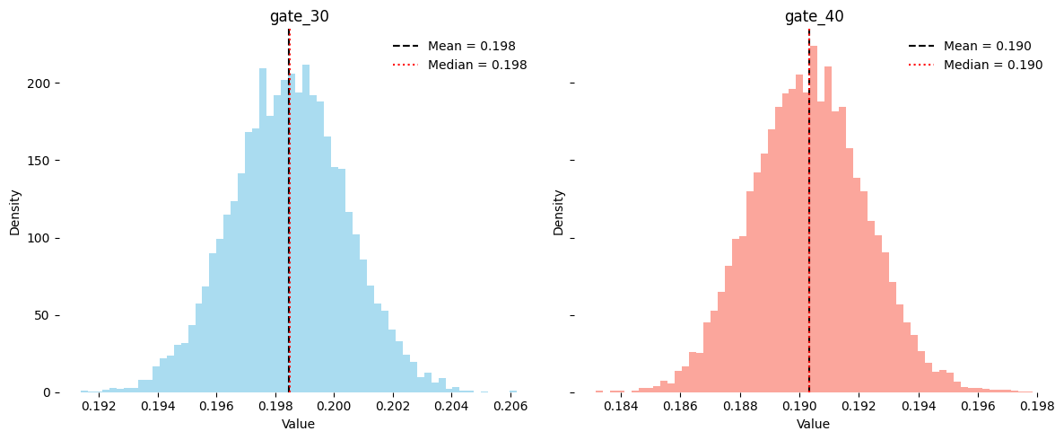
Retention Day 7
Posterior Distribution

Slide 7
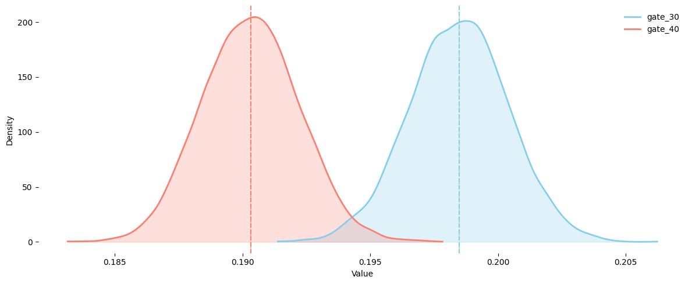
Retention Day 7
Posterior Distribution

Slide 8
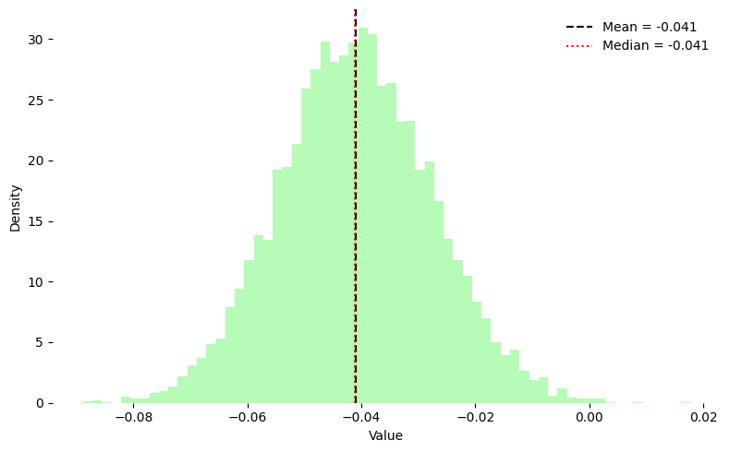
Retention Day 7
Lift Distribution

Slide 9
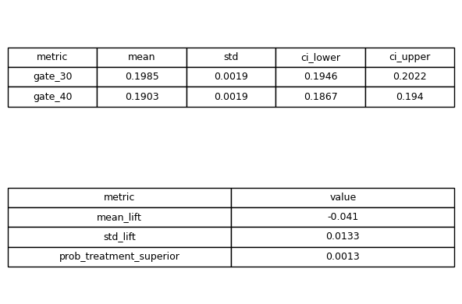
Retention Day 7
Summary

Slide 10
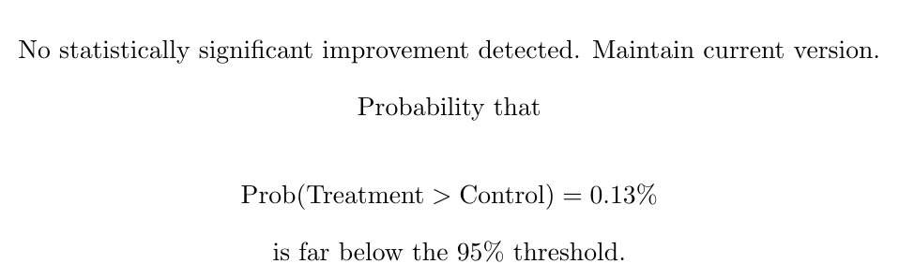
Retention Day 7
Recommendations

Slide 11
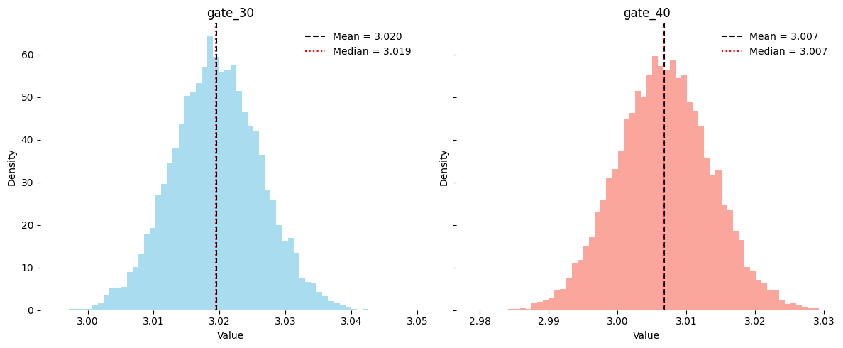
Total Rounds
Posterior Distribution

Slide 12
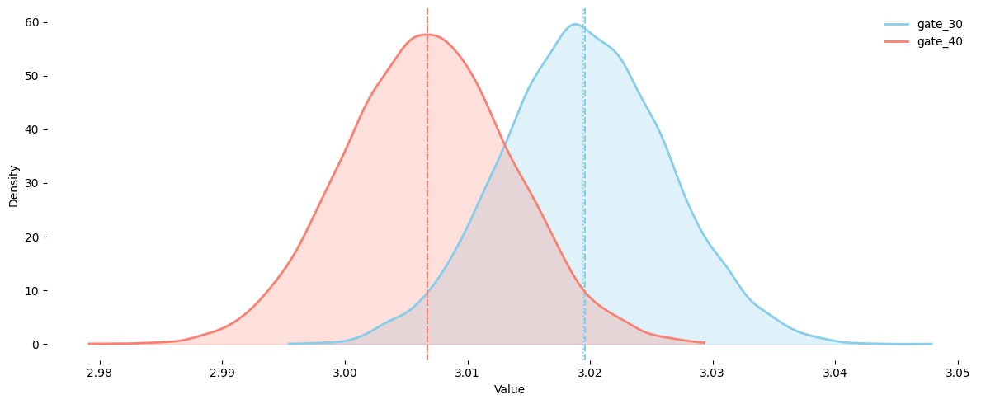
Total Rounds
Posterior Distribution

Slide 13
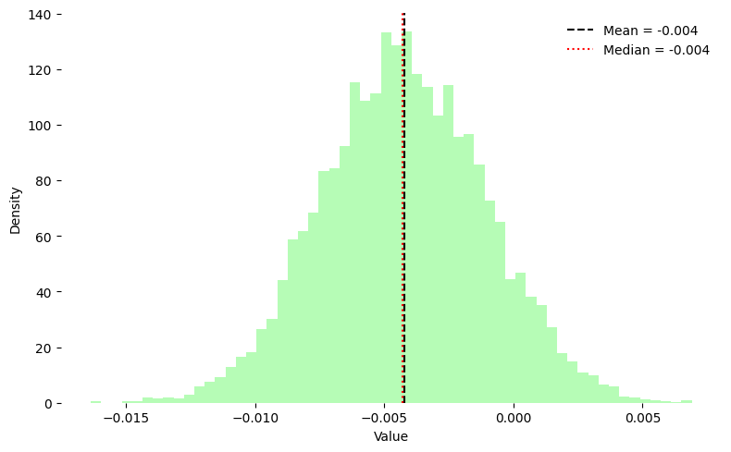
Total Rounds
Lift Distribution

Slide 14
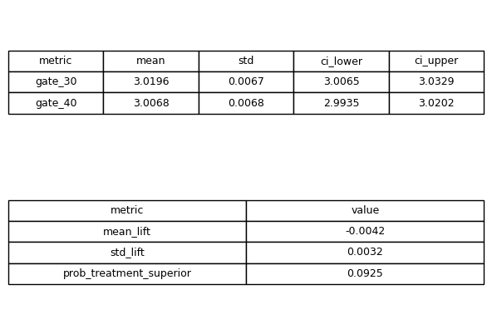
Total Rounds
Summary

Slide 15

Total Rounds
Recommendations

Slide 16
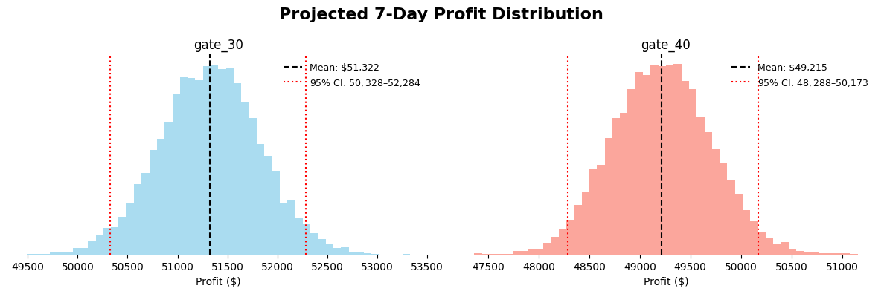
Business Performance
Posterior Distribution

Slide 17
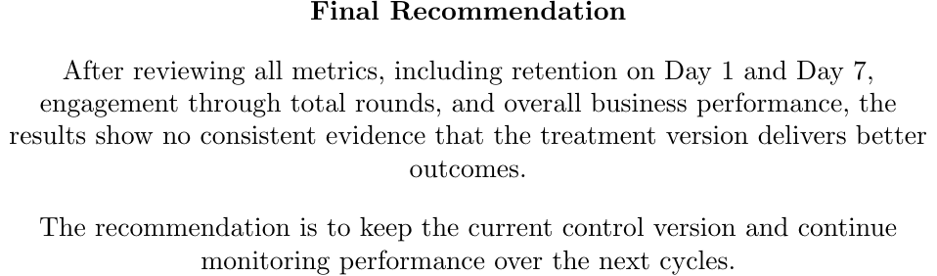
Conclusion

