Slide 1
ESG Supply Chain Risk Intelligence
Portfolio case study • Responsible procurement risk scoring & dashboarding (simulated data)
Thiago Lefebure
Data Analyst • ESG • Data Governance
Disclaimer: All datasets and results are simulated for demonstration purposes.
© Portfolio case study (simulated)
Notes:
[Sources] - Simulated dataset generated for portfolio. [/Sources]

Slide 2
Problem & objectives
Turn supplier ESG data into a decision tool (risk-based approach)
Typical challenges
This case study delivers
Dispersed sources (ERP + questionnaires + ratings + audits)
Heterogeneous formats and missing values
Need for traceability and auditability
Prioritization: where to audit / mitigate first
A consolidated supplier “master dataset”
Data quality KPIs (completeness, staleness)
Explainable ESG risk score (E/S/G + signals)
Risk × Spend matrix to prioritize action
Tableau-ready exports for dashboards
All metrics on the next slides are simulated.
Notes:
[Sources] - Simulated dataset generated for portfolio. [/Sources]

Slide 3
Data model (simulated)
Four tables merged into a single analytics-ready dataset
suppliers.csv
esg_scores.csv
Supplier master data (tier, category, spend)
Traceability flags & charter status
E / S / G pillar scores
Last update & data source
audits.csv
incidents.csv
Audit score, non-compliance severity
Deadlines & third-party audit flag
Incident type, pillar, severity
Used as a risk signal/penalty
Join key: supplier_id
Output: cleaned_master_dataset.csv (Tableau-ready)
Notes:
[Sources] - Simulated dataset generated for portfolio. [/Sources]

Slide 4
Key results (simulated)
Risk distribution and spend exposure
Suppliers by risk class
Spend exposure by risk class (CHF)
High-risk spend exposure: 46.5M CHF
Notes:
[Sources] - Simulated dataset generated for portfolio. [/Sources]

Slide 5
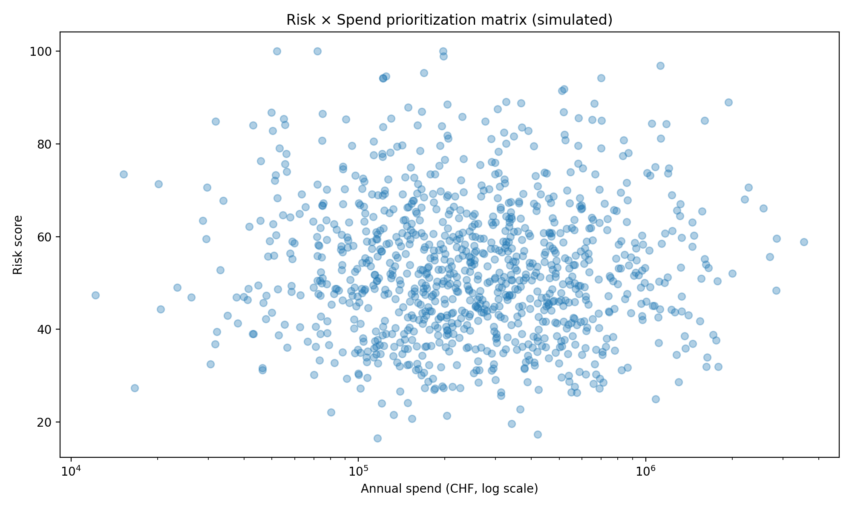
Prioritization view
Risk × Spend matrix to focus audits and mitigation
How to use
Top-right: audit & mitigate first
High spend + medium risk: monitor closely
Low spend + high risk: targeted actions
Use drill-down for root causes (E/S/G, audits, incidents)
Matrix shown as an illustrative static view; Tableau version enables drill-down.
Notes:
[Sources] - Simulated dataset generated for portfolio. [/Sources]

Slide 6
Operational recommendations
Turn ESG reporting into a controlled process and measurable actions
1) Data governance
Single supplier ID across sources (ERP / questionnaires / audits)
Data quality KPIs: completeness, staleness, audit trail
Clear owners: collection, validation, publication
Deliverables included in this repo
Simulated datasets (4 tables, 1,000 suppliers)
Python notebook: scoring + exports
Tableau dashboard build spec
Curated outputs: risk_scores.csv
This 6-slide deck
2) Risk management
Use the Risk × Spend matrix for prioritization
Define thresholds per ESG pillar (avoid “compensation” effects)
Link risk class to standard actions (audit, mitigation plan, monitoring)
Next step: connect to real ERP + supplier questionnaire data and validate thresholds with stakeholders.
Notes:
[Sources] - Simulated dataset generated for portfolio. [/Sources]

