Slide 1

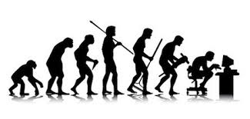
[available at www.specrunner.org]
thiago.lvl.santos@gmail.com

Slide 2
Questions about testing?
Process?
Formal Vs “informal”: “its all about fashion!”
Agile implies TDD (ATDD)?
Premises & Problems?
Target audience? Performance? Maintenance? ∞
Demands?
Outsourcing? Metrics? Legal restrictions? ∞
Tools?
Depends on… everything. Where are we?
Lets consider TDD! Black or White.
This is not about stress or load testing… but data for these tests should be easy to produce.

Slide 3
Wish list
Good support ☺;
Multiple inputs types;
Free specification style;
Replaceable components;
Compositional components;
Better performance (time & memory);
Better reports (useful and nice looking);
Better error messages;
Customized expression language;
Predefined fixtures for things that matters;
Event aware (listeners);
Built in object reuse support;
Thread-safe and support for concurrency issues;
Real-time debugging;
Reports for developers and for end users;
Easy to extend;
Easy to integrate;
JUnit friend (good?);
Spring friend (good?);
Maven friend (good?);
Lessons learned…

Slide 4
Learning from…
Concordion
Fit + Fitnesse/SLIM
Site:
http://www.concordion.org
Pros:
Documentation (web site);
Learning curve;
Free specification style;
Adoption;
Ports to other languages.
Cons:
HTML input only;
Poor meta-variables set;
Fixtures for every project (“But I’m not the only one”)
Site:
http://fit.c2.com/
http://fitnesse.org/
(FitNesse.UserGuide.SliM)
Pros:
Documentation (Guides);
Predefined actions (+SLIM);
Multi-input formats;
Wiki style (PO are writers?);
Adoption.
Cons:
Poor API;
Performance (-SLIM);
Setup.

Slide 5
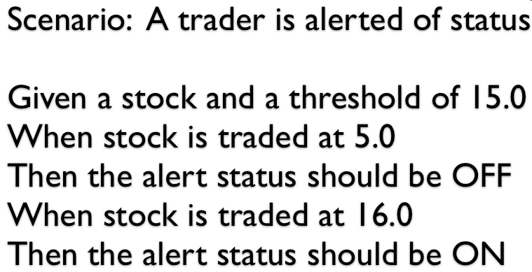
Learning from…
JBehave
Cucumber
Site:
http://jbehave.org/
Pros:
Documentation (web site);
Specification language;
Multiple reports;
Highly configurable.
Cons:
Adoption;
Highly configurable.
Site:
http://cukes.info/
Pros:
Documentation (book);
Specification language.
Cons:
Ruby (port to Java available)
Plain and match by regexp

Slide 6
Learning from…
Twist
Thucidides
Site:
http://www.thoughtworks.com/products/twist-agile-testing/
Pros:
Specification style;
Integration with Eclipse;
Support for refactoring.
Cons:
Proprietary
Pros:
http://thucydides-webtests.com/
Pros:
Graphic reports;
Web testing.
Cons:
Version 0.9;
Web testing only.

Slide 7
Learning from…
Robot framework
∞ others
Site:
http://robotframework.org/
Pros:
Born in Nokia;
Variables;
Support for macros;
Predefined sets of fixtures.
Cons:
Phyton/Jhyton;
Rigid specification style (table);
Setup.
JUnit:
Runners
DBUnit:
DB restrictions
HtmlUnit/Canoo Web Test:
Headless,GUI vs HTTP level
JWebUnit:
HtmlUnit abstraction
WebDriver (W3C):
Multi-target
Selenium/Robot:
Fragile, record and play
Jubula:
Swing? Web?

Slide 8
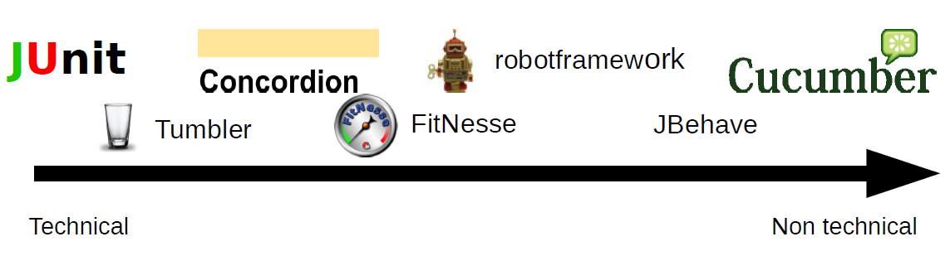
Specification audience
By Thomas Sundberg
That’s all you need!

Slide 9
Design - Premises
Old school (“one rule to rule them all” = hide)
“I know what is best for you”;
“Attributes must be private”;
“Friendly instead of protected”;
Private inner classes and so on.
Tool/Framework ≠ End user product/API
Protected is very welcome;
Everything is replaceable;
Everything can be overridden;
Assume the consequences of your actions.

Slide 10
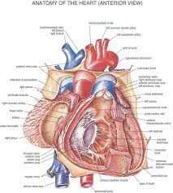

Design – Overview
Test
1. Reference
6. Report
Context, Runners & Plugins
Readers
2. Tree
5. Res
Writers
SpecRunner
3. Invoke
4. React
SUT
Black box
White box

Slide 11
Calling SpecRunner
Using SRRunner (+runners, introduces $THIS)
Test class become a fixture and there must be a HTML or Excel or TXT (…) file corresponding to it.
Point to a file (+runners):
Test class has methods @Test calling SpecRunner services.
Don’t use a specification file, create a program:
@RunWith(SRRunner.class)
public class TestSet {…}
public class TestSet {
@Test
public class run() {
Iconfiguration cfg = …;
SpecRunnerJUnit.defaultRun(“input.txt”,“output.html”, cfg);
}}
public class TestSet {
@Test
public class run() { …
IPluginGroup group = …
PluginBrowser browser = …;
group.add(browser);…
SpecRunnerJUnit.defaultRun(group, cfg);
}}

Slide 12
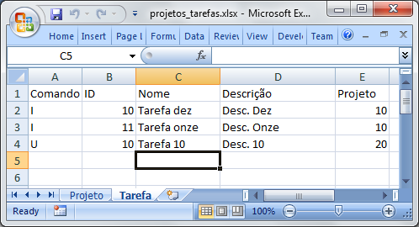
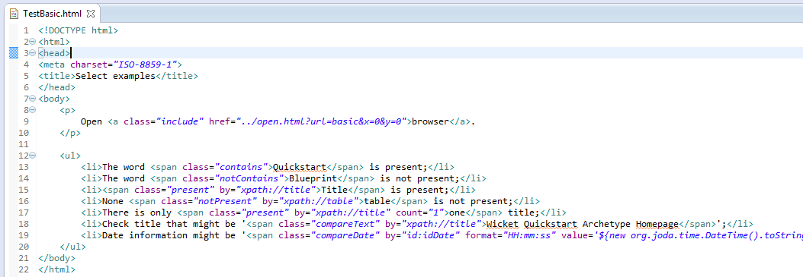
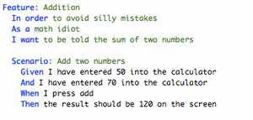
Readers [HTML+ Excel + txt + …]
Specification is/as
a tree!
Excel at specrunner-core-excel
HTML at specrunner-core
Gherkin at specrunner-core-text (i18n)

Slide 13
Basic concepts – context & plugins
<html><body>…
<p class="macro" name="googleSearch">
When I open a <span class="browser">browser</span>,
at <open>http://www.google.com</open> and search
for <span class="type" by="name:q">#{Query}</span>,
the result is #{Result}.
</p>
<p>
Examples:
<table class="map" name="examples“ scope=“body”>
<tr><th>Query</th><th>Result</th></tr>
<tr>
<td>SpecRunner</td>
<td>
<span class="compareText" by="xpath://a[0]“>www.specrunner.org</span>
</td>
</tr>
<table>
</p><iterator name="examples“><call name="googleSearch“/></iterator>
</body></html>
CSS defines a macro named ‘googleSearch’.
Element open the given url.
Placeholder
for value.
Placeholder accept nodes.
Defines a map named ‘examples’.
Placehoder names.
Lookup for xpath in result page
Call the macro for each example.

Slide 14
Basic concepts – core elements
Plugin factories (CSS, element, attribute, text,..);
Var (local, global, scoped, strict);
Macros (definition and call);
Maps (tables of named values);
Loops (for, while, iterator);
Conditions (ifs thens elses);
Parametrized includes (multi-format);
Expressions factories:
Values, classes instances, and models
Configurations (local) Vs Features (global)
Objects constructors (stubs support)

Slide 15
What is a plugin?
void initialize(IContext context)
throws PluginException;
Set plugin properties.
ENext doStart(IContext context, IResultSet result) …
Perform on start action;
Return skip or step into.
void doEnd(IContext context,
IResultSet result) …
Perform on end action.
public class PluginPause extends AbstractPlugin {
private boolean enter;
public Long time;
private String msg = “Pause requested.”;
// enter, SET/IS
public void message(String message) {
msg = message;
}
void initialize(IContext context) ... {
super.initialize(context);
IFM fm = SRServices.getFeatureManager();
fm.set(FEATURE_ENTER,this);
if(time == null){ fm.set(FEATURE_TIME,this); }
}
ENext doStart(Icontext context,…)…{
if(time != null) { Thread.sleep(time); }
else {
if(enter){ pressEnter(msg); }
else { showDialog(msg); }
} return ENext.DEEP;
}
}
Usage:
(CSS)
<span class=“pause”
enter=“true”
message=“Pause!”>
<type by=“…”>…</type>
</span>
(Element)
<pause time=“1000”/>

Slide 16
Binding plugins
Property files (loaded from classpath,multi-module)
sr_plugins_css.properties
pause=org.specrunner.plugins.core.flow.PluginPause
sr_plugins_element.properties
pause=org.specrunner.plugins.core.flow.PluginPause
Plugin by example (on test setup)
IPluginFactory factory = SRServices.get(IPluginFactory.class);
PluginInclude increase = new PluginInclude();
increase.setDir("src/test/java/example/include");
increase.setHref("increase.html");
factory.bind(PluginKind.CSS, "incr", increase);
PluginInclude decrease = new PluginInclude();
decrease.setHref(“excel/decrease.xlsx");
factory.bind(PluginKind.ELEMENT, "decr", decrease);
Usage:
<p class=“incr”>increment</p>
<decr/>

Slide 17
What about “fixtures”?
TestSet.java
@RunWith(SRRunner.class)
public class TestSet {
public String greetingFor(String firstName) { return "Hello “+firstName+ "!“;}
public void doSomethingOn(@Converter(args = { “MM/yyyy" }) Date date) {…}
@Sentence(“with \\d+ and $string”) @Synonyms({“find $int and (\.+)”})
public void search(int id, @Converter(args = { “MM/yyyy" }) DateTime date) {…}
}
TestSet.html (.htm,.xhtml)
<html>
<head><link href="concordion.css" rel="stylesheet" type="text/css”></head>
<body>
<p>
The greeting for user <span class="set" name="firstName">Bob</span>
will be: <span class="eq" value="$THIS.greetingFor(firstName)">Hello Bob!</span>.
<sentence>Do something on: “12/2013”</sentence>.
<sentence>Find users with 15 and 12/2013</sentence>.
</p>
</body></html>
CSS/JS/images preserved.
Meta-variable
Automatic match and conversion.

Slide 18
Expressions (Janino at your service)
IExpressionFactory ef = SRServices.get(IExpressionFactory.class);
ef.bindValue("pattern", "HH:mm:ss").bindClass("dt", DateTime.class);
ef.bindModel(“text6000“, new IModel<String>(){
public String getObject(IContext context) … {
StringBuilder sb = …; for(int i=0;i<6000;i++){ sb.append(i%10); }
return sb.toString();
}});
Usage:
<span class=“type” by=“id:textArea”>${text6000}excedente</span>
<type by=“name:startDate” value=‘dt.toString(pattern)’>date</type>
<type by=“id:xmlField” value=‘$INNER_XML’><date>${dt.toString(pattern)}</date></type>
Meta-variables
$THIS
$BEAN
$NODE
$PLUGIN
$TEXT
$XML
$INNER_XML
$CONTENT
$CONTENT_UNSILENT
$PACKAGES
Converters
sr_converters.properties
Primitives;
Dates;
Objects.
Comparators
sr_comparators.properties
Primitives;
Dates;
Objects;
Nodes.

Slide 19
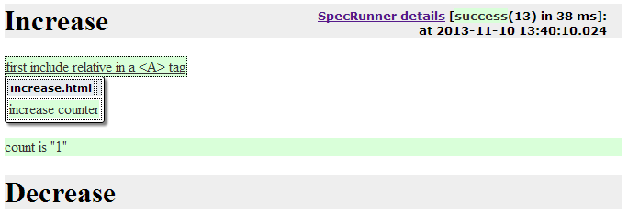
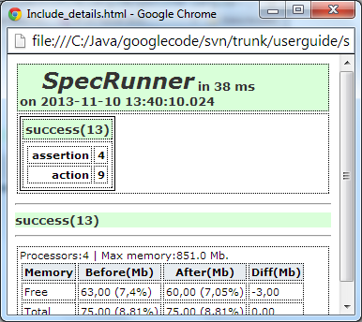
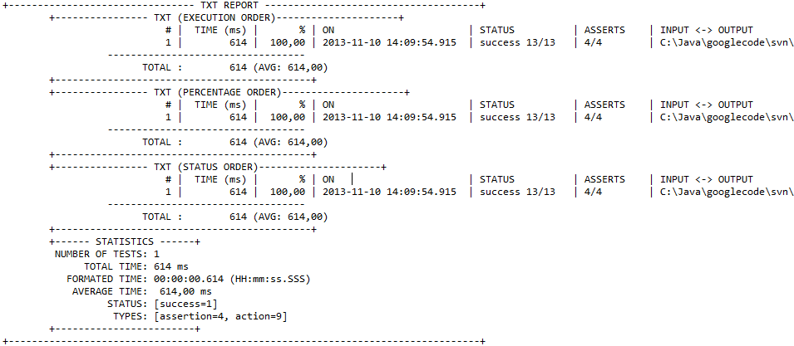
Writers [HTML+ console + …]
Do exist tests without assertions?
Coverage ≠ Correctness!

Slide 20
Profiles (sets of predefined plugins)
Jetty + Tomcat:
Embeddable web servers.
Hibernate3 + JPA:
Objects persistence and assertions.
SQL (JDBC based):
High performance database setup and assertions.
HtmlUnit + WebDriver:
Web browser technologies.
Ant
Ant support

Slide 21
Jetty + Tomcat
Plugins
Outstanding
Start
Dynamic ports;
Target port provider.
Stop
“Shutdown” servers
Jetty loaded from a jetty.xml file (more flexible);
Support for objects reuse keep server alive until JVM shutdown if the configuration file is the same in different tests.

Slide 22
Hibernate3 + [JPA]
Plugins
Outstanding
Configuration
Based on a configuration…
SessionFactory
Prepare sessions…
Objects extension
Create objects…
Insert
To insert…
Update
To update…
Delete
To delete…
Select
To verify.
None code is required to create objects, only if you want (embeddable support provided);
Object attributes are compared using comparators by type. For example, if an object attribute is of type DateTime (from JodaTime), the ComparatorJodaTime will be used, moreover, time comparators can set tolerance for these comparisons;
Assertions using objects are independent of insertion/update/delete order.

Slide 23
SQL (reusable and cached objects)
Plugins
Outstanding
Connection
Datasources
Scripts
DDLs, DMLs
Schema
Meta model
Database
Comands executor.
Prepare
Setup operations
Verify (positive)
Assertions
Compare base (negative)
Assertion.
Configurable filter.
Connections can be thread independent;
Scripts can be performed in failsafe mode;
Interfaces for connection providers, schema loaders, database services, sequence handlers, comparison filters;
Support for explicit IDs specifications, implicit identities, implicit sequences, all together;
Database actions against multiple databases (compositional);
Database comparison reports meaningful.

Slide 24
HtmlUnit+WebDriver
Plugins
Outstanding
Browsers for web applications;
Easy to map;
Easy to extend;
Easy to change;
Actions:
By component type
Assertions:
By component type
With WebDriver (!htmlunit):
Real-time monitoring of web application behavior
Pause on failure listener is a must have feature.
Search strategy unification: easily extensible;
Rich output with your CSS/JS/images;
Automatic screenshots of SUT;
High customizable fields and table comparison;
Smart node comparison: no more missing images or other elements and attributes (also inside tables);
Compare Excel report: compare your table specification (in HTML or Excel) with a downloaded Excel file.

Slide 25
Ant
Plugins
Outstanding
Perform Ant call
Requires a build file;
Basedir can be set relative to test or by absolute path.
If something is missing, use ANT.

Slide 26
Conclusions
Tools must serve, not slave!
Use the way you feel happy, but remember to avoid bad smells.
Better abstractions implies in happier test designers and, perhaps, developers:
Choose how to specify: hardly it wont be able to instrument.
Better development support implies in less unhappier developers:
Errors are stressing to all, specially to developers, help them to find problems is a good thing.
Concurrent testing depend on concurrent system:
Avoid static variables, they should be carefully used.

Slide 27
Next steps
Heavy users (very welcome);
Load and stress test data can be fully generated with the help of looped specifications;
Built in commons configurations: packages of configurations can be part of customization, for example: automatic inclusion of time variables such as ‘d’ or ‘dt’ for JodaTime LocalDate and DateTime respectively, disable CSS/JS/images to speed up;
Debug of tool flaws not captured by user guide examples;
Creation of other profiles (i.e. h3270 terminal interaction, file handlers – Ant is enough?).

