Slide 1
Thiago Mendes Rosa
Universidade de Brasília
thiagomendesrosa@outlook.com
Advisors: Prof. Rafael Terra de Menezes
Prof. Ana Carolina Pereira Zoghbi
Broadband connection and election in Brazil: what is role of the internet?

Slide 2
Question?
Did the introduction of internet broadband connection affect election outcomes in Brazil (2008, 2010 and 2012)?
Identification strategy:
RDD applied to Backhaul Program roll out – multiple cutoffs, following Cattaneo et al. (2018)
Answer:
Apparently, it did not (at least for fixed line).

Slide 3




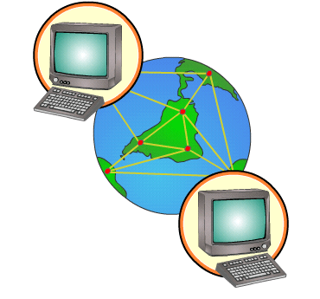





Theoretical Framework
INFORMATION
ELECTIONS
OUTCOMES
INTERNET
CROWD OUT
Other medias
LEISURE

Slide 4






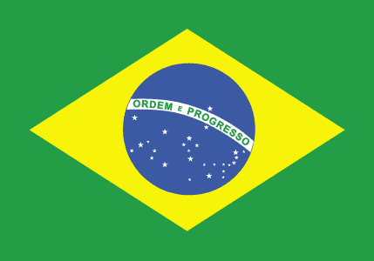
Review
VOTE SHARE
TURNOUT
Campante et al. (2017)
Poy & Schüller (2016)
Miner (2015)
Falck et al. (2014)
Czernich (2012)
Gavazza et al. (2015)
Jaber (2013)
Tolbert & McNeal (2003)
Menezes (2015)

Slide 5
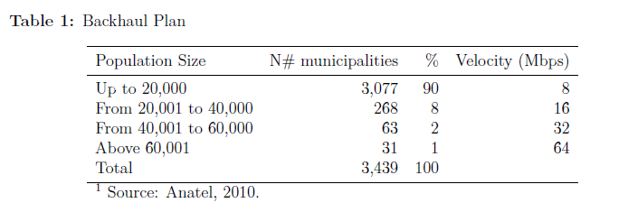
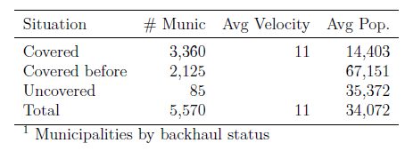
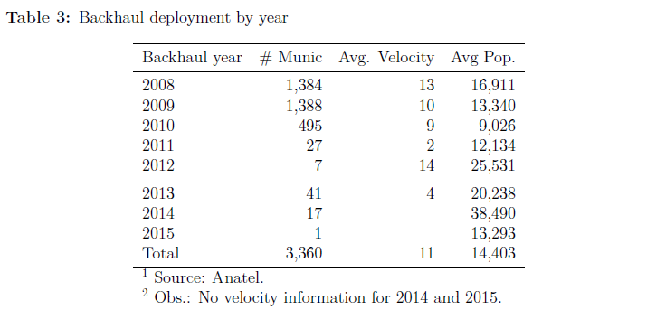
BACKHAUL PROGRAM

Slide 6
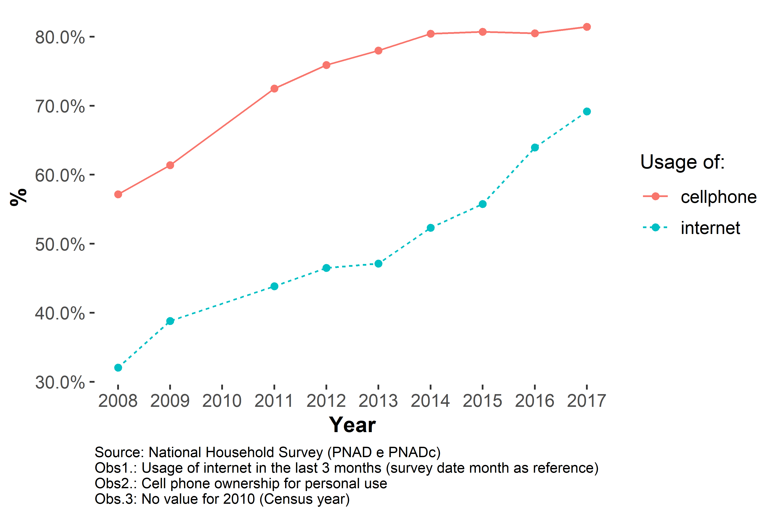
Internet and cell phone usage in Brazil, % of 16+ years-old population,
2008-2009 and 2011-2017

Slide 7
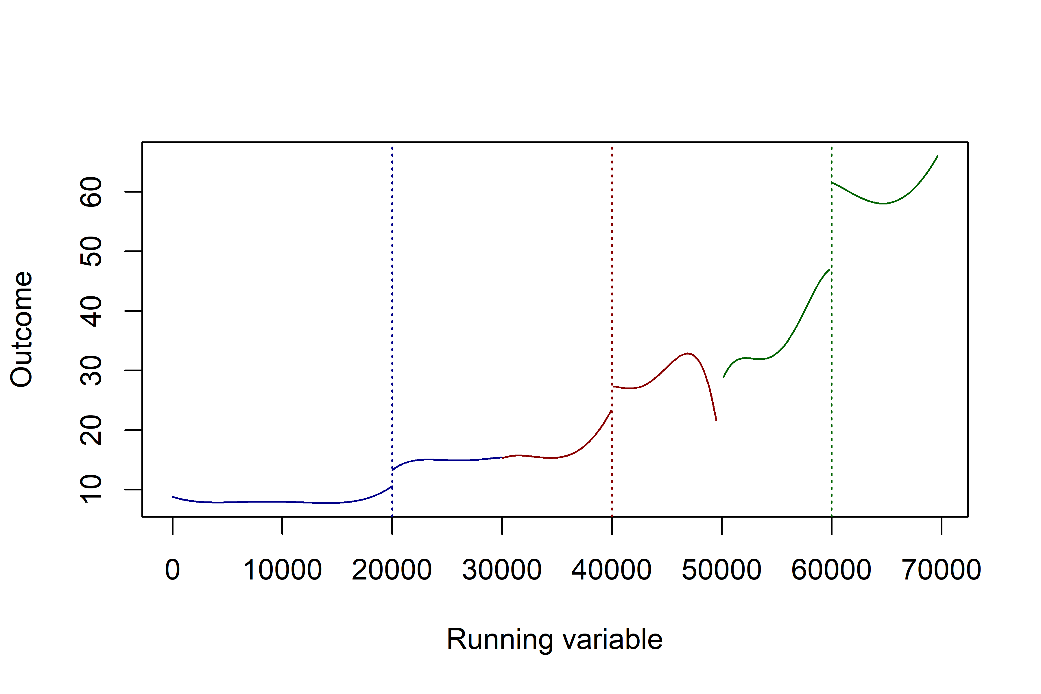

RDD – Internet velocity vs population size

Slide 8
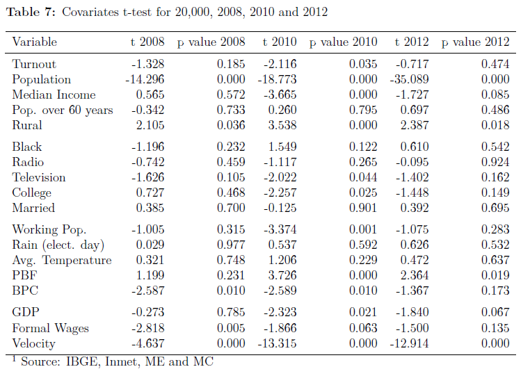
* BW: 5,000
Fujiwara (2016)

Slide 9
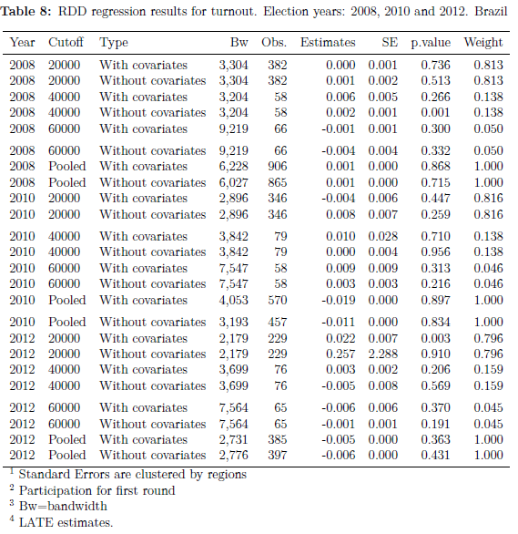
TURNOUT

Slide 10
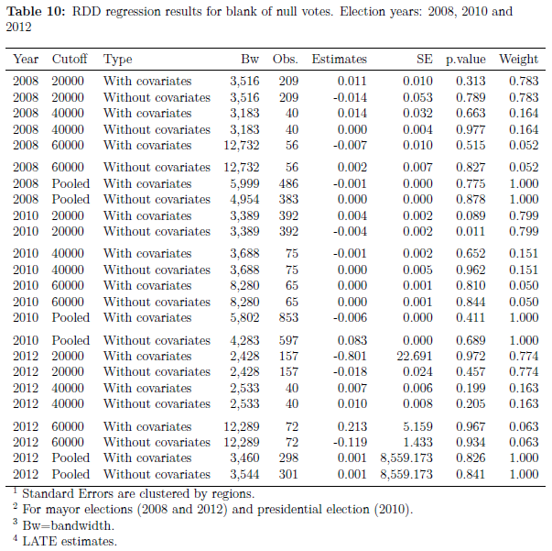
Blank and Null votes

Slide 11
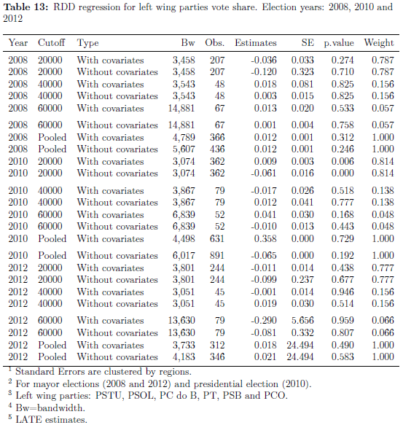
Left wing vote share

Slide 12
Discussion and conclusions
Results suggest that broadband connection (fixed line) availability did not change election outcomes (2008, 2010 and 2012);
Results for Brazil seems to be different from those observed in other countries (USA, Italy, Germany, UK and Malaysia);
Institutional background may play a role (e.g. compulsory voting in Brazil and differences in government and voting systems);
Lack of information about mobile broadband connection (no data at municipal level is available);
Rise in social media usage and the “fake news market” in recent elections could show a different scenario.

Slide 13
References
Campante, F., Durante, R. & Sobbrio, F. (2017). Politics 2.0: The multifaceted effect of broadband internet on political participation. Journal of the European Economic Association, 16, 1094–1136;
Cattaneo, M.D., Titiunik, R. & Vazquez-Bare, G. (2018). Analysis of Regression Discontinuity Designs with Multiple Cutoffs or Multiple Scores. 18. Retrieved from https://sites.google.com/site/rdpackages/rdmulti/Cattaneo-Titiunik-VazquezBare_2018_rdmulti.pdf
Czernich, N. (2012). Broadband Internet and Political Participation: Evidence for Germany. Kyklos, 65, 31–52.
Falck, O., Gold, R. & Heblich, S. (2014). E-lections: Voting Behavior and the Internet. American Economic Review, 104, 2238–65.
Gavazza, A., Nardotto, M. & Valletti, T.M. (2015). Internet and politics: Evidence from uk local elections and local government policies.
Jaber, A. (2013). Broadband Internet and Political Behavior: Evidence from the United States. Available at SSRN 2353549.
Menezes, A. (2015). Internet Availability, Political Information, and Voting: Evidence from Brazil.
Miner, L. (2015). The unintended consequences of Internet diffusion: Evidence from Malaysia. Journal of Public Economics, 132, 66–78.
Poy, S. & Schüller, S. (2016). Internet and voting in the Web 2.0 era: Evidence from a local broadband policy.
Tolbert, C.J. & McNeal, R.S. (2003). Unraveling the effects of the Internet on political participation? Political research quarterly, 56, 175–185.

Slide 14

References

