Slide 1

Broadband connection and election in Brazil: what is role of the internet?
Thiago Mendes Rosa
Universidade de Brasília
thiagomendesrosa@outlook.com
Mentors: Rafael Terra
Ana Carolina

Slide 2
Question?
Did the introduction of internet broadband connection affect election outcomes in Brazil?
Identification strategy:
RDD applied to Backhaul Program roll out
Answer:
Appearently, no.

Slide 3




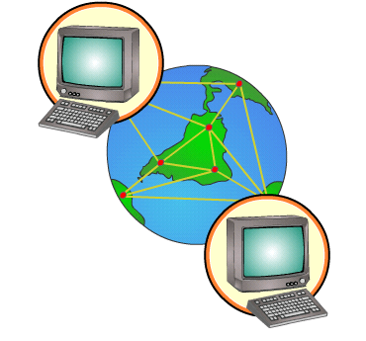
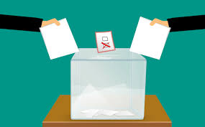




Theoretical Framework
INFORMATION
INTERNET
ELECTIONS
CROWD OUT
LEISURE

Slide 4







Review
VOTE SHARE
TURNOUT
Campante et al. (2017)
Poy & Schüller (2016)
Miner (2015)
Falck et al. (2014)
Czernich (2012)
Gavazza et al. (2015)
Jaber (2013)
Tolbert & McNeal (2003)
Menezes (2015)

