Slide 1



desafio_01
View in Power BI
Last data refresh:
10/06/2024 21:26:26 UTC
Downloaded at:
10/06/2024 21:30:57 UTC

Slide 2
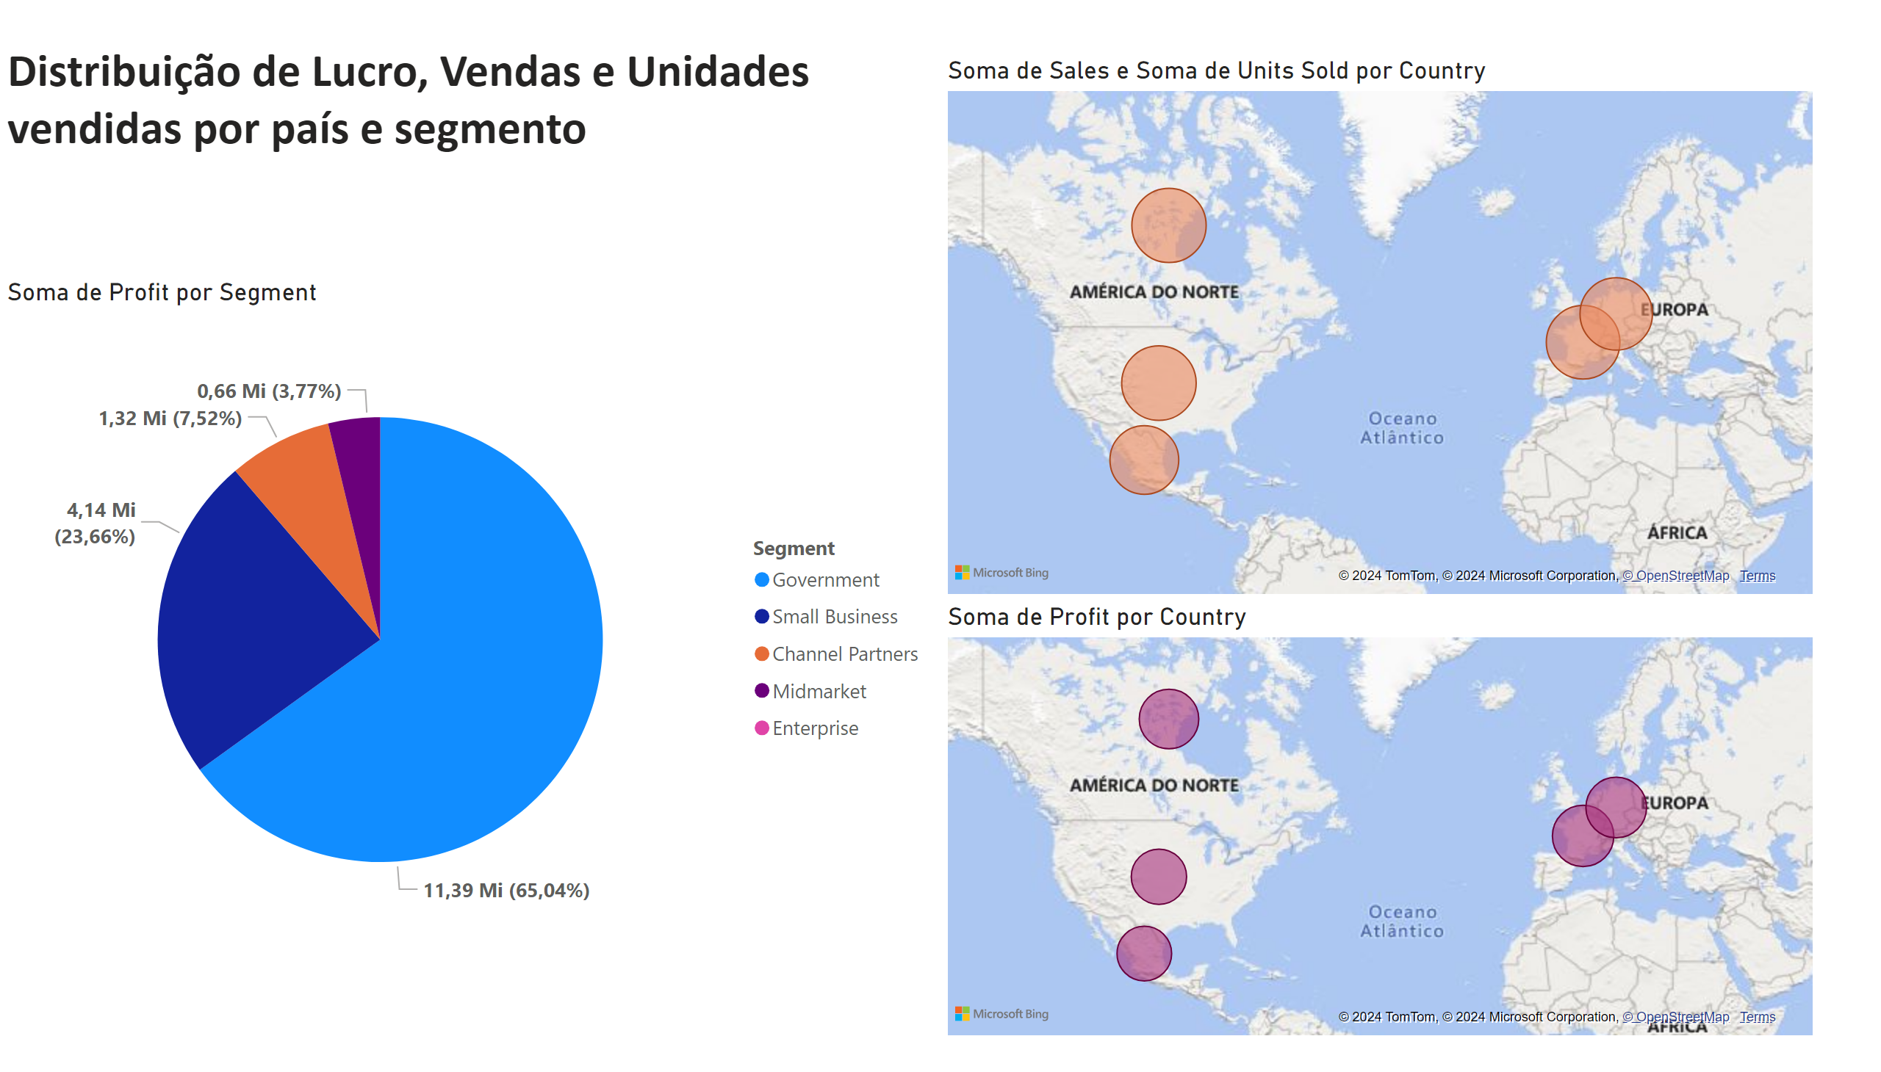
Página 1
Notes:
map
No alt text provided
map
No alt text provided
pieChart
No alt text provided
textbox
No alt text provided

