Slide 1
Extracting and Rendering Primitives from Point Clouds
Thiago Perrotta
Daniel Coutinho
Ricardo Marroquim
(LCG/UFRJ)
Saturday, August 30
10:30 - 12:30

Slide 2
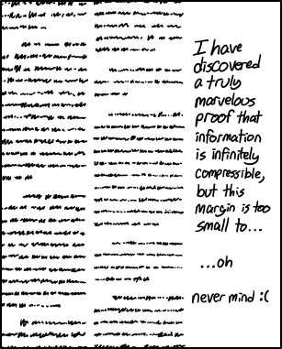
Copyright © Randall Munroe, xkcd

