Slide 1
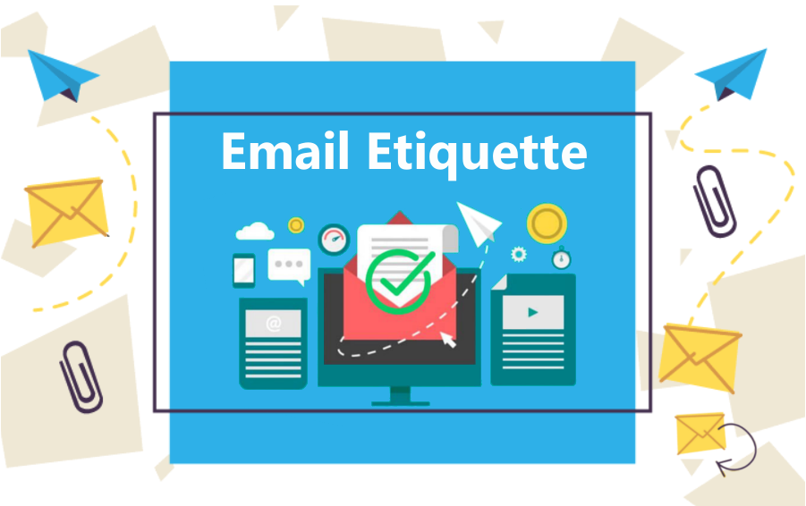
Email etiquette
Introduction
Importance: Email communication is a vital tool in today's professional world. However, proper email etiquette is crucial for effective communication.
Key Points:
Clear and concise communication,
Professional tone and language,
Respect for recipients' time.

Slide 2
Recipient, CC, and BCC
Understanding Recipient, CC, and BCC
Importance: Properly addressing recipients and understanding CC and BCC fields are essential for effective communication and privacy.
Key Points:
Recipient: The primary recipient(s) who should take action or respond to the email.
CC (Carbon Copy): Additional recipients who should be kept informed but are not directly responsible for the action.
BCC (Blind Carbon Copy): Recipients who receive the email without others' knowledge, maintaining their privacy.

Slide 3
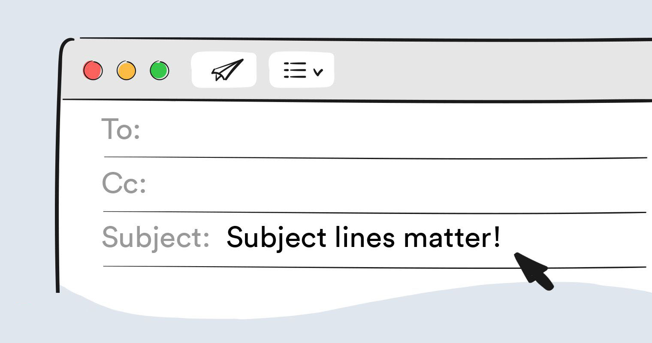
Subject Lines
Crafting Effective Subject Lines
Importance: The subject line is the first thing recipients see and determines whether they open the email.
Key points:
Be specific and relevant,
Use keywords for easy searchability,
Avoid all caps and spammy language.

Slide 4
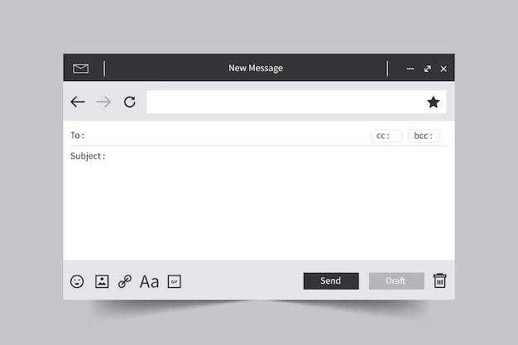
Body of the Email
Structuring Your Message
Importance: The body of the email should convey your message clearly and respectfully.
Key points:
Use proper greeting and salutation,
Organize content with paragraphs and bullet points,
Proofread for grammar and spelling errors.

Slide 5

Tone and Language
Maintaining Professionalism
Importance: The tone and language of your email impact how your message is received.
Key points:
Use a polite and respectful tone,
Avoid slang and abbreviations,
Be mindful of cultural differences.

Slide 6
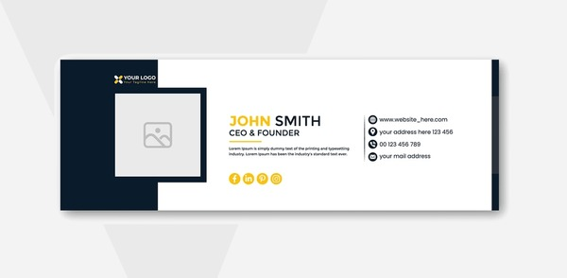
Closing and Sign-off
Ending on a Positive Note
Importance: A proper closing leaves a lasting impression and promotes further communication.
Best Practices:
Express gratitude if applicable,
Use appropriate sign-offs (e.g., "Regards“,
“Sincerely,"),
Include your contact information if necessary.

