Slide 1
DSO 510 Final Project
Benjamin Zhao, Lisa Xiao, En-Ning Chiang,
Mridula Singhal, Himani Desai, Suwara Thianrungrot

Slide 2
What is the problem you are seeking to answer?
Do Twitter mention impact stock prices? If so, which type of source of twitter mentions impact stock prices the most?
Why would a data-driven approach be useful to obtain insights regarding this problem?
A data-driven approach gave us the medium to better understand, verify, and quantify the results of our decision. The problem we are trying to solve requires the evaluation of important metrics first through statistical analysis and then assessing the impact of categories on stock prices.
What is the ideal experiment to examine the issue?
Other factors such as inflation rate, interest rate, and economics that affects the stock market. Thus, to help eliminate this impact, the randomization of stocks we examined is important. Moreover, the sources of twitters should be randomized as well.

Slide 3
Do Twitter Mentions impact Stock Prices?
David Wallach's Stockerbot on Kaggle
API tracked tweets from 7/6/2018-7/18/2018 for stock mentions
Tracked from sources such as MarketWatch, WSJ, Yahoo Finance, the Federal Reserve, Ben Bernanke, StockTwits

Slide 4
Do Twitter Mentions Impact Stock Prices?
Collected stock data for mentioned stocks over same period
Tracked day-to-day stock change
Compared number of twitter mentions to stock performance and mention by source type to stock performance

Slide 5
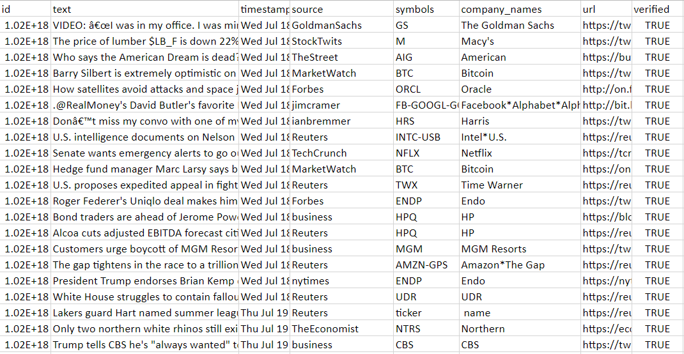

Slide 6
Key Facts
396 Stocks
24753 Tweets
Prominent representation by major stocks such as Apple, FB, Google, Amazon, Netflix, etc.
Sources include Yahoo Finance, Federal Reserve, Jim Cramer, Goldman Sachs, Morgan Stanley, Mark Cuban, Ben Bernanke, Forbe, The Economist, etc.

Slide 7
Data discrepancies?
The data that we received from stockerbot only had one row that occurred in February and rest all the data was of the month July, hence we removed the row.
Some of the symbols in this data is not the stock. We checked the symbols with yahoo finance API and exclude some that are not stock symbols such as BTC. Moreover, some stock symbols are changed. We have to update these symbols to match with the historical stock price.
Some of the rows contained more than one stock symbols hence we had to develop a regex to split it into rows containing value of each stock symbols separately.
Lastly, COL price is below $1 because it about to be delisted. Thus, we exclude this stock symbol from our analysis.

Slide 8
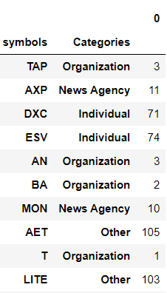
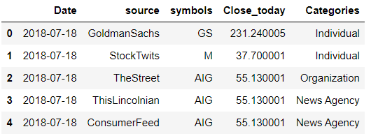
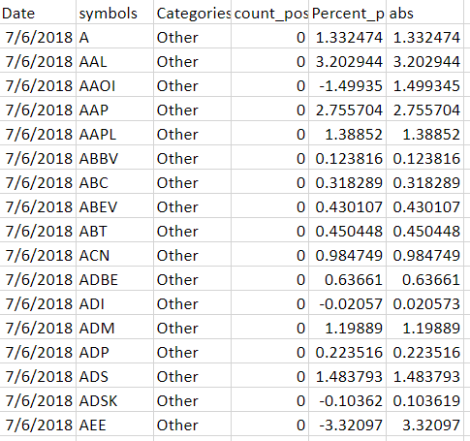
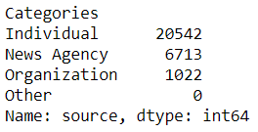

Slide 9
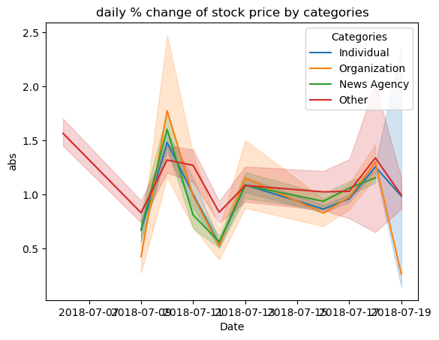

Slide 10
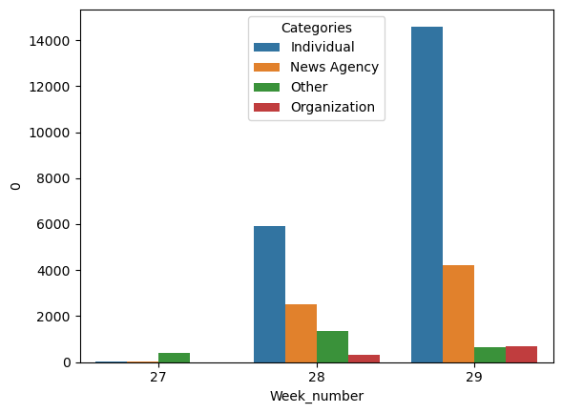

Slide 11
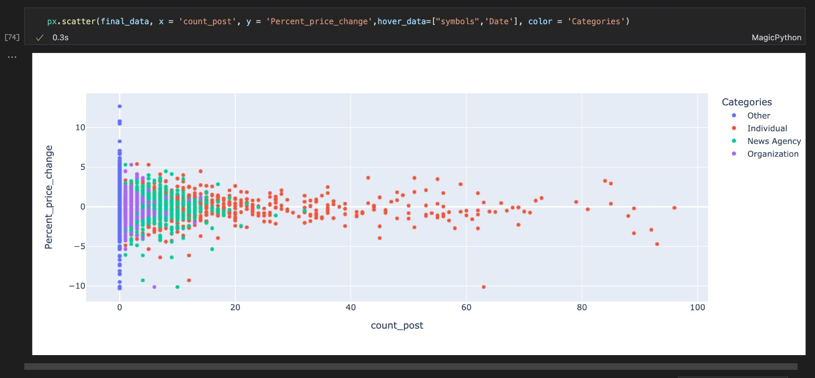

Slide 12
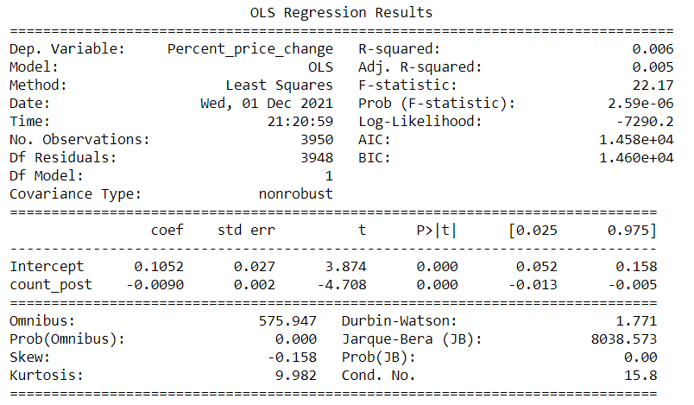

Slide 13
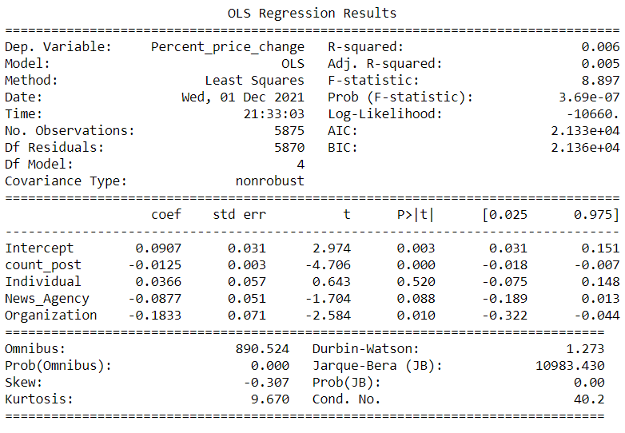

Slide 14
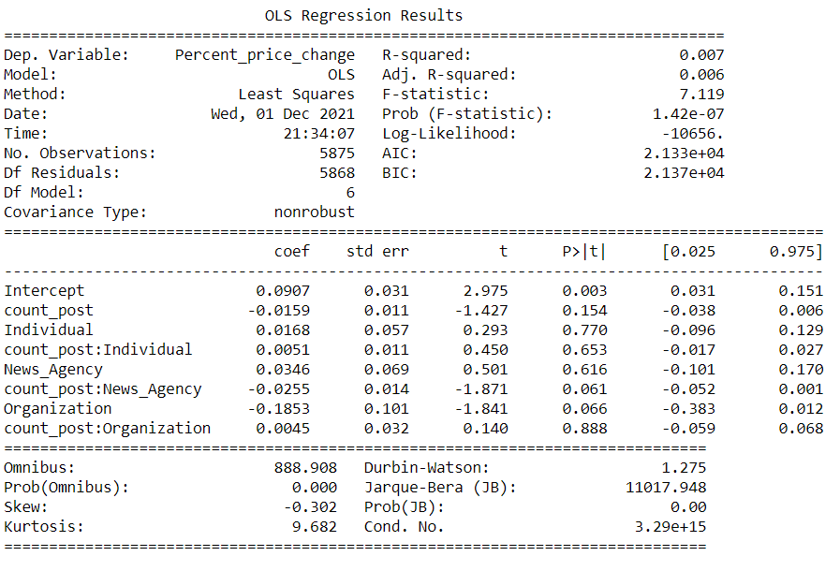

Slide 15
Conclusion
According to our analysis, the number of Twitter posts does influence stock prices. Additionally, Twitter posts by organizations also influence stock prices. However, news agencies and individual Twitter posts do not appear to influence stock prices.

