Slide 1
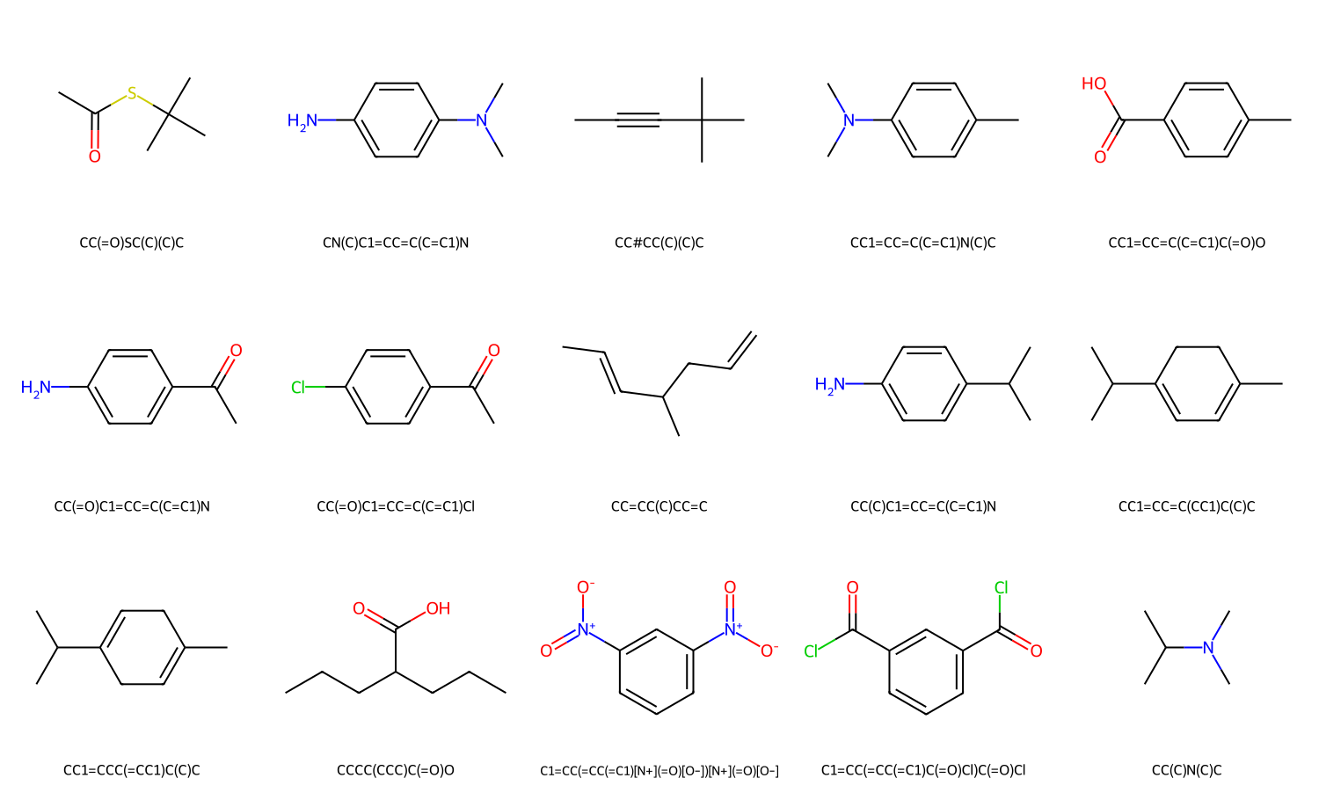
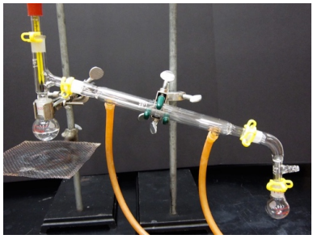
Module 1
Structure
Boiling Point
https://tinyurl.com/3hvwavka

