Slide 1
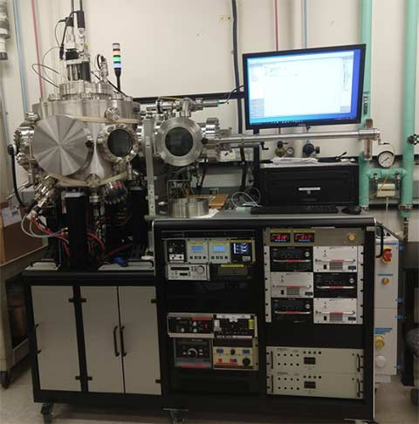
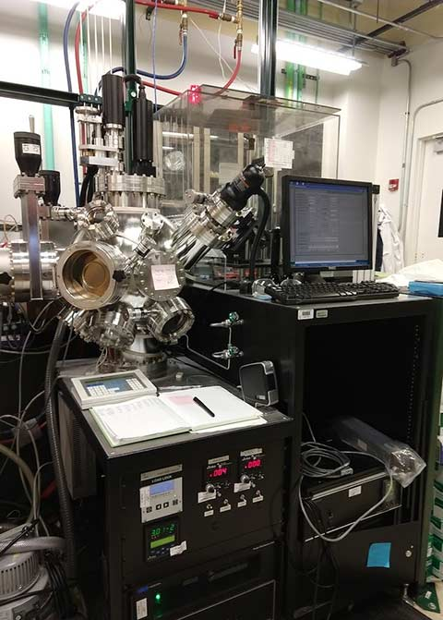
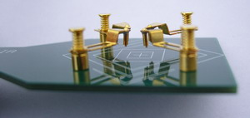
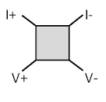
Module 3
Process/Composition
Electronic
Conductivity
https://www.nlr.gov/materials-science/combinatorial-depositions.html
http://www.bridgetec.com/hms3000.html

