Slide 1

Pikcio Tokens basic properties
Name | Type | Initial | Description
name | str | '' | The friendly name of the token
symbol | str | '' | The symbol of the token currency. Should be 3 or 4 characters long.
decimals | int | MAX_TOKEN_DECIMALS | Maximum number of decimals to express an amount of the token.
initial_supply | int | 0 | The initial amount of the token on the market.
total_supply | int | 0 | The current amount of the token on the market, in case some has been minted or burnt.
balance_of | dict[str,int] | {} | Maps customers addresses to their current balance
Allowance | dict[str,dict[str,int]] | {} | Gives for each customer a map to the amount spenders are allowed to spend on their behalf.
According to Smart Contract definition, these properties have to be at the root of the module to be saved in the storage between each call.
PIKCIO CONFIDENTIAL 2018

Slide 2
Pikcio Tokens basic functions
Name | Type | Initial | Description
name | str | '' | The friendly name of the token
symbol | str | '' | The symbol of the token currency. Should be 3 or 4 characters long.
decimals | int | MAX_TOKEN_DECIMALS | Maximum number of decimals to express an amount of the token.
initial_supply | int | 0 | The initial amount of the token on the market.
total_supply | int | 0 | The current amount of the token on the market, in case some has been minted or burnt.
balance_of | dict[str,int] | {} | Maps customers addresses to their current balance
Allowance | dict[str,dict[str,int]] | {} | Gives for each customer a map to the amount spenders are allowed to spend on their behalf.
According to Smart Contract definition, these properties have to be at the root of the module to be saved in the storage between each call.
PIKCIO CONFIDENTIAL 2018

Slide 3
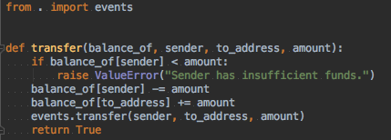
Pikcio Token: Events module
Some functions can trigger events collected by the execution environment to notify the outside world.
For example, the Transfer event should be propagated once a transfer is made (and not rolled back).
Recommendations:
The implementation details might vary. That is why the event triggering should be encapsulated in its own dedicated module.
Though a minimal set of events should exist, user should be able to register/trigger more events.
PIKCIO CONFIDENTIAL 2018

Slide 4

Pikcio Token: Base module
Token implementation has to be easy and fast for users.
Thus, each basic function should have a default implementation provided by Pikcio.
Because endpoints have to be at the root of the module, this cannot be provided as a base class to inherit. Instead, default behaviors should belong to the base module and be called by the user:
Recommendations:
Base functions should have same signature but also accept in front the other arguments collected on the way.
Base functions should also trigger any related event.
PIKCIO CONFIDENTIAL 2018

Slide 5
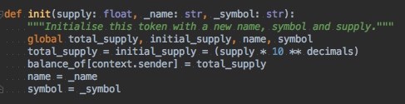
Pikcio Token: Context module
Some information needs to be provided at runtime
The easiest example is the « sender », the address of the user that invoked the endpoint.
Forcing additional parameters in each function would painful. It is impossible to tell which function is going to use each attribute and the signatures could soon become heavy.
Providing a « context » object as a first argument of each method seems reasonable. However, since each parameter has to be typed with a builtin type to be valid (c.f. Smart Contract definition), this option is excluded.
The simplest way is to provide all context attributes in a separate module that can be imported. This way, adding attributes to the context is smooth as it does not impact existing code. Signatures also stay as small as possible.
PIKCIO CONFIDENTIAL 2018

Slide 6
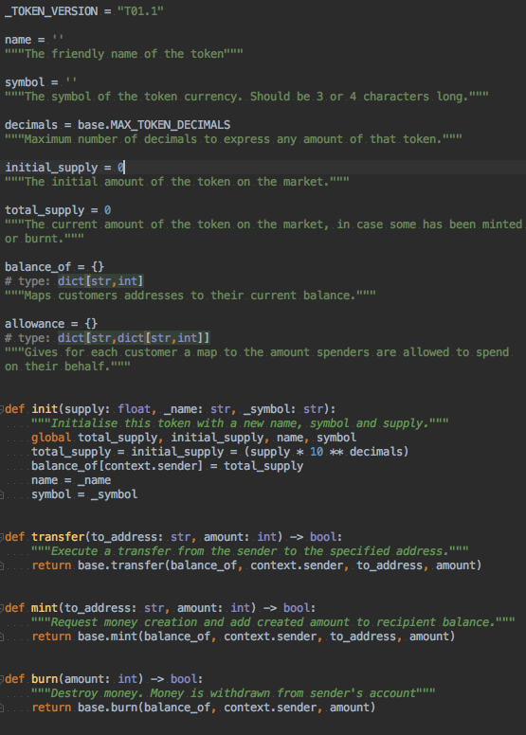
Pikcio Token: Minimal Example
PIKCIO CONFIDENTIAL 2018

