Slide 1

Pikcio Tokens: Summary
Basic Properties
Basic Functions
Int, float and Decimal considerations
Endpoint success, failure and error
Events module
Base module
Context module
Minimal example
Storage issue & solution
PIKCIO CONFIDENTIAL 2018

Slide 2
Pikcio Tokens basic properties
Name | Type | Initial | Description
name | str | '' | The friendly name of the token
symbol | str | '' | The symbol of the token currency. Should be 3 or 4 characters long.
decimals | int | MAX_TOKEN_DECIMALS | Maximum number of decimals to express an amount of the token.
initial_supply | int | 0 | The initial amount of the token on the market.
total_supply | int | 0 | The current amount of the token on the market, in case some has been minted or burnt.
balance_of | dict[str,int] | {} | Maps customers addresses to their current balance
Allowance | dict[str,dict[str,int]] | {} | Gives for each customer a map to the amount spenders are allowed to spend on their behalf.
According to Smart Contract definition, these properties have to be at the root of the module to be saved in the storage between each call.
PIKCIO CONFIDENTIAL 2018

Slide 3
Pikcio Tokens: Basic Functions
Name | Signature | Description
init | supply: float, _name: str, _symbol: str | Initialise this token with a new name, symbol and supply.
transfer | to_address: str, amount: int -> bool | Execute a transfer from the sender to the specified address.
mint | to_address: str, amount: int -> bool | Request money creation and add created amount to recipient balance.
burn | amount: int -> bool | Destroy money. Money is withdrawn from sender's account
approve | to_address: str, amount: int -> bool | Allow specified address to spend provided amount from sender account. The approval is set to specified amount.
add_approve | to_address: str, delta_amount: int -> bool | Relative change on allowance. Negative amounts decrease the approval.
transfer_from | from_address: str, to_address: str, amount: int -> bool | Require Transfer from another address to specified recipient. Operation is only allowed if sender has enough allowance on the source account.
burn_from | from_address: str, to_address: str, amount: int -> bool | Require Burn from another account. Operation is only allowed if sender has sufficient allowance on the source account.
According to the Smart Contract definition, these functions have to be at the root of the module to be public.
PIKCIO CONFIDENTIAL 2018

Slide 4
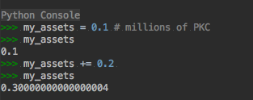
Pikcio Tokens: Int, Float and Decimal
There are three main numeric types in python (excluding Complex which is out of bounds here):
int: is the default integer type. It is the most performant to handle. In Python, it is not bounded, e.g. you can have an infinitely long integer
float: is the default floating point type (64 bytes). Great to handle decimals as long as the precision is not critical:
Decimal: a pure python type dedicated to handle fractions accurately
PIKCIO CONFIDENTIAL 2018

Slide 5
Pikcio Tokens: Decimal
Pros:
Great precision with decimals
Cons:
Not a builtin type, so slower.
No default JSON serialisation. Requires more work. Also quid of inter-process representation?
PIKCIO CONFIDENTIAL 2018

Slide 6
Pikcio Tokens: Float
Pros:
Builtin standard type to handle floating values
Consistent serialisation/representation between platforms (Python, Java, C++, C#...)
Cons:
Can’t guarantee exact value
In order to use that type, we would always have to round it before handling it.
PIKCIO CONFIDENTIAL 2018

Slide 7
Pikcio Tokens: Int
Pros:
Fastest numeric type
Unlimited size
Consistent serialisation/representation between platforms (Python, Java, C++, C#...)
Cons:
It is not a decimal type.
PIKCIO CONFIDENTIAL 2018

Slide 8
Pikcio Tokens: Numeric Type conclusion
Competition:
Both ERC20 and NEP5 use a « biginteger » type to store token amounts. Each token also define a precision that is used to represent a decimal as an integer.
Example:
Amount: 20.5345
Precision: 4
Stored value: 20.5345 * 10 **4 = 205345
Conclusion:
Pikcio Token should use integers as well, with the advantage that since Python integers are not bounded, the precision could be almost unlimited.
PIKCIO CONFIDENTIAL 2018

Slide 9
Pikcio Tokens: Endpoint Success, Failure and Error
Calling an endpoint can result in three different ways:
Success: The operation succeeded. State is saved and the appropriate result is returned. The endpoint should return a value: the result of a computation or True to indicate success.
Failure: The operation could not complete but some changes are permanent. The state is saved. The endpoint should return a default negative value depending on the operation (False, 0, ’’…)
Error: The operation could not complete and the changes have been rolled back. The endpoint raises an exception instead of returning a value.
PIKCIO CONFIDENTIAL 2018

Slide 10
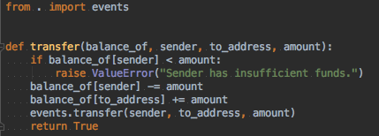
Pikcio Token: Events module
Some functions can trigger events collected by the execution environment to notify the outside world.
For example, the Transfer event should be propagated once a transfer is made (and not rolled back).
Recommendations:
The implementation details might vary. That is why the event triggering should be encapsulated in its own dedicated module.
Though a minimal set of events may exist, user should be able to register/trigger more events.
PIKCIO CONFIDENTIAL 2018

Slide 11

Pikcio Token: Base module
Token implementation has to be easy and fast for users.
Thus, each basic function should have a default implementation provided by Pikcio.
Because endpoints have to be at the root of the module, this cannot be provided as a base class to inherit. Instead, default behaviors should belong to the base module and be called by the user:
Recommendations:
Base functions should have same signature but also accept in front the other arguments collected on the way.
Base functions should not trigger any related event as it would otherwise lessen the reuse possibilities.
PIKCIO CONFIDENTIAL 2018

Slide 12
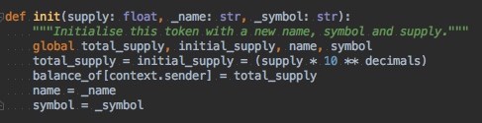
Pikcio Token: Context module
Some information needs to be provided at runtime
The easiest example is the « sender », the address of the user that invoked the endpoint.
Forcing additional parameters in each function would painful. It is impossible to tell which function is going to use each attribute and the signatures could soon become heavy.
Providing a « context » object as a first argument of each method seems reasonable. However, since each parameter has to be typed with a builtin type to be valid (c.f. Smart Contract definition), this option is excluded.
The simplest way is to provide all context attributes in a separate module that can be imported. This way, adding attributes to the context is smooth as it does not impact existing code. Signatures also stay as small as possible.
PIKCIO CONFIDENTIAL 2018

Slide 13
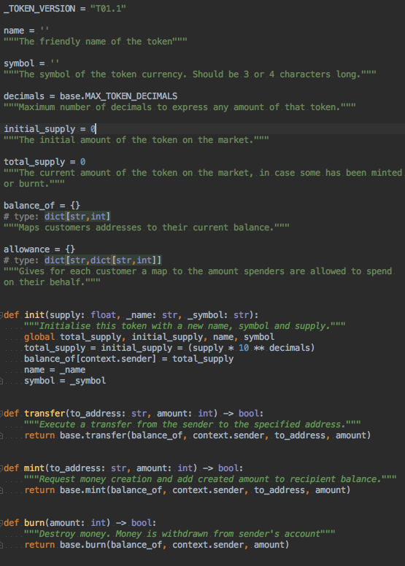
Pikcio Token: Minimal Example
PIKCIO CONFIDENTIAL 2018

Slide 14
Pikcio Token: Storage issue
Balance and allowances can potentially become huge
If the token has hundreds of thousands users, those two maps (plus possibly other storage variables) may become a burden to store. Let’s assume (roughly):
A balance entry stored as JSON is ~70 digits long: 64 for the address, 5 for the amount plus a separator.
The balance has 100,000 entries.
100,000 x 70 = 7,000,000 bytes = 6.67 Mb
If balance is mentioned in the JSON in the “before” and “after” sections of the call, it makes it a payload of 13Mb per call to store in the ledger.
This statement applies:
to all types of variable which length is not fixed (str, map, list, set, tuple, bytes)
To all kinds of smart contracts
PIKCIO CONFIDENTIAL 2018

Slide 15
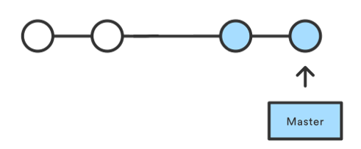
Pikcio Token: Storage solution
The ledger should not save consecutive states of a variable but only the delta of each call
This is the standard approach used by source control tools like git which have to handle large amounts of data:
Each commit (execution details stored in the ledger) contains only the changes with the previous commit
It is possible to rebuild the current state by applying in order all the commits
The masternodes should each “cache” the current version of the storage per contract
Rebuilding the current state from scratch might take a long time. On the other hand, the nature of the network between the masternodes make it easy to share and cache the current version of the contract state out of the ledger:
The node executing the contract shares the execution details with all masternodes.
Each masternode computes the change and saves it into its chain, then updates its state for the contract.
If a masternode joins the network or loses its cache, it can ask it back from the other nodes.
PIKCIO CONFIDENTIAL 2018

