Slide 1
Just like Whatsapp, but better
Arne Vanmarcke
Thibault Dekock

Slide 2
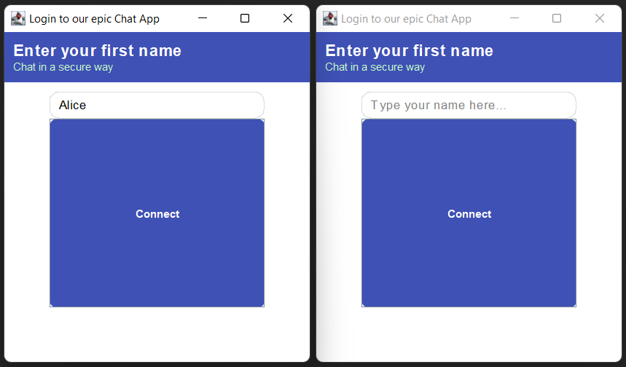
Functionality

Slide 3
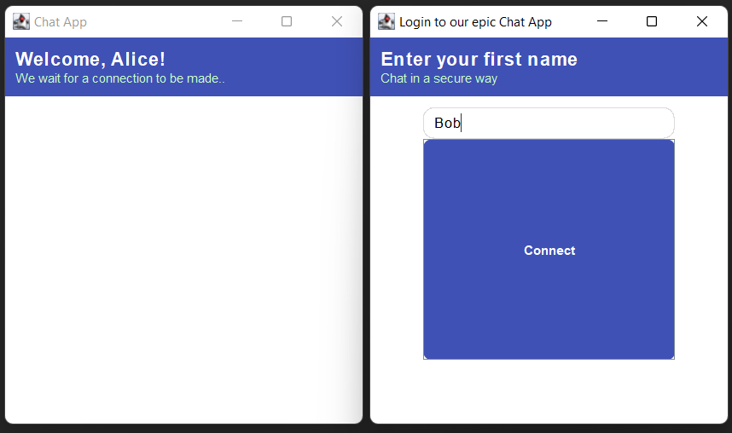
Functionality

Slide 4
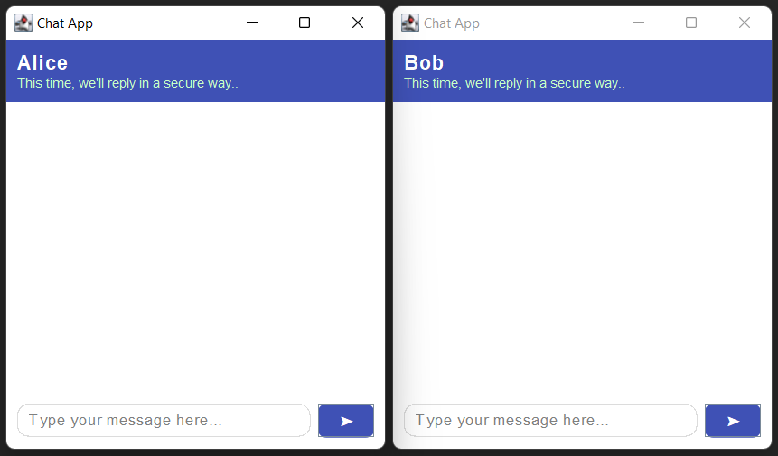
Functionality

Slide 5
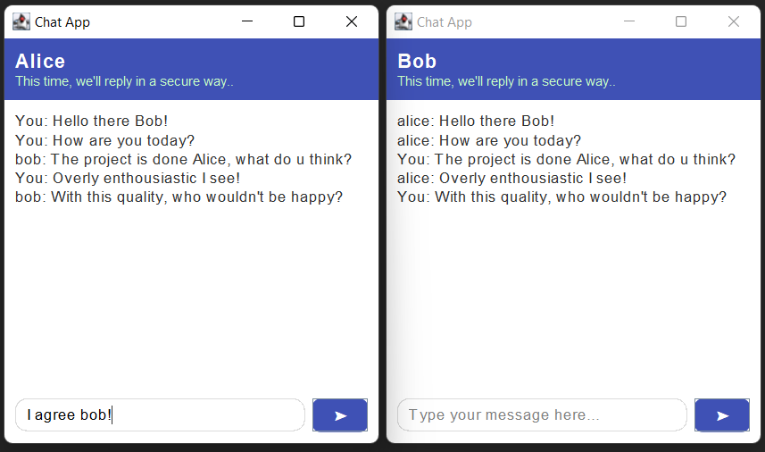
Functionality

Slide 6
Implementation
Bumpfile mechanism
Created on login
Stores client's public key, index and tag
BASE64 encoded for security
Distinct filenames for identical usernames

Slide 7
Implementation
Secret key generated using Diffie-Hellman (ECDH)
Combining private and public key
Never transmitted
Updated with public key and HMAC (SHA-256)

Slide 8
Implementation
Messages are sent using a byte buffer
Contains message, index, tag
Encrypted with AES before storage
Prevents use of delimiters
Prevents simple exploits (injections)
Tags are hashed using SHA-256
Ensures integrity and unlinkability

Slide 9
Advanced features
Tackling Denial-of-Service (DoS) attacks
Rate limiting
Sessions
Proof-of-Work (PoW) - our weapon of choice
Server generates a challenge
Clients solves computational puzzle
Adjustable difficulty
Static on 3x 0s == [10, 500] ms

Slide 10
Advanced features
Supporting recoverability of corrupted states
Encrypting & storing serialized states as backup
Encrypted with key only known to the client
Increasing scalability through partitioning
Dividing bulletin board across multiple servers
Static with index ranges
Dynamic with load monitoring

Slide 11
Reflection
Handling bump files could be improved
Causes naming restrictions
No persistent storage for messages
Messages lost upon server restart
Bulletin board is a single point of failure
+ No format for messages
+ PoW:
Allows to spread the incoming messages in time
~ Introduces computational delays for client

Slide 12
Demo
Greatness awaits...

