Slide 1
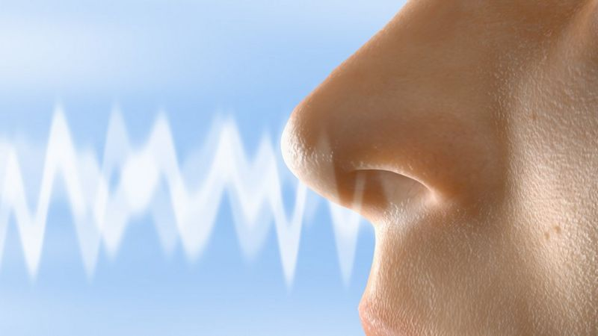

Olfactory dysfunction after SARS-CoV-2-Infection?
Fachdienstkurs Militär und Katastrophenmedizin
(FDK MKM 2022)
07. – 11. November, Kaserne Thun
Thibault Lovey, MMed
thibault.lovey@uzh.ch
Groupe de recherche Prof. Patricia Schlagenhauf
Notes:
Moustique pique Afrique (general connaissance) mais couvre également Europe.
1.Vecteur présent en Europe
2. Sujet complexe et on va se focaliser sur l’Europe

Slide 2
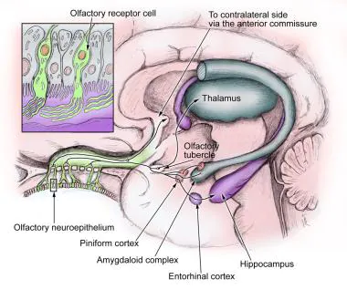
Olfactory Nerve (CN I)
Average length 25 to 35mm
Special sensory nerve for smell
Nerve cell bodies present in the mucosa
Generate and get replace every 3 day.
Source: Medscape
Notes:
Smell and emotion

Slide 3
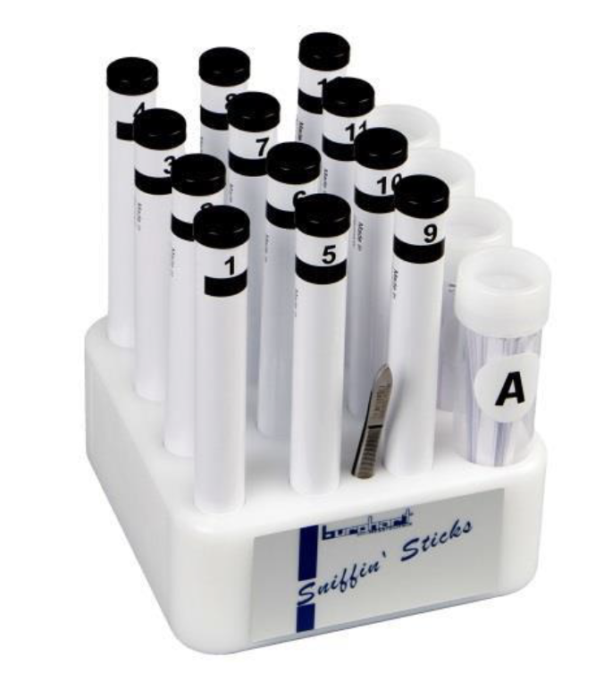
How to test smell in clinics ?
Question
Do you smell Coffee
or Tabaco?
Screening 12 Test
Source: Burghart Messtechnik
Notes:
This test can be used to roughly answer the question of whether a patient has a normal or reduced sense of smell. This olfactory test was developed for the practising ENT physician, neurologist and general practitioner.

Slide 4
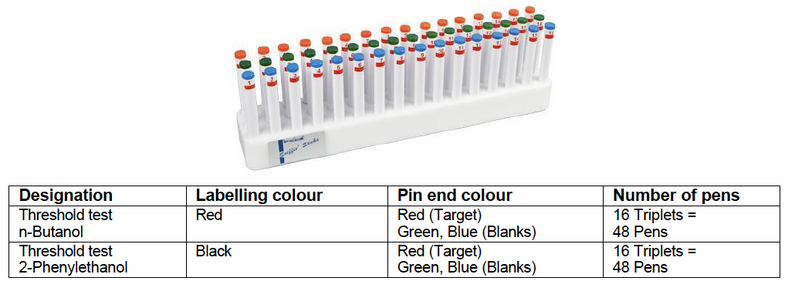
How to test smell in details: Threshold test
Source: Burghart Messtechnik
Notes:
The olfactory threshold is determined in a so-called "staircase procedure". After determining a starting concentration of the odour, the dilution level is determined (target) at which the odour can just be distinguished from non-smelling samples (blanks).

Slide 5
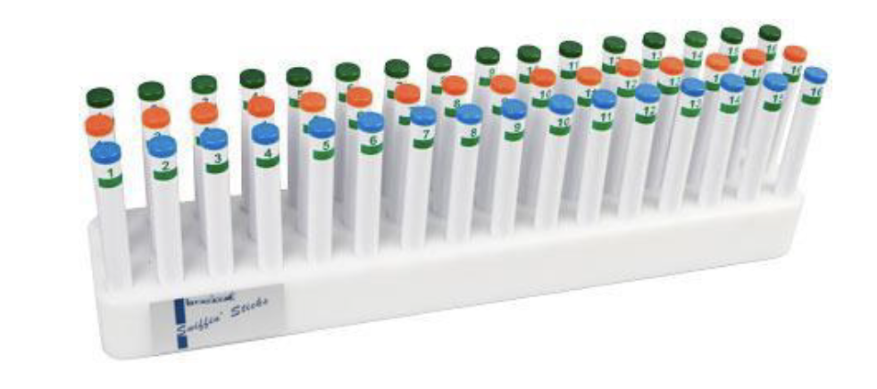
How to test smell in details: Discrimination test
Source: Burghart Messtechnik
Notes:
The discrimination of odours is based on a comparison between 3 odour presentations (triplet). The same odour is offered twice (non-target) and a different odour is offered once (target). The task of the test persons is to indicate which smell is different in each case. These comparisons are carried out for 16 triplets.

Slide 6
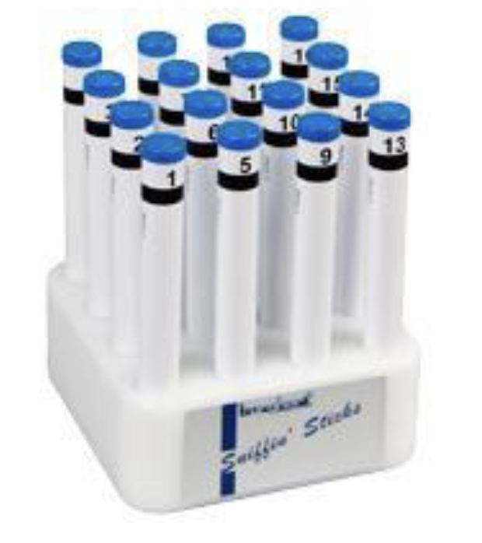
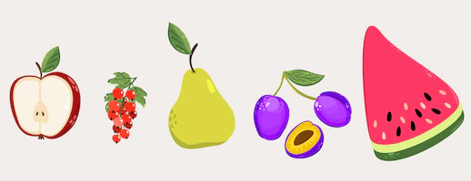
How to test smell in details: Identification test
??
Source: Burghart Messtechnik
Notes:
Here, the ability to identify everyday smells is examined.
This smell test was developed for ENT specialists, neurologists and general practitioners. The identification test 16, blue consists of 16 smelling sticks with everyday smells which are to be named by the patient with the help of a selection card (multiple choice cards) with four terms each.

Slide 7
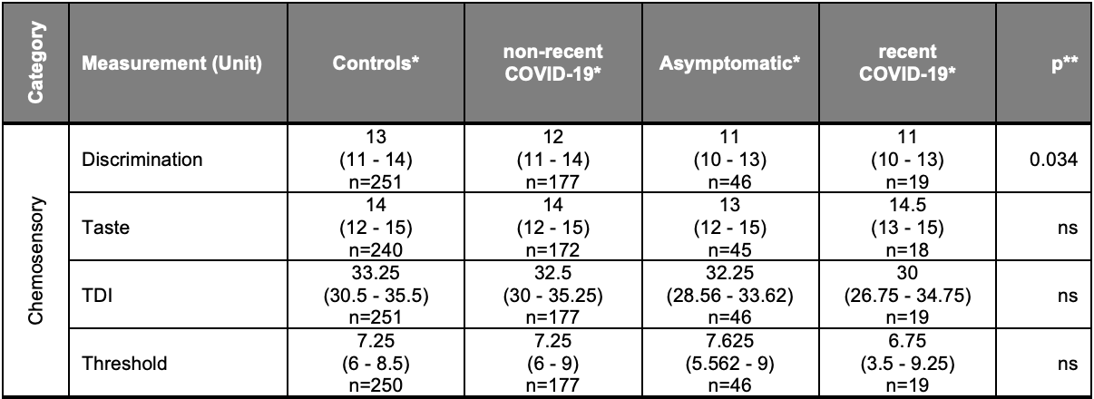
Threshold-Discrimination-Identification [TDI] score
normosmia [TDI ≥31]
hyposmia [TDI <31]
functional anosmia [TDI ≤16]
Source: Deuel et al.
Notes:
(Wilcoxon rank sum test between Control and non-recent COVID-19

Slide 8
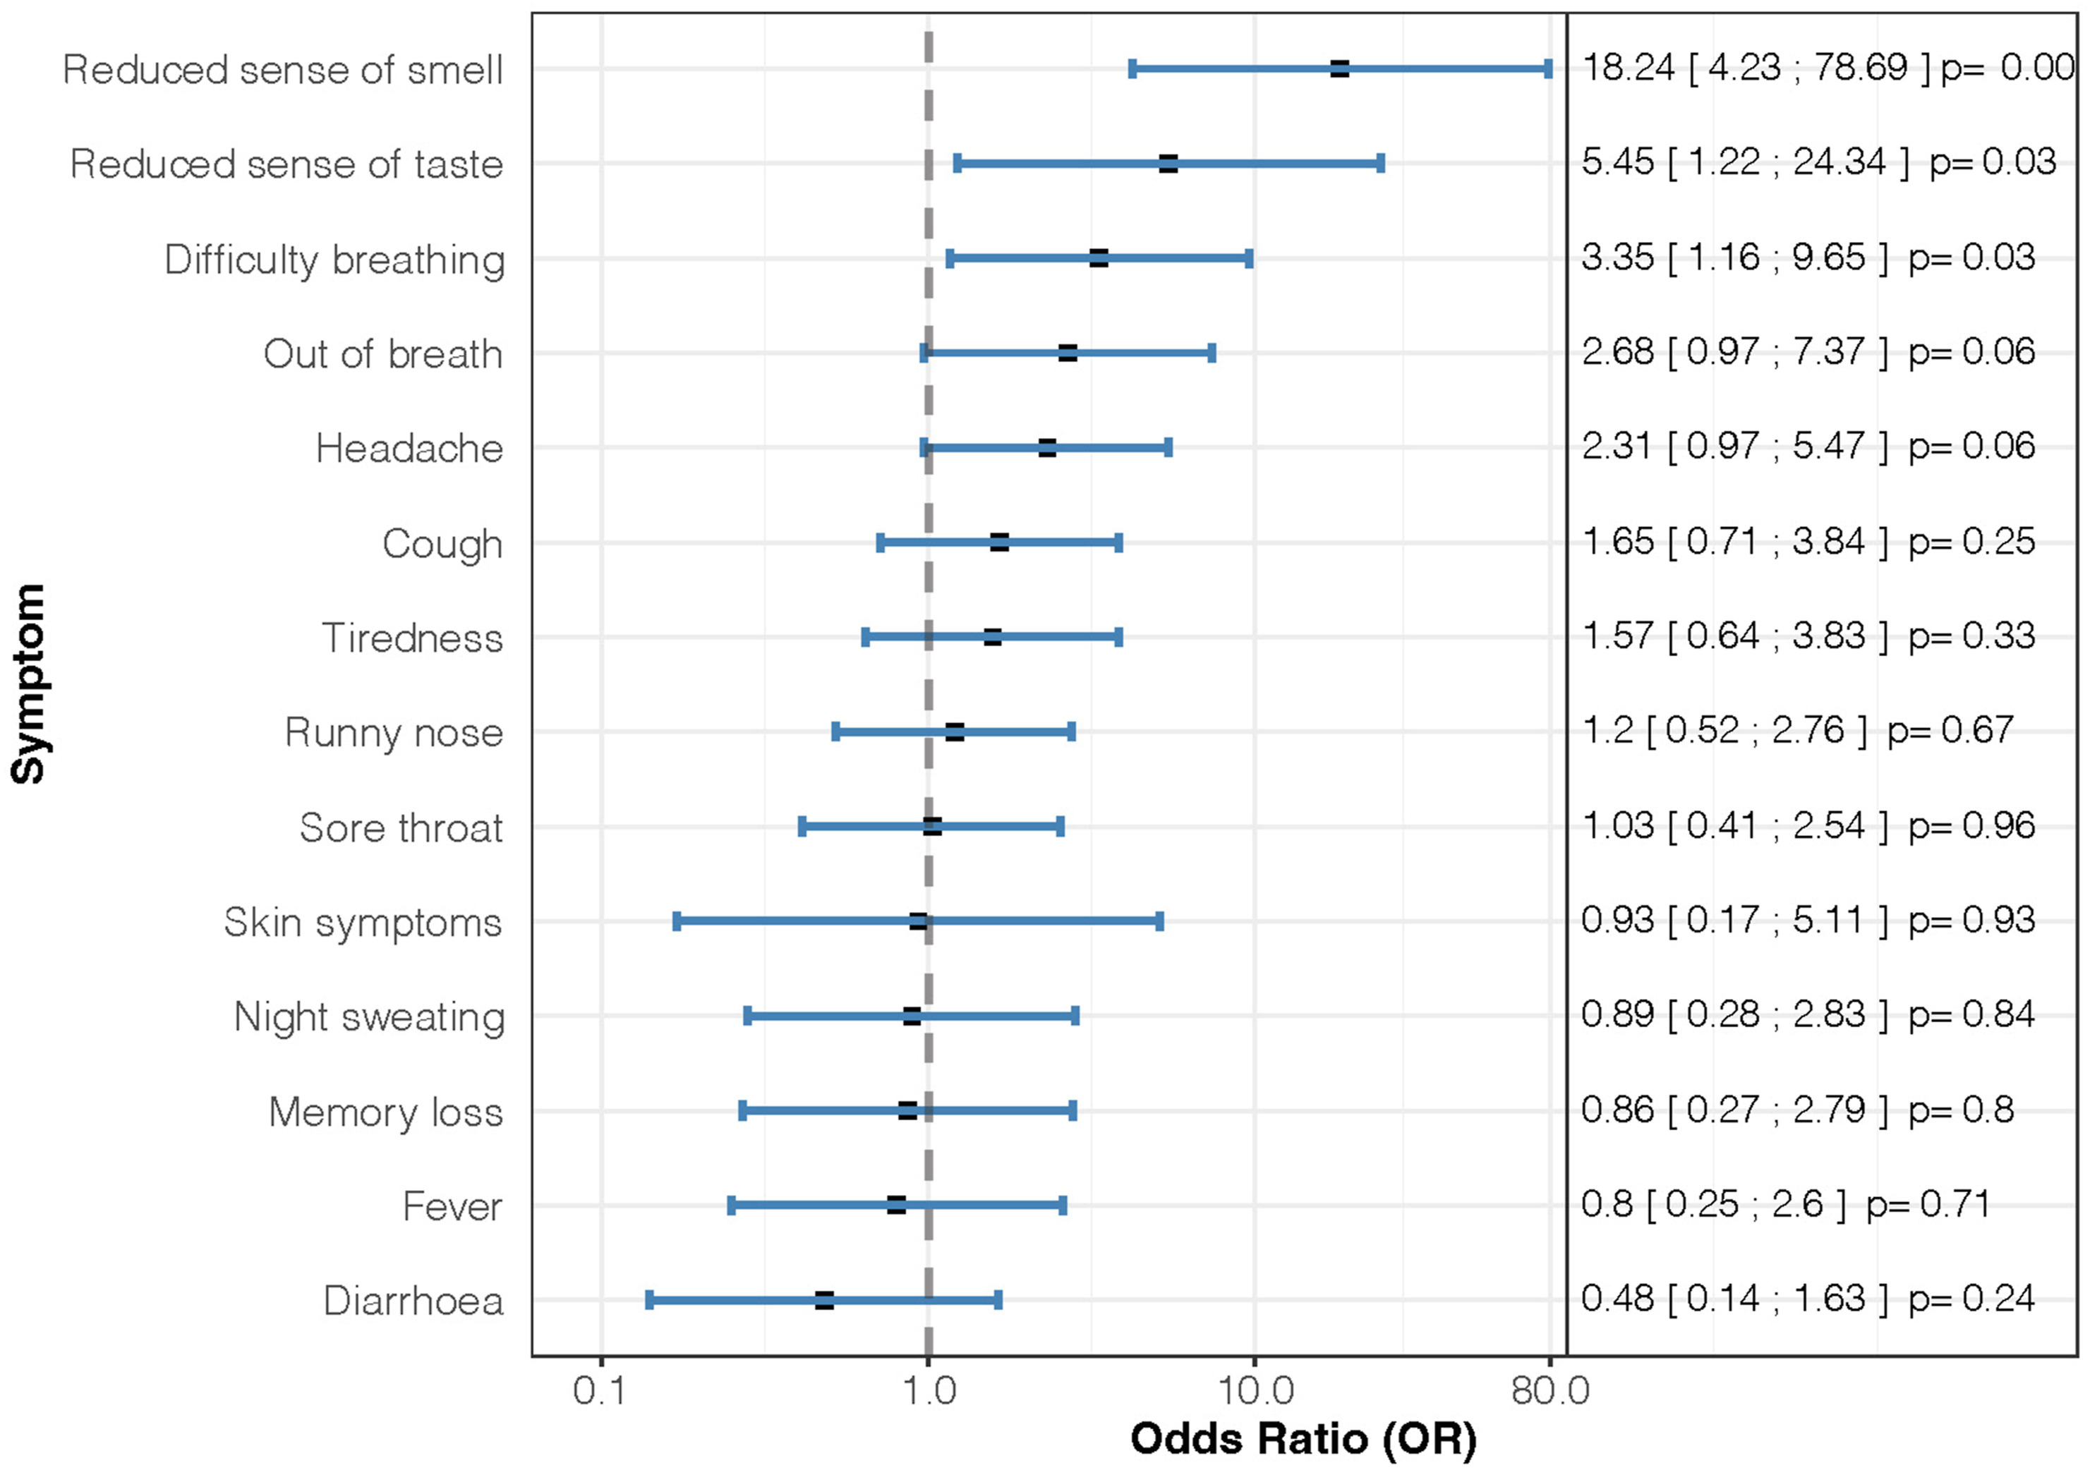
Persistent loss of smell
mean duration ~ 6 weeks
Source: Lovey et al.
Notes:
mean follow-up time of 54 days
hyposmia persisted for a mean duration of 6·4 weeks after testing positive

Slide 9
Tests for this morning's workshop: Identification test
1 | Orange | Brombeere | Erdbeere | Ananas
2 | Rauch | Schuhleder | Klebstoff | Gras
3 | Honig | Vanille | Schokolade | Zimt
4 | Schnittlauch | Pfefferminz | Fichte | Zwiebel
5 | Kokos | Banane | Walnuss | Kirsche
6 | Pfirsich | Apfel | Zitrone | Grapefruit
7 | Lakritz | Gummibärchen | Kaugummi | Kekse
8 | Senf | Gummi | Menthol | Terpentin
9 | Zwiebel | Sauerkraut | Knoblauch | Möhre
10 | Zigarette | Kaffee | Wein | Kerzenrauch
11 | Melone | Pfirsich | Orange | Apfel
12 | Gewürznelke | Pfeffer | Zimt | Senf
13 | Birne | Pflaume | Pfirsich | Ananas
14 | Kamille | Himbeere | Rose | Kirsche
15 | Anis | Rum | Honig | Fichte
16 | Brot | Fisch | Käse | Schinken
Source: Burghart Messtechnik
Notes:
mean follow-up time of 54 days
hyposmia persisted for a mean duration of 6·4 weeks after testing positive

Slide 10
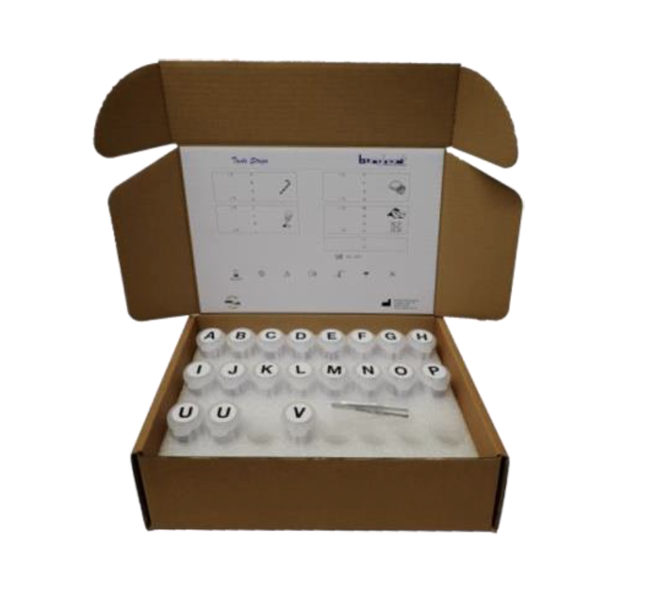
Tests for this morning's workshop: Taste Strips
 | Probe | süss | sauer | salzig | bitter
1 | D
2 | P
3 | L
4 | H
5 | G
6 | C
7 | O
8 | K
9 | F
10 | B
11 | J
12 | N
13 | A
14 | E
15 | I
16 | M
süss = sweet, sucré, dolce
sauer = sour, acide, acido
bitter = bitter, amer, amaro
salzig = salty, salé, salato
Source: Burghart Messtechnik
Notes:
mean follow-up time of 54 days
hyposmia persisted for a mean duration of 6·4 weeks after testing positive

Slide 11
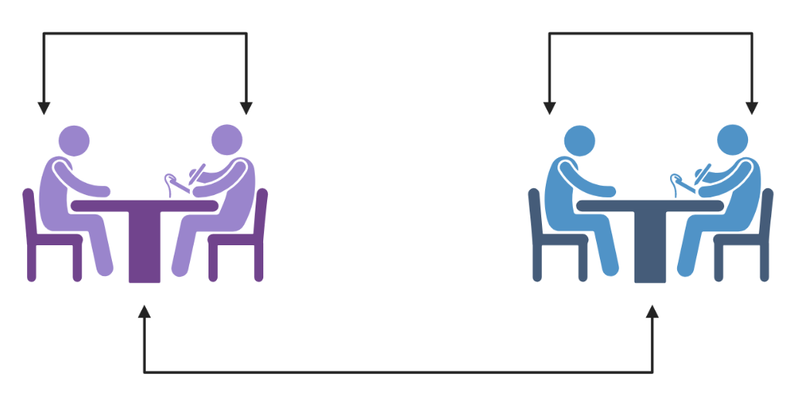
Tests for this morning's workshop: Rotation
Source: Biorender
Notes:
mean follow-up time of 54 days
hyposmia persisted for a mean duration of 6·4 weeks after testing positive

Slide 12
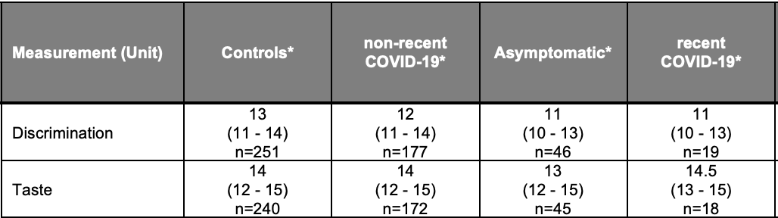
Solution
1 = orange | 9 = garlic
2 = shoe leather | 10 = coffee
3 = cinnamon | 11 = apple
4 = peppermint | 12 = cloves
5 = banana | 13 = pineapple
6 = lemon | 14 = rose
7 = liquorice | 15 = anis
8 = turpentine | 16 = fish
Within the box (take picture)
Identification
Taste
Notes:
mean follow-up time of 54 days
hyposmia persisted for a mean duration of 6·4 weeks after testing positive

Slide 13
The olfactory nerve is special (CN I)
There are special tests to test the sense of smell.
Covid impairs the sense of smell with a loss that lasts an average of 6 weeks.
It appears to impair the ability to discriminate odors.
Merci Thun!
Notes:
Receptivité: vectorial capacity of the mosquito susceptibility of the human population to malaria infection strength of the health system, including malaria interventions
Vulnérabilité:

