Slide 1

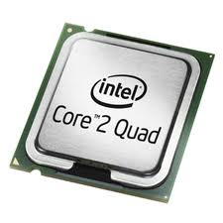
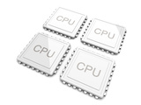
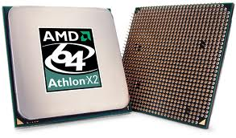
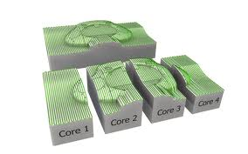


Claude TADONKI
Mines ParisTech / CRI
LAL / CNRS / IN2P3

Slide 2
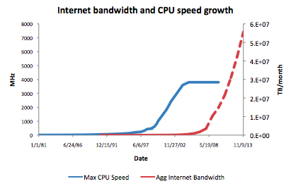


claude.tadonki@mines-paristech.fr claude.tadonki@u-psud.fr
HISTORICAL CONTEXT
we can observe a stagnation of the (single) processor clock speed
we need to still following the trend of Moore’s Law (transistor count)
in order to scale up with processor speed, we need more cores per chip
should we only focus on the number of cores per chip ? what about other devices ?

Slide 3
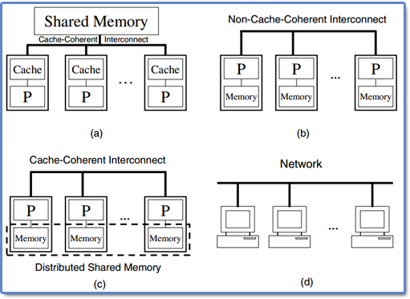
claude.tadonki@mines-paristech.fr claude.tadonki@u-psud.fr
MULTICORE SPECIFICITY
Multiprocessor computers
The main goal of the multi-core design is to provide computing units
with an increasing processing power (at least at the slope of the Moore's Law,
which is no longer possible with classical processors).
what is the main difference between a multicore and multiprocessor ?

Slide 4
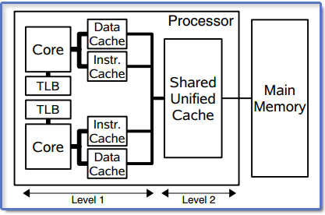

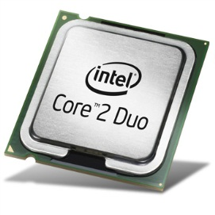


claude.tadonki@mines-paristech.fr claude.tadonki@u-psud.fr
MULTICORE PROCESSOR
A multicore processor is a single computing component with two or more “independent” processors (called "cores").
EXAMPLES
dual-core processor with 2 cores
e.g. AMD Phenom II X2, Intel Core 2 Duo E8500
quad-core processor with 4 cores
e.g. AMD Phenom II X4, Intel Core i5 2500T)
hexa-core processor with 6 cores
e.g. AMD Phenom II X6, Intel Core i7 Extreme Ed. 980X
octa-core processor with 8 cores
e.g. AMD FX-8150, Intel Xeon E7-2820
Describe some nice examples where multi-core computing could be considered.
Is the multi-core computing just a matter of hardware achievements ?
Does the performance of a multicore processor only depends on its number of cores ?

Slide 5
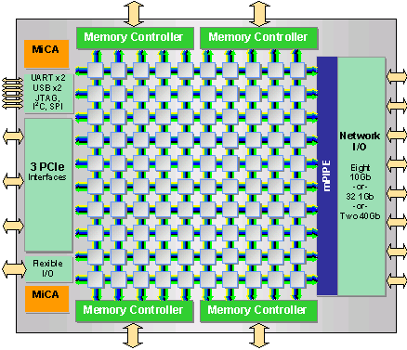


claude.tadonki@mines-paristech.fr claude.tadonki@u-psud.fr
MANYCORE PROCESSOR
A many-core processor is a multi-core processor (probably heterogeneous) in which the number of cores is large enough that traditional multi-processor techniques are no longer efficient.
EXAMPLES
Tilera TILE-GX processor family with 16 to 100 identical processor cores.
Intel Knights Corner with around 50 cores.
64-bit; Up to 750 billion operations/s; Up to 500Gbps of memory bandwidth;
32K L1i & 32K L1d & 256K L2; C & C++ programming; Linux
1 trillion calculations per second; C & C++ & Fortran
APPLICATIONS
Cloud Computing (Web Applications , Data Center, Database Applications , High-Performance Computing)
Digital Video (Video Transcoding, Videoconferencing, Streaming)
Wireless Infrastructure and Advanced Networking (Base Station, Intrusion Detection, Network Monitoring)
What do you think could be the issue when designing many-core processors ?
Did you heard about the Intel Larrabee ? Any words about the IBM CELL BE ?

Slide 6
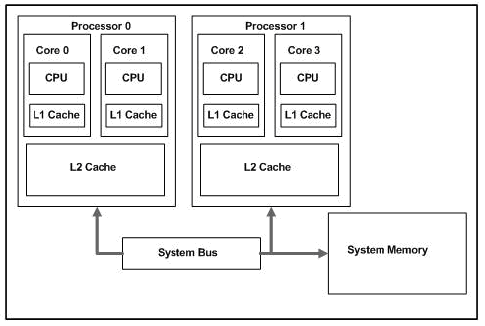
claude.tadonki@mines-paristech.fr claude.tadonki@u-psud.fr
MULTICORE ARCHITECTURE
In a multicore architecture, there are several cores inside the main processor.
the cores can concurrently access the main memory (many other resources are also shared)
the cores are independent to each other (but indirect dependences occur because of sharing)
the system uses the cores through threads
Concerning the last-level cache, there are two possibilities:
keeping the last-level cache private to each core
sharing the last-level cache among different cores
Notes:
On a multi-level supercomputer, a computing node is either a single core or an aggregated set of cores. The desired partitioning can be configured at runtime by the user when launching the program.
What are pros and cons for or against private (resp. shared) last-level cache ?
What are advantages and disadvantages of sharing ?

Slide 7
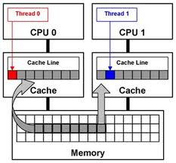

claude.tadonki@mines-paristech.fr claude.tadonki@u-psud.fr
IMPORTANT POINTS ABOUT MEMORY
Memory is stored within the cache system in units known as cache lines (2^{k} contiguous bytes, k = 5 or 6).
A memory address is said to be aligned if it is a multiple of the cache line length (important for performance).
Memory is multi-level. The typical hierarchy is from the main memory to the last-level cache (L1 cache), via intermediate level caches (L3 cache, L2 cache)
The cost to access data from a given memory level increases significantly from the last-level cache to the main memory. Having useful data at the last-level cache when needed is the key for maximum performances.
Any good programmer should be aware of this !!!
The so-called false sharing occurs when one variable located in the same cache line whose copies are hold by different cores is modified. Since that cache line will be systematically invalidated (even if not really necessary), the performance will suffer.
How can we aligned a memory allocation of N bytes starting at address p? Padding ?
How could we address the false sharing issue ?

Slide 8
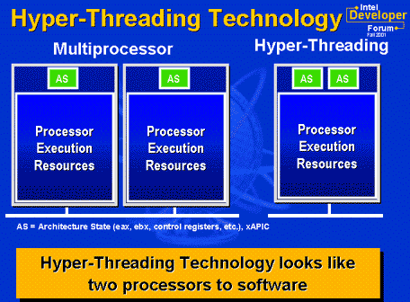
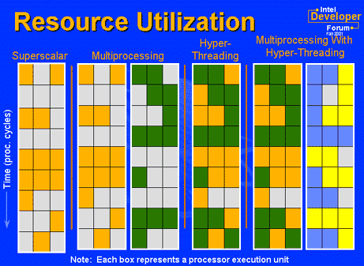
claude.tadonki@mines-paristech.fr claude.tadonki@u-psud.fr
HYPERTHREADING TECHNOLOGY
Hyper-threading (HT - Intel) is the ability, for the hardware and the system, to schedule and run two threads or processes simultaneously on the same processor core (could be only one on the machine).
Principles:
Hyper-threading processor appears as two “logical” or “virtual” processors to the host operating system.
Different from standard multi-tasking, true low-level parallelism may occur
The workload is shared between the “logical” cores
Hyper-threading mainly parallelizes the instructions pipeline
E.g.: Integer and floating point calculation could be done simultaneously on their respective units.
Windows Task Manager will show up twice the number of effectives cores.
Hyper-threading can speed up a program from 0% to ~30%.
However, a single core with Hyper-Threading is dramatically different from two separate physical cores.
How is hyper-threading technology different from multi-core ? Describe the case it can impact.

Slide 9
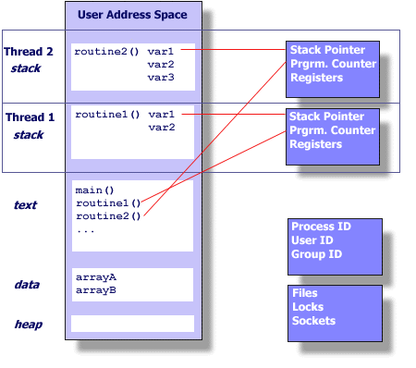


claude.tadonki@mines-paristech.fr claude.tadonki@u-psud.fr
WHAT IS A THREAD ?
A thread is as an independent stream of instructions that can be launch and scheduled to run as such by the operating system.
In a program, an independent section or a routine can be executed as a thread.
A multi-threaded program is a program
that contains several concurrent threads.
A thread can be seen as a lightweight process (memory is shared among threads).
A thread is a child of a (OS) process. Thus it uses the main resources of the process (shared between all running threads),
while keeping its own
Stack pointer
Registers
Scheduling properties (policy ,priority)
Set of pending and blocked signals
Thread specific data.

Slide 10
claude.tadonki@mines-paristech.fr claude.tadonki@u-psud.fr
THREAD PROPERTIES
In relation with the parent process, a thread
exists as a child of a system process and uses the parent process resources
has its own independent flow of control
duplicates only the essential resources it needs as an independent program
share the process resources with other threads
dies if the parent process dies (could be interrupted or killed too)
is lightweight as the overhead has already been paid at the creation of the process.
In relation with other threads
changes made by one thread to shared resources will be seen by all other thread
two pointers having the same value point to the same data
concurrent I/O to the same memory locations is possible,
and therefore may requires explicit synchronization by the programmer
threads are scheduled dynamically by the operating system (no a priori order)
Is it always better to have two threads than one for the same task ?
Who is responsible for the execution (logical) coherence of the threads ?
Could you clearly restate the difference between process and thread ?

Slide 11
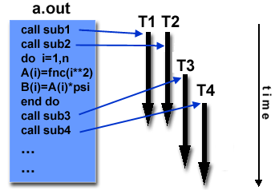

claude.tadonki@mines-paristech.fr claude.tadonki@u-psud.fr
THREAD IMPLEMENTATIONS
A threaded program is built from a classical program by embedding the execution of some of its subroutines within the framework of associated threads.
Typical scenario to design a threaded program implies
calls to a specialized library (thread implementation)
programming directives for threads creation
appropriate compiler directives
There are several (incompatible) implementations of threads depending on the target architecture (vendors) or the operating system. This impacts on programs portability.
Two standard implementations of threads are: POSIX Threads and OpenMP.
POSIX Threads (or Pthreads)
Library based: explicit calls to the functions of the library are required
C/C++ programs; parallelism is under the entire responsibility of the programmer
Most hardware vendors now offer Pthreads (in addition to their own implementation)
OpenMP
Compiler directives based: implicit (high-level) parallelism based on code annotations
C/C++/Fortran programs; multi-platform; very intuitive and quite efficient; flexible.
Microsoft has its own threads implementation,

Slide 12
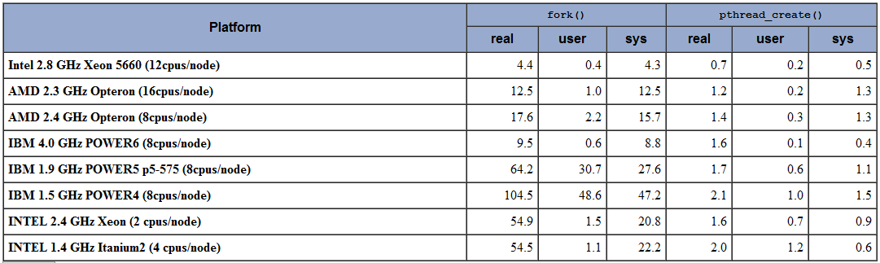
claude.tadonki@mines-paristech.fr claude.tadonki@u-psud.fr
MAIN MOTIVATIONS IN FAVOR OF THREADS
Because of the small system overhead for creating a threads (compare to a process), substancial performance gain is expected using threads whenever possible.
Since all threads within a process share the same memory address space, inter-threads communication is faster than inter-process communication.
Overlapping threads activities offers a great opportunity for (system) parallelism.
Dynamic scheduling (through priorities management) can help to optimise resources usage. Skillful programmer could really take advantage of this.
On supercomputers, local data transfers can avoided by using threads on multicore nodes. This also increases the “local memory” of the computing nodes.

Slide 13
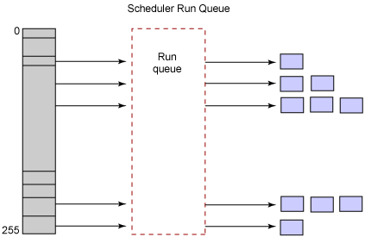
claude.tadonki@mines-paristech.fr claude.tadonki@u-psud.fr
THREAD SCHEDULING
Although threads are scheduled by the system using a predetermined mechanism, the programmer can explicitly set thread scheduling policies and priorities which may influence or override the default mechanisms.
In most cases, the default scheduling mechanism is sufficient. However, threads library provides several facilities to handle
and control the (non deterministic) scheduling of threads.
Among the policies used by the dispacher to assign threads to available CPU, we have:
FIFO (First In First Out)
simplest policy, but rarely used because of its non-preemptive nature.
a started thread runs all the way to completion, thus holding on the target CPU.
under special circumstances, a running thread can be asleep and releases the CPU.
Round robin
a scheduled thread shares the CPU timeslices with all other entries of the same priority.
a thread is scheduled to run until it uses up its timeslice (or is blocked for I/O).
SCHED_OTHER (dynamic and handled by the programmer)
How and when the aforementioned policies are appropriate (resp. inappropriate) ?

Slide 14
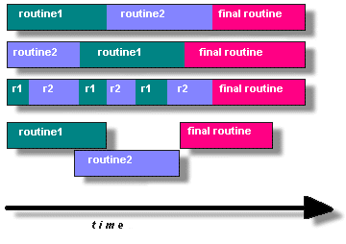

claude.tadonki@mines-paristech.fr claude.tadonki@u-psud.fr
BEHIND THREAD PROGRAMMING
A
In order for a given program to take advantage of Pthreads, it must be organized into independent tasks (sections or routines) which can be executed concurrently.
B
C
One could think about threading two routines if they can be interchanged, interleaved and/or overlapped.
Pthread is one way to implement parallelism, the programmer should care about fundamental aspect like parallel scheduling; load balancing; dependencies; concurrent accesses; memory issues; performance; programming effort;
The following characteristics should guide the choice of threading
presence of routines that can be executed simultaneously.
heavy I/O; unbalanced load; different priorities; interaction with external events;
Thread programming model includes
Manager/worker: a single thread (manager) assigns work to other threads (workers) ~ Peer
Pipeline: a task is broken into an interleaved series of suboperations assigned to #threads
Pthread can be used in serial programs to emulate parallel execution or control tasks priority
When it could it be useful to emulate parallel execution or play with tasks priority? Peer ?

Slide 15
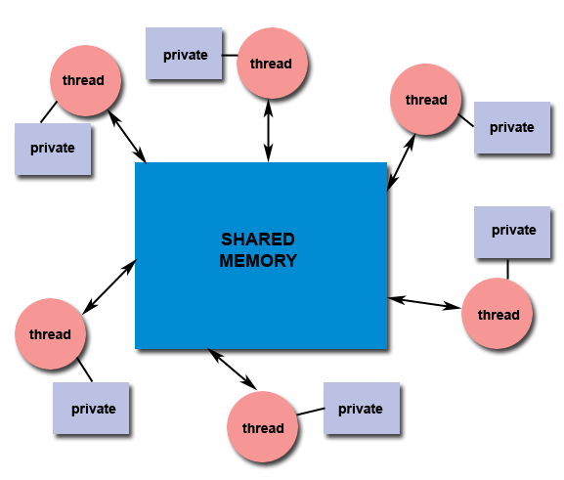
claude.tadonki@mines-paristech.fr claude.tadonki@u-psud.fr
CLOSE LOOK TO THE SHARED MEMORY MODEL
Thread programming is a shared memory programming paradigm
All threads have equal priority read/write access to the same global (shared) memory.
Threads also have their own private data. For a threaded routine, these are local variables for instance.
Programmer is responsible for synchronizing any write access (protection) to globally shared data.
Give some examples where unprotected concurrent accesses could yield a wrong result.
What could happen if the same variable is declared static in a multi-threaded routine ?

Slide 16
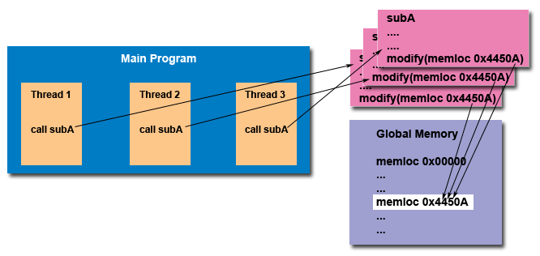
claude.tadonki@mines-paristech.fr claude.tadonki@u-psud.fr
THREAD SAFENESS AND COHERENCY
Since threads run concurrently and share critical resources, the programmer should be careful about safeness and coherency.
Typical situations include
Race conditions: Occur when multiple access has not been properly controlled.
Deadlock: cross-dependencies or a thread waiting for signal from another thread who will never send it (unexpectedly / if control).
Infinite loop: one thread enters a loop and expects to exit upon a condition (resp. event) which is kept unsatisfied (resp. invalidated) by actions performed by another thread.
Execution failure: one thread has opened a file and is still working on it while another thread tries to write on that file (this write access will fail).
Illustrate a “race condition” on the calculation c = a + c*d by two threads.
Explain why safeness is the responsibility of the programmer and how it makes parallel programming not a trivial task.

Slide 17
claude.tadonki@mines-paristech.fr claude.tadonki@u-psud.fr
The Pthread API
The original Pthreads API was defined in the ANSI/IEEE POSIX 1003.1 - 1995 standard.
The POSIX (Portable Operating System Interface) standard has continuously evolved. Implementations of the Pthreads API are available on many Unix-like POSIX-conformant operating systems (Linux, Mac OS X, Solaris), and also Microsoft Windows.
The Pthreads library contains hundred of routines that can be grouped into four categories:
Thread management: Routines to create, terminate, and manage the threads.
Mutexes: Routines for synchronization (through a “mutex” ≈ mutual exclusion ).
Condition variables: Routines for communications between threads that share a mutex.
Synchronization: Routines for the management of read/write locks and barriers.
All identifiers of the Pthreads routines and data types are prefixed with « pthread_ »
Example: pthread_create, thread_join, pthread_t, …
For portability, the pthread.h header file should be included in each source file
The generic compile command is « cc –lpthread » or « cc –pthread », cc = compiler
In which case do you think we should use « -lpthread » ? With including pthread.h ?
How could we easily recognize a Pthreaded program? What is required for the execution?

Slide 18
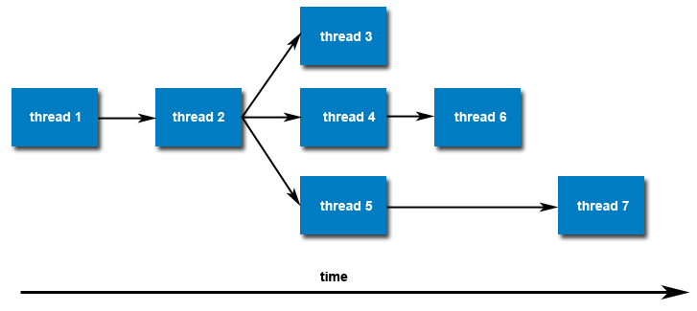
claude.tadonki@mines-paristech.fr claude.tadonki@u-psud.fr
Creating threads
Once created, threads are peers, and may create other threads. There is no a priori or implied hierarchy or dependency between threads.
A thread is created using a call to pthread_create (thread, attr, thread_routine, arg)
pthread_create arguments:
- thread: identifier of the created thread returned by the subroutine.
- attr: object that may be used to set thread attributes (NULL otherwise).
- thread_routine: pointer to the routine that the thread will execute once it is created.
- arg: single argument (pointer) that may be passed to thread_routine (NULL otherwise).
Example:
if(pthread_create(&threads[t], NULL, HelloWorld, (void *)t)) printf(“Thread created.”);
Your main() is the single default thread, other threads are create using pthread_create()
The maximum number of threads that can be create depends on the API and the system.
Once a thread is created, it becomes executable and can be scheduled by the system.
Can we create a thread from another thread ? Does a thread start just after created?
What do you think the thread identifier could be used for? What about thread attributes?

Slide 19
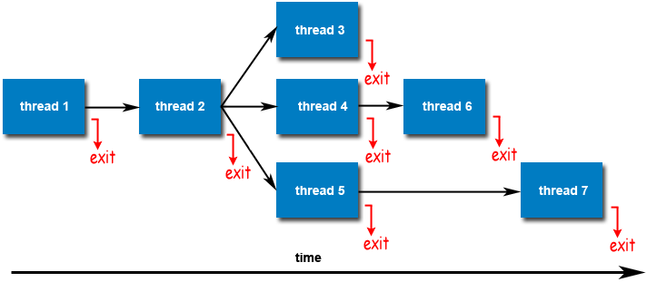
claude.tadonki@mines-paristech.fr claude.tadonki@u-psud.fr
Terminating threads
Upon completion (or not), a thread should be terminated (or cancelled). Otherwise, it will remain active until the end of the (parent) process.
A thread is terminated using a call to pthread_exit (status)
Example:
pthread_exit(NULL);
There are several ways in which a thread may be terminated
The thread returns normally to its starting routine. It's work is done.
The thread makes a call to the pthread_exit() (whenever and wherever).
The thread is canceled by another thread via a call to pthread_cancel().
The (parent) process is terminated by a call to either the exec() or exit()
If main() finishes first, without calling pthread_exit() explicitly itself
Calling pthread_exit() is not mandatory (unless the status parameter is needed)
The pthread_exit() does not cleanup anything (close opened files, free allocated memory, …)
Having main() calling pthread_exit() => wait for threads completion (interrupted otherwise)
What could happen if a routine who has created a thread does not care about its termination?

Slide 20
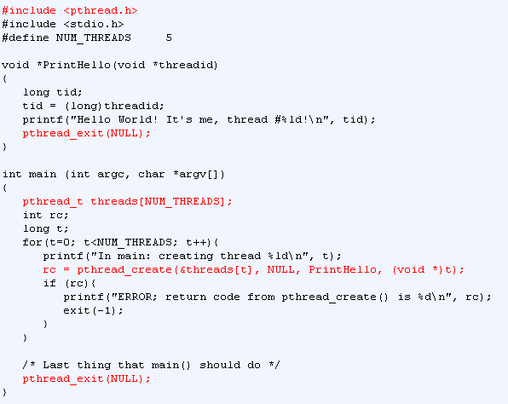
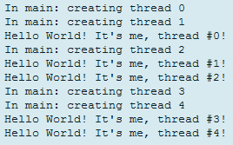
claude.tadonki@mines-paristech.fr claude.tadonki@u-psud.fr
Basic threaded program

Slide 21
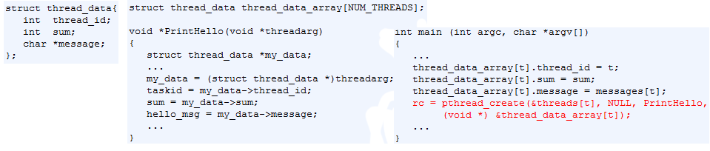

claude.tadonki@mines-paristech.fr claude.tadonki@u-psud.fr
Passing arguments to thread
The pthread_create() routine permits the programmer to pass one argument to the thread’s routine.
For cases where multiple arguments need to be passed, the problem is solved by creating a structure which contains all of the arguments, and then passing a pointer to that structure (always cast to (void *)) as the arg argument of the pthread_create() routine.
Example:
As the thread argument is a pointer, we should care about not having the same memory location modfied by another thread (or the main).
Could you exhibit one case where the thread data could be corrupted before considered ?
Design an appropriate thread structure for a block (resp. cyclic) partitioning of an array.

Slide 22
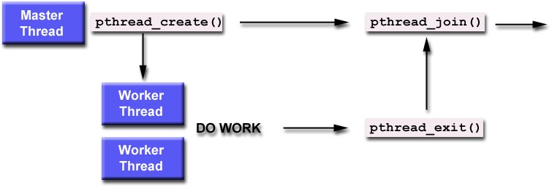

claude.tadonki@mines-paristech.fr claude.tadonki@u-psud.fr
Joining and Detaching Threads
“Joining” is one way to implement synchronization between threads. It is relevant only when the threads has terminated.
A thread can wait for the completion of another thread by issuing the command pthread_join (thread_id, &thread_status), where thread_id (resp. thread_status) is the identifier (resp. the returned status) of the awaited thread. It is a blocking command.
A thread should have called pthread_exit() to be able to “respond” to any pthread_join().
A joining thread cannot call pthread_join() twice on the same target thread (logical error).
The typical sequence used by the main() to wait for its threads is the following:
for(t=0; t<NUM_THREADS; t++){
if(pthread_join(thread[t], &status))
printf(“Thread %ld joined with status %ld\n",t,(long)status);
else printf("ERROR; return code from pthread_join() is %d\n", rc);
}
In the pthread_join() loop, does the order impact the completion time of the main() ?
Is there any effect of pthread_join() the on the target thread ?
Do we always need to call pthread_join() ?.

Slide 23
claude.tadonki@mines-paristech.fr claude.tadonki@u-psud.fr
Joining and Detaching Threads
When a thread is created, one of its attributes defines whether it is joinable or detached. Only threads that are created as joinable can be joined. If a thread is created as detached, it can never be joined.
The current POSIX standard specifies that threads should be created as joinable (default).
To explicitly create a thread as joinable or detached, the attr argument of pthread_create() is used. The typical sequence is the following:
Declare a pthread attribute variable of the pthread_attr_t data type
Initialize the attribute variable with pthread_attr_init()
Set the attribute detached status with pthread_attr_setdetachstate()
When done, free library resources used by the attribute with pthread_attr_destroy()
pthread_attr_t attr;
pthread_attr_init(&attr);
pthread_attr_setdetachstate(&attr, PTHREAD_CREATE_JOINABLE); if(pthread_create(&th_ptr, &attr, Work, (void *)t)) printf(“Thread created");
The pthread_detach() can be used to explicitly detach a thread (even created as joinable).
What are your recommendations for setting a thread as joinable or not?
When do you think it might be useful to detach a thread ?

Slide 24
claude.tadonki@mines-paristech.fr claude.tadonki@u-psud.fr
Joining and Detaching Threads
#include <pthread.h>
#include <stdio.h>
#include <stdlib.h>
#define NUM_THREADS 4
void *BusyWork(void *t)
{
int i;
long tid;
double result=0.0;
tid = (long)t;
printf("Thread %ld starting...\n",tid);
for(i = 0; i < 1000000; i++)
{
result = result + sin(i) * tan(i);
}
printf("Thread %ld done. Result = %e\n",
tid, result);
pthread_exit((void*) t);
}
int main (int argc, char *argv[])
{
pthread_t thread[NUM_THREADS];
pthread_attr_t attr;
int rc;
long t;
void *status;
/* Initialize and set thread detached attribute */
pthread_attr_init(&attr);
pthread_attr_setdetachstate(&attr, PTHREAD_CREATE_JOINABLE);
for(t = 0; t < NUM_THREADS; t++) {
printf("Main: creating thread %ld\n", t);
rc = pthread_create(&thread[t], &attr, BusyWork, (void *)t);
if (rc) {
printf("ERROR; return code from pthread_create() is %d\n", rc);
exit(-1);
}
}
/* Free attribute and wait for the other threads */
pthread_attr_destroy(&attr);
for(t = 0; t < NUM_THREADS; t++) {
rc = pthread_join(thread[t], &status);
if (rc) {printf(« ERROR: pthread_join() is %d\n", rc); exit(-1);}
printf(« Join with thread %ld with status %ld\n",t,(long)status);
}
/* All the threads have terminated, now we are done */
printf("Main: program completed. Exiting.\n");
pthread_exit(NULL);
}

Slide 25
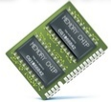

claude.tadonki@mines-paristech.fr claude.tadonki@u-psud.fr
Handling Threads Stack
Each created thread has a stack to store “its” data. The size of this stack depends on the API implementation and is variable.
Exceeding the (default) stack limit can easily happen, with the consequence of program termination and/or corrupted data
Safe and portable programs do not depend upon the default stack parameter (address and limit), but instead, the programmer should prepare to apply appropriate settings.
The pthread_attr_setstacksize() routine can be used to explicitly allocate enough stack.
The pthread_attr_getstackaddr() returns the address of the thread stack
The pthread_attr_getstackaddr() returns the size of the thread stack
pthread_attr_t attr;
size_t mystacksize, stacksize = 10000*sizeof(double);
pthread_attr_getstacksize(&attr, &mystacksize);
printf("Thread’s stack size = %li bytes \n", mystacksize);
pthread_attr_setstacksize(&attr, stacksize);
pthread_create(&threads[t], &attr, myroutine, (void *)t);
What are typical programming mistakes that can lead to a stack overflow?

Slide 26
claude.tadonki@mines-paristech.fr claude.tadonki@u-psud.fr
Handling Threads Stack
#include <pthread.h>
#include <stdio.h>
#define NTHREADS 4
#define N 1000
#define MEGEXTRA 1000000
pthread_attr_t attr;
void *dowork(void *threadid)
{
double A[N][N];
int i,j;
long tid;
size_t mystacksize;
tid = (long)threadid;
pthread_attr_getstacksize(&attr, &mystacksize);
printf("Thread %ld: stack size = %li bytes \n",
tid, mystacksize);
for(i=0; i<N; i++)
for(j=0; j<N; j++)
A[i][j] = ((i*j)/2.0) + (N-i);
pthread_exit(NULL);
}
int main(int argc, char *argv[])
{
pthread_t threads[NTHREADS];
size_t stacksize;
int rc;
long t;
pthread_attr_init(&attr);
pthread_attr_getstacksize(&attr, &stacksize);
printf("Default stack size = %li\n", stacksize);
stacksize = sizeof(double)*N*N+MEGEXTRA;
printf("Amount of stack needed per thread = %li\n",stacksize);
pthread_attr_setstacksize(&attr, stacksize);
printf("Creating threads with stack size = %li bytes\n",stacksize);
for(t=0; t<NTHREADS; t++){
rc = pthread_create(&threads[t], &attr, dowork, (void *)t);
if (rc){
printf("ERROR; return code from pthread_create() is %d\n", rc);
exit(-1);
}
}
printf("Created %ld threads.\n", t);
pthread_exit(NULL);
}

Slide 27
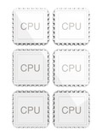
claude.tadonki@mines-paristech.fr claude.tadonki@u-psud.fr
Miscellaneous Threads Routines
pthread_self() returns the unique (system assigned) thread ID of the current thread.
The pthread_equal(th1, th2) compares two thread IDs (th1 and th2), returns 0 if equal.
The pthread_once(once_param, init_routine) executes init_routine() exactly once within the process. The first call to this routine by any thread within the process executes the given init_routine(), without parameters.
Any subsequent call will be ignored.
The init_routine() is typically an initialization or checking routine
The once_param parameter is a synchronization control structure that should be initialized before calling pthread_once().
Example: pthread_once_t once_control = PTHREAD_ONCE_INIT;
How could we use the pthread_self() routine?
Why was it necessary to have the pthread_once() routine?
In what kind of situations could we need to compare two thread IDs?

Slide 28
claude.tadonki@mines-paristech.fr claude.tadonki@u-psud.fr
Mutex Variables
We mentioned the pthread_join() routine as a way synchronize threads. But it’s external.
Mutex (MUTual EXclusion) is used to protect shared data, thus a way to synchronize inside threads.
Only one thread can lock (or own) a mutex variable at any given time.
If several threads try to lock (or get) a mutex, only one thread will succeed, the remaining threads will be blocked while waiting their turn (critical section).
Mutexes can be used to prevent “race” conditions, like when updating a shared variable,
Thread 1 | Thread 2 | Balance
Read balance: 5000 |  | 5000
 | Read balance: 1000 | 5000
 | Deposit 2000 | 5000
Deposit 1000 |  | 5000
Update balance 5000 + 1000 |  | 6000
 | Update balance 5000 + 2000 | 7000
Instead of 8000!
In the above example, a mutex should be used to lock the “Balance” when used by a thread.
An unblocking call (to get the mutext) is available with "trylock" instead of the "lock" call.
Describe other situations where a mutex is required.
In what kind of situation could we use a non blocking call to get the mutex?

Slide 29
claude.tadonki@mines-paristech.fr claude.tadonki@u-psud.fr
Creating and Destroying Mutexes
A typical sequence when using a mutex is as follows:
Create and initialize a mutex variable
Several threads attempt to lock the mutex
Only one succeeds and that thread owns the mutex
The owner thread performs some set of actions
The owner unlocks the mutex
Another thread acquires the mutex and repeats the process
Finally the mutex is destroyed
Mutex variables are declared with type pthread_mutex_t and is initially unlocked
Static declaration: pthread_mutex_t mymutex = PTHREAD_MUTEX_INITIALIZER;
Dynamic construction: pthread_mutex_init(pthread_mutex_t *mutex, pthread_mutexattr_t *attr)
The pthread_mutexattr_init(attr) routine is used to create mutex attribute objects
The pthread_mutexattr_destroy(attr) routine is used to destroy mutex attribute objects
The pthread_mutex_destroy(attr) routine is used to free a mutex object no longer needed
Where should we create and destroy the mutex ?.
Ca we use the same mutex at different places within a thread ?

Slide 30
claude.tadonki@mines-paristech.fr claude.tadonki@u-psud.fr
Locking and Unlocking Mutexes
The pthread_mutex_lock(pthread_mutex_t *mutex) routine is used by a thread to acquire a lock on the specified mutex variable. If the mutex is already locked by another thread, this call will block the calling thread until the mutex is unlocked.
The pthread_mutex_trylock(pthread_mutex_t *mutex) routine is used by a thread to also acquire a lock on the specified mutex variable. However, if the mutex is already locked by another thread, the routine will return immediately with a "busy" error code. Thus, this is an unblocking attempt to get a lock on a mutex.
The pthread_mutex_unlock(pthread_mutex_t *mutex) is used to unlock a mutex. ERROR if
If the mutex was already unlocked
If the mutex is owned by another thread
The threads that need to update concurrently a shared variable should all make a lock and unlock calls on the corresponding mutex.
pthread_mutex_t mutexsum;
pthread_mutex_lock(&mutexsum);
total_sum += thread_sum;
pthread_mutex_unlock(&mutexsum);
What about the order in which the lock on the mutex is granted to the threads ?
What would happen if a thread having a lock on a mutex does not unloack it ?

Slide 31
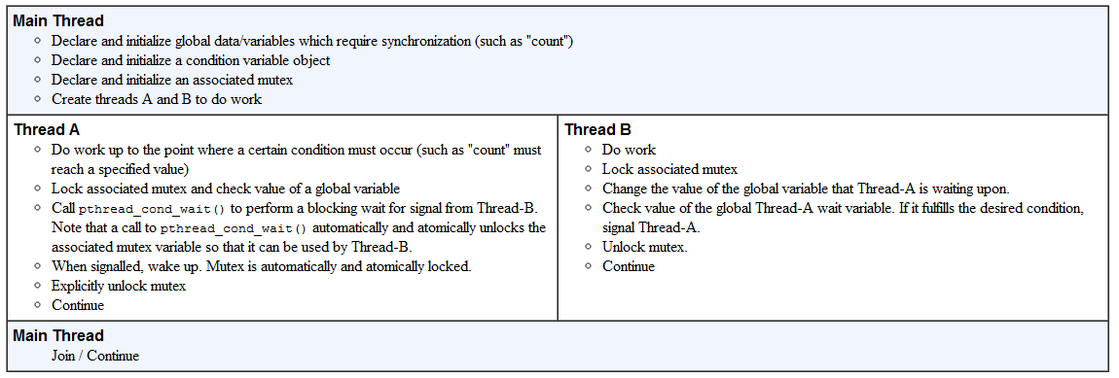
claude.tadonki@mines-paristech.fr claude.tadonki@u-psud.fr
Condition Variables
pthread_join() and mutexes are used for systematic synchronizations.
Condition variables allow threads to synchronize based on the actual value of variables.
Without condition variables, the programmer would need to make threads continually polling (possibly in a critical section), to check if the condition is met. This makes the threads being unnecessarily busy.
A condition variable is always used in conjunction with a mutex lock.
A representative sequence for using condition variables

Slide 32
claude.tadonki@mines-paristech.fr claude.tadonki@u-psud.fr
Creating and Destroying Condition Variables
Condition variables are declared with type pthread_cond_t and must be initialized before used
Static declaration: pthread_cond_t myconvar = PTHREAD_COND_INITIALIZER;
Dynamic construction: pthread_cond_init(pthread_cond_t *cond, pthread_condattr_t *attr)
The ID of the created condition variable is returned through the condition parameter
The attr object is optional and can be used to set condition variables attributes (process-shared)
The pthread_condattr_init(attr) routine is used to create condition variable attribute objects
The pthread_condattr_destroy(attr) will destroy condition variable attribute objects
The pthread_cond_destroy(attr) routine is used to free a condition variable no longer needed

Slide 33
claude.tadonki@mines-paristech.fr claude.tadonki@u-psud.fr
Waiting and Signaling on Condition Variables
The pthread_cond_wait(cond, mutex) will block the calling thread until cond is signalled
called while mutex is locked, and it will automatically release the mutex while it waits
after signal is received, mutex will be automatically locked for its use by the thread
The programmer is then responsible for unlocking mutex when no longer needed
The pthread_cond_signal(cond) routine is used to signal (or wake up) another thread which is waiting on the condition variable.
called after mutex is locked
must unlock mutex in order for pthread_cond_wait() routine to complete.
pthread_cond_wait() should always precede pthread_cond_signal()
Failing to lock the mutex before calling pthread_cond_wait() may cause it NOT to block.
Failing to unlock the mutex after calling pthread_cond_signal() will make a matching pthread_cond_wait() not to complete (it will remain blocked).
Describe one situation where using a condition variable is appropriate.
Exhibit some configuration that can led to a deadlock.

Slide 34
claude.tadonki@mines-paristech.fr claude.tadonki@u-psud.fr
Waiting and Signaling on Condition Variables
#include <pthread.h>
#include <stdio.h>
#include <stdlib.h>
#define NUM_THREADS 3
#define TCOUNT 10
#define COUNT_LIMIT 12
int count = 0;
int thread_ids[3] = {0,1,2};
pthread_mutex_t count_mutex;
pthread_cond_t count_threshold_cv;
void *inc_count(void *t)
{
int i;
long my_id = (long)t;
for(i=0; i<TCOUNT; i++) {
pthread_mutex_lock(&count_mutex);
count++;
/*
Check the value of count and signal waiting thread when condition is
reached. Note that this occurs while mutex is locked.
*/
if(count == COUNT_LIMIT) {
pthread_cond_signal(&count_threshold_cv);
printf("inc_count(): thread %ld, count = %d Threshold reached.\n", my_id, count);
}
printf("inc_count(): thread %ld, count = %d, unlocking mutex\n", my_id, count);
pthread_mutex_unlock(&count_mutex);
/* Do some "work" so threads can alternate on mutex lock */
sleep(1);
}
pthread_exit(NULL);
}

Slide 35
claude.tadonki@mines-paristech.fr claude.tadonki@u-psud.fr
Waiting and Signaling on Condition Variables
void *watch_count(void *t)
{
long my_id = (long)t;
printf("Starting watch_count(): thread %ld\n", my_id);
/*
Lock mutex and wait for signal. Note that the pthread_cond_wait
routine will automatically and atomically unlock mutex while it waits.
Also, note that if COUNT_LIMIT is reached before this routine is run by
the waiting thread, the loop will be skipped to prevent pthread_cond_wait
from never returning.
*/
pthread_mutex_lock(&count_mutex);
while(count<COUNT_LIMIT) {
pthread_cond_wait(&count_threshold_cv, &count_mutex);
printf("watch_count(): thread %ld Condition signal received.\n", my_id);
count += 125;
printf("watch_count(): thread %ld count now = %d.\n", my_id, count);
}
pthread_mutex_unlock(&count_mutex);
pthread_exit(NULL);
}

Slide 36
claude.tadonki@mines-paristech.fr claude.tadonki@u-psud.fr
Waiting and Signaling on Condition Variables
int main (int argc, char *argv[])
{
int i, rc;
long t1=1, t2=2, t3=3;
pthread_t threads[3];
pthread_attr_t attr;
/* Initialize mutex and condition variable objects */
pthread_mutex_init(&count_mutex, NULL);
pthread_cond_init(&count_threshold_cv, NULL);
/* For portability, explicitly create threads in a joinable state */
pthread_attr_init(&attr);
pthread_attr_setdetachstate(&attr, PTHREAD_CREATE_JOINABLE);
pthread_create(&threads[0], &attr, watch_count, (void *)t1);
pthread_create(&threads[1], &attr, inc_count, (void *)t2);
pthread_create(&threads[2], &attr, inc_count, (void *)t3);
/* Wait for all threads to complete */
for(i=0; i<NUM_THREADS; i++) {
pthread_join(threads[i], NULL);
}
printf("Main(): Waited on %d threads. Done.\n", NUM_THREADS);
/* Clean up and exit */
pthread_attr_destroy(&attr);
pthread_mutex_destroy(&count_mutex);
pthread_cond_destroy(&count_threshold_cv);
pthread_exit(NULL);
}

Slide 37


claude.tadonki@mines-paristech.fr claude.tadonki@u-psud.fr

