Slide 1
ONE-DAY WORKSHOP · 09:30 – 10:00
AI-Assisted Game Development
A first scene from scratch in the morning, the inside of a living game in the afternoon — one day
Prepared for Panteon Games — Codeo
Codeo · Panteon Games — Opening

Slide 2
MEASUREMENT
We record the baseline today — in 90 days we compare
T1
T2
T3
%
Development time
Art production time
Bug resolution time
Approval rejection rate
Average time from idea to merged code
From request to approved asset
From report to verified fix
Failing approval on the first pass
The baseline metrics template is being handed out now — team leads fill in current values at the end of the day.
Codeo · Panteon Games — Opening

Slide 3



CORE PRINCIPLE
“Tools do the producing; people make the final call.”
Art approval gate
Code review
Provenance record
Every generated image and model passes through the art director's formal approval gate.
No agent-authored change merges to the main branch without review.
Which tool, which model, which prompt — all generated content is kept on record (provenance).
Codeo · Panteon Games — Opening

Slide 4
THE ARC OF THE DAY
In the morning you build from an empty scene; in the afternoon you work inside 4,800 lines you did not write.
From scratch
Discovery and intervention
Proof
Morning: from an empty scene to a playable game with Unity CLI — eval, the agent in plan mode, prefabs.
Afternoon: mapping a foreign codebase and extending it without breaking it — data, features, content.
The rule does not change: no fix until the root cause is proven, and no proof means not done.
Codeo · Panteon Games — Opening

Slide 5
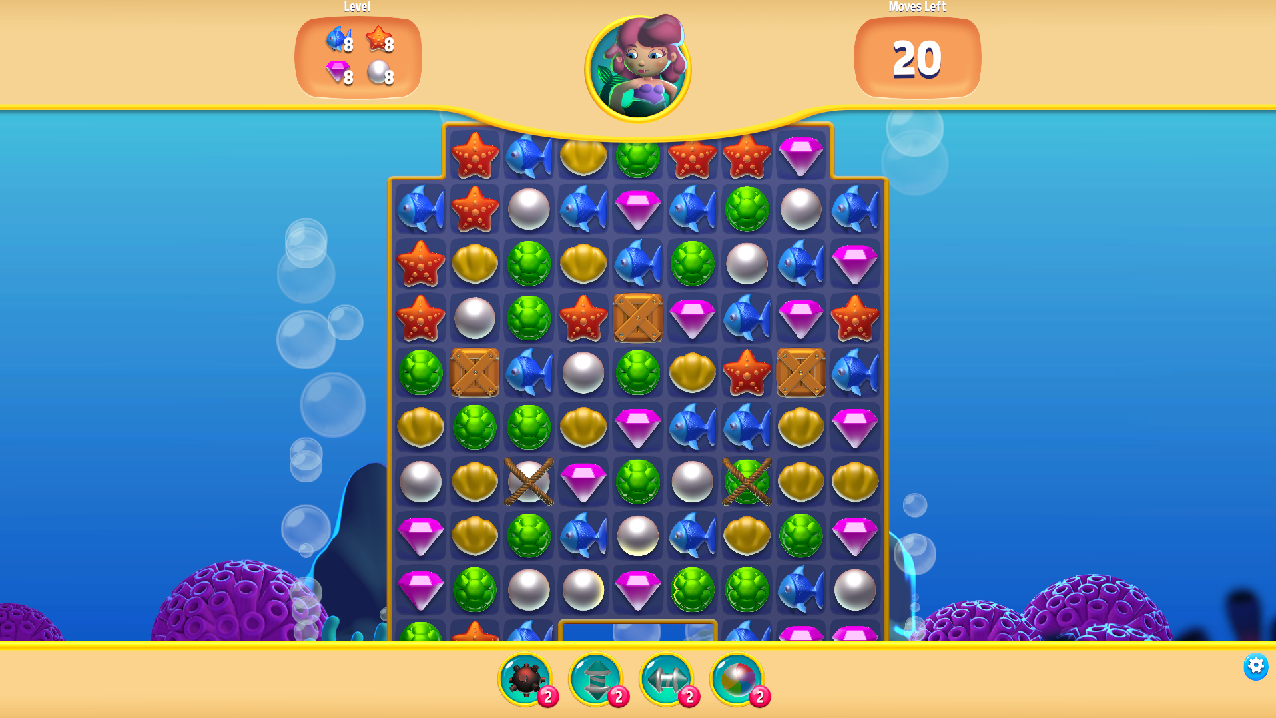
TODAY'S GAME
Gem Hunter Match — Unity's official match-3 sample
A slice of real production quality: board logic, boosters, a shop, 3 levels, a 2D lighting and VFX showcase.
~4,800 lines of C#, 34 scripts — graspable but real. The closest scale to Panteon's daily work.
Licensed to your account from the Asset Store; source records and provenance are complete.
The engineering track extends the game and hunts bugs; the art track reskins the same game in the studio style.
In the workshop project, running in a CLI-connected editor
Codeo · Panteon Games — Opening

Slide 6
TODAY'S SCHEDULE
From CLI-from-scratch to living code — one day
Time | Session | Who
09:30 – 10:00 | Opening: foundations, art approval, baseline metrics + meeting Gem Hunter | All teams
10:00 – 11:00 | Unity CLI from scratch: the three layers + your first scene, hands-on (Coin Rush) | All teams
11:15 – 12:30 | The agent in foreign code: techniques + live demo BUG-312 | All teams
13:30 – 15:00 | Track A: Gem Hunter engineering lab (compressed) | Engineering + DevOps
15:15 – 16:45 | Track B: Reskinning Gem Hunter in the studio style | Art + Tech Art
16:45 – 17:30 | Closing: the combined game, metrics, next steps | All teams
Codeo · Panteon Games — Opening

