Slide 1
TRACK A · 13:30 – 15:00 · ENGINEERING + DEVOPS
Coin Rush: Unity CLI Game Lab
An end-to-end mobile mini game in 9 exercises, side by side with the agent
Prepared for Panteon Games — Codeo · August 2026
Codeo · Panteon Games — Track A: Coin Rush Lab

Slide 2
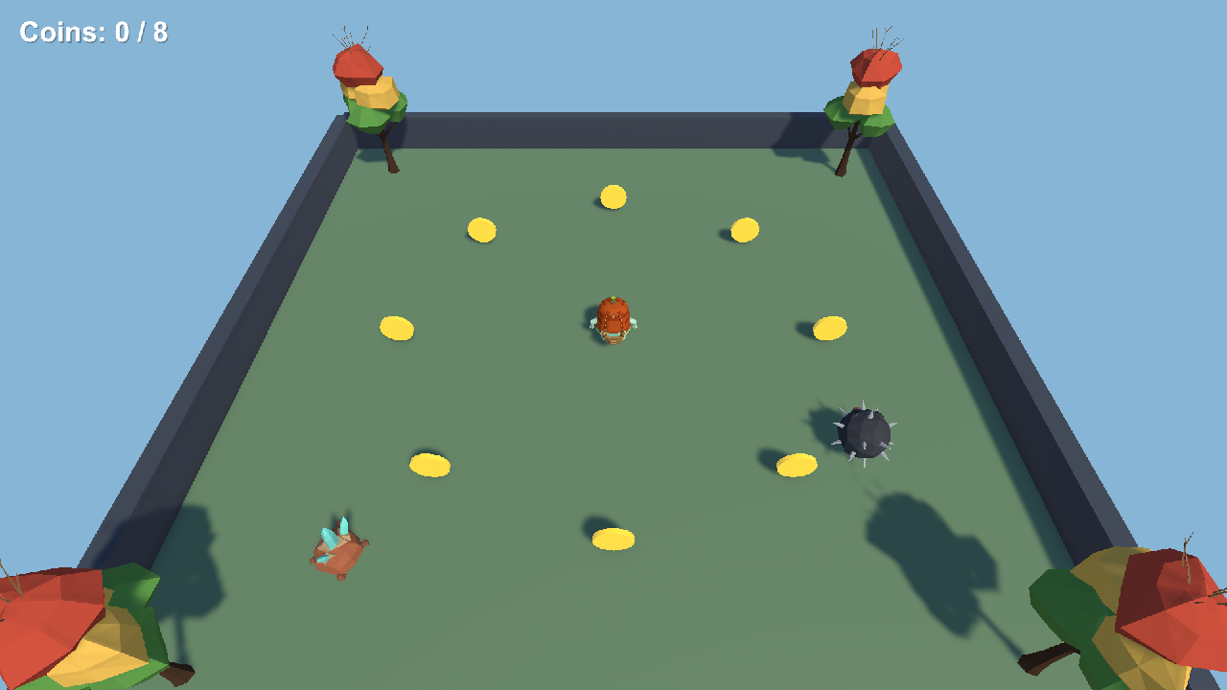
THE GAME YOU BUILD TODAY
Coin Rush — a mini mobile game with real assets
A robot character roams the arena collecting 8 coins — without getting caught by the patrolling mine.
Score, win/lose screens, a magnet power-up and an iOS build — all today, all from the terminal.
Art comes from Polyfork; every asset's provenance is recorded in _Shared/Art/SOURCES.md — the provenance principle from this morning, applied.
The compressed flow: Ex01, Ex02, Ex06 and Ex07 hands-on; Ex03–Ex05 and Ex09 as fast instructor demos; Ex08 briefed for after the workshop.
Verified end state: workshop_validate PASS · the game is won with 8/8 coins
Codeo · Panteon Games — Track A: Coin Rush Lab

Slide 3
THE MAP
9 exercises, one game
# | Folder | What we build | Skill taught
01 | SceneSetup | Ground + player | unity status · command discovery · creating objects with eval
02 | Movement | Movement script | Having the agent write code in plan mode · the CLAUDE.md contract
03 | Coins | Coin prefab + ring | Prefab workflow · live scene queries with eval
04 | Score | Score UI + win | Coordinated multi-file change from a single request
05 | Hazard | Mine patrol + lose | Iterating on behavior with follow-up prompts
06 | BugHunt | The BUG-201 fix | Reproduce · prove the root cause · fix · prove it again
07 | CliCommand | The workshop_validate command | Opening a studio tool to the CLI and to agents
08 | Magnet | Magnet power-up | Solo flight: from ticket to verified feature
09 | MobileBuild | iOS build | Async build from the live editor · the road to CI
Timing: 10 min environment check + 4 hands-on core exercises + demos ≈ 90 minutes.
Codeo · Panteon Games — Track A: Coin Rush Lab

Slide 4




NO ONE FALLS BEHIND
The sync-point model: if you miss one, open the next and catch up
The sync rule
At the start of every exercise EVERYONE opens that exercise's Start scene — whether you finished or fell behind, you begin from the same point. Nobody restores anything.
Snapshot folders
The Assets/Workshop/ExNN folder carries a Start scene equal to the finished state of the previous exercise; the solutions are therefore always at hand.
Conflict-free copies
Each folder's scripts compile in their own assembly (Workshop.Ex05, Workshop.Ex06…). Ten snapshots of the same game live side by side in one project.
The disaster button
If a machine breaks, WorkshopBuilder regenerates all scenes and prefabs: Workshop > Build All Checkpoints.
Codeo · Panteon Games — Track A: Coin Rush Lab

Slide 5
BLOCK 1 · 13:40 – 14:15
Ex01 – Ex03: from CLI to agent
1
Ex01 — Meeting the CLI
unity status, the command list; you create the ground and the player from the terminal with eval. No mouse.
2
Ex02 — The agent writes the first script
PlayerController in plan mode: no file is written until you approve the plan; the result is tested in play mode.
3
Ex03 — Coins
Demo: the coin prefab and the ring of 8; the remaining coins are counted from the terminal with eval — the core muscle of bug hunting.
Codeo · Panteon Games — Track A: Coin Rush Lab

Slide 6
DEMO · 14:15 – 14:25
Ex04 – Ex05: features and iteration
1
Ex04 — Score and winning
One request, four moving parts: ScoreManager, GameManager, the CoinPickup change and UI — a rehearsal of multi-file work with the agent.
2
Ex05 — The mine and losing
The first prompt is not the final behavior: you change speed and route with follow-up prompts. Iteration is cheap; demanding perfection up front is not.
After the demo the scene opens with a QA report — Ex06 is in your hands.
Codeo · Panteon Games — Track A: Coin Rush Lab

Slide 7
EX06 · 14:25 – 14:45
Bug hunt: the rule — no fix until the root cause is proven
This morning's loop, now in your hands
BUG-201 · QA REPORT
The Ex06 scene ships with a real QA report: some coins award 2 points; the counter can show 9/8
If the agent tries to patch the symptom (cap the score, add a cooldown) REJECT the plan
Proof: two trigger colliders on the coin prefab — eval says 2, it should be 1
Minimal fix + verification with the same proof: a full run ends at 8/8
"Sometimes a coin gives 2
points instead of 1. The
counter can show 9/8 after
collecting everything.
No console errors."
— QA, on device, intermittent
Codeo · Panteon Games — Track A: Coin Rush Lab
Notes:
Most common mistake: the agent hides the symptom by adding a 'collected' flag. Stop any student who skips the root-cause proof and point them to eval.

Slide 8


EX07 – EX08 · 14:45 – 14:55
Write a tool, then fly solo
Ex07 — workshop_validate
Ex08 — FEAT-77, no template
Your own CLI command: a level validator that audits the scene. Registered with the [CliCommand] attribute; it shows up in the unity command list. Sabotage test: move the player to x=50 and the command must turn red.
Today just the briefing: you get the acceptance criteria (magnet, 5 s, radius ~4) — fly this one solo after the workshop. Your validator must stay green.
Codeo · Panteon Games — Track A: Coin Rush Lab

Slide 9
EX09 · DEMO · 14:55 – 15:00
iOS build from the terminal
The live editor builds asynchronously
COMMANDS
No second Unity opens: the build command goes to the running editor, and you follow it with build_status
The CI version of the same job: unity build on a closed project + a service account — this morning's story, practiced
The first iOS export takes a few minutes; we read the BuildReport while it runs
An error at the Xcode signing step is fine today: the exercise is the pipeline, not the provisioning profile
$ unity command build \
--target iOS \
--outputPath Builds/iOS-Ex09 \
--scenes .../Ex09_Start.unity
$ unity command build_status
→ completed · BuildReport
Codeo · Panteon Games — Track A: Coin Rush Lab

Slide 10




RULES OF THE GAME
Three rules for the whole day + the closing deliverable
CLAUDE.md boundaries
The agent touches only the exercise folder you are working in; Start scenes and _Shared never change. If a plan crosses that line, reject it.
No proof, no done
Every exercise's 'Verify' section runs from the terminal: without eval output, a command result or play-mode proof, it does not count as complete.
When stuck, in this order
First the exercise README, then the solution in the next folder, then the instructor. Missed one? Open the next Start scene — you are caught up.
Deliverable for the closing (16:40)
One bug→fix loop with proof + your workshop_validate command; the iOS build report comes from the demo. Write your T3 observation into the metrics template.
Codeo · Panteon Games — Track A: Coin Rush Lab

