Slide 1
ADVANCED WORKSHOP · 09:30 – 10:00
AI in a Real Codebase
The advanced workshop — this time not from scratch, but inside a living game
Prepared for Panteon Games — Codeo · Advanced Workshop
Codeo · Panteon Games — Advanced Workshop: Opening

Slide 2
WHERE WE CAME FROM
90 days since the first workshop: let's look at the metrics together
T1
T2
T3
%
Development time
Art production time
Bug resolution time
Approval rejection rate
Change against the baseline recorded in the first workshop
From request to approved asset
From report to verified fix
Failing approval on the first pass
Values are filled in from the table the team champions bring at the start of the session — this slide is for live discussion.
Codeo · Panteon Games — Advanced Workshop: Opening

Slide 3



WHAT'S DIFFERENT TODAY
You wrote Coin Rush from scratch. Today you work inside 4,800 lines you did not write.
Discovery
Intervention
Proof
Having the agent map a foreign codebase — and verifying its claims.
Extending someone else's system without breaking it: data, features, content.
The rule has not changed: no fix until the root cause is proven, and no proof means not done.
Codeo · Panteon Games — Advanced Workshop: Opening

Slide 4
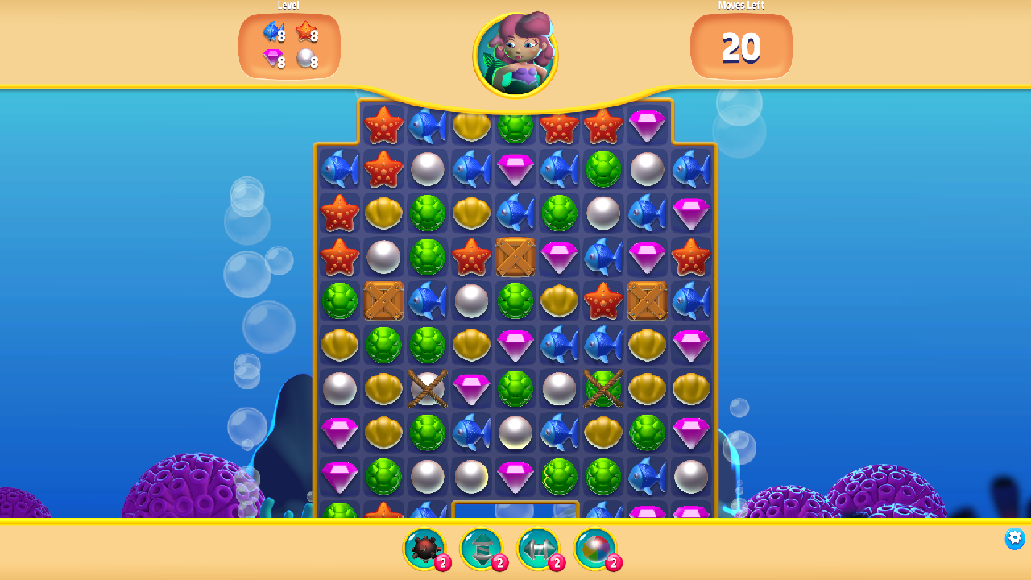
TODAY'S GAME
Gem Hunter Match — Unity's official match-3 sample
A slice of real production quality: board logic, boosters, a shop, 3 levels, a 2D lighting and VFX showcase.
~4,800 lines of C#, 34 scripts — graspable but real. The closest scale to Panteon's daily work.
Licensed to your account from the Asset Store; source records and provenance are complete, as in the first workshop.
The engineering track extends the game and hunts bugs; the art track reskins the same game in the studio style.
In the workshop project, running in a CLI-connected editor
Codeo · Panteon Games — Advanced Workshop: Opening

Slide 5
TODAY'S SCHEDULE
The advanced workshop — one day
Time | Session | Who
09:30 – 10:00 | Opening: the 90-day review + meeting Gem Hunter | All teams
10:00 – 10:45 | The agent in a foreign codebase: techniques + git checkpoints | All teams
11:00 – 12:30 | Live demo: BUG-312 — from discovery to a proven fix | All teams
13:30 – 16:45 | Track A: Gem Hunter engineering lab (9 exercises) | Engineering + DevOps
13:30 – 16:45 | Track B: Reskinning Gem Hunter in the studio style | Art + Tech Art
16:45 – 17:30 | Closing: the combined game, metrics, next steps | All teams
Codeo · Panteon Games — Advanced Workshop: Opening

