Slide 1
TRACK A · 13:30 – 16:45 · ENGINEERING + DEVOPS
The Gem Hunter Lab
9 exercises: understand » extend » hunt bugs » ship — in foreign code
Prepared for Panteon Games — Codeo · Advanced Workshop
Codeo · Panteon Games — Advanced Workshop Track A: The Gem Hunter Lab

Slide 2
THE MAP
9 exercises, one living game
# | Exercise | What you do | Skill taught
01 | Recon | Produce ARCHITECTURE.md | Code archaeology; verifying the agent's claims
02 | Contract | Write the real CLAUDE.md | Turning discovery into rules
03 | LevelData | Make Level 2 harder | Data-driven change; eval on the live board
04 | ComboCounter | Add a combo counter | Finding and using existing hooks
05 | NewGem | The 7th gem: Amethyst | Extending someone else's system correctly
06 | BugHunt | Solve BUG-312 | Root-cause proof in foreign code
07 | LevelLint | The level_lint command | A studio tool for the content pipeline
08 | CrossBomb | FEAT-88, no template | From ticket to proven feature, solo
09 | Build | iOS build from the terminal | Reading the build preprocessor; the road to CI
The rhythm is the same: 5 min demo + 5–10 min your turn + verification from the terminal. Details in the Workshop/Ex0N_*.md files (in English).
Codeo · Panteon Games — Advanced Workshop Track A: The Gem Hunter Lab

Slide 3
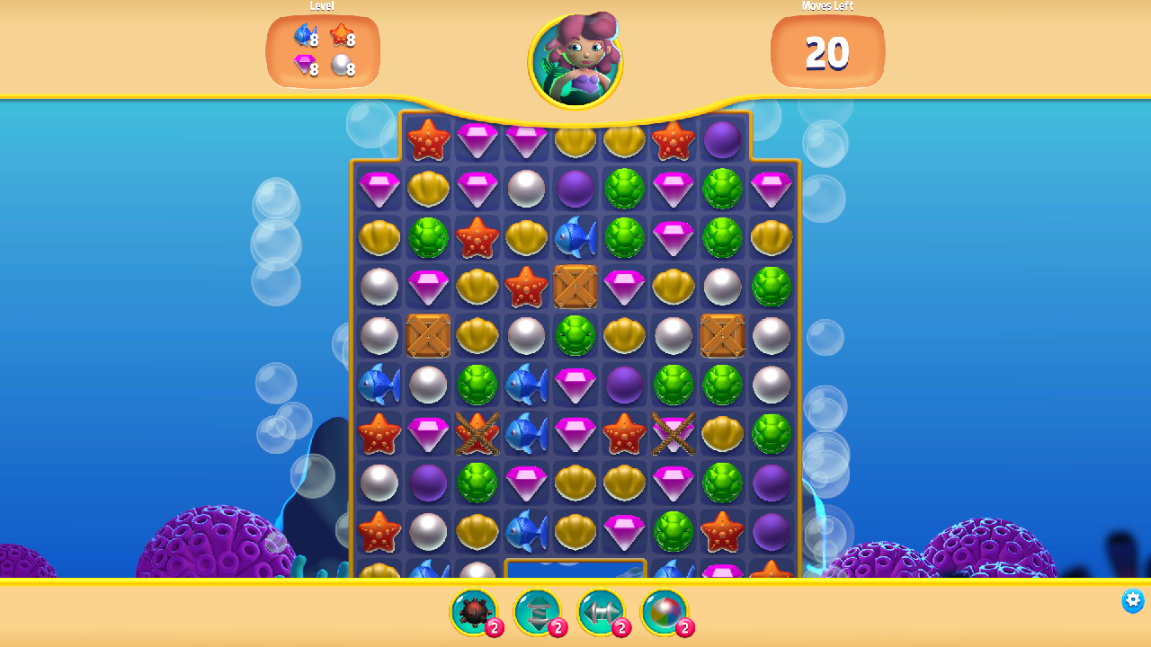
YOUR GAME AFTER EX05
A seventh gem on the board: Amethyst
The purple pearl — GemType 6 — registered into Level 1's gem mix through the CLI; not a single line of C# changed.
The next exercise's scene also carries BUG-312: the counter drops even on a bounced-back swap.
The proof uses the same command: eval 'Match3.LevelData.Instance.RemainingMove'.
The ex06-start checkpoint: purple Amethysts on the board
Codeo · Panteon Games — Advanced Workshop Track A: The Gem Hunter Lab

Slide 4
BLOCK 1 · 13:45 – 14:45
Ex01 – Ex04: understand, then the first touch
1
Ex01 — Recon
The agent maps the architecture into ARCHITECTURE.md; you verify two claims against the source. A wrong attribution = make it correct itself.
2
Ex02 — Contract
The stub CLAUDE.md becomes a real contract. The test: ask a fresh agent session 'what are you not allowed to touch?'
3
Ex03 — LevelData
Level 2: MaxMove 20→16, chest goal 6→11 — in scene data, through the CLI, without opening YAML by hand.
4
Ex04 — ComboCounter
A ComboTracker that subscribes to LevelData's existing delegates: the acceptable plan is the one that invents no new plumbing.
Codeo · Panteon Games — Advanced Workshop Track A: The Gem Hunter Lab

Slide 5
BLOCK 2 · 14:45 – 16:30
Ex05 – Ex09: extend, hunt, ship
1
Ex05 — Amethyst
Copy the prefab, GemType 6, purple tint, add to Level 1's mix. Zero C# changes is the goal itself.
2
Ex06 — BUG-312
This morning's demo, at your keyboard. A symptom-patch plan gets REJECTED; the eval proof shows 20→19, the fix shows 20→20.
3
Ex07 — level_lint
A CLI command that audits the open scene; with a sabotage test you turn it red and back to green.
4
Ex08 — FEAT-88
A ticket with no template: Cross Bomb, clears row+column. The SmallBomb pattern shows the way; proof: 13+1 gems in one match.
5
Ex09 — iOS build
unity command build + build_status; you read from the source how LevelList's build preprocessor fills the scene list.
15:00 – 15:15 break. Fell behind? ./catchup.sh exNN — one command, full sync.
Codeo · Panteon Games — Advanced Workshop Track A: The Gem Hunter Lab

Slide 6




RULES AND DELIVERABLE
In force all day — and what carries into the closing
The contract is your contract
The CLAUDE.md you write in Ex02 governs your agent for the rest of the day — reject any plan that crosses its lines.
No proof, no done
Every exercise's Verify section runs from the terminal; a 'done' without eval output is not done.
The solution = the next branch
When stuck: README → git diff exNN..exNN+1 → instructor. Missed one: ./catchup.sh.
Deliverable for the closing (16:40)
The BUG-312 proof pair + your level_lint command + the Cross Bomb video/demo + the build report. T1/T3 observations go into the metrics table.
Codeo · Panteon Games — Advanced Workshop Track A: The Gem Hunter Lab

