Slide 1
Housing Market in the U.S.
Presented by:
Sunmin lee, THIDAR Swe Tin, Wen yin

Slide 2
Project Description
There may be some factors that affect the housing prices in the US.
This project will examine correlations between the various factors and their impact on the housing prices in New York.

Slide 3
Research Questions to Answer
What is the trend in house prices over 25 years ( 1991 – 2016)?
Are there any correlation between US house prices (1991-2016) and
Household income
GDP
Interest rates
Compare the model with actual house prices and analyze the impact of each factor
Predict house prices in New York for the 8-year period (2009 –2016)
Track the correlation of New York house prices for 8 years (2009-2016) with
Household income
Crime rate
Weather

Slide 4
US House Prices
(1991 – 2016)

Slide 5
US House Prices
Data source: CSV
Objective: Analyze the trend in US house prices across all states over 25 years ( 1991 – 2016)
Data manipulation:
Normalize all house prices in all US states to start from 100 in 1991 to analyze the trend
Highlight the states with highest and lowest standard deviation, New York and compare them with the mean house prices over the years
Line plot: matplotlib

Slide 6
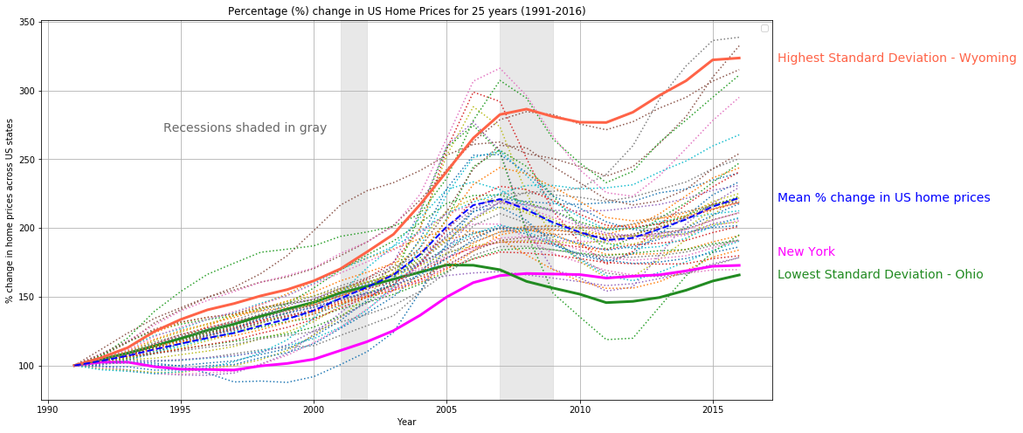
US House Prices

Slide 7
US House Prices
Observations:
House prices have doubled over the 25-year period
Wyoming is the state with the highest standard deviation in house prices – most change
Ohio is the state with the lowest standard deviation in house prices – least change
Great Recession from Dec 2007 - June 2009
The subprime mortgage crisis led to the collapse of the United States housing bubble
House prices in most states went down.
New York is an exception; the house prices remained stable

Slide 8
US Household Income
(1991 – 2016)

Slide 9
US Household Income
Data source: CSV and Census API
Objective: Analyze the trend in US household income across all states over 25 years ( 1991 – 2016)
Data manipulation:
Normalize all median household income in all US states to start from 100 in 1991 to analyze the trend
Highlight the states with highest and lowest standard deviation, New York and compare them with the mean household income over the years
Line plot: matplotlib

Slide 10
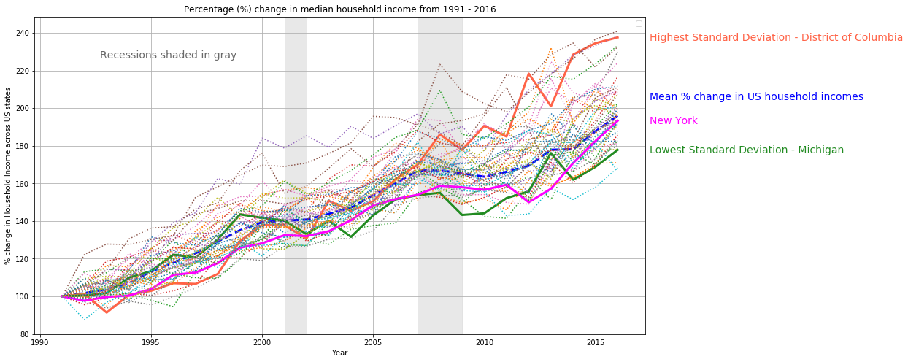
US Household Income

Slide 11
US Household Income
Observations:
House prices have doubled over the 25-year period
District of Columbia is the state with the highest standard deviation in household income – most change
Michigan is the state with the lowest standard deviation in house prices – least change
Great Recession from Dec 2007 - June 2009
Household income in most states went down.
New York has a delayed impact; the household income dropped a couple of years later in 2013

Slide 12
US GDP & Interest Rates
(1991 – 2016)

Slide 13
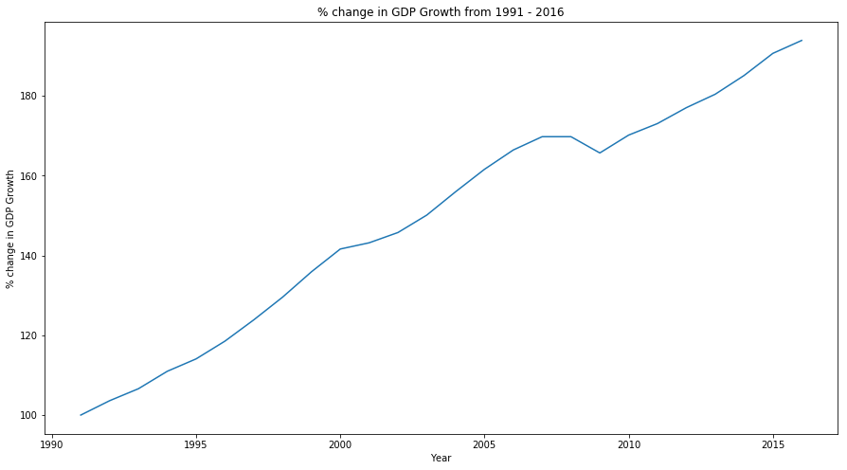
GDP
Data source: CSV
Objective: Analyze the trend in US GDP over 25 years
Data manipulation:
Convert GDP growth rate from year after year to start from 100 in 1991 to analyze the trend
Line plot: matplotlib
Observations:
GDP has grown linearly except for a slight dip after the great recession

Slide 14
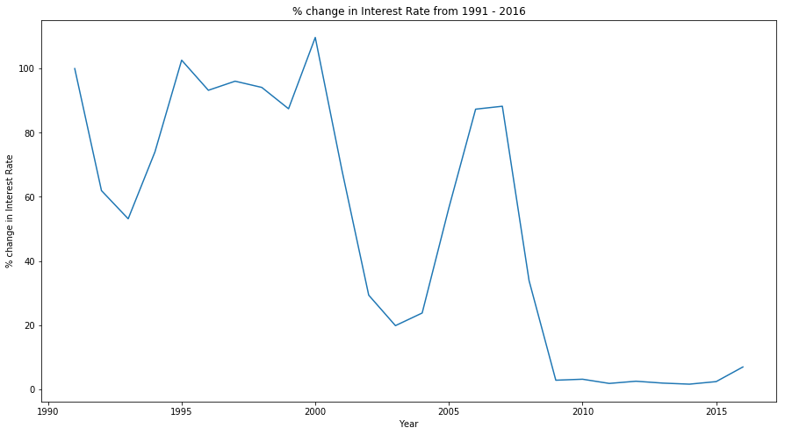
Interest Rates
Data source: CSV
Objective: Analyze the trend in interest rates over 25 years
Data manipulation:
Normalize interest rates to start from 100 in 1991 to analyze the trend
Line plot: matplotlib
Observations:
Interest rates dipped significantly after both recessions and remained stable until 2015

Slide 15
Analysis - US
(1991 – 2016)

Slide 16
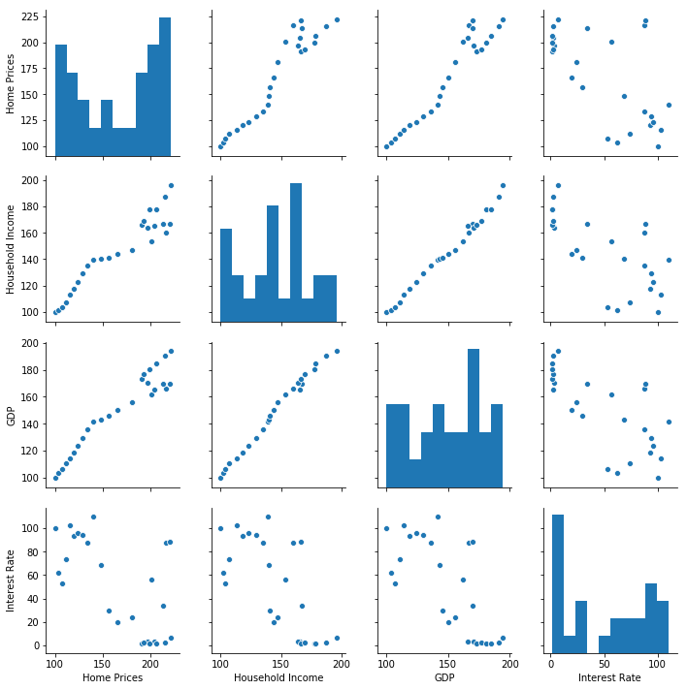
Analysis Pairplot: Seaborn
House Prices
Household Income
GDP
Interest Rate

Slide 17
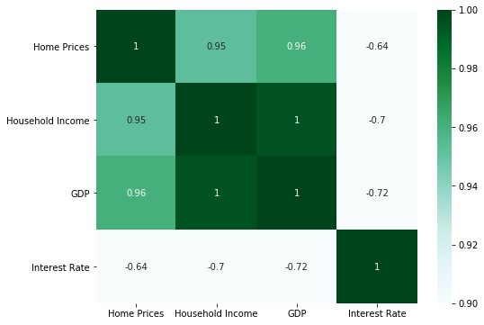
Analysis Heatmap: Seaborn
House Prices
Household Income
GDP
Interest Rate

Slide 18
US Crime Rate
(2009 - 2016)

Slide 19
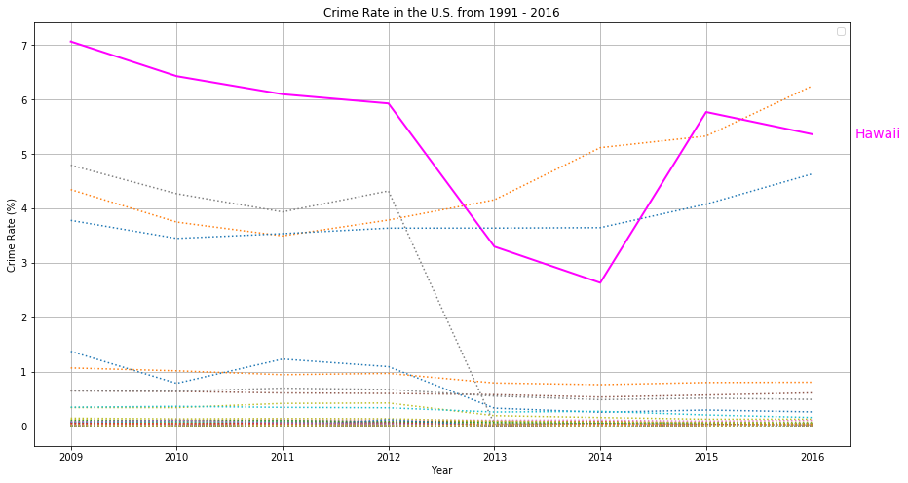
Crime Rate
Data source: API from FBI
Data retrieval: Convert into JSON and export in CSV file
Data manipulation: Merge with "state" and "population" dataframe and clean data
Data wrangling: Calculate crime rate and include in the dataframe
Line plot: matplotlib

Slide 20
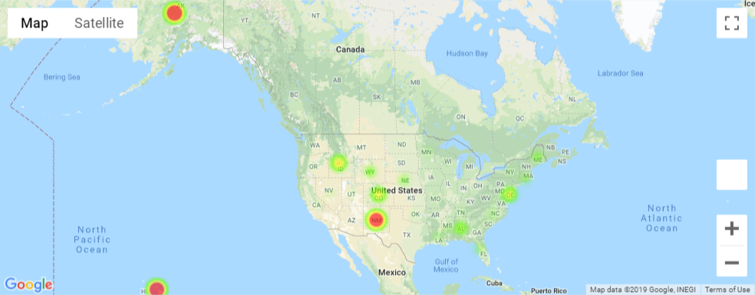
Crime Rate 2016 - Heat Map

Slide 21
US Weather
(1999 – 2017)

Slide 22
US Weather
Data source: CSV
Objective: Analyze the trend in US TEMPERATURE across all states around 20 years ( 1999 – 2017)
Data manipulation:
Computerize the temperature range for each state
Calculate the correlation between temperature and housing price in some cold-winter (<30 F) or hot-summer (> 90 F) states
Line plot: matplotlib

Slide 23
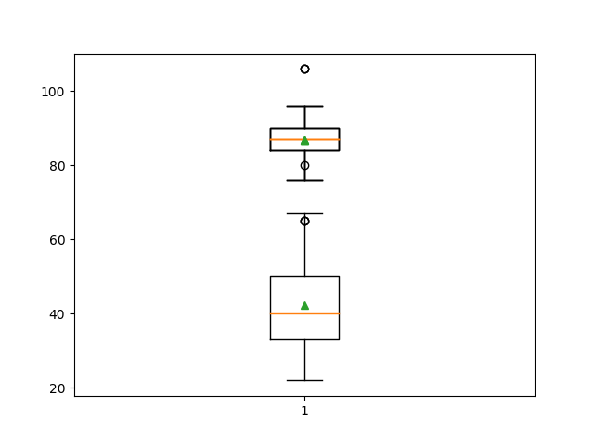
Weather Data
Summer (25%-75%) : 84 F to 90 F ( 6 F difference)
Winter (25% - 75%) : 33 F to 50 F (17 F difference)

Slide 24
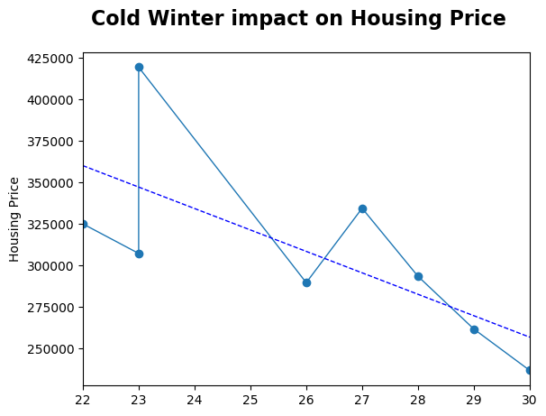
Weather Data Correlation = - 0.7

Slide 25
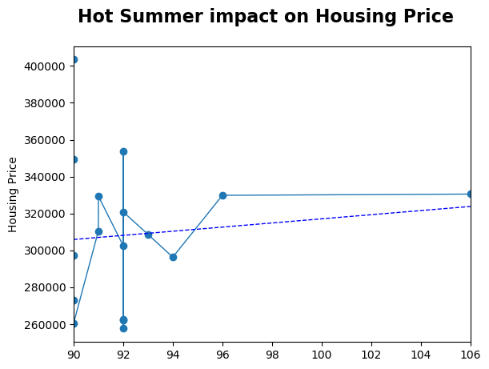
Weather Data Correlation = 0.1

Slide 26


Why President Trump try hard to build a Barrier to protect Texas inside of a Wall to protect the Alaska?

Slide 27
Because Nobody wants to come to Alaska
High housing price + Less job = Homeless
Homeless + Cold Winter = Froze to death

Slide 28
Analysis - New York
(2009 – 2016)

Slide 29
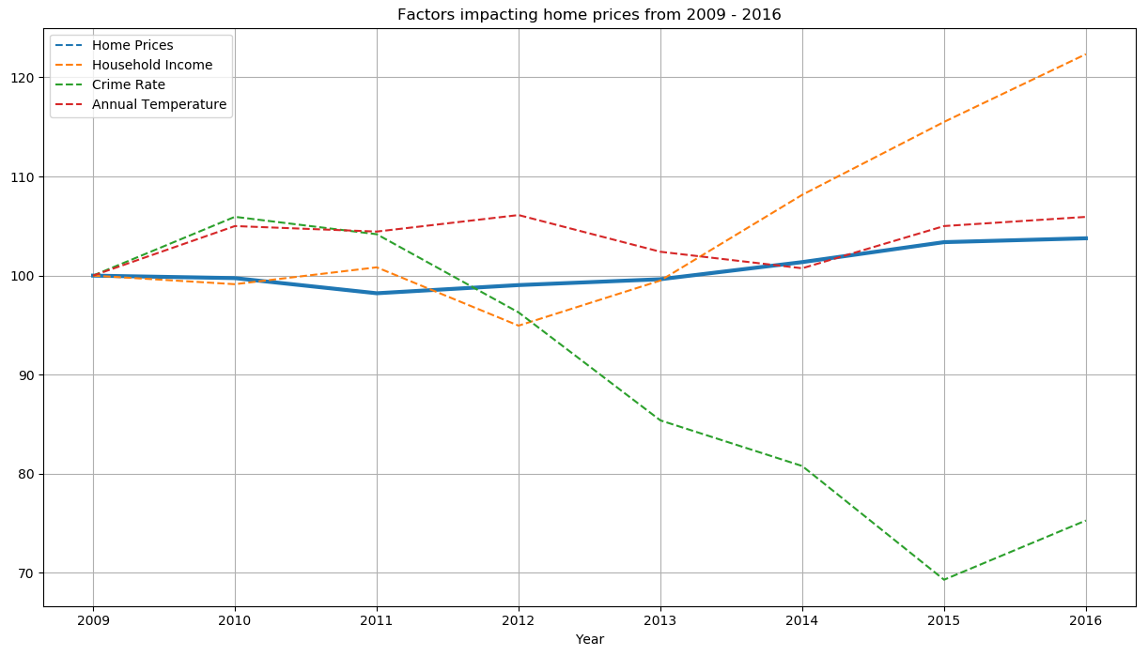
Analysis – New York
Data source: CSV
Objective: Track the correlation of New York house prices for 8 years (2009-2016) with household income, crime rate, and annual temperature.
Data manipulation:
Normalize all factors to start from 100 in 2009 to analyze the trend
Line plot: matplotlib
Observations:
Crime rate decreased> 30% significantly from 2010 – 2015
Household Income increased > 20% from 2012 - 2016

Slide 30
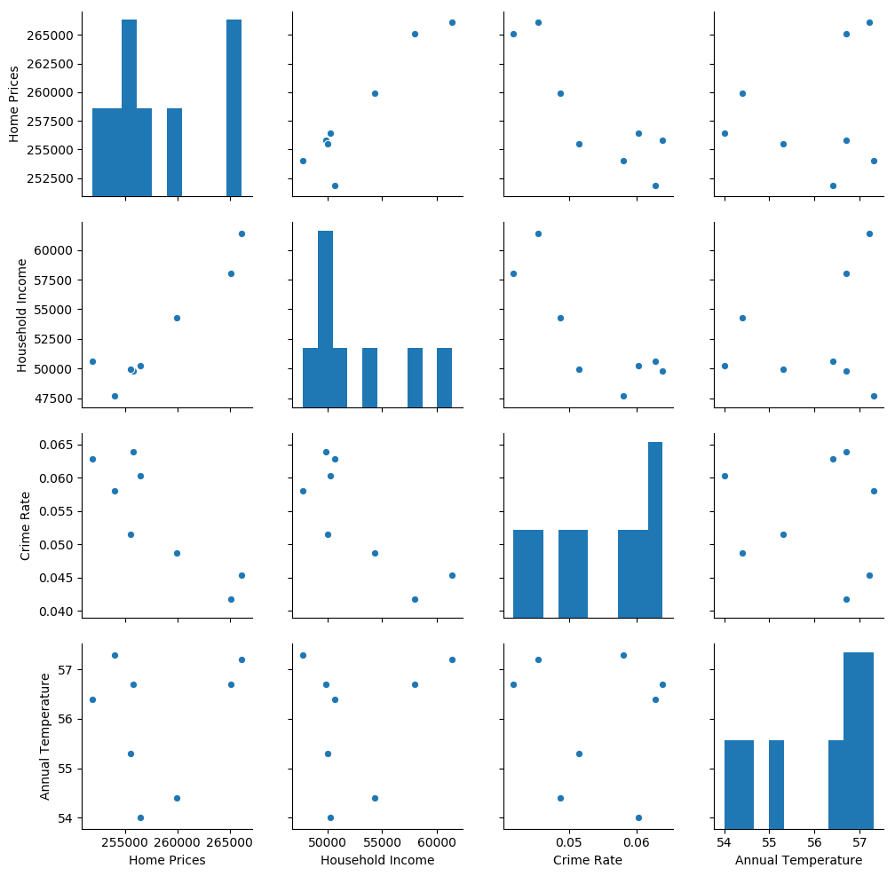
Analysis Pairplot: Seaborn
House Prices
Household Income
Crime Rate
Annual Temperature

Slide 31
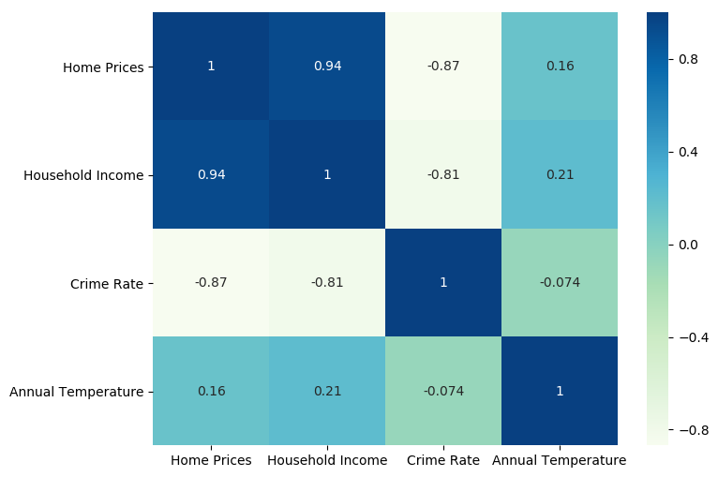
Analysis Heatmap: Seaborn
House Prices
Household Income
Crime Rate
Annual Temperature

Slide 32
Prediction – New York
(2009 – 2016)

Slide 33
Prediction – New York
Objective: Predict house prices in New York for the 8-year period (2009 –2016) and compare the model with actual house prices and analyze the impact of each factor
2 ways used to make our model:
Statsmodels.api
An ordinary least square model
Statsmodels.formula.api
A formula (y ~ HI + CR)
The results are the same for both linear regressions.
In our model,
X denotes factors, which are
Household income (HI)
Crime rate (CR)
y denotes a target variable, which is house prices in New York

Slide 34
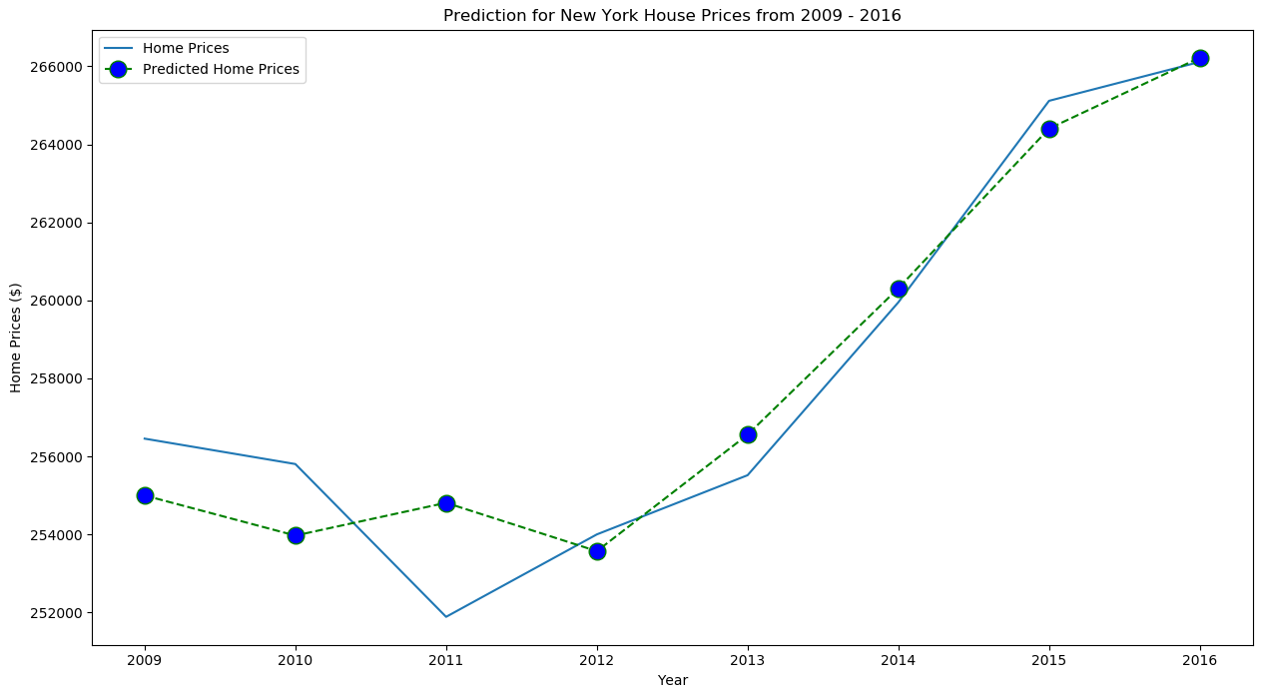
Prediction – New York
R-squared score is used to check the importance of factors:
Crime Rate (CR)
Household Income (HI)
Model Type | R-squared
Base Model | 0.915
Model Without HI | 0.753
Model Without CR | 0.879

Slide 35
Conclusion
Both household income and crime rate are factors that are important to our prediction model.
Household income has more impact on house prices in New York than crime rate.
Suggestions to improve the prediction model
More factors (such as mortgage rates, GDP) can be analyzed and added
No. of observations in the training data can be increased, currently only 8 years
Future home prices (2019 upwards) can be predicted if estimated values of the factors are added to the training data

Slide 36
GitLab URL
Codes are available in the project GitLab: main.ipynb
https://columbia.bootcampcontent.com/thidar/project1_wts.git

