Slide 1
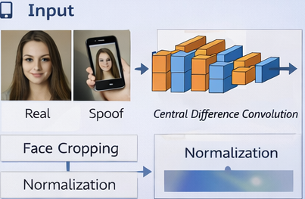
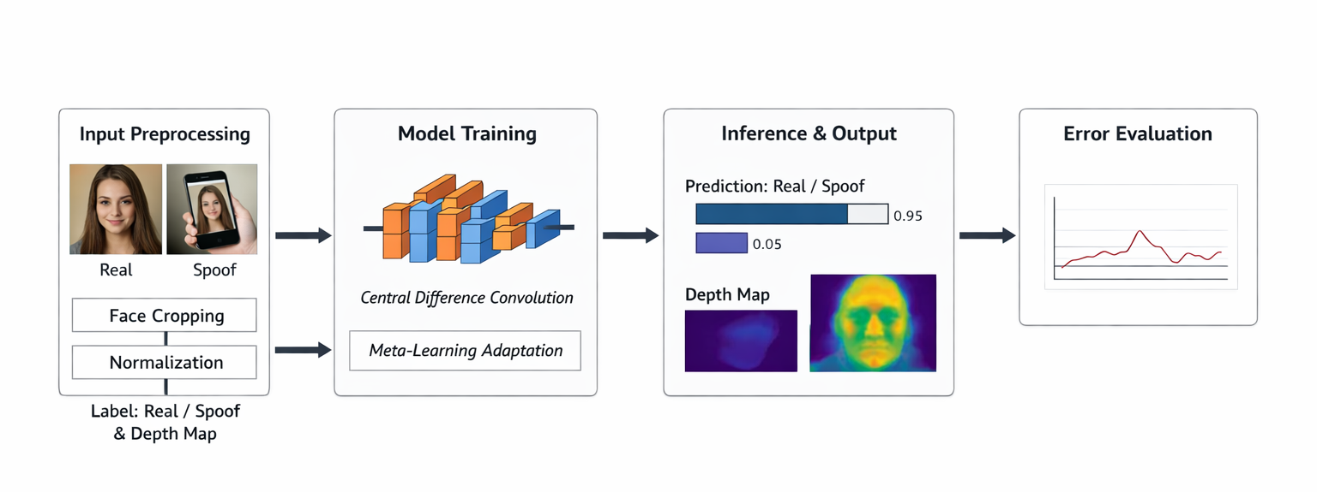
A STUDY ON DEEP VISION-BASED FACE ANTI-SPOOFING METHODS
Le Hoang Thien
¹ University of Information Technology, Ho Chi Minh City, Vietnam
² Vietnam National University, Ho Chi Minh City, Vietnam
Face biometric systems are increasingly vulnerable to attacks using printed photos,replayed videos,or 3D masks (Presentation Attacks - PAs). This research studies Face Anti-Spoofing (FAS) methods using deep vision models to detect such threats. Key components include fine-grained texture analysis and depth map estimation from single images. Experiments on OULU-NPU AND SiW datasets aim to enhance security for eKYC and access control systems.
Face recognition is widely used in modern security systems. but is vulnerable to simple presentation attacks. Comprehensive studies [3] emphasize the tieed for an ad­ ditionallayer of liveness detection.
Recent CVPR trends include using deep
learning to extract fine-grained textures and estimate depth maps from single RGB images [1, 2]. This study systematically explores state-of-the-art FAS techniques based on deep vision models.
1 Input
Study deeplearning architectures specialized for FAS.
2 Analyze benchmark datasets like OULU­ NPU and SiW.
3 Propose a robust pipeline for effective face anti-spoofing.
Datasets: OULU-NPU AND SIW
Public benchmark datasets..No diverse attack scenarios.
Approach:Central Difference Convolution (CDC) focuses on intensity differences between
Input
Neural Architecture Search (NAS)
for automatic network optimization.
Depth-map-based analysis for 30 cues and feature: analka1s.
Average Classification Error Rate (ACER)
key evaluation metric
Progress
Comprehensive understand g of FAS
challenges and methods.
Robust and adaptable FAS framework
Foundation for future implementations.
Le Hoang Thien - University of Information Technology, Ho Chi Minh City, Vietnam
Email: thienlh.20@grad.uit.edu.vn

