Slide 1
Topic: Game Maze
Sinh Viên Thực Hiện : Hạ Huy Thiện - 22014474
Email: 22014474@st.phenikaa-uni.edu.vn

Slide 2
Game Maze
I
Introdution
II
The Maze
III
Q –learning Algorithm
IV
Code Structure
Results
IV
Conclusion
IV
Conclusion

Slide 3
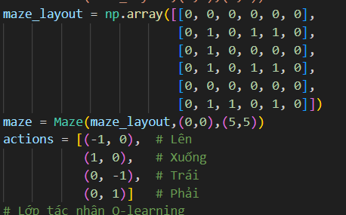
I. Introduction
Project Goal: Utilize Q-learning to develop an intelligent agent capable of navigating a maze.
Objective: To demonstrate the learning process of the agent as it optimizes its path to reach a defined goal, highlighting the fundamentals of

Slide 4
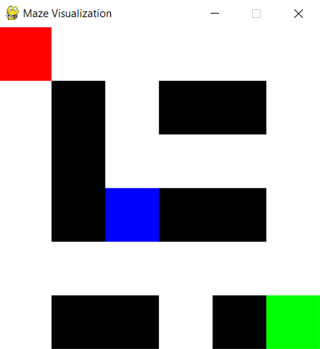
II. The Maze Concept: The maze is represented as a 2D numpy array, where each element corresponds to a cell in the maze. Structure: 0: Open path (the agent can move through these cells). 1: Wall (the agent cannot cross these cells).

Slide 5
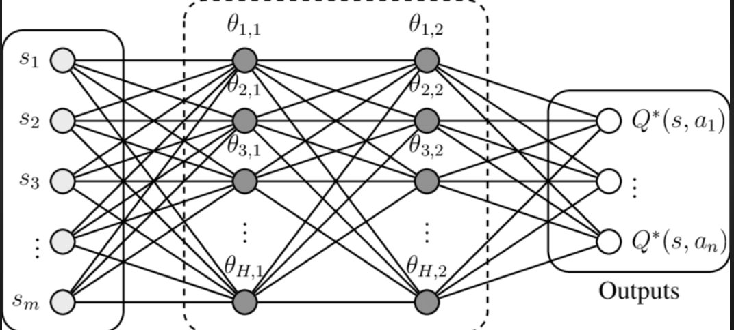
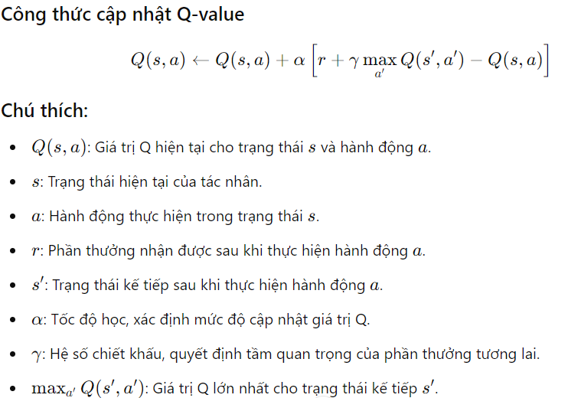
III. Q-learning Algorithm
Definition: Q-learning is a form of model-free reinforcement learning where the agent learns to maximize its cumulative reward through interactions with the environment.
Mechanism:The Q-table is updated based on the agent's experience, which includes the current state, action taken, the resulting state, and the reward received.
Exploration vs. Exploitation:Initially, the agent explores random actions, gradually shifting to selecting actions based on learned Q-values to exploit its knowledge.

Slide 6
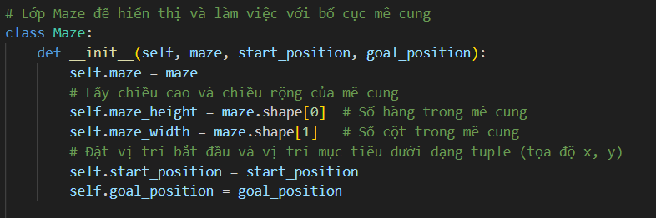
IV. Code Structure
Maze Class: Responsible for managing maze data, displaying the maze, and handling the visualization of the agent's path.

Slide 7
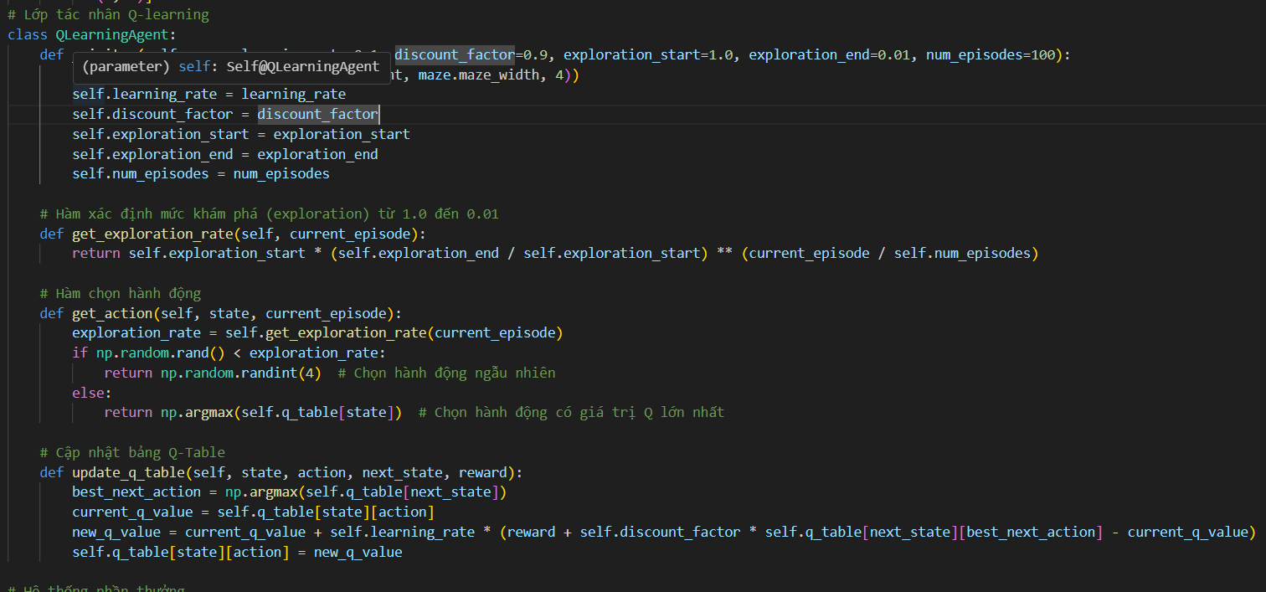
IV. Code Structure
QLearningAgent Class: Encapsulates the agent's learning process, maintaining the Q-table and implementing action selection and update mechanisms.

Slide 8
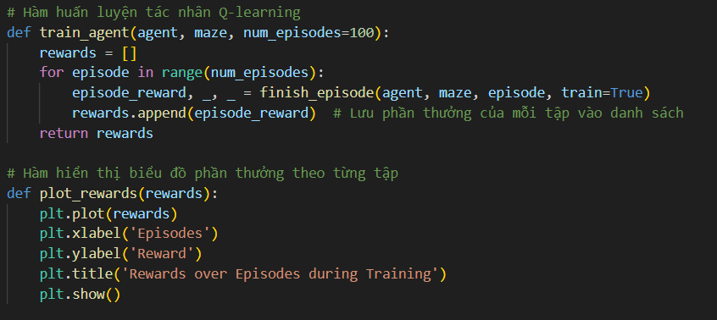
IV. Code Structure
Training Process:During training, the agent interacts with the maze environment, receives feedback in the form of rewards, and updates the Q-table accordingly.
.

Slide 9
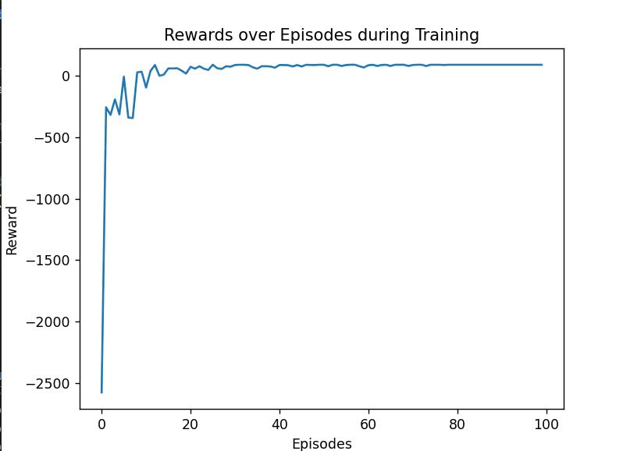
V. Results
Performance Evaluation:Display a graph showing the rewards received over episodes, illustrating the agent's learning curve and improvements over time.

Slide 10
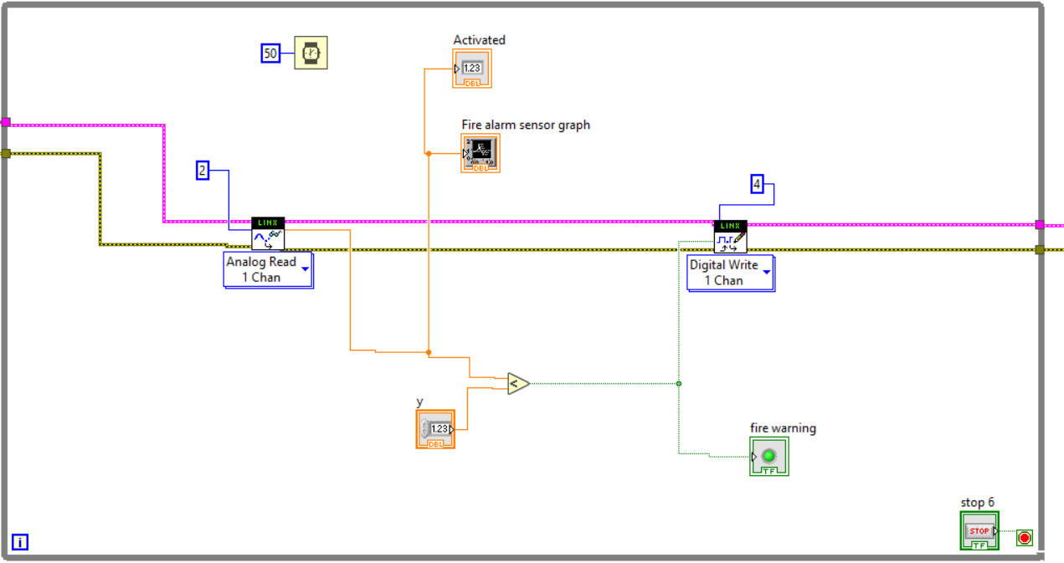
VI. Conclusion
6. Hệ thống hiển thị nhiệt độ.
Sử dụng cảm biến nhiệt độ lm35 khi cảm biến nhận được nhiệt độ hiện tại trong phòng sẽ hiển thị lên trang điều khiển.

Slide 11
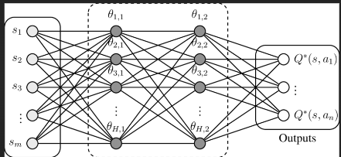
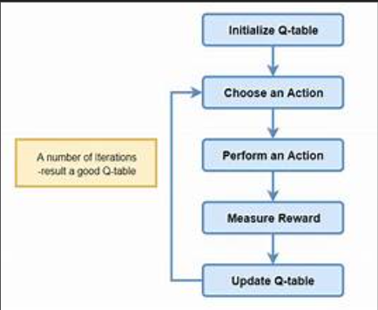
VI. Conclusion
Summary: The project successfully demonstrates how Q-learning can be applied to navigate complex environments and enhance decision-making in agents.
Future Directions:Explore implementing more complex maze structures and experimenting with different Q-learning parameters to further improve agent performance.

Slide 12
THANK YOU EVERYONE FOR LISTENING

