Slide 1



REINFORMENT LEARNING
TOPIC : Game maze
next slide
STUDENT : Hạ Huy Thiện
Class : K16 AI&RB

Slide 2
Game Maze
INTRODUTION
BASIC ALGORITHM
RL FOR MAZE GAME
STRUCTURE OF THE GAME
Q-LEARNING AND SARSA FOR MAZE GAME
RESULTS
HYPERPARAMETER TUNING
CONCLUSION
next slide

Slide 3


01
thynk unlimited
Introduction
Reinforcement Learning (RL) is a machine learning method where an agent learns to make decisions by interacting with an environment. The agent’s goal is to maximize rewards based on its actions. RL is effective in dynamic, changing environments. The agent improves through experience.
next slide

Slide 4
02
BASIC ALGORITHM
Q-LEARNING
SARSA
MONTE CARLO
Type of algorithm: Off-policy.
Description: The agent learns the optimal policy by updating the Q-value for state-action pairs, independent of the current policy that the agent is pursuing.
Advantages: Simple, efficient, and learns the optimal policy directly.
Type of algorithm: On-policy.
Description: Updates the Q-value based on the actual action taken according to the current policy that the agent is following.
Advantages: More stable when learning policies in complex and changing environments.
Type of algorithm: On-policy or off-policy.
Description: Estimates the value of a policy by sampling through complete episodes (from start to finish). Q-values are updated based on the total reward from experiences.
Advantages: Effective learning in model-free environments, suitable for problems where the terminal state can be clearly identified.
next slide

Slide 5
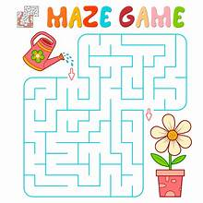
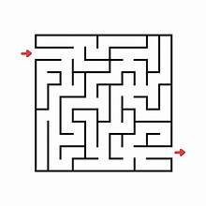
03
RL FOR MAZE GAME
The Maze game is a traditional problem in machine learning where the agent must find its way from a starting point to a goal point in a maze. The maze is typically represented as a matrix, with empty cells (navigable) and walls (non-navigable).
next slide

Slide 6
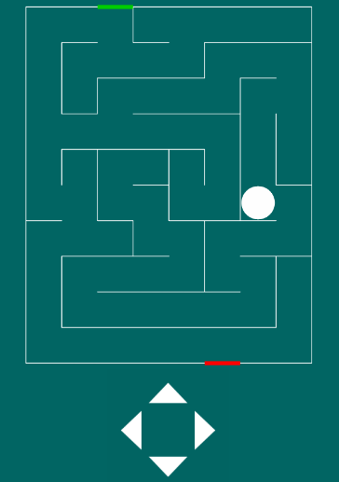
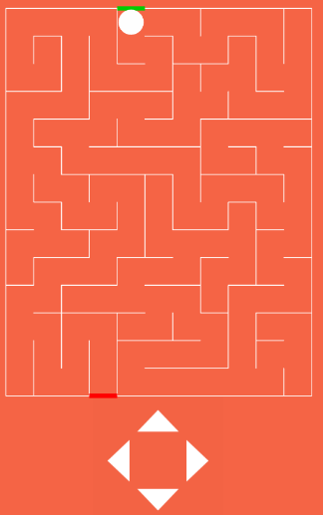
Structure of the Game
04
States:
The cells in the maze are different states. The agent starts from a defined state (the starting point) and aims to move to the goal state.
Actions:
The agent can perform actions to move up, down, left, or right to change its state.
Rewards:
Goal Reward: When the agent reaches the goal state, it receives a reward of +100.
Wall Penalty: If the agent hits a wall, it receives a penalty of -10.
Step Penalty: For each valid move, the agent receives a penalty of -1
next slide

Slide 7

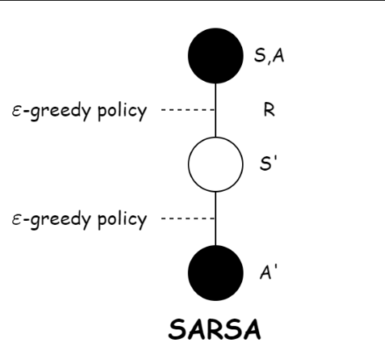
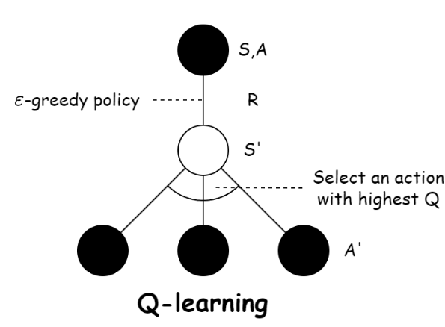
05
Q-learning and Sarsa for Maze Game

Slide 8
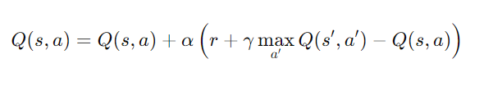
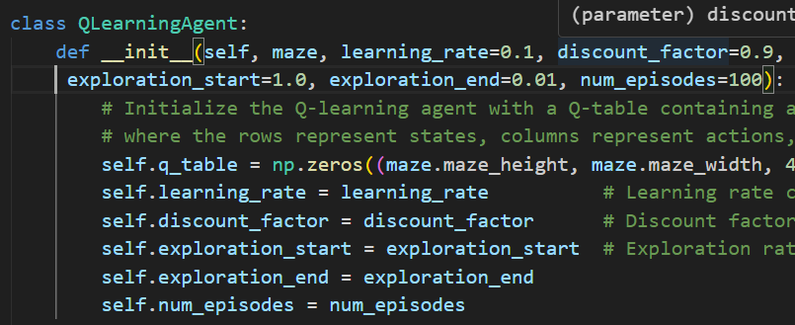
Q-learning for maze game
06
Q-learning is an off-policy algorithm, meaning it updates Q values based on the optimal future action, regardless of the current policy. Here's how it works in a maze game:
Q-table initialization: Q-learning creates a Q-table where each cell represents a (state, action) pair. Initially, the values in the Q-table are either random or set to zero.
Action selection: At each state, the agent selects an action using an epsilon-greedy strategy. With probability ε, the agent explores by choosing a random action; with probability 1 - ε, it exploits by selecting the action with the highest Q value.
Q-value update: After taking an action and observing the resulting state and reward, the Q-value is updated using the formula
next slide

Slide 9

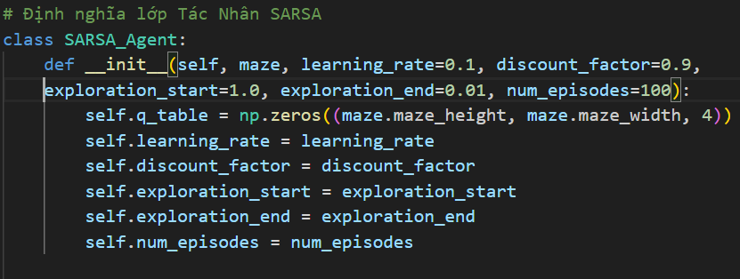
Sarsa for maze game
SARSA is an on-policy algorithm, meaning it updates the Q-value based on the actual action taken according to the current policy. Here's how it works in a maze game:
Q-table initialization: Like Q-learning, SARSA initializes a Q-table for storing state-action values.
Action selection: The agent selects actions using an epsilon-greedy strategy, similar to Q-learning.
Q-value update: The key difference is that SARSA updates the Q-value using the next action actually chosen by the agent, following the current policy:
07
next slide

Slide 10
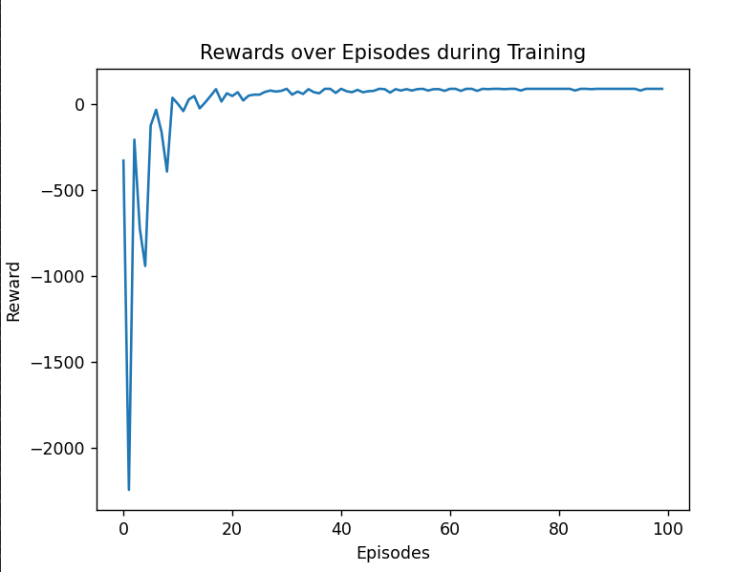
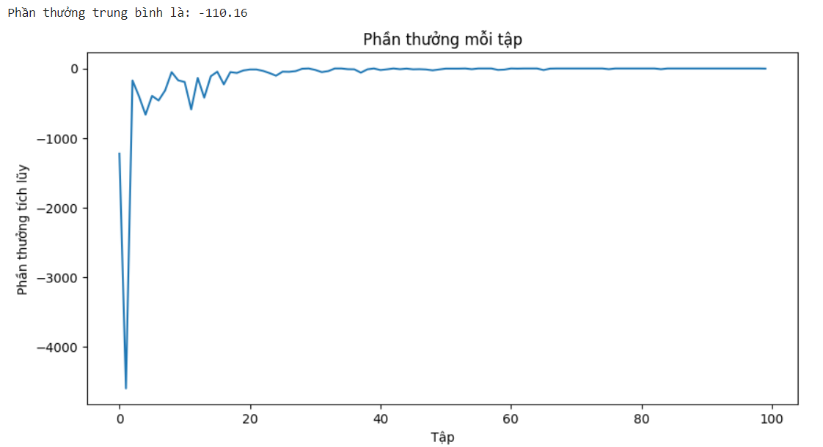
Results
Q-LEARNING
SARSA
08
next slide

Slide 11
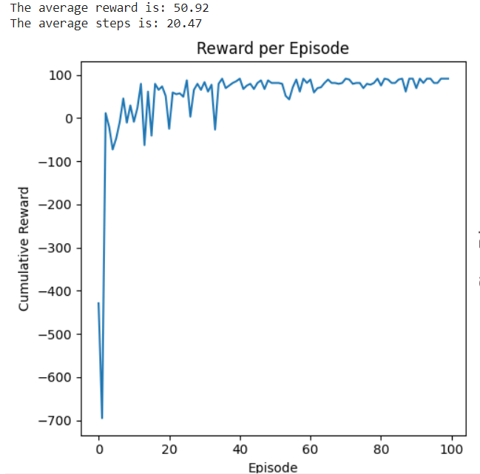
Hyperparameter Tuning
09
For the Q-learning algorithm:
When we change the parameters as follows:
• learning rate = 0.2
• discount factor = 0.8
• exploration start = 0.5
• exploration end = 0.1
next slide

Slide 12


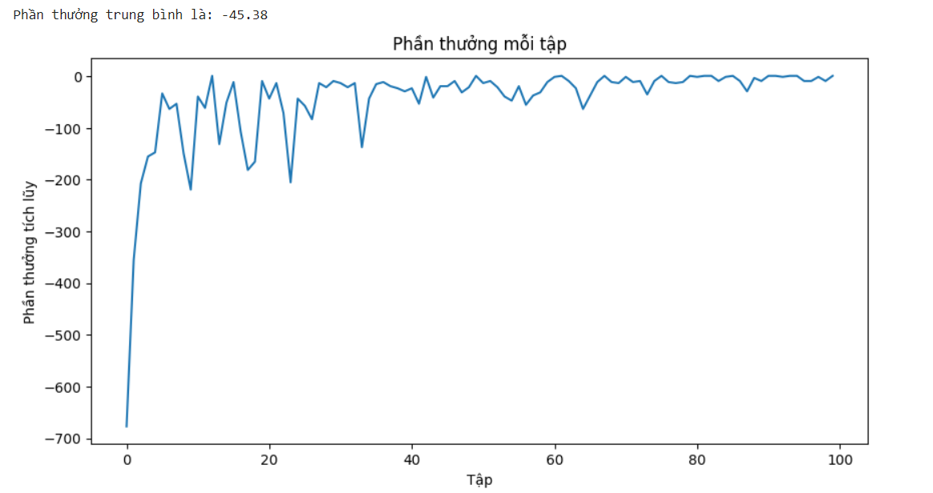
Hyperparameter Tuning
10
For the SARSA algorithm:
When we change the parameters as follows:
• learning rate = 0.2
• discount factor = 0.8
• exploration start = 0.5
• exploration end = 0.1
next slide

Slide 13

11
Conclusion
Both Q-learning and SARSA are effective for maze navigation:
Q-learning explores quickly by choosing optimal actions, suitable for environments that require fast exploration, but it may lack stability in complex mazes.
SARSA is more stable, learning from actual actions taken, making it better for uncertain environments, though it may be slower.
Depending on the need for speed or stability, you can choose either Q-learning or SARSA to optimize the agent's learning process.
next slide

Slide 14



Thank You!
22014474@st.phenikaa-uni.edu.vn
0327074071

