Slide 1
Topic: Game Maze
Sinh Viên Thực Hiện : Hạ Huy Thiện - 22014474
Email: 22014474@st.phenikaa-uni.edu.vn

Slide 2
Game Maze
I
Introdution
II
The Maze
III
Q –learning Algorithm
IV
Code Structure
Results
IV
Conclusion
IV
Conclusion

Slide 3
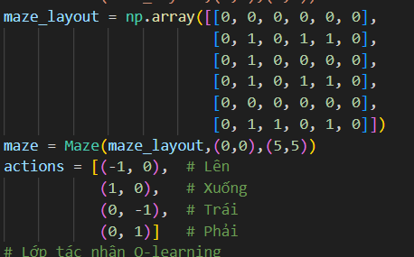
I. Introduction
Project Goal: Utilize Q-learning to develop an intelligent agent capable of navigating a maze.
Objective: To demonstrate the learning process of the agent as it optimizes its path to reach a defined goal, highlighting the fundamentals of

Slide 4
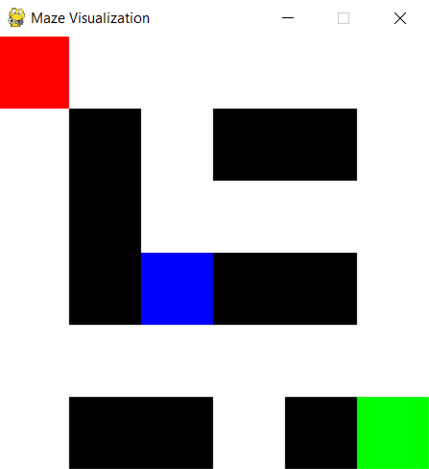
II. The Maze Concept: The maze is represented as a 2D numpy array, where each element corresponds to a cell in the maze. Structure: 0: Open path (the agent can move through these cells). 1: Wall (the agent cannot cross these cells).

Slide 5
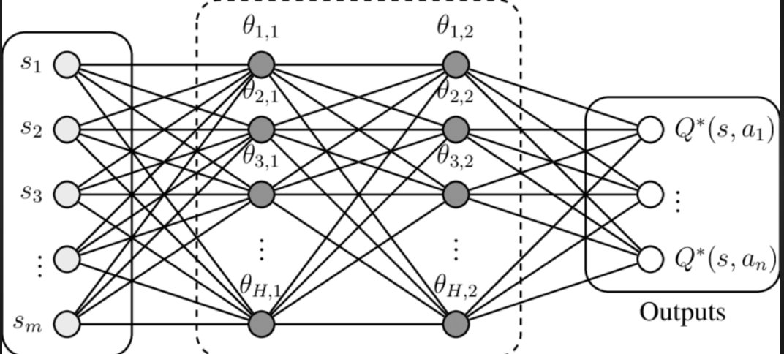
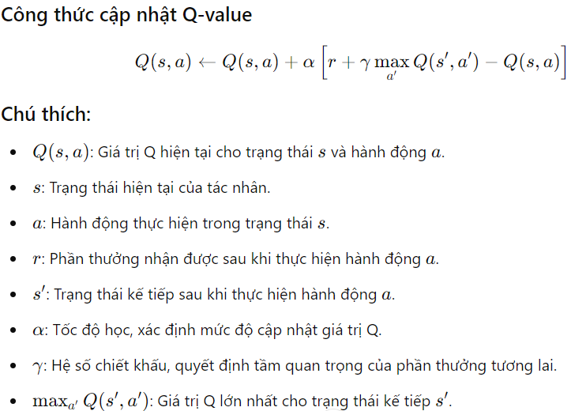
III. Q-learning Algorithm
Definition: Q-learning is a form of model-free reinforcement learning where the agent learns to maximize its cumulative reward through interactions with the environment.
Mechanism:The Q-table is updated based on the agent's experience, which includes the current state, action taken, the resulting state, and the reward received.
Exploration vs. Exploitation:Initially, the agent explores random actions, gradually shifting to selecting actions based on learned Q-values to exploit its knowledge.

Slide 6
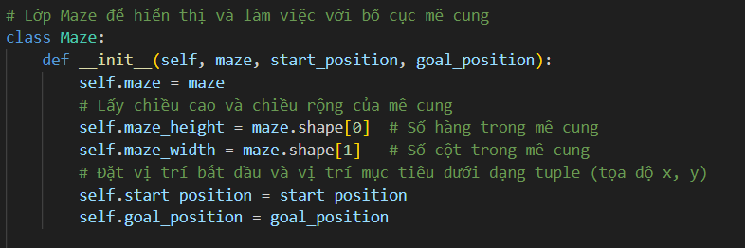
IV. Code Structure
Maze Class: Responsible for managing maze data, displaying the maze, and handling the visualization of the agent's path.

Slide 7
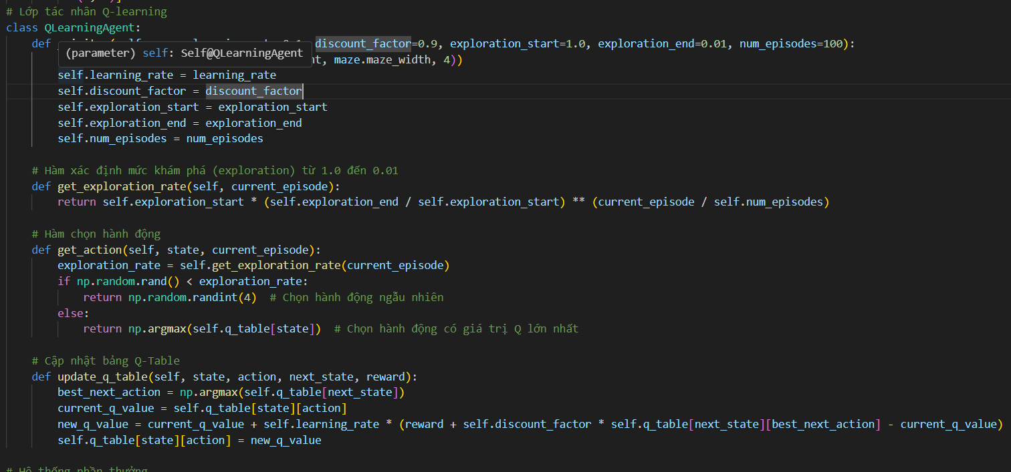
IV. Code Structure
QLearningAgent Class: Encapsulates the agent's learning process, maintaining the Q-table and implementing action selection and update mechanisms.

Slide 8
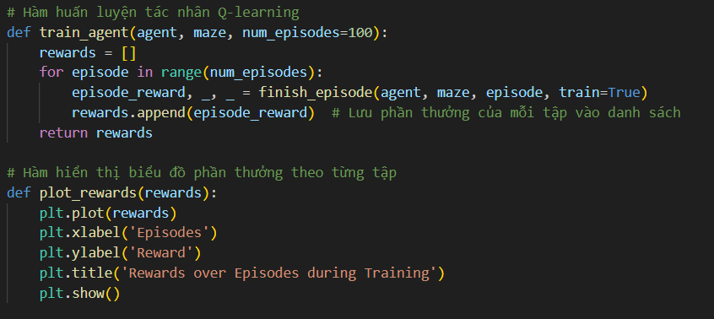
IV. Code Structure
Training Process:During training, the agent interacts with the maze environment, receives feedback in the form of rewards, and updates the Q-table accordingly.
.

Slide 9
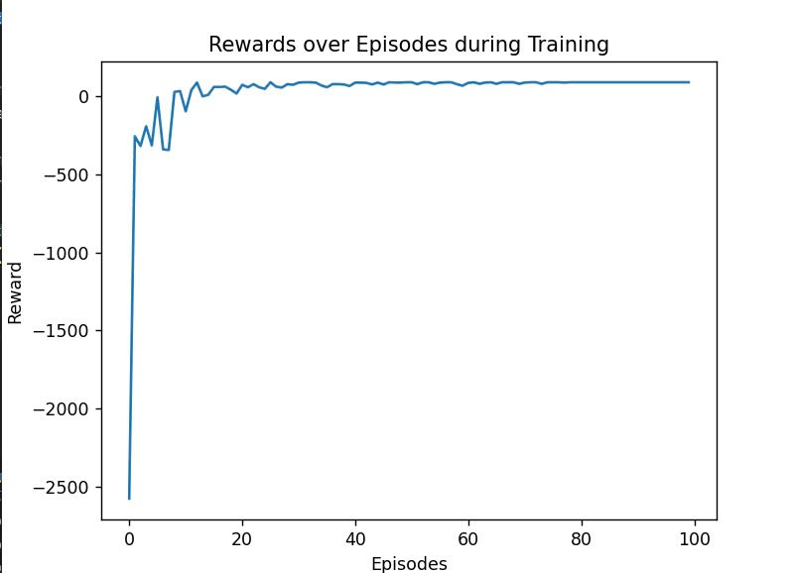
V. Results
Performance Evaluation:Display a graph showing the rewards received over episodes, illustrating the agent's learning curve and improvements over time.

Slide 10
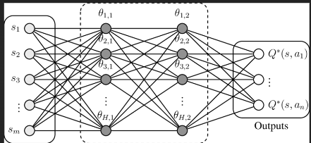
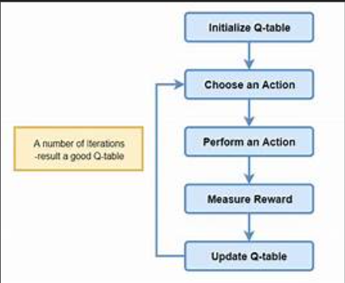
VI. Conclusion
Summary: The project successfully demonstrates how Q-learning can be applied to navigate complex environments and enhance decision-making in agents.
Future Directions:Explore implementing more complex maze structures and experimenting with different Q-learning parameters to further improve agent performance.

Slide 11
THANK YOU EVERYONE FOR LISTENING

