Slide 1

Warehouse Management Group 1
Notes:
NOTE:
To change the image on this slide, select the picture and delete it. Then click the Pictures icon in the placeholder to insert your own image.

Slide 2
INTRODUCTION
Topic: Warehouse Management
Member:
Nguyen Hoang Thien An
Nguyen Ly Minh Hieu
Pham Ngoc Thien
Vo Phan Hien
Teacher:
Mr. Hoang Duc Quang

Slide 3
Technology
Html, Css, Javascript, Bootstrap
Java Spring Boot, Thymeleaf
Ajax, SQL server

Slide 4
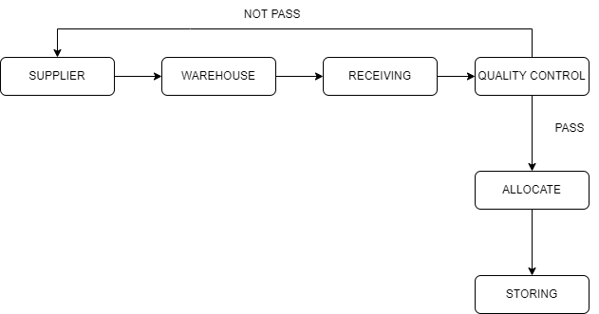
Workflow import

Slide 5
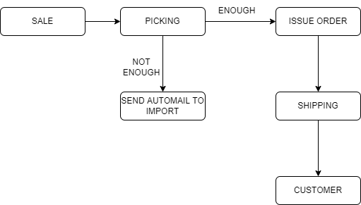
Workflow export

Slide 6
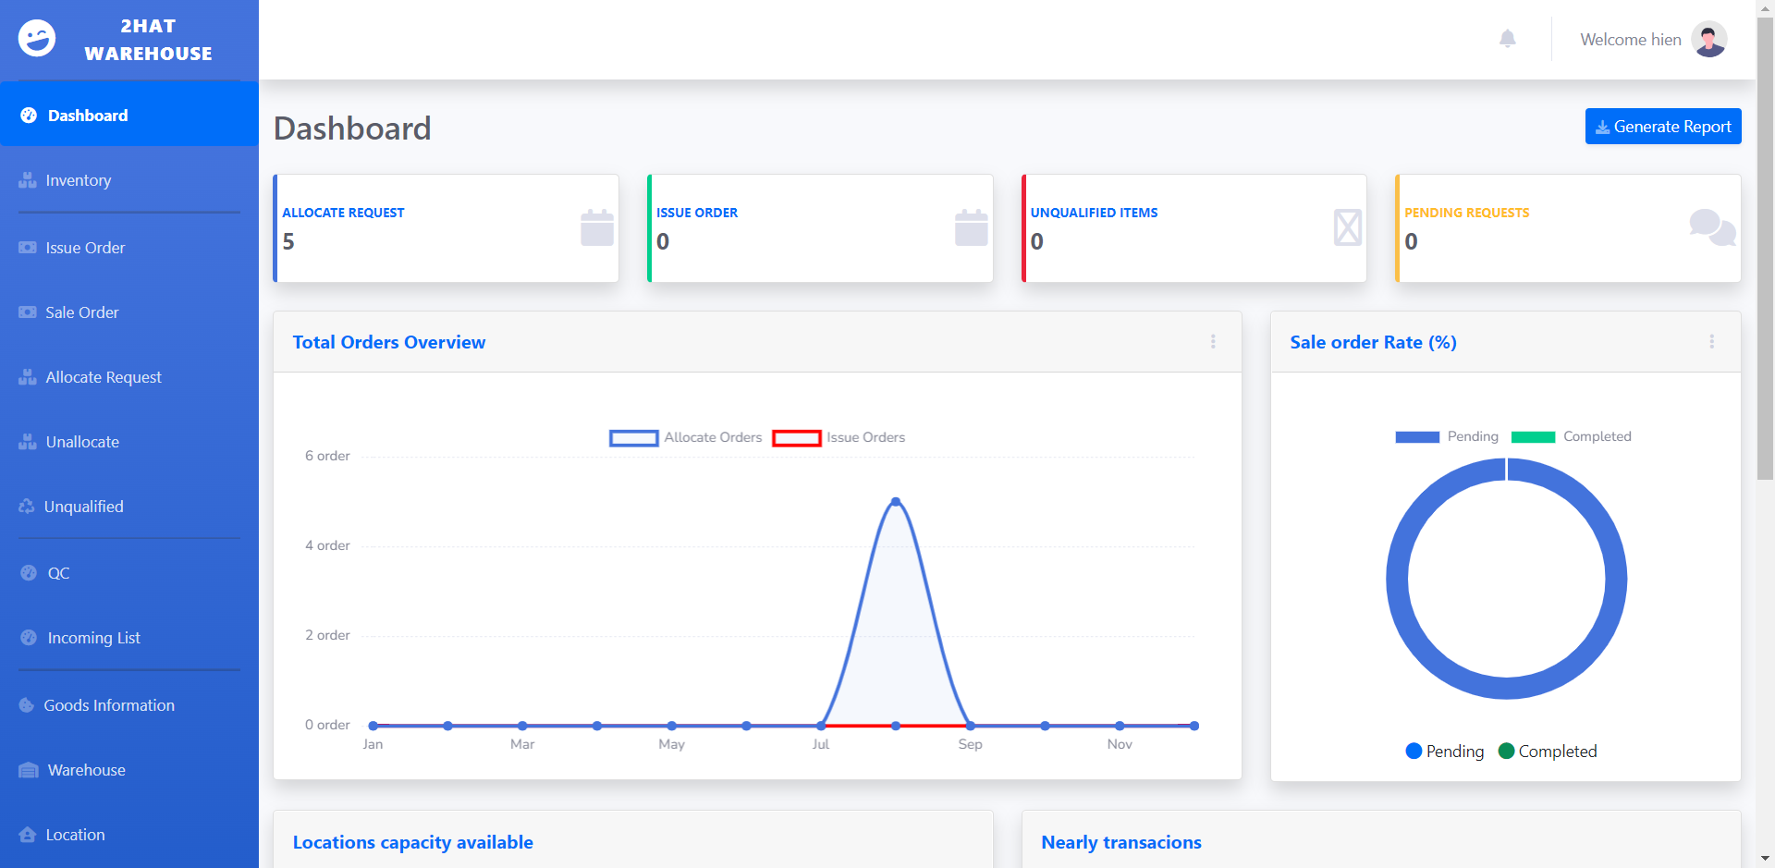
App design

Slide 7
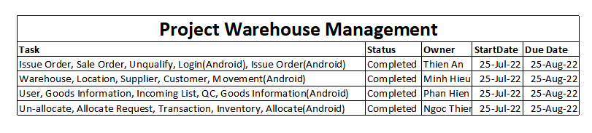
Task sheet Project

