Slide 1
Restaurant Finder
Professor: Asaad Saad
Group Members: Chau Ky Nguyen – 986085
Nu Quynh Nhu Tran – 986121
Thien An Nguyen – 986124

Slide 2
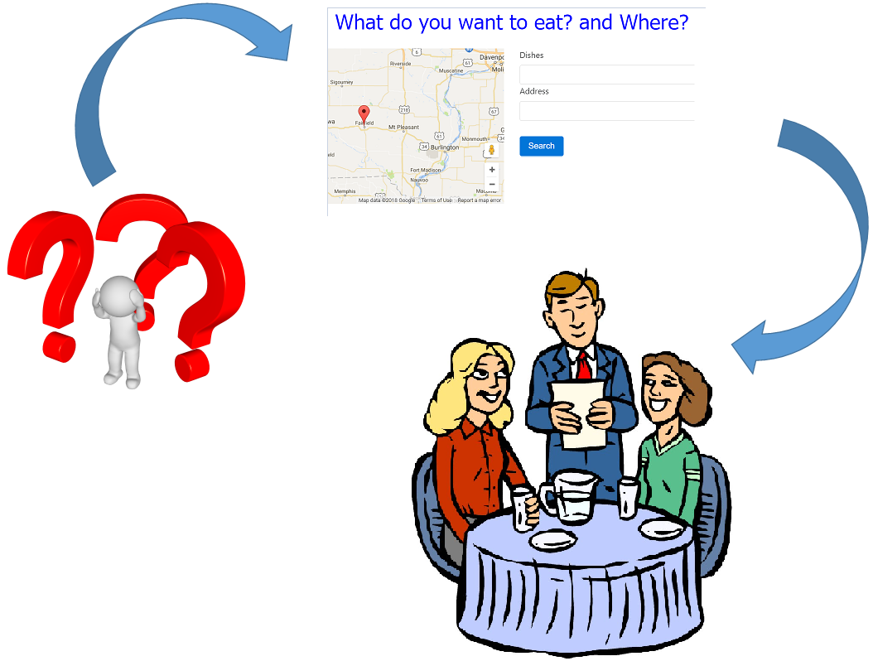
Restaurant Finder

Slide 3
Git repository
https://github.com/thienanmum/restaurantfinder

Slide 4
Main Features
Login
User Registration
Restaurant Entry Creation
Restaurant Search
Restaurant View

Slide 5
Techniques used
Geolocation service: google map api, angular google map
Angular:
Custom Directive
Guard
Mongoose
Node

Slide 6
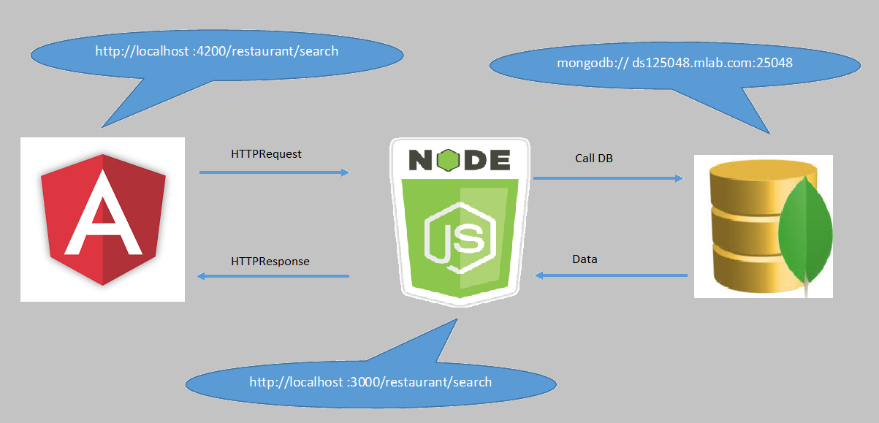
Search Restaurant

Slide 7
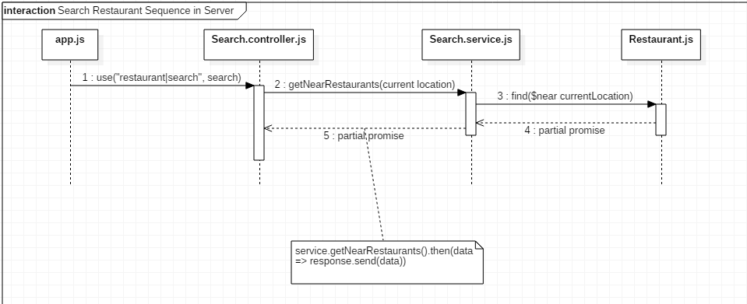
Server Module

Slide 8
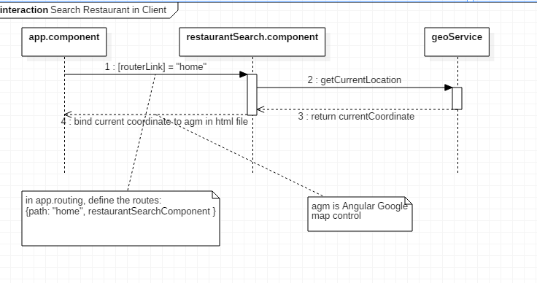
Client Module: Loading Search

Slide 9
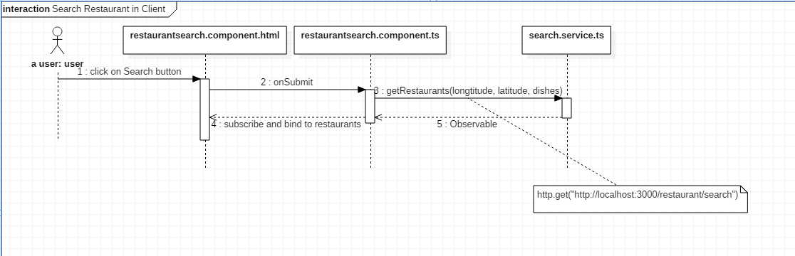
Client Module: Searching

Slide 10
Login

Slide 11
Create Restaurant Entry

