Slide 1
Restaurant Finder
Professor: Asaad Saad
Group Members: Chau Ky Nguyen – 986085
Nu Quynh Nhu Tran – 986121
Thien An Nguyen – 986124

Slide 2
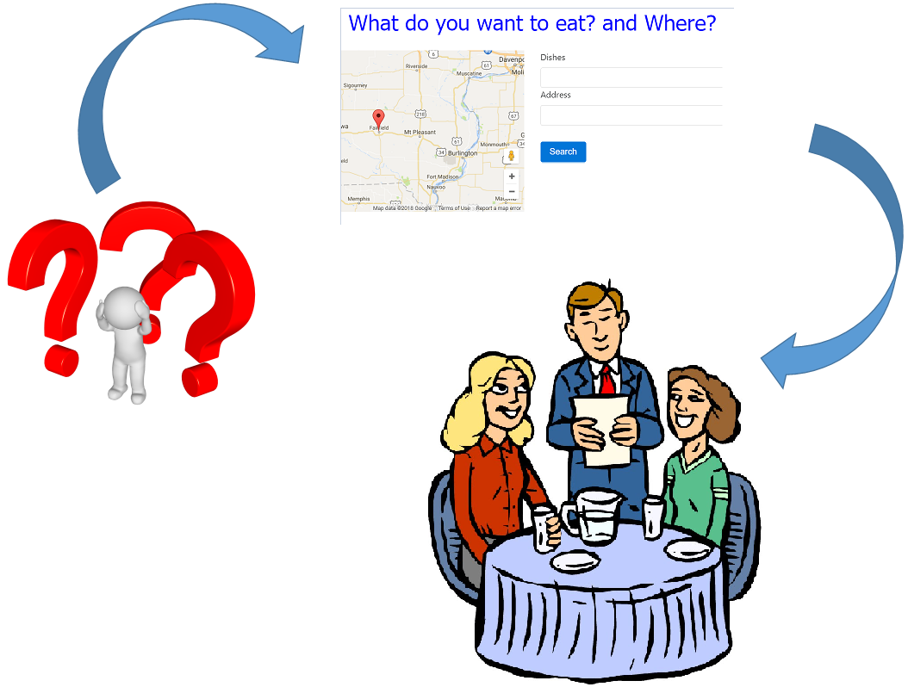
Restaurant Finder

Slide 3
Git repository
https://github.com/thienanmum/restaurantfinder

Slide 4
Main Features
Login
User Registration
Restaurant Entry Creation
Restaurant Search
Restaurant View

Slide 5
Techniques used
Geolocation service: google map api, angular google map
Angular:
Custom Directive
Guard
Mongoose
Node

Slide 6
Login

Slide 7
Create Restaurant Entry

Slide 8
Search Restaurant

Slide 9
Restaurant List and Recreation
List out all restaurants by Admin role
This function is to Add/Update/Delete restaurant by Admin role
To implement these features, apply some key points in lectures:
Router
Data Driven Forms
Validation in Form controls
HTTP Interceptor
Restful API
Pipe

Slide 10
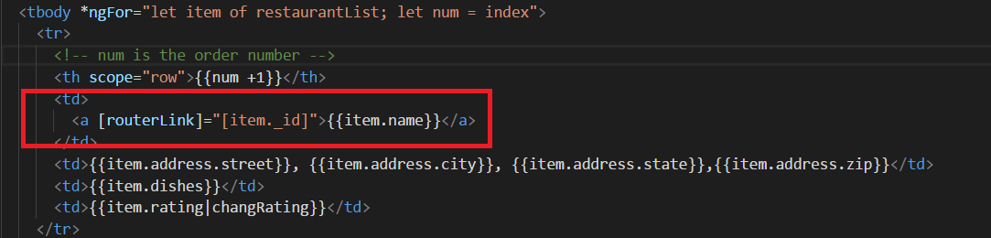
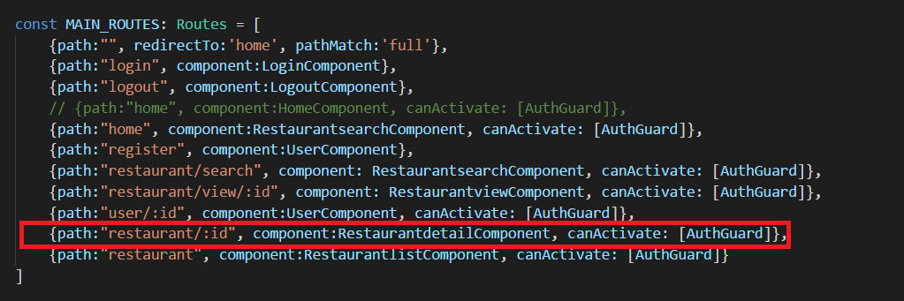
Restaurant List - UI
Router: to navigate to Restaurant details

Slide 11
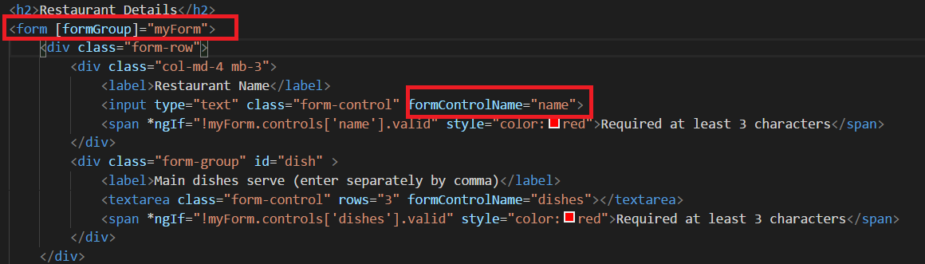
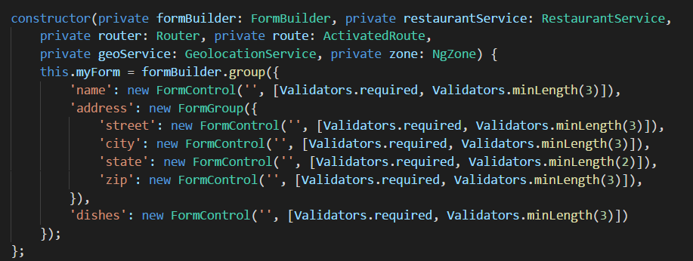
Restaurant Entry Recreation - UI
Data Driven Form: to bind Form control with it in Component

Slide 12
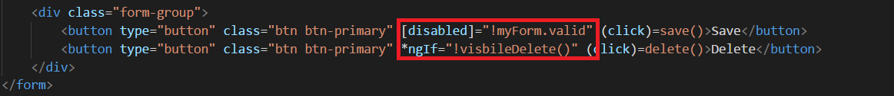
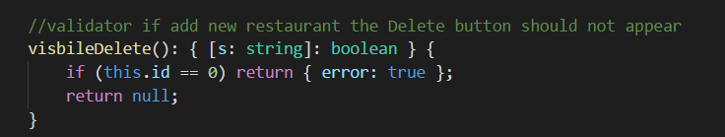
Restaurant Entry Recreation - UI
Validation: to validate as condition to visible or invisible Form control

Slide 13
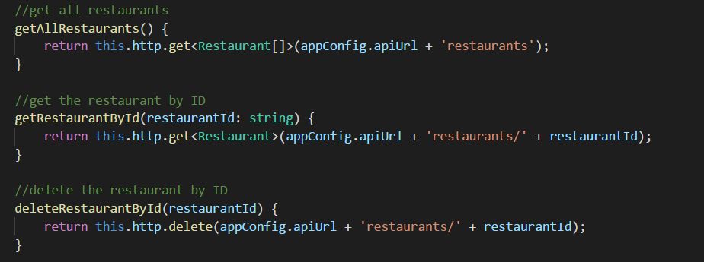
Restaurant CRUD request
HTTP Interceptor: submit and send request to backend

Slide 14
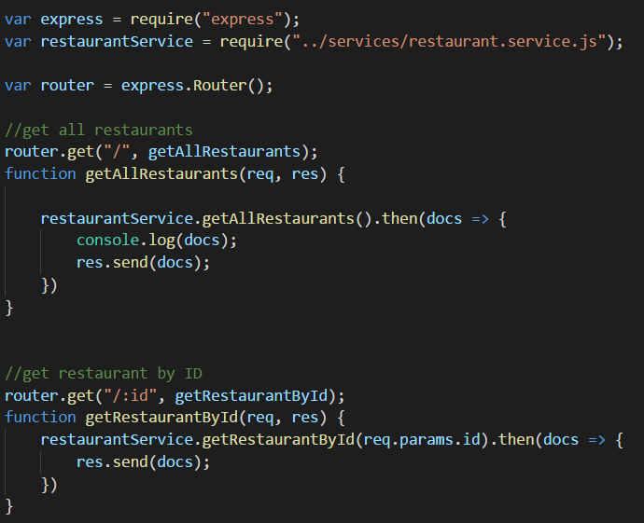
Restaurant Backend – Node Express
Restful API: have responsibility to handle request from Frontend, connect to Mongodb for CRUD restaurant and response

Slide 15
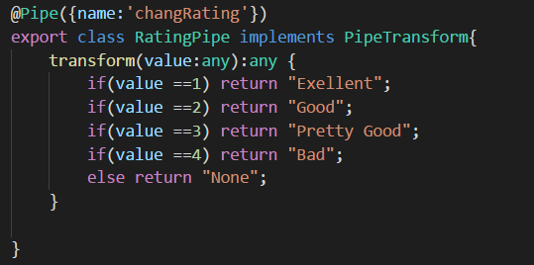
Restaurant detail display
Pipe: Custom to transform display value to template

