Slide 1

LAMP Server
Lecturer: Dr. Bui Ha Duc
Dept. of Mechatronics
Email: ducbh@hcmute.edu.vn

Slide 2

LAMP server
LAMP is made up of Linux – Apache – MySQL – PHP
Operating system
Database
Webserver
Server-side language

Slide 3
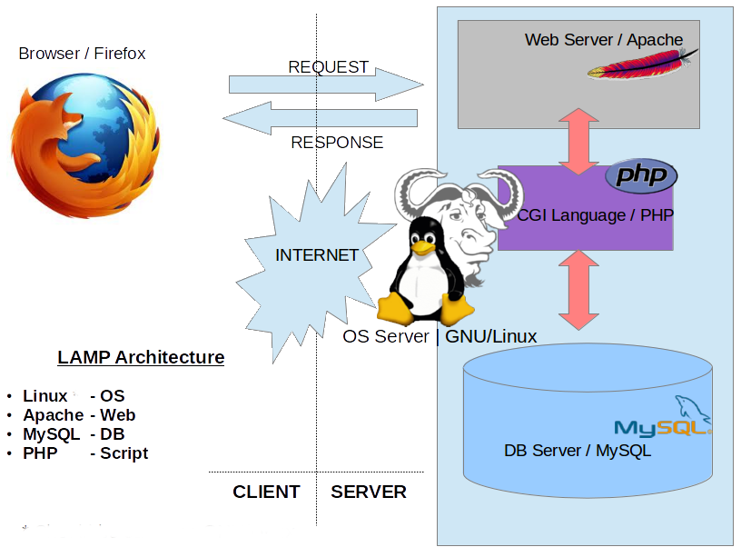
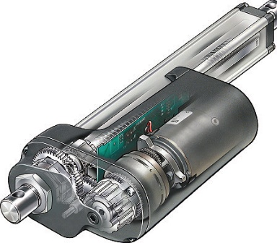
LAMP Server
Hardware

Slide 4
Setting up LAMP Server
Apache:
sudo apt-get install apache2 -y
MySQL:
sudo apt-get install mariadb-server mariadb-client
During installation, set up password for “root” user or change password later with
sudo mysql_secure_installation
C library for MySQL:
sudo apt-get install libmariadbclient-dev
PHP:
sudo apt-get install php php-mysql
Notes:
sudo mysql -u root –p
drop user 'root'@'localhost';
create user 'root'@'%' identified by 'your_password';
grant all privileges on *.* to 'root'@'%' with grant option;
flush privileges;

Slide 5
Setting up MySQL
Create new account for MySQL
sudo mysql -u root –p
create user ‘your_name’@’localhost’ identified by ‘your_password’;
grant all privileges on *.* to ‘your_name’@’localhost’ with grant option;
flush privileges;

Slide 6
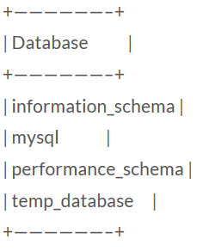
Create new database in MySQL
Open MySQL with:
sudo mysql –uroot –p
This command will logs into MySQL as the root user (-u) and it will prompt for a password (-p) on entry.
Create new database:
CREATE DATABASE temp_database;
List all databases:
SHOW DATABASES;

Slide 7
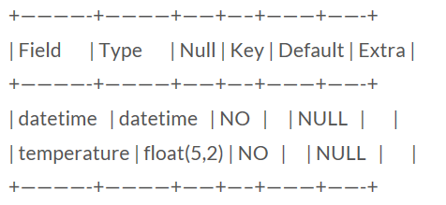
Create new database in MySQL
Select temp_database
USE temp_database;
Create a new table name “tempLog”
CREATE TABLE tempLog(datetime DATETIME NOT NULL, temperature FLOAT(5,2) NOT NULL);
Check new table
mysql> DESCRIBE tempLog;

Slide 8
Create new database in MySQL
Insert data in to tempLog table:
INSERT INTO tempLog (datetime,temperature) VALUES (“2018-10-04 22:29:24”,32.6);
Read data from tempLog table:
SELECT datetime, temperature FROM tempLog;

Slide 9
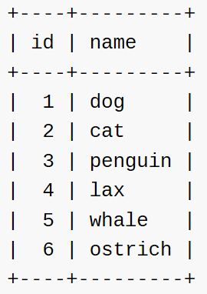
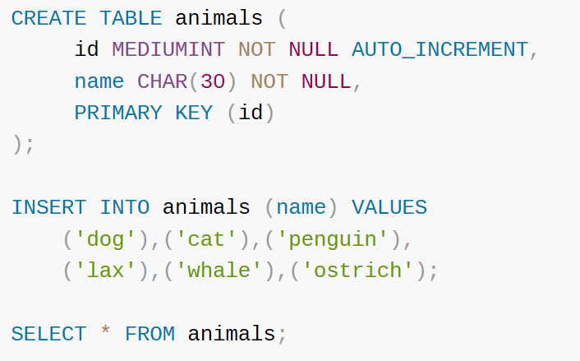
Example
https://dev.mysql.com/doc/refman/8.0/en/example-auto-increment.html

Slide 10
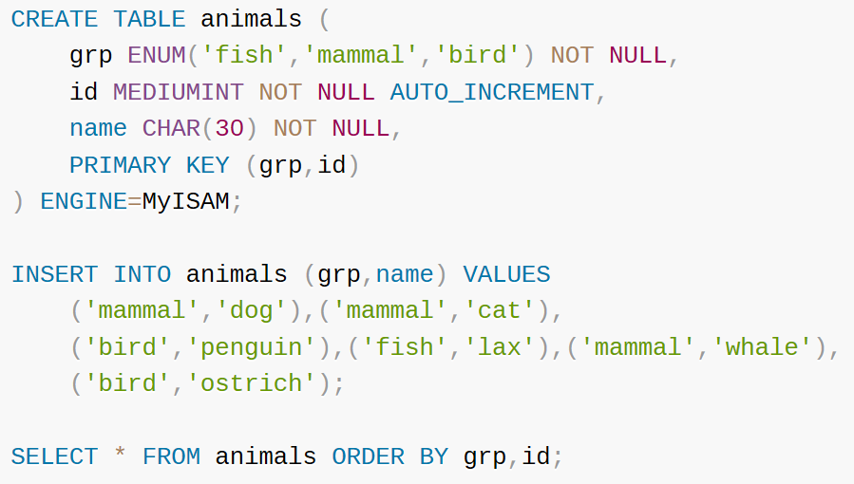
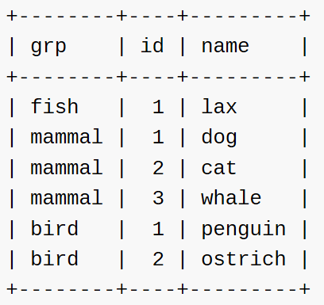
Example

Slide 11
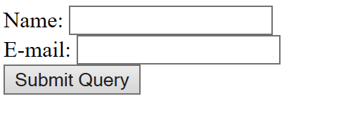
Exercise
<!DOCTYPE HTML> <html> <body> <form action="welcome.php" method="post"> Name: <input type="text" name="name"><br> E-mail: <input type="text" name="email"><br> <input type="submit"> </form> </body> </html>
Create a table in MySql to store user name and email?

Slide 12
MySQL data types
(Refer to https://www.tutorialspoint.com/mysql/mysql-data-types.htm and https://dev.mysql.com/doc/refman/8.0/en/data-type-overview.html for more detail)
Numeric types
INT: signed 32bit int, range from -2147483648 to 2147483647
TINYINT: signed 8bit INT
MEDIUMINT: signed 24bit INT
FLOAT(M,D): floating-point number with display length M and number of decimals D.
Date and Time types
DATE: a date in YYYY-MM-DD format
DATETIME: date and time combination in YYYY-MM-DD HH:MM:SS format.
TIME: store time in HH:MM:SS format

Slide 13
MySQL data types
String types
CHAR(M): fixed-length (M) string, max 255 characters
VARCHAR(M): variable-length string, max 255 characters
BLOB or TEXT: a field with maximum 65535 characters

Slide 14
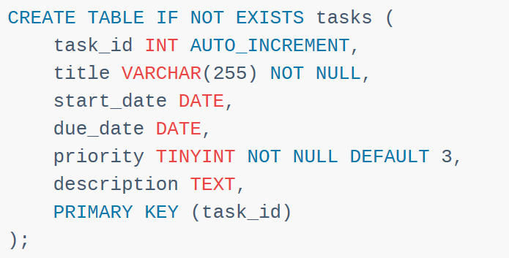
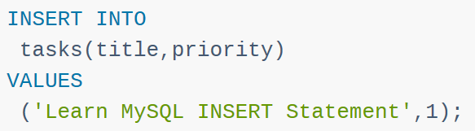
Examples

Slide 15
MySQL Data manipulation
Insert data to a table
Insert a single row
INSERT INTO table(c1,c2,...) VALUES (v1,v2,...);
Insert multiple rows:
INSERT INTO table(c1,c2,...) VALUES (v11,v12,...),(v21,v22,...),
..., (vnn,vn2,...);
Delete data from a table
Delete rows:
DELETE FROM table_name WHERE condition;
e.g. DELETE FROM temperature WHERE ID = 4;
DELETE FROM temperature WHERE ID < 4;
DELETE FROM diemdanh WHERE name = ‘Hieu’;

Slide 16
MySQL Data manipulation
Update data in a table:
Update a row:
UPDATE table_name
SET
column_name1 = expr1,
column_name2 = expr2,
...
[WHERE
condition];
e.g. UPDATE sensor SET temp = 30, humid = 65 WHERE id = 1;
UPDATE table1 SET col1 = col1 + 1, col2 = col1;

Slide 17
MySQL Data manipulation
Select data from a table
Select clause:
SELECT
column_1, column_2, ...
FROM
table_1
WHERE
conditions
ORDER BY column_1
LIMIT offset, length;
e.g. SELECT ho, ten, mssv FROM danhsach;
SELECT temp FROM sensor LIMIT 50,20

Slide 18
Exercise
Create a table which stores 50 newest sensor value.

Slide 19
Send data to database in C
#include <mysql.h>
#include <stdio.h>
float data; // data you want to send to database
int main(void) {
MYSQL *conn;
MYSQL_RES *res;
MYSQL_ROW row;
char *server = "localhost";
char *user = "root";
char *password = "PASSWORD"; /* set me first */
char *database = "temp_database";
while(1){
// Connect to database
conn = mysql_init(NULL);
mysql_real_connect(conn,server,user,password,database,0,NULL,0);
Notes:
http://www.raspberry-projects.com/pi/programming-in-c/databases-programming-in-c/mysql/accessing-the-database

Slide 20
Send data to database in C
// Create sql command
char cmd[200];
sprintf(cmd,"insert into gyro(Gx) values (%.2f)",data);
// send SQL query
mysql_query(conn, cmd);
mysql_close(conn);
}
return 0;
}
Notes:
http://www.raspberry-projects.com/pi/programming-in-c/databases-programming-in-c/mysql/accessing-the-database

Slide 21
Send data to database in C
Compile the program with:
$ gcc -o output_file $(mariadb_config --cflags) source_code.c $(mariadb_config --libs)

Slide 22
Send data to database with PHP
<?php
// Read HTTP request message and retrieve input data
$data1 = $_POST["name1"];
$data2 = $_POST["name2"];
// Connect to database
$server = "localhost";
$user = "root";
$password = "password";
$dbname = "database";
$conn = mysqli_connect($server,$user,$password,$dbname);

Slide 23
Send data to database with PHP
// Create SQL command
$sql = "insert into data(col1,col2) values ($data1,$data2)";
mysqli_query($conn, $sql);
// disconnect from database
mysqli_close($conn);
?>

Slide 24
Exercise
<!DOCTYPE HTML> <html> <body> <form action="welcome.php" method="post"> Name: <input type="text" name="name"><br> E-mail: <input type="text" name="email"><br> <input type="submit"> </form> </body> </html>
Create a table in MySql to store user name and email. Write a php file to read user inputs and ad the data to the SQL table?

Slide 25
Retrieving data from the DB in C
In C (refer to this link for more detail http://zetcode.com/db/mysqlc/ )
Step 1: select data
mysql_query(con, "SELECT * FROM sensor")
Step 2: save data into a variable
MYSQL_RES *result = mysql_store_result(con);
Step 3: get number of columns
int num_fields = mysql_num_fields(result);
Step 4: retrieve each row data
MYSQL_ROW row;
while ((row = mysql_fetch_row(result)))
{
for(int i = 0; i < num_fields; i++)
{
// your code
}
}

Slide 26
Retrieving data from the DB in C
#include <mysql.h>
#include <stdio.h>
int main(void) {
MYSQL *conn;
MYSQL_RES *res; // variable used to store DB data
MYSQL_ROW row;
char *server = "localhost";
char *user = "root";
char *password = "PASSWORD"; /* set me first */
char *database = "temp_database";
while(1){
// Connect to database
conn = mysql_init(NULL);
mysql_real_connect(conn,server,user,password,database,0,NULL,0);

Slide 27
Retrieving data from the DB in C
// Read data from database
mysql_query(conn, "select * from data_table");
res = mysql_store_result(conn);
int num_column = mysql_num_fields(res);
while (row = mysql_fetch_row(res))
{
printf("%s \t %s \t %d \n",row[0], row[1],row[2]);
}
// clear result and close the connection
mysql_free_result(res);
mysql_close(conn);
}
return 0;
}

Slide 28
Retrieving data from the DB with PHP
<?php
// send a JSON message to website
header('Content-Type: application/json');
// Connect to DB
$conn = mysqli_connect("localhost","root","123456","MPU6050");
// Create command to select data from DB
$sql = "SELECT stt,Gx FROM gyro Where stt>(select max(stt) from gyro)-30";
$result = mysqli_query($conn,$sql);
// Read each row and send it to website in JSON format
$data = array();
foreach ($result as $row) {
$data[] = $row;
}
mysqli_close($conn);
echo json_encode($data);
?>

Slide 29
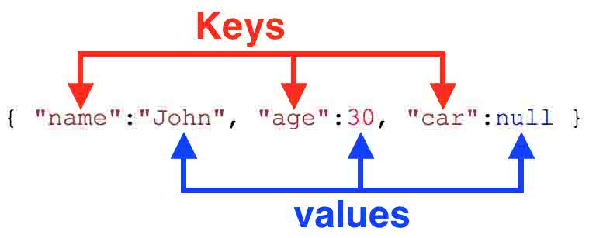
JSON Message
JSON - JavaScript Object Notation
JSON is a lightweight data-interchange format
easy for humans to read and write
machines to parse and generate
Structure of a JSON object

Slide 30
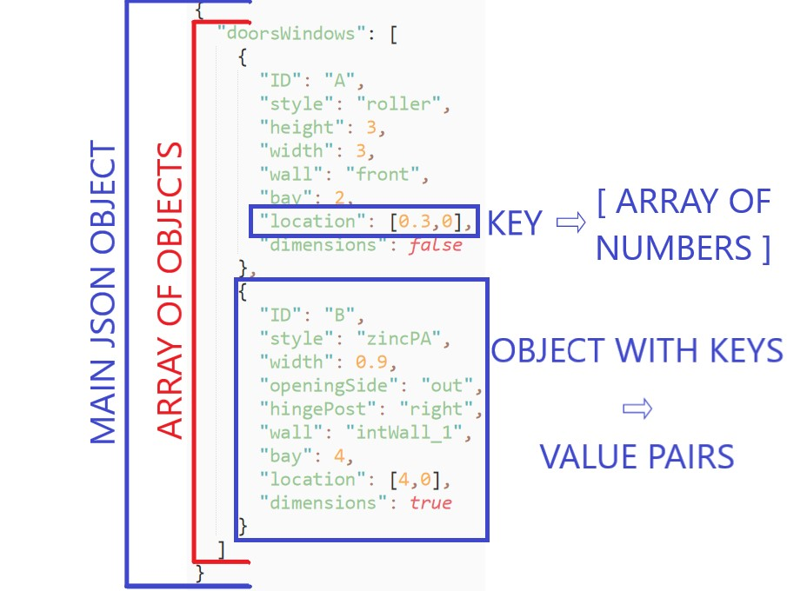
JSON Message

Slide 31
Useful commands
Check if php module has been enabled in apache:
a2query –m
Enable module
a2enmod ten_module
Disable module
a2dismod ten_module
Restart Apache
sudo systemctl restart apache2
sudo service apache2 restart
Install php module for apache
sudo apt-get install libapache2-mod-php

