Slide 1


PROJECT PROPOSAL
for
PREDICTIVE AWARD SYSTEM
Client: Mr. Lam Quang Vu
Team members:
Huy Vu | Quan Le | Phuc Nguyen | Son Tran | Tan Vu

Slide 2
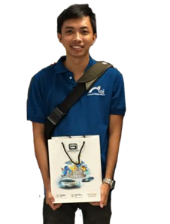
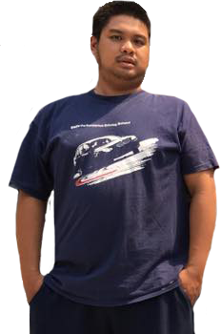

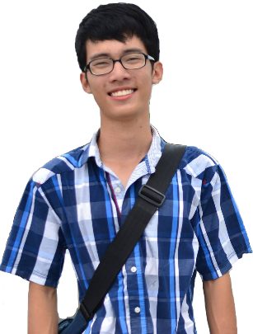
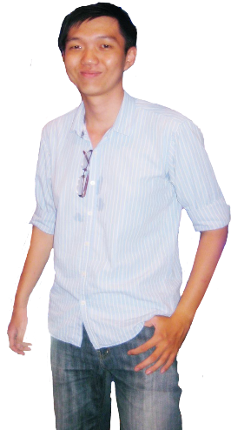
OUR TEAM
Nguyen Trung Thien Phuc
Backend Developer
Vu Quang Nhat Huy
SCRUM Master
Tran Long Son
Database Designer
Tester
Le Minh Quan
Frontend Developer
UI Designer
Vu Duy Tan
Frontend Developer
Tester

Slide 3
SKILL AND KNOWLEDGE
1
Soft and Professional Skill
Leadership
Project management Decision making
Teamwork
Communication
Documenting
.
Knowledge
2
Web programming: Java, PHP, CSS, HTML
3
Technical Skill
Programming: Microsoft Visual Studio, MySQL
Documenting: Microsoft Office
Managing
4
GitHub
Trello
Microsoft Project
5
UI Design
Photoshop
Dreamweaver
Balsamiq Mockups
.

Slide 4
RATIONALE OF THE PROJECT
Issues
Opportunities
Setting a clear and concise system and guidelines across the whole university
Saving on expense as well as storage space.
Transparency within many different process of predictive award.
Wastage on material and efforts
Create unnecessary hassles with primitive managing method by documents.
Data does not get updated constantly and usually getting delayed.
Easily leading to human’s errors without uniform guidelines.

Slide 5

01 – Being to manage faculty’s personal achievements for rewarding. 02 – Following an ascending priority: 03 – Freedom in coding language. 04 – Being able to function properly in both web and mobile interface. 05 – Form will be filled by checklist with different options. 06 – Account will be divided into different types: standard users, department head, mod, admin.
CLIENT REQUIREMENTS
Individual
Department
University
Higher Level
Notes:
© Copyright Showeet.com

Slide 6
SCOPE OF THE PROJECT
1
2
Analyze and understand weaknesses and strength of the currently existed Predictive Award System (P.A.S)
Research the most applicable type of webpage and interface for newly-designed P.A.S
Design two layer of controls for this new P.A.S webpage
Internal control: many accounts with different layered of priorities.
External control: personnel’s award can be checked and awarded in convenience and transparency.
.
Generate a standalone and fully functional webpage for the new P.A.S
3
4

Slide 7
METHODOLOGY (SCRUM)
Why are we choosing SCRUM ?
No fixed positions and roles, everything is depending largely on nature of work at the particular time interval
Providing more flexibility not only for team but also to clients
Clear-divided sprint will help condensing work into neat and easy-to-define cubes
Easier to constantly adapting with new changes or requirements from clients side

Slide 8


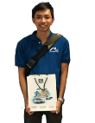


IDENTIFYING COST INCURRED
 | Initiating Phase | Executing Phase | Closing Phase
Huy Vu | 28 hrs/ week | 25 hrs/ week | 28 hrs/ week
Quan Le | 26 hrs/ week | 29 hrs/ week | 25 hrs/ week
Phuc Nguyen | 24 hrs/ week | 30 hrs/ week | 25 hrs/ week
Tan Vu | 27 hrs/ week | 28 hrs/ week | 25 hrs/ week
Son Tran | 25 hrs/ week | 27 hrs/ week | 29 hrs/ week

Slide 9
PROJECT MANAGEMENT PLANS
Project proposal, requirements, interview
(A1)
er30, 2016
Mid review, edit and fix bugs
(A7)
Host Deployment, checking prototype and optimize for mobile usage (A6)
Final review and confirm product with client (A8)
Design Database, Web Template and UI
(A2)
Implement and Design
user level
(A5)
Continue on January work, touching up for perfection (A5)
Testing and Debugging
(A7)
Finish and Presentation
(A9)
Learning Python and code basic features
(A3)
Sep Oct Nov Dec Jan Feb Mar Apr May June

Slide 10
hank ou!
Notes:
© Copyright Showeet.com

