Slide 1
Photographer Booking System
Team FA20FE21
Supervisor : Lại Đức Hùng
Members : Trần Thiện Thảo (Leader)
Bồ Công Đạt
Đào Sỹ Trung Kiên
Trương Ngọc Mỹ

Slide 2
Table of Contents
01
Introduction
02
Our Approach & Implement
Outline
03
Assessment
04
Future Plan

Slide 3
Introduction
Introduction
Current situation, Proposed solution

Slide 4
Introduction
Proposed
Photographer Booking System (PBS) is conducted to provide customers with a faster, more convenient and effective way to contact photographers. They now can view photographers’ working schedules and make their reservations easily without double-booking. Similarly, photographers can also efficiently arrange their schedule and manage their bookings

Slide 5










Introduction
Current Situation
Overflow
on
Want to hire
at
Ms Uyên
Overcharge
Photographer
Take photos
through
Inconvenient

Slide 6
Introduction
Issues
01
Costs
The overall price of photography is still very high.
02
Supply X
Many photographers have good skills but not many guest recognition.
03
There is currently no mobile app that offers a book photographer service.

Slide 7
Our Approach & Implement
Our Approach & Implement

Slide 8





Our Approach & Implement
Architecture
Notify
Http request
Http response
Spring Web Server
Http request
Http request
Controller
Restful Controller
Firebase Cloud Messaging
Web Client
Http response
View
Service
Http response
Http request
Repository
Http response
Annotation:
call/send
return
Query
Return
Notes:
Để xây dựng lên phần mềm đặt lịch thợ chụp ảnh, bọn em đã áp dụng mô hình kiến trúc N-tier vào kiến trúc tổng của hệ thống và cụ thể ở đây là mô hình 3 lớp. (Kiến trúc đa tầng cung cấp mô hình mà dựa vào đó các nhà phát triển có thể tạo được các ứng dụng linh hoạt và sử dụng lại bằng việc tách biệt một ứng dụng thành nhiều tầng, từ đó tùy chỉnh thay đổi hoặc thêm lớp thay vì làm lại toàn bộ ứng dụng.)
Tier 1, lớp presentation của hệ thống được chúng em được thể hiện thông qua web và mobile.
Tier 2, lớp logic là spring web server có chứa các Controller, Domain Model, Service, Repository để ghi chép cũng như xử lý chi tiết các request từ lớp presentation thông qua giao thức HTTP bằng RESTful service.
Tier 3, lớp data là nơi chứa database, cụ thể là chúng em sử dụng Amazon Relational Database Service kết hợp với Amazon S3 làm nơi để chứa dữ liệu và quản lý thông qua MySQL.
(Tính bảo mật cao: Ưu điểm nổi bật nhất cảu kiến trúc N – Tier là tính bảo mật rất cao, bạn có thể bảo mật riêng cho 3 lớp, hạn chế các rủi ro.
Dễ dàng quản lý: Do là 3 tầng khác nhau, có thể tách biệt nên việc quản lý cũng trở nên đơn giản, dễ dàng hơn nhiều. Nếu trường hợp một tầng bị lỗi thì cũng không làm ảnh hưởng đến các tầng con lại, hoàn toàn có thể sửa lỗi riêng biệt.
Có thể mở rộng: Bạn cũng có thể dễ dàng thêm vào đo nhiều tài nguyên, việc thêm tài nguyên của một tầng không làm ảnh hưởng đến các tầng khác.
Linh hoạt: Bạn có thể linh hoạt thêm tài nguyên vào từng tầng, sửa lỗi của từng tầng phù hợp với yêu cầu đặt ra.
Phát triển hiệu quả, có thể sử dụng lại: khi sử dụng kiến trúc N – Tier, bạn có thể sử dụng lại từng tầng vì giữa chúng có sự phân chia độc lập.)

Slide 9
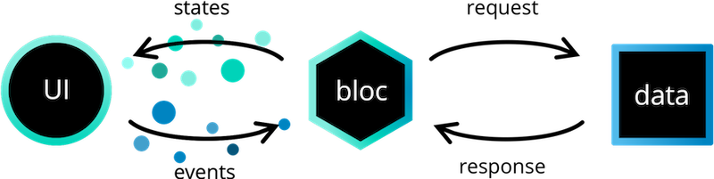
Our Approach & Implement
Mobile Architecture
The Business Logic Component (BLoC) pattern
Notes:
Đối với kiến trúc của mobile app, chúng em áp dụng BloC pattern của Flutter chia app ra làm 3 phần.
Tầng presentation là nơi cho khách hàng và photographer tương tác với hệ thống thông qua các events và states.
Tầng BLoC giống như một cầu nối giữa tầng presentation và tầng data, giúp 2 tầng này giao tiếp. Tầng BloC sẽ tiếp nhận yêu cầu từ Presentation thông qua các events, đồng thời gửi xuống tầng data để xử lý, sau đó response lại cho BloC và trả về một state tương ứng lên giao diện.
Tầng data để kết nối với RESTful Controller từ server để lấy dữ liệu thông qua giao thức http.

Slide 10




Our Approach & Implement
Difficulty
Too many photographers
Confusing
Unexpected result

Slide 11
Our Approach & Implement
Algorithm X
Three criteria affect the results of photographer searching :
01
Rating
The rate that photographers get after completing customers’ requests.
02
Distance
The distance between photographers’ working place and the area that customers want to shoot.
03
Price
The price of photographers’ services.

Slide 12
Our Approach & Implement
How does Multiple-factors weighted sorting work?
Step 1: Choose suitable factors
We will rank the photographers based on the following factors:
Customer’s rating.
Photographer’s average service price.
Distance (from photographer’s working location to the booked location).
Step 2: Specify weight for each factor (Admin can change the weights).
Factor | Weight
Rating | 0.3
Price | 0.4
Distance | 0.3
Total | 1

Slide 13
Our Approach & Implement
How does Multiple-factors weighted sorting work?
Step 3: Set a common scale for factors
Common scale = from 0 (worst) to 100 (best)
Step 4: Transform each object’s factors score to the common scale
Rating = (rating / 5) * 100
Price = (1 – price/sum) * 100
Distance = (1 – distance/sum) * 100

Slide 14
Our Approach & Implement
How does Multiple-factors weighted sorting work?
Step 5: Sum the scores
Score of a photographer = 0.3 * rating score + 0.3 * distance score + 0.4 * price score
Step 6: Sort photographers based on the score.
Factor | Weight | Photographer A | Photographer B
Rating | 0.3 | 80 | 70
Price | 0.4 | 67.12 | 80.92
Distance | 0.3 | 73 | 50
Score |  | 73.336 | 65.276

Slide 15




Our Approach & Implement
Choose the service package provided by photographer
Booking Process
Find photographer as desired
Enter the shooting time, location, and receiving time as needed
Receive products and reviews
Take pictures

Slide 16



Our Approach & Implement
Rules
The customer will be reminded if the customer's booking time is close to another within 1 hour.
Customer may not choose a shooting time with the photographer coinciding with the time chosen by another client.
Customers are not allowed to choose the delivery time within 24 hours from shooting date.
After 24 hours if the photographer does not accept the request will be canceled.

Slide 17


Our Approach & Implement
Take pictures
Booking process
Accept requests from customers
Edit photos
Return products and receive feedback

Slide 18

Our Approach & Implement
Rules
Photographer will be reminded if the customer's booking time is close to another within 1 hour.
After 24 hours if the photographer does not accept the request will be canceled.
Photographer will be reminded if the shooting location is 50 km apart.

Slide 19

Our Approach & Implement
State Machine Diagram
Book [date available] / notify photographer
Pending

Slide 20
Our Approach & Implement
State Machine Diagram
Book [date available] / notify photographer
Photographer accepts
Pending
Ongoing

Slide 21
Our Approach & Implement
State Machine Diagram
Book [date available] / notify photographer
Photographer accepts
Pending
Ongoing
Photographer rejects / increase rejecting rate
Rejecting

Slide 22
Our Approach & Implement
State Machine Diagram
Book [date available] / notify photographer
Done shooting / requires delivery method
Photographer accepts
Pending
Ongoing
Editing
Photographer rejects / increase rejecting rate
Rejecting

Slide 23
Our Approach & Implement
State Machine Diagram
Book [date available] / notify photographer
Done shooting / requires delivery method
Photographer accepts
Pending
Ongoing
Editing
Photographer rejects / increase rejecting rate
Customer cancels / increase rejecting rate
Photographer cancels / increase rejecting rate
Rejecting
Canceling

Slide 24
Our Approach & Implement
State Machine Diagram
Book [date available] / notify photographer
Done shooting / requires delivery method
Photographer accepts
Pending
Ongoing
Editing
Photographer rejects / increase rejecting rate
Customer cancels / increase rejecting rate
Photographer cancels / increase rejecting rate
Photographer cancels editing / increase rejecting rate
Rejecting
Canceling

Slide 25

Our Approach & Implement
State Machine Diagram
Book [date available] / notify photographer
Done shooting / requires delivery method
Photographer accepts
Done editing
Pending
Ongoing
Editing
Done
Photographer rejects / increase rejecting rate
Customer cancels / increase rejecting rate
Photographer cancels / increase rejecting rate
Photographer cancels editing / increase rejecting rate
Customer cancels editing / increase rejecting rate
Rejecting
Canceling

Slide 26
Our Approach & Implement
Booking Process
Find photographer as desired
Choose the service package provided by photographer
Enter the shooting time, location, and receiving time as needed
Take pictures
Receive products and reviews

Slide 27
Our Approach & Implement
Rules
Customer will be reminded if time is too tight between shooting days.
Customers are not allowed to choose the delivery time within 24 hours from shooting date.
After 24 hours if the photographer does not accept the request will be canceled.

Slide 28
Our Approach & Implement
Booking Process
Accept requests from customers
Take pictures
Edit photos
Return products and receive feedback

Slide 29
Our Approach & Implement
Rules
Photographer will be reminded if time is too tight between shooting days.
After 24 hours if the photographer does not accept the request will be canceled.
Photographer will be reminded if the shooting location is 50 km apart.

Slide 30



Our Approach & Implement
Issues
Weather is really important when it comes to Photography.

Slide 31

Our Approach & Implement
Issues
Weather is really important when it comes to Photography.
To shoot or not to shoot ?

Slide 32
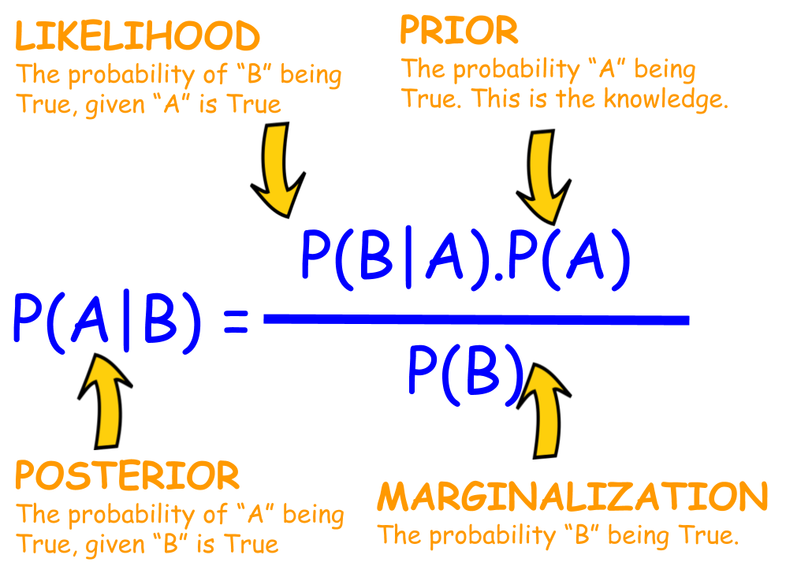
Our Approach & Implement
Naive Bayes Classifiers
Naive Bayes are collection of classification algorithms based on Bayes’ Theorem.
Naive Bayes classifiers mostly used in spam filtering, fraud analysis, weather prediction

Slide 33






Our Approach & Implement
Feature and Class Variable
Outlook
Temperature
Humidity
Windy
Shooting?
Notes:
Feature matrix contains all the vectors(rows) of dataset in which each vector consists of the value of dependent features. In above dataset, features are ‘Outlook’, ‘Temperature’, ‘Humidity’ and ‘Windy’. Response vector contains the value of class variable(prediction or output) for each row of feature matrix. In above dataset, the class variable name is ‘Play golf’

Slide 34
Our Approach & Implement
Prepared Dataset
Outlook | Temperature | Humidity | Windy | Shooting
Sunny | Hot | High | Normal | No
Sunny | Cool | High | Strong | No
Overcast | Hot | High | Strong | Yes
Sunny | Hot | High | Normal | Yes
Rainy | Cool | Normal | Strong | Yes
Rainy | Cool | Normal | Normal | No
Overcast | Cool | Normal | Strong | Yes
Sunny | Mild | High | Normal | No

Slide 35
Our Approach & Implement
Analyze and Compute
Outlook | Temperature | Humidity | Windy | Shooting
Sunny | Hot | High | Normal | No
Sunny | Cool | High | Strong | No
Overcast | Hot | High | Strong | Yes
Sunny | Hot | High | Normal | Yes
Rainy | Cool | Normal | Strong | Yes
Rainy | Cool | Normal | Normal | No
Overcast | Cool | Normal | Strong | Yes
Sunny | Mild | High | Normal | No
According to the weather API, the weather’s condition on 20-12-2020 in Da Lat is:
Outlook: Sunny,
Temperature: Hot,
Humidity: High,
Windy: Strong

Slide 36
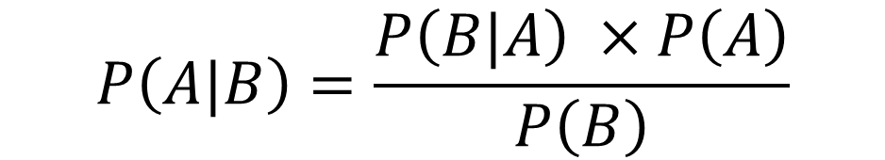
Our Approach & Implement
Analyze and Compute
Outlook: Sunny, Temperature: Hot, Humidity: High, Windy: Strong
$$P\left(A|B\right)=\frac{P\left(B|A\right) ×P\left(A\right)}{P\left(B\right)}$$

Slide 37
Our Approach & Implement
Analyze and Compute
Outlook: Sunny, Temperature: Hot, Humidity: High, Windy: Strong:
The probability of the shooting will be able to take place:
$$P\left(Shoot|Weather\right)=\frac{P\left(Weather|Shoot\right) ×P\left(Shoot\right)}{P\left(Weather\right)}$$
The probability of the shooting will not be able to take place:
$$P\left(Not Shoot|Weather\right)=\frac{P\left(Weather|Not Shoot\right) ×P\left(Not Shoot\right)}{P\left(Weather\right)}$$

Slide 38
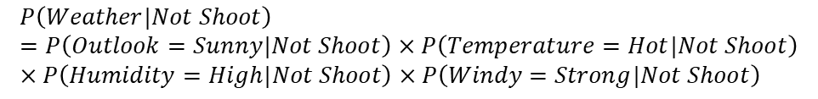
Our Approach & Implement
Analyze and Compute
Outlook: Sunny, Temperature: Hot, Humidity: High, Windy: Strong:
$$P\left(Weather\right)=P\left(Outlook=Sunny\right)×P\left(Temperature=Hot\right)×P\left(Humidity=High\right)×P\left(Windy=Strong\right)$$
$$P\left(Weather|Shoot\right)=P\left(Outlook=Sunny|Shoot\right)×P\left(Temperature=Hot|Shoot\right)×P\left(Humidity=High|Shoot\right)×P\left(Windy=Strong|Shoot\right)$$
$$P\left(Weather|Not Shoot\right)=P\left(Outlook=Sunny|Not Shoot\right)×P\left(Temperature=Hot|Not Shoot\right)×P\left(Humidity=High|Not Shoot\right)×P\left(Windy=Strong|Not Shoot\right)$$

Slide 39




Our Approach & Implement
Analyze and Compute
Outlook | Temperature | Humidity | Windy | Shooting
Sunny | Hot | High | Normal | No
Sunny | Cool | High | Strong | No
Overcast | Hot | High | Strong | Yes
Sunny | Hot | High | Normal | Yes
Rainy | Cool | Normal | Strong | Yes
Rainy | Cool | Normal | Normal | No
Overcast | Cool | Normal | Strong | Yes
Sunny | Mild | High | Normal | No
Outlook: Sunny,
Temperature: Hot,
Humidity: High,
Windy: Strong
$$P\left(Outlook=Sunny\right)= \frac{3}{8}$$
$$P\left(Temperature=Hot\right)= \frac{3}{8}$$
$$P\left(Humidity=High\right)= \frac{5}{8}$$
$$P\left(Windy=Strong\right)= \frac{4}{8}$$

Slide 40





Our Approach & Implement
Analyze and Compute
Outlook | Temperature | Humidity | Windy | Shooting
Sunny | Hot | High | Normal | No
Sunny | Cool | High | Strong | No
Overcast | Hot | High | Strong | Yes
Sunny | Hot | High | Normal | Yes
Rainy | Cool | Normal | Strong | Yes
Rainy | Cool | Normal | Normal | No
Overcast | Cool | Normal | Strong | Yes
Sunny | Mild | High | Normal | No
Outlook: Sunny, Temperature: Hot,
Humidity: High, Windy: Strong,
Shoot: Yes
$$P\left(Outlook=Sunny | Shoot\right)= \frac{1}{4}$$
$$P\left(Temperature=Hot | Shoot\right)= \frac{2}{4}$$
$$P\left(Humidity=High | Shoot\right)= \frac{2}{4}$$
$$P\left(Windy=Strong | Shoot\right)= \frac{3}{4}$$
$$P\left(Shoot\right)= \frac{4}{8}$$

Slide 41





Our Approach & Implement
Analyze and Compute
Outlook | Temperature | Humidity | Windy | Shooting
Sunny | Hot | High | Normal | No
Sunny | Cool | High | Strong | No
Overcast | Hot | High | Strong | Yes
Sunny | Hot | High | Normal | Yes
Rainy | Cool | Normal | Strong | Yes
Rainy | Cool | Normal | Normal | No
Overcast | Cool | Normal | Strong | Yes
Sunny | Mild | High | Normal | No
Outlook: Sunny, Temperature: Hot,
Humidity: High, Windy: Strong,
Shoot: No
$$P\left(Outlook=Sunny | Not Shoot\right)= \frac{3}{4}$$
$$P\left(Temperature=Hot | Not Shoot\right)= \frac{1}{4}$$
$$P\left(Humidity=High | Not Shoot\right)= \frac{3}{4}$$
$$P\left(Windy=Strong | Not Shoot\right)= \frac{1}{4}$$
$$P\left(Not Shoot\right)= \frac{4}{8}$$

Slide 42
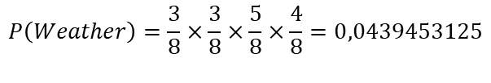




Our Approach & Implement
Analyze and Compute
Outlook: Sunny, Temperature: Hot, Humidity: High, Windy: Strong:
$$P\left(Weather\right)=\frac{3}{8}×\frac{3}{8}×\frac{5}{8}×\frac{4}{8}=0,0439453125$$
$$P\left(Weather|Shoot\right)=\frac{1}{4}×\frac{2}{4}×\frac{2}{4}×\frac{3}{4}=0,046875$$
$$P\left(Weather|Not Shoot\right)=\frac{3}{4}×\frac{1}{4}×\frac{3}{4}×\frac{1}{4}=0,03515625$$
$$P\left(Shoot|Weather\right)=\frac{0,046875 ×0,5}{0,0439453125 }=0,53333333333$$
Fine weather for shooting
$$P\left(Not Shoot|Weather\right)=\frac{0,03515625×0,5}{0,0439453125 }=0,4$$

Slide 43
Assessment
Assessment

Slide 44

Assessment
Values:
The system assists customers in finding a suitable photographer.
The system helps photographers find potential clients, as well as increases the income for photographers.
Creating trust for customers through reviews.
There is a forum for sharing recent information.

Slide 45

Assessment
Limitations:
The system only support Vietnamese language.
The application has not supported payment.
The system has not had a photo verification feature.
The system has not provided a website version to both customers and photographers. Users may find it uncomfortable to use applications.

Slide 46
Future Plan
Future Plan

Slide 47


Future plan
Plan 1:
The researchers are going to add online payment method so that customers can conveniently transfer commissions for photographers. Besides, we also make customers deposit, which would help photographers feel assured to use the system.
Plan 2:
We are going to add automatically deletion feature, which would automatically remove inappropriate albums
Plan 3:
The system has provided a website version to both customers and photographers. Users may find it comfortable to use applications.

Slide 48
Thanks
Thanks
Does anyone have any questions?

Slide 49


Our Approach & Implement
Policy
Cancellation rate and How to calculate.
Punishment

Slide 50

Our Approach & Implement
Policy
Cancellation Rate
$$\frac{\text{photographer}\text{−}\text{cancelled} bookings}{\text{total} bookings}$$
Note:
Time period: every month.
CR under 20% in order to sell on PBS.

Slide 51


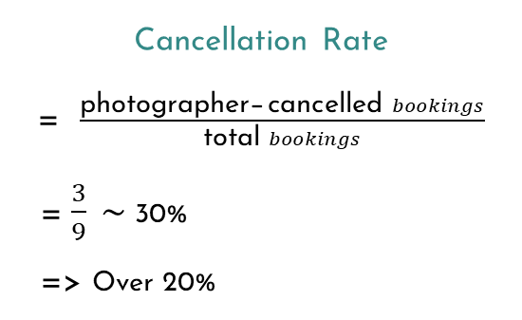
Our Approach & Implement
Example
Photographer has 9 confirmed bookings for the month. In which, 3 bookings have been canceled.
Cancellation Rate
= $\frac{\text{photographer}\text{−}\text{cancelled} bookings}{\text{total} bookings}$
= $\frac{3}{9} \sim$ 30%
=> Over 20%
9 confirmed bookings
3 canceled bookings

Slide 52
Our Approach & Implement
Policy
20% > 40%
Admin will reminder the photographer via email.
40% or more
The photographer account will be deactivated.

Slide 53

Study Objectives
Mercury
Venus
Jupiter
Mercury is the closest planet to the Sun and the smallest one in the Solar System—it’s only a bit larger than our Moon
Venus has a beautiful name and is the second planet from the Sun. Its atmosphere is extremely poisonous
Despite being red, Mars is a cold place, not hot. The planet is full of iron oxide dust, which gives the planet its reddish cast

Slide 54
Schedule
January
February
March
April
May
June
PHASE 1
Jan 1 - Mar 1
Task 1
Jan 1 - 27
Task 2
PHASE 2
Feb 1 - Mar 25
Task 1
Apr 1 - Jun 25
Task 2
April 1 - 23
May 1 - Jun 25

Slide 55
Methodology
Analysis
Research
Comparison
Data Study
Jupiter is a gas giant and the biggest planet
Venus has a beautiful name, but it’s terribly hot
Saturn is the ringed one and a gas giant
Despite being red, Mars is a cold place

Slide 56
Table
Test 1
Test 2
Test 3
Test 4
Describe here your metrics 1
Describe here your metrics 2
Describe here your metrics 3
Describe here your metrics 4
Describe here your metrics 5

Slide 57
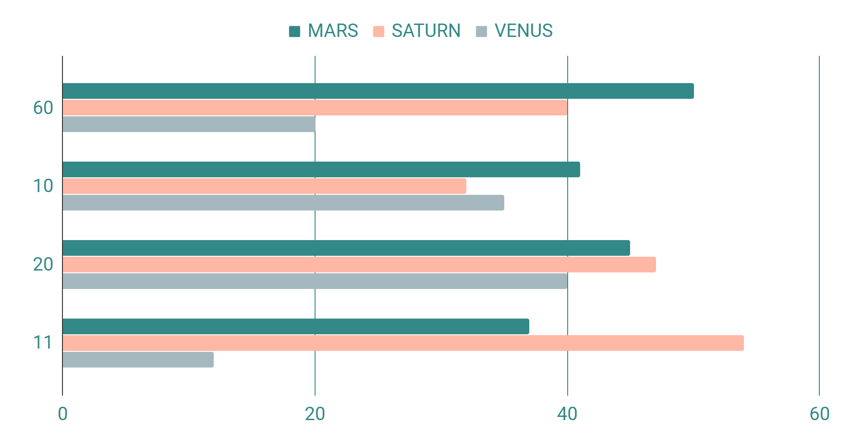
Results Analysis
Statistics
Mercury
Jupiter
1,369 Results last month
5,408 Results this month
60%
Venus
Venus has a beautiful name, but it’s terribly hot
If you want to modify this graph, click on it, follow the link, change the data and replace it

Slide 58
Bibliography
AUTHOR (YEAR). Title of the publication. Publisher.
AUTHOR (YEAR). Title of the publication. Publisher.
AUTHOR (YEAR). Title of the publication. Publisher.
AUTHOR (YEAR). Title of the publication. Publisher.
AUTHOR (YEAR). Title of the publication. Publisher.
AUTHOR (YEAR). Title of the publication. Publisher.

Slide 59
Credits
This is where you give credit to the ones who are part of this project.
Did you like the resources on this template? Get them for free at our other websites.
Presentation template by Slidesgo
Icons by Flaticon
Infographics by Freepik
Images created by Freepik
Author introduction slide photo created by Freepik
Text & Image slide photo created by Freepik.com

Slide 60
Resources
Vector
Photos
Infographic timeline concept with road
Road desert landscape Morocco
Rear view woman walking boardwalk mountain
Couple running sunny road
High angle view tropical trees growing forest
Hiker sitting rock
High angle view winding road surrounded by green trees
Woman with book looking bookshelves
Elevated view road forest during sunny day

