Slide 1
LINUX Overview
Tin hoc Nhã uyên 10/2018

Slide 2
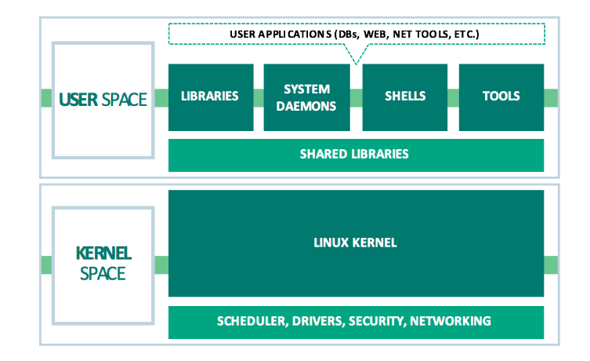
ARCHITECH OVERVIEW

Slide 3
THE CORE OPERATING SYSTEM KERNEL
Kernel task
Process scheduling
Linux is a preemptive multitasking – multi-process running follow rule that governing by scheduler
Memory management – share physical memory among process in efficient way
Process are isolated from one to other and from the kernel, one process can’t read and modify the memory of another process or kernel
Only part of process need to be kept in memory
Provision of a file system
Provide a file system management on disk and allow file can be created, retrieved, updated, deleted, copy …
Creation and termination of processes
Load/reload a program(binary) into RAM, provide it the resource (CPU, memory, …) that it need in order to run and free all resource when it terminate
Access to devices
Allow communication between computer and outside world, input and output . Kernel provide standard interface and simplifies access to devices while arbitrating access by multi-process to devices
Networking
Kernel transmit/receive packet from network as a part of user process. This task include routing packets to target
Provision of system call API
Processes can request the kernel to perform various task use kernel entry point as system call

Slide 4
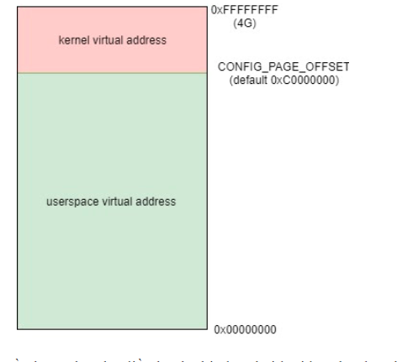
Kernel mode and user mode
CPU operate on two difference mode
User Mode
CPU running on user mode only access to memory that belong to User process, access to kernel space cause hardware exception
Kernel Mode
CPU can access to both user and kernel space
When CPU communicate with real hardware, it need to operate in kernel mode

Slide 5
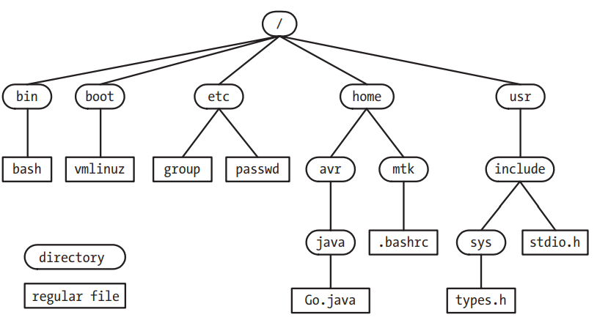
directory
Hierarchical directory structure
Store all system file
Base is root directory
All sub directory and file are children or descendants of root directory
Symbolic link
A shortcut of file
Is called softlink

Slide 6
FILE I/O
Universality of I/O
Same of system call set (open/read/write/close) used to perform I/O on all types of file, including devices
Sequence byte stream type and random access with lseek
File descriptor
Refer to open files using file descriptor
Program running from shell inherit 3 open file
stdin – number 0 – standard input
stdout – number 1 –standard output
Stderr – number 2 – standard error
Stdio library
Layer on top of File I/O system
Provide set of function for input/output as fopen, fclose, scanf, printf, fgets, fputs

Slide 7

Program
Program
Two form of program
Source code – human-readable text
Binary – machine language instruction
Source code covert to binary through a compile
Filter
A program that reads its input from stdin, perform some transformation of that input and write transformed output to stdout
Cat, more, grep, wc, sort, seq and awk
Command line argument
Word give to program when it running
argc number of argument
argv array of argument string

Slide 8
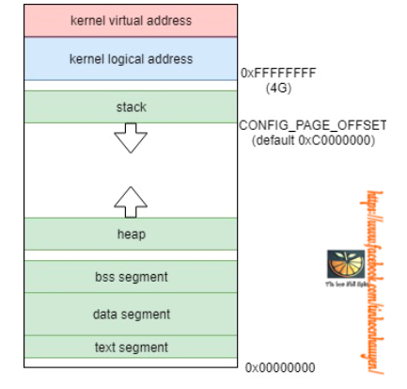
Process
An instance of an executing program
Process memory layout
Text: the instructions of the program.
Data: the static variables used by the program.
Heap: an area from which programs can dynamically allocate extra memory.
Stack: a piece of memory that grows and shrinks as functions are called and return and that is used to allocate storage for local variables and function call linkage information.
Process creation and program execution
Process ID and parent process ID
Process termination and status
Init and deamon process
Environment List

Slide 9
Static and shared libraries
Static libraries
Linking object to create static lib
Static linker
Some disadvantages of static lib
Shared libraries
Dynamic linker

Slide 10
SIGNAL
Software interrupt
Send from kernel to user-space process
Notify some event happen in kernel or error
User type interrupt character (Ctr-C)
One of children terminate
Timer expire
Process attempted to access an invalid memory address
Behavior of process when receive a signal
It ignore the signal
It is killed by signal
It suspended until being resume

Slide 11
INTERPROCESS COMMUNICATION
Method to communicate and synchronize between two/ more processes
Signal
Pipe
Sockets
File locking
Message queue
Semaphores
Shared memory

