Slide 1
SOCKET

Slide 3
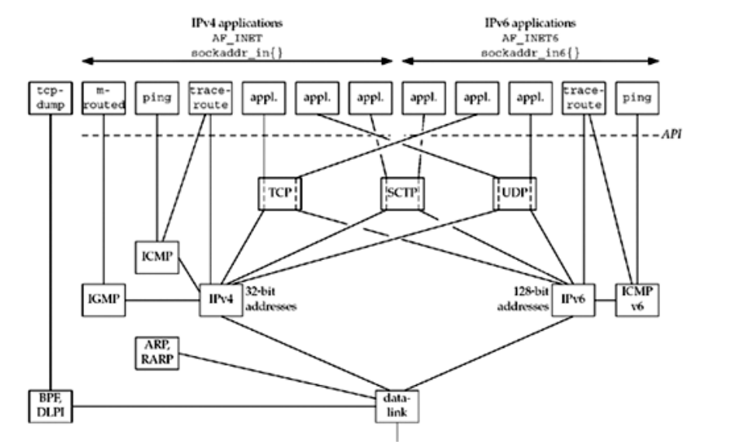

Socket overview
Typical client-server scenario
Socket is window to the word
Each application open its own socket
Server bind its socket to a well-known address
Client connect its socket to that address

Slide 4
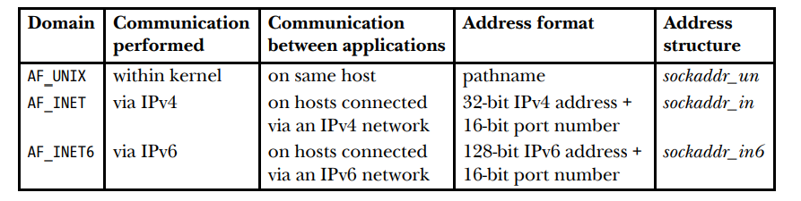
Communication domain
Communication domain
Method of identifying a socket
The range of communication (same host or network)
Type of Domain
UNIX : allow communication between application on the same host
IPv4: allow communication between applications running on hosts connected via IPv4 network
IPv6 allow communication between application running on hosts connected via IPv6

Slide 5
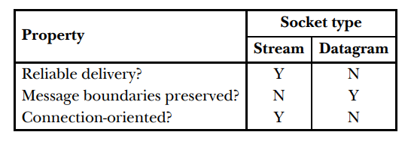
SOCKET TYPES
Two types of socket
Stream
Reliable – Data at receiver exactly as data at transmitter
Bidirectional – Data transmit two directions
Byte-stream – No concept of boundary
TCP is typical
Datagram
Exchange in form of message called datagram
Message boundaries but data transmission is not reliable , message may be out-of-order, duplicate, not arrived
Don’t need to establish a connection
UDP is typical

Slide 6
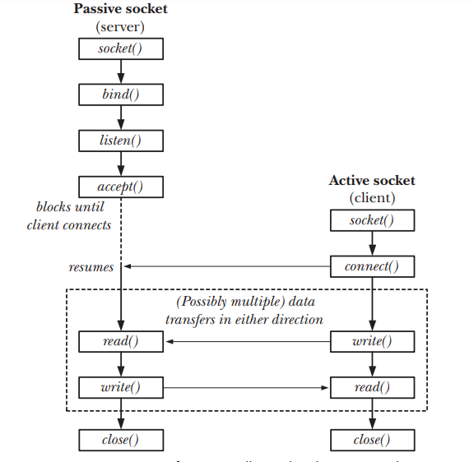
SOCKET SYSTEM CALL- stream socket flow
Socket
Domain AF_UNIX && AF_INET
Type SOCK_STREAM && SOCK_DGRAM && SOCK_RAW
Protocol IPPROTO_UDP, IPPROTO_TCP, 0
Return file descriptor
Socket operate in connected pair
Peer socket – refer to socket at other end of a connection
Peer address – denotes the address of peer socket
Peer application – denotes application use peer socket

Slide 7
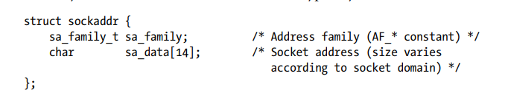
BIND A SOCKET TO AN ADDRESS
Bind a socket to an well-known address
Error Address already in use
Use netstat –a to find which application open it

Slide 8

LISTENING FOR INCOMING CONNECTION
Listen
Each connection request coming, kernel record information into pending connection queue → it consume kernel memory
/proc/sys/net/core/somaxconn
Backlog limit number of pending connection
netstat –l to find all listening port

Slide 9
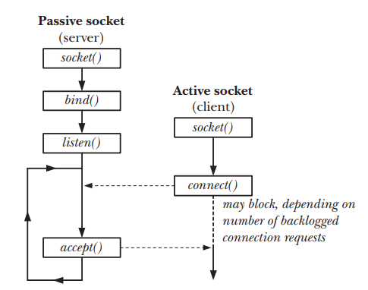
ACCEPT A CONNECTION
accept function
Accept an incoming connection on listening stream socket refer to by file descriptor
If no pending connection exist, accept block until connection request arrive
Accept create new socket and keep listening socket to accept new request
Addr and addrlen give the address of peer and length of that address
Pass NULL to irgnore it

Slide 10
Connecting to peer socket
Connect function
Connect to a socket refer to by file descriptor whose address specified by addr and addrlen
Establish a connection

Slide 11
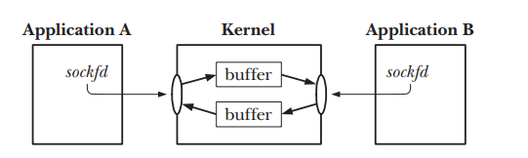
IO stream operation
Use read/write to request data and send data

Slide 12
Terminate a connection
Usual way to terminate a connection use close
If multiple file descriptor refer to the same socket, the connection is terminated when all of file descriptor are closed
If peer crash, with datagram socket, we don’t know that event, with stream socket, it have some mechanism to notify that event

Slide 13
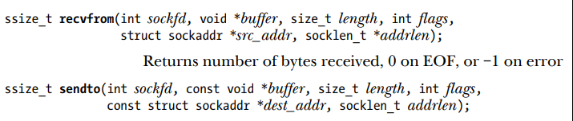
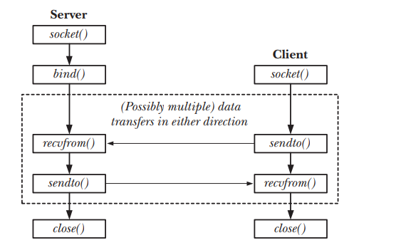
Datagram flow
sockfd – socket file descriptor
buffer – start address of message to send
Length – length of message to send
Flag – control receive/send as ancillary data, it is usually set to 0
addr – address of sender in recvfrom and address of receiver in sendto

Slide 14
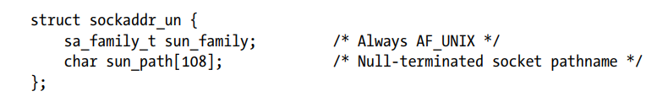
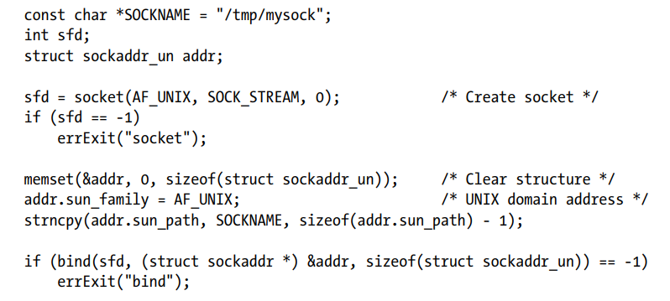
Unix domain socket
Allow communication between processes on the same host system
Unix Domain socket addresses
Take a form of pathname
Use snprintf or strncpy to avoid buffer overflow of pathname
Ls –l, we can see type s in first column
Bind a Unix domain socket
cast an sockaddr_un to sockaddr
We can’t bind an existing pathname, error EADDRINUSE
Absolute pathname is appreciated
A socket can bind only one pathname, a pathname can be bound to only one socket
Can’t use open to open a socket
When the socket is no longer require, use unlink to remove it

Slide 15
STREAM SOCKET IN UNIX DOMAIN
iterative server
Create socket
Remove/unlink unix pathname
Construct an address structure for server socket, bind socket to address and mark socket as listening
Loop to handle incoming client request
Accept connection, obtain new socket
Read data from connected socket and write to standard output
Close the socket
Server terminate manually
client
create socket
Construct an address structure for server socket and connect to socket at address
Loop to copies data from standard input to the socket connection until end of file

Slide 16
DATAGRAM SOCKET IN UNIX DOMAIN

Slide 17
MULTIPLEXING IO WITH SELECT
Server/Client model
Server terminate and send goodbye message to client
Client busy to waiting command/message from stdio and cannot receive message from server
Client have to read from both stdin and socket
Client have multiple socket?
Multiplexing is essential when
Client need to handling multiple descriptors(sockets + stdin)
TCP handle both a listening socket and connected socket
Server handle both TCP(Stream) and UDP(datagram)
Server handle multiple service and multiple protocol
Not limited to network programming. This technique use every where

Slide 18
i/o model – BLOCKING I/O
5 I/O model available
Blocking I/O
Non-blocking I/O
I/O multiplexing
Signal driven
Asynchronous I/O
Two phase of input operation
Waiting for the data to be ready
Copying the data from the kernel to the process

Slide 19
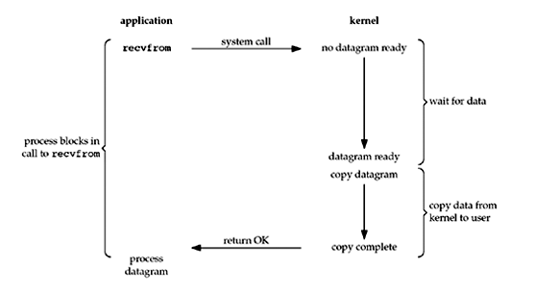
BLOCKING I/O
By default, all sockets are blocking
Process waiting a message coming, but message has not arrived, process sleep to wait
Calling recvfrom cause context-switching and process fire CPU
Message is coming, process is wake up to process message
Recvfrom copy message from kernel buffer to user buffer
CPU usage optimization but can’t handle multiple events

Slide 20

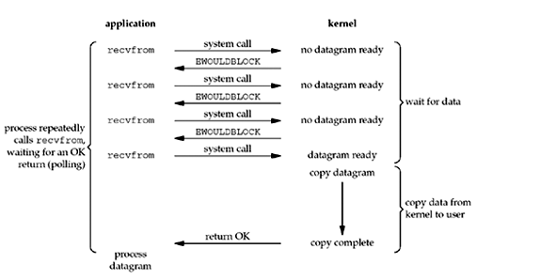
NON-BLOCKING I/O
Socket is set to Non-blocking I/O
O_NONBLOCK flags
Call recvfrom return immediately with EWOULDBLOCK error code
Can handle multiple file descriptor but waste CPU time

Slide 21
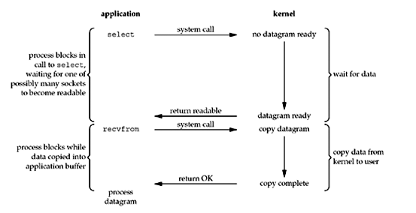
MULTIPLEXING I/O
I/O multiplexing
Call select or polling to wait data from multiple descriptor available
Sleep on select instead recvfrom
Can handle multiple file descriptor and CPU usage optimization

Slide 22
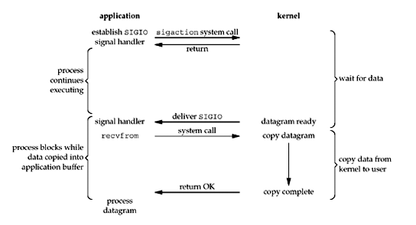
SIGNAL-DRIVEN I/O
Signal-driven I/O
Enable socket for signal-driven I/O
Install a signal handler in process
When datagram ready to read, a SIGIO signal is generated and deliver to process
Can handle multiple file descriptor and CPU usage optimization but it it not popular

Slide 23
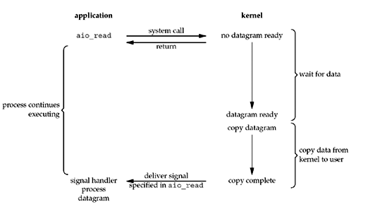
Asynchronous i/o model
AIO
Call aio_read to notify to kernel start operation and notify us when the entire operation is complete
The main difference between this model and the signal-driven I/O model is kernel tell process when I/O operation initiated but in AIO, kernel tell us when an I/O operation is completed

Slide 24
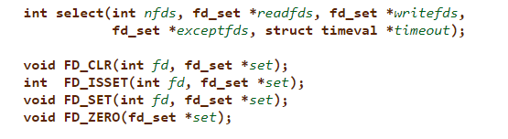
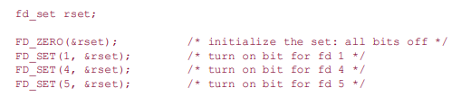
select
Arguments
Max of file descriptor tested, its value is file descriptor has maximum value + 1
Readset, writeset, exeptionset collect all file descriptor tested (data ready)
Timeout - tell the kernel how long we wait the events
Select blocking until
Any events in readset, writeset or exceptionset occur
Timer expire
File descriptor set/clear/zeroout/test by bitmap operation

Slide 25
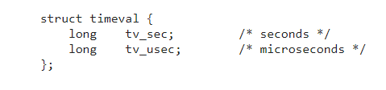
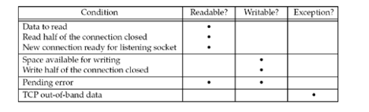
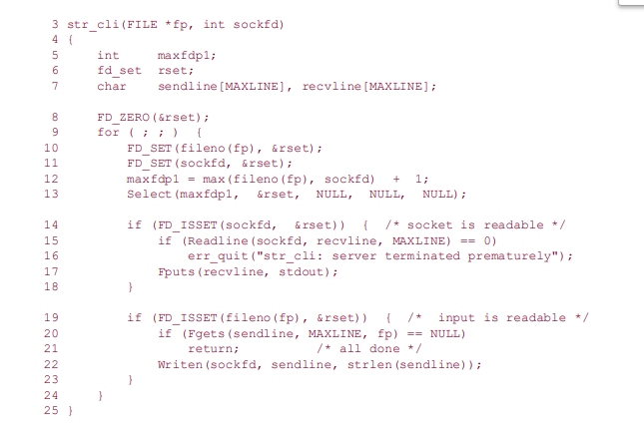
SELECT(2)
With timer, there is 3 situations
Wait forever, return only when one of specified descriptor is ready for I/O, timeout argument set to NULL pointer
Wait up to a fixed amount of time, time can set in second and millisecond
Return immediately after checking the file descriptors, this called polling, timeout argument set to 0
Initialize the set is important
since unpredictable result can occur if the set is allocated as automatic variable and not initialized
Kernel use set to notify which file descriptor has data ready, then each time select is called, these set need to fill file descriptor again
When is Data ready?

